Slide 1
Leveraging Cache Coherence to Detect and Repair False Sharing On-the-fly
MICRO’24
Vipin Patel, Swarnendu Biswas, and Mainak Chaudhuri
PROSPAR, Computer Science and Engineering,
Indian Institute of Technology Kanpur
Artifact available at: https://zenodo.org/records/13293424
Or Scan the QR code

Slide 2
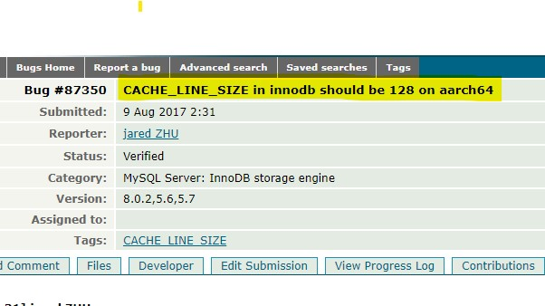
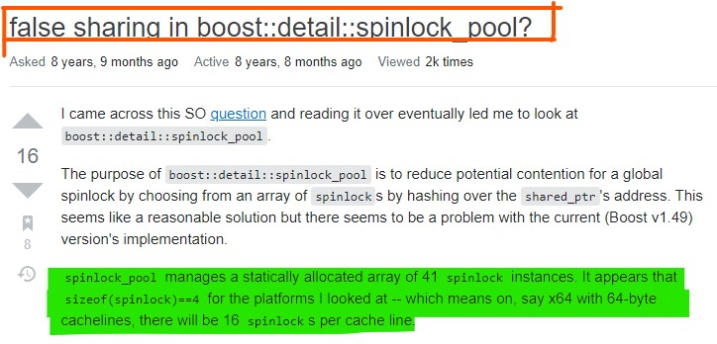
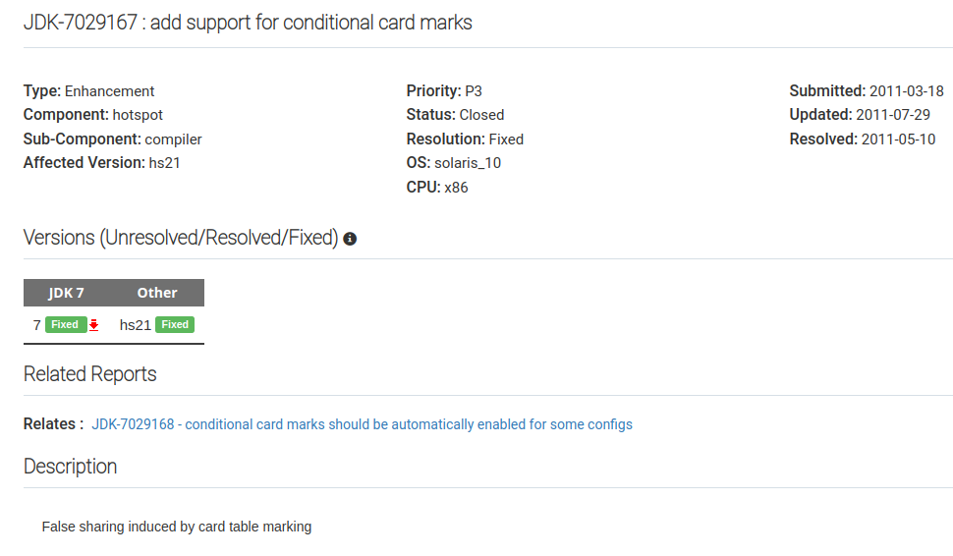
False Sharing in Real World Applications
Notes:
False Sharing is a performance bug that has been reported across various real-world applications like MYSQL database, Linux kernel, Disruptor library, and Java Garbage Collector, Boost Spinlock

Slide 3
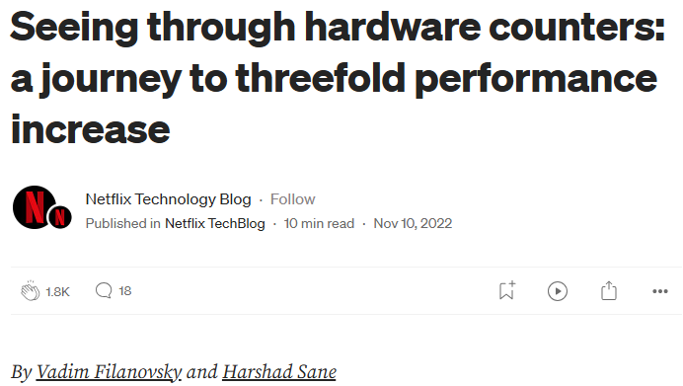
The Netflix Case Study
Notes:
To gauge the gravity of the situation, the initial three attempt by the team to debug the performance bottleneck did not lead to any conclusion. In the fourth attempt the engineers were able to zero down on false sharing as the root cause of the slowdown..

Slide 4
The Netflix Case Study
Notes:
Moreover, the false sharing was induced by the use of secondary super cache structure present in the open JDK library

Slide 5
The Netflix Case Study
Notes:
The bug was dormant. Finally got fixed in 2024 release.

Slide 6
Cache Contention due to False Sharing
Notes:
Eager invalidation based cache coherence protocol

Slide 7
Cache Contention due to False Sharing
0 | 1 | 2 | 3
0 | 1 | 2 | 3
Core C0
Core C1
Directory Controller
Notes:
For instance, the C0 store to byte1 and C2 load of byte2

Slide 8
Cache Contention due to False Sharing
0 | 1 | 2 | 3
0 | 1 | 2 | 3
Core C0
Core C1
1. GetX
Directory Controller

Slide 9
Cache Contention due to False Sharing
0 | 1 | 2 | 3
0 | 1 | 2 | 3
ST
Core C0
Core C1
2. Data
1. GetX
Directory Controller

Slide 10
Cache Contention due to False Sharing
0 | 1 | 2 | 3
0 | 1 | 2 | 3
ST
Core C0
Core C1
2. Data
1. GetX
3. GetS
Directory Controller

Slide 11
Cache Contention due to False Sharing
0 | 1 | 2 | 3
0 | 1 | 2 | 3
ST
Core C0
Core C1
2. Data
4. Fwd_GetS
1. GetX
3. GetS
Directory Controller
Notes:
An application experiences cache line contention when a lot of invalidation messages are communicated in the network for a cache block among cores.
The cache line contention arises as a result of the eager invalidation cache coherence protocol.
1.False Sharing in MySQL. (https://bugs.mysql.com/bug.php?id=87350)
4. Disruptor library(https://www.programmersought.com/article/16214346188/)
3. https://stackoverflow.com/questions/11037655/false-sharing-in-boostdetailspinlock-pool
2. Silas Boyd-Wickizer et al., An Analysis of Linux Scalability to Many Cores. OSDI’10
Core0 access the bytes 3 and 4 of the block, while Core1 accesses the bytes 4 and 5 of the block. TS for byte 4 of the block.
Core0 access the bytes 1 to 4 of the block, while Core1 accesses the bytes 7 and 8 of the block. FS for the block.

Slide 12
Cache Contention due to False Sharing
0 | 1 | 2 | 3
0 | 1 | 2 | 3
ST
LD
5b. Data
Core C0
Core C1
2. Data
4. Fwd_GetS
1. GetX
5a. WB
3. GetS
Directory Controller

Slide 13
Cache Contention due to False Sharing
0 | 1 | 2 | 3
0 | 1 | 2 | 3
ST
LD
5b. Data
Core C0
Core C1
2. Data
4. Fwd_GetS
6. Ack
1. GetX
5a. WB
3. GetS
Directory Controller

Slide 14
Cache Contention due to False Sharing
0 | 1 | 2 | 3
0 | 1 | 2 | 3
ST
LD
5b. Data
Core C0
Core C1
2. Data
4. Fwd_GetS
6. Ack
1. GetX
5a. WB
3. GetS
7. Upg
Directory Controller

Slide 15
Cache Contention due to False Sharing
0 | 1 | 2 | 3
0 | 1 | 2 | 3
ST
LD
5b. Data
Core C0
Core C1
2. Data
4. Fwd_GetS
6. Ack
8. INV
1. GetX
5a. WB
3. GetS
7. Upg
Directory Controller

Slide 16
Cache Contention due to False Sharing
0 | 1 | 2 | 3
0 | 1 | 2 | 3
ST
LD
5b. Data
Core C0
Core C1
2. Data
9. Inv_Ack
4. Fwd_GetS
6. Ack
8. INV
1. GetX
5a. WB
3. GetS
7. Upg
Directory Controller
Notes:
During execution, the additional intervention and invalidations flood interconnect network, leading to performance degradation and wastage of energy

Slide 17
Cache Contention due to False Sharing
0 | 1 | 2 | 3
0 | 1 | 2 | 3
Degrades performance
Inflates interconnect traffic
Increases energy consumption
ST
LD
5b. Data
Core C0
9. Inv_Ack
Core C1
2. Data
4. Fwd_GetS
6. Ack
8. INV
1. GetX
5a. WB
3. GetS
7. Upg
Directory Controller

Slide 18
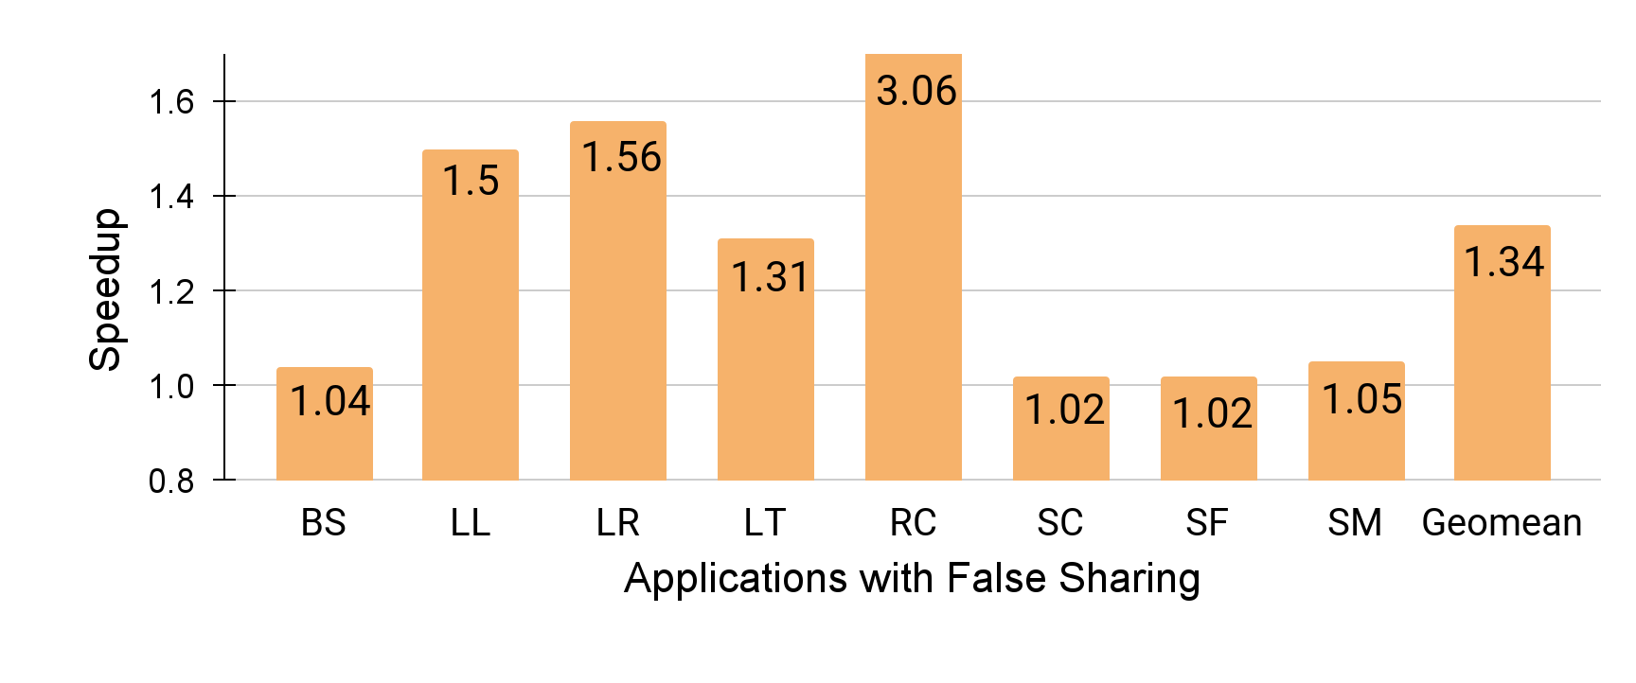
Speedup by Manually Fixing False Sharing
Avg speedup 1.34x and max speedup of 3.06x
Notes:
Over a set of applications from PARSEC, PHOENIX, and SYNCHROBENCH suites and Huron artifact

Slide 19
Speedup by Manually Fixing False Sharing
Savings: 84% in interconnect traffic and 25% in energy consumption
Notes:
Researched since early 90’s, still prevalent in the production software and applications.
Involve multiple factor including compiler toolchain, runtime environment, application stack etc
Manual fix not easy, 7 years to fix a false sharing instance in JVM
Say simulation using gem5

Slide 20
Challenges in False Sharing Elimination
Notes:
However, Padding does not guarantee freedom from false sharing in the future execution as:

Slide 21
Challenges in False Sharing Elimination
Heap Organization¹
For these applications, the memory allocator is often a bottleneck that severely limits program performance and scalability on multiprocessor systems. Previous allocators suffer from problems that include poor performance and scalability, and heap organizations that introduce false sharing.
E. D. Berger et al., “Hoard: a scalable memory allocator for multithreaded applications,” ASPLOS’00
Notes:
Memory allocator can introduce false sharing during movement of the heap blocks.

Slide 22
Challenges in False Sharing Elimination
Heap Organization
Cache Organization
Variable X | Variable Y
Variable X | Variable Y
64 Bytes
64 Bytes
128 Bytes
(a) No False Sharing
(b) False Sharing w/ larger cache line size
Notes:
A program can experience false sharing based on cache block size of the underlying architecture. Var X and Y allocated on adjacent cache line on 64 bytes architecture, can be falsely shared on system with 128 Byte cacheline size

Slide 23
Challenges in False Sharing Elimination
Heap Organization
Cache Organization
struct {
pthread_t tid; POINT_T* points;
int num_elems; long long SX;
long long SY; long long SXX;
long long SXY; long long SYY;
} lreg_args;
Compiler Optimization¹
M. Nanavati et al., “Whose Cache Line Is It Anyway? Operating System Support for Live Detection and Repair of False Sharing,” EuroSys ’13
Notes:
GCC unintentionally fixes false sharing in the Phoenix linear regression benchmark, while clang compiler fails to eliminate false sharing.

Slide 24
Challenges in False Sharing Elimination
Heap Organization
Cache Organization
Compiler Optimization
Runtime Environment¹
False Sharing induced by Card Table Marking: Online
Notes:
The helper libraries might consist false sharing instances

Slide 25
Challenges in False Sharing Elimination
Heap Organization
Cache Organization
4.3.1 Challenges of Runtime Object Modification
Changing the layout of just the contended instances of a class is impossible, as all instances of a class must be binary compatible. Moreover, modifications must respect inheritance.
Compiler Optimization
Runtime Environment
Application Language¹
A. Eizenberg et al., “REMIX: Online Detection and Repair of Cache Contention for the JVM,” PLDI’16
Notes:
The existing solution for false sharing solution developed for C/C++ application does not work for java applications. The FS repair for java application is quiet complex due to the JVM.

Slide 26
Shortcomings of the existing approaches
Notes:
Most approach used hardware performance counter/events for identification of FS. The HITM events on Intel architecture works well for WR instance of FS while incurs inaccuracy for R-W and W-W false sharing
Coherence protocol modification: Protozoa require newer acache architecture, VIPS family of protocol require Data race freedom guarantee from software.
Sheriff does not support TSO model.
Algorithm feature:
Efficient: The mechanism should incur low overhead during detection and repair phase.
Effective: The mechanism fix the instances of false sharing.
Accurate: The mechanism should detect the actual location of false sharing instance.
Portability: The solution should be portable on different hardware architecture and work for different languages

Slide 27
Shortcomings of the existing approaches
Inflation of memory footprint
Notes:
Most approach used hardware performance counter/events for identification of FS. The HITM events on Intel architecture works well for WR instance of FS while incurs inaccuracy for R-W and W-W false sharing
Coherence protocol modification: Protozoa require newer acache architecture, VIPS family of protocol require Data race freedom guarantee from software.
Sheriff does not support TSO model.
Algorithm feature:
Efficient: The mechanism should incur low overhead during detection and repair phase.
Effective: The mechanism fix the instances of false sharing.
Accurate: The mechanism should detect the actual location of false sharing instance.
Portability: The solution should be portable on different hardware architecture and work for different languages

Slide 28
Shortcomings of the existing approaches
Inflation of memory footprint
Introduction of additional instructions
Notes:
Most approach used hardware performance counter/events for identification of FS. The HITM events on Intel architecture works well for WR instance of FS while incurs inaccuracy for R-W and W-W false sharing
Coherence protocol modification: Protozoa require newer acache architecture, VIPS family of protocol require Data race freedom guarantee from software.
Sheriff does not support TSO model.
Algorithm feature:
Efficient: The mechanism should incur low overhead during detection and repair phase.
Effective: The mechanism fix the instances of false sharing.
Accurate: The mechanism should detect the actual location of false sharing instance.
Portability: The solution should be portable on different hardware architecture and work for different languages

Slide 29
Shortcomings of the existing approaches
Inflation of memory footprint
Introduction of additional instructions
Extending support to every language
Notes:
Most approach used hardware performance counter/events for identification of FS. The HITM events on Intel architecture works well for WR instance of FS while incurs inaccuracy for R-W and W-W false sharing
Coherence protocol modification: Protozoa require newer acache architecture, VIPS family of protocol require Data race freedom guarantee from software.
Sheriff does not support TSO model.
Algorithm feature:
Efficient: The mechanism should incur low overhead during detection and repair phase.
Effective: The mechanism fix the instances of false sharing.
Accurate: The mechanism should detect the actual location of false sharing instance.
Portability: The solution should be portable on different hardware architecture and work for different languages

Slide 30
Shortcomings of the existing approaches
Inflation of memory footprint
Introduction of additional instructions
Extending support to every language
Access to application source code¹
3 Design
In this section, we describe the design of Huron, our hybrid in-house/in-production false sharing detection and repair system. Huron first detects and repairs false sharing in house using developer test cases.
T. A. Khan et al., “Huron: hybrid false sharing detection and repair,” PLDI’19
Notes:
Most approach used hardware performance counter/events for identification of FS. The HITM events on Intel architecture works well for WR instance of FS while incurs inaccuracy for R-W and W-W false sharing
Coherence protocol modification: Protozoa require newer acache architecture, VIPS family of protocol require Data race freedom guarantee from software.
Sheriff does not support TSO model.
Algorithm feature:
Efficient: The mechanism should incur low overhead during detection and repair phase.
Effective: The mechanism fix the instances of false sharing.
Accurate: The mechanism should detect the actual location of false sharing instance.
Portability: The solution should be portable on different hardware architecture and work for different languages

Slide 31
Shortcomings of the existing approaches
Inflation of memory footprint
Detector process
Laser
Repair
Application process
Introduction of additional instructions
Linux Kernel
Extending support to every language
Driver
Haswell Processor
Access to application source code
Laser
OS and Kernel modification^{1,2}
L. Luo et al., “LASER: Light, Accurate Sharing dEtection and Repair,” HPCA’16
T. Liu et al., “Cheetah: Detecting False Sharing Efficiently and Effectively,” CGO’16
Notes:
Most approach used hardware performance counter/events for identification of FS. The HITM events on Intel architecture works well for WR instance of FS while incurs inaccuracy for R-W and W-W false sharing
Coherence protocol modification: Protozoa require newer acache architecture, VIPS family of protocol require Data race freedom guarantee from software.
OS based approach plastic sheriff
Algorithm feature:
Efficient: The mechanism should incur low overhead during detection and repair phase.
Effective: The mechanism fix the instances of false sharing.
Accurate: The mechanism should detect the actual location of false sharing instance.
Portability: The solution should be portable on different hardware architecture and work for different languages

Slide 32
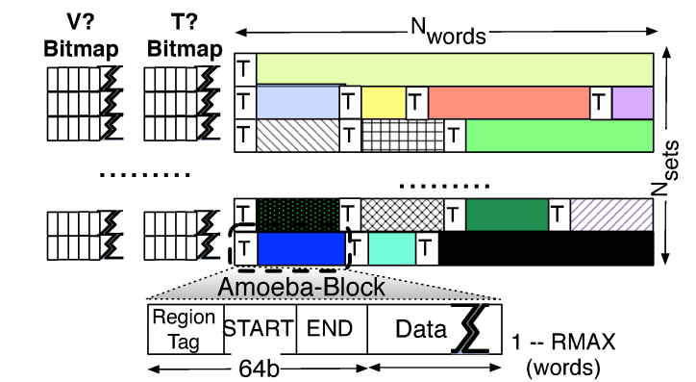
Shortcomings of the existing approaches
Inflation of memory footprint
Introduction of additional instructions
Extending support to every language
Access to application source code
OS and Kernel modification
Amoeba Cache Architecture¹
Cache organization modification
S. Kumar et al., “Amoeba-Cache: Adaptive Blocks for Eliminating Waste in the Memory Hierarchy,” MICRO’12
Notes:
Most approach used hardware performance counter/events for identification of FS. The HITM events on Intel architecture works well for WR instance of FS while incurs inaccuracy for R-W and W-W false sharing
Coherence protocol modification: Protozoa require newer acache architecture, VIPS family of protocol require Data race freedom guarantee from software.
Sheriff does not support TSO model.
Algorithm feature:
Efficient: The mechanism should incur low overhead during detection and repair phase.
Effective: The mechanism fix the instances of false sharing.
Accurate: The mechanism should detect the actual location of false sharing instance.
Portability: The solution should be portable on different hardware architecture and work for different languages

Slide 33
Shortcomings of the existing approaches
Inflation of memory footprint
Introduction of additional instructions
PORTABLE
EFFICIENT
Extending support to every language
Access to application source code
OS and Kernel modification
ACCURATE
EFFECTIVE
Cache organization modification
Notes:
Most approach used hardware performance counter/events for identification of FS. The HITM events on Intel architecture works well for WR instance of FS while incurs inaccuracy for R-W and W-W false sharing
Coherence protocol modification: Protozoa require newer acache architecture, VIPS family of protocol require Data race freedom guarantee from software.
Sheriff does not support TSO model.
Algorithm feature:
Efficient: The mechanism should incur low overhead during detection and repair phase.
Effective: The mechanism fix the instances of false sharing.
Accurate: The mechanism should detect the actual location of false sharing instance.
Portability: The solution should be portable on different hardware architecture and work for different languages

Slide 34
Shortcomings of the existing approaches
Inflation of memory footprint
Introduction of additional instructions
PORTABLE
EFFICIENT
Extending support to every language
FSDetect and FSLite
Access to application source code
OS and Kernel modification
ACCURATE
EFFECTIVE
Cache organization modification
Notes:
Most approach used hardware performance counter/events for identification of FS. The HITM events on Intel architecture works well for WR instance of FS while incurs inaccuracy for R-W and W-W false sharing
Coherence protocol modification: Protozoa require newer acache architecture, VIPS family of protocol require Data race freedom guarantee from software.
Sheriff does not support TSO model.
Algorithm feature:
Efficient: The mechanism should incur low overhead during detection and repair phase.
Effective: The mechanism fix the instances of false sharing.
Accurate: The mechanism should detect the actual location of false sharing instance.
Portability: The solution should be portable on different hardware architecture and work for different languages

Slide 35
Key Insights
Tracks the sharing patterns of block
FSDetect
EFFICIENT
Identifies the impactful instance of false sharing
Notes:
Most approach used hardware performance counter/events for identification of FS. The HITM events on Intel architecture works well for WR instance of FS while incurs inaccuracy for R-W and W-W false sharing
Coherence protocol modification: Protozoa require newer acache architecture, VIPS family of protocol require Data race freedom guarantee from software.
Sheriff does not support TSO model.
Algorithm feature:
Efficient: The mechanism should incur low overhead during detection and repair phase.
Effective: The mechanism fix the instances of false sharing.
Accurate: The mechanism should detect the actual location of false sharing instance.
Portability: The solution should be portable on different hardware architecture and work for different languages

Slide 36
Key Insights
Tracks the sharing patterns of block
FSDetect
EFFICIENT
Identifies the impactful instance of false sharing
Eliminates false sharing by privatizing the blocks
FSLite
Allows multiple writers for the disjoint bytes
Notes:
Most approach used hardware performance counter/events for identification of FS. The HITM events on Intel architecture works well for WR instance of FS while incurs inaccuracy for R-W and W-W false sharing
Coherence protocol modification: Protozoa require newer acache architecture, VIPS family of protocol require Data race freedom guarantee from software.
Sheriff does not support TSO model.
Algorithm feature:
Efficient: The mechanism should incur low overhead during detection and repair phase.
Effective: The mechanism fix the instances of false sharing.
Accurate: The mechanism should detect the actual location of false sharing instance.
Portability: The solution should be portable on different hardware architecture and work for different languages

Slide 37
Baseline Architecture
LLC
Main Memory
Directory Ctrl
LLC Ctrl
Core 0
L1 Ctrl
N Cores
L1I
L1D
Notes:
As FS is a artifact of hardware based coherence protocol.
An architectural solution

Slide 38
Overview of Architectural Modification
Shared Access Metadata (SAM) to track the access history
SAM
LLC
Main Memory
Directory Ctrl
LLC Ctrl
Core 0
L1 Ctrl
N Cores
L1I
L1D
Notes:
As FS is a artifact of hardware based coherence protocol.
An architectural solution

Slide 39
Overview of Architectural Modification
Shared Access Metadata (SAM) to track the access history
SAM
LLC
Main Memory
Directory Ctrl
LLC Ctrl
Core 0
Byte B
L1 Ctrl
L1I
L1D
Last Writer
(LW)
(log₂ N bit)
Sharers
(N bits)
N # of Cores
Notes:
As FS is a artifact of hardware based coherence protocol.
An architectural solution

Slide 40
Overview of Architectural Modification
Private Access Metadata (PAM) to track the local access
SAM
LLC
Main Memory
Directory Ctrl
LLC Ctrl
Core 0
L1 Ctrl
PAM
L1I
L1D
Notes:
As FS is a artifact of hardware based coherence protocol.
An architectural solution

Slide 41
Overview of Architectural Modification
Private Access Metadata (PAM) to track the local access
SAM
LLC
Main Memory
Directory Ctrl
LLC Ctrl
Core 0
Writer BitVector
1
2
...
64
L1 Ctrl
PAM
N Cores
L1I
L1D
Reader BitVector
1
2
...
64
Notes:
As FS is a artifact of hardware based coherence protocol.
An architectural solution

Slide 42
Overview of Architectural Modification
SAM
LLC
Main Memory
Directory
Ctrl
LLC Ctrl
Counters
Core 0
L1 Ctrl
PAM
L1I
L1D
Notes:
As FS is a artifact of hardware based coherence protocol.
An architectural solution

Slide 43
Overview of Architectural Modification
Fetch (FC) and Invalidation (IC) to filter the impactful instance
Pending Metadata Message (PMMC) to track the inflight metadata
SAM
LLC
Main Memory
Directory
Ctrl
LLC Ctrl
Counters
FC
(7bits)
IC
(7 bits)
PMMC
(log₂N bits)
HC
(2 bits)
Core 0
L1 Ctrl
PAM
L1I
L1D
N # of Cores
Notes:
As FS is a artifact of hardware based coherence protocol.
An architectural solution

Slide 44
Detecting False Sharing in FSDetect
0 | 1 | 2 | 3
0 | 1 | 2 | 3
Core C0
Core C1
Directory Controller
Block B0 (I)
Notes:
Consider a Write-Read false sharing instance. C0 performs a store on byte 1, and C1 performs a load of byte2.
Directory receives the GETX from C0, updates the byte 1 metadata in the global access tracking table and FETCH counter. C0 updates the Overlap detection table entry.
Similarly, the request by C1 triggers coherence action, and the directory updates the global access tracking table. C1 updates the overlap detection table entry.
During prolonged execution of the application, the counters will increment on each subsequent request. The directory flag it as an impactful false sharing instance once the counters crosses the threshold count X.
I am going to unveil the magic of our repair scheme.
←----------------------------------------------------------------------------------------------------------------------------------------------------------------------------------------------→
A scenario of W-R instance of FS.
C0 sends out request to directory. Directory updates the GlobalACT entry for byte 1 of the block. C0 on response update OD entry.
Similarly, on receiving C1 request, Directory updates the byte2 entry and C1 updates OD entry.
The execution continues , the value of counter keeps updating with each fetch and INV. Once the value of INV and FETch reaches X, directory identify the block for repair.

Slide 45
Detecting False Sharing in FSDetect
0 | 1 | 2 | 3
0 | 1 | 2 | 3
Core C0
Core C1
1. GetX
Directory Controller
Block B0 (I)
Notes:
Consider a Write-Read false sharing instance. C0 performs a store on byte 1, and C1 performs a load of byte2.
Directory receives the GETX from C0, updates the byte 1 metadata in the global access tracking table and FETCH counter. C0 updates the Overlap detection table entry.
Similarly, the request by C1 triggers coherence action, and the directory updates the global access tracking table. C1 updates the overlap detection table entry.
During prolonged execution of the application, the counters will increment on each subsequent request. The directory flag it as an impactful false sharing instance once the counters crosses the threshold count X.
I am going to unveil the magic of our repair scheme.
←----------------------------------------------------------------------------------------------------------------------------------------------------------------------------------------------→
A scenario of W-R instance of FS.
C0 sends out request to directory. Directory updates the GlobalACT entry for byte 1 of the block. C0 on response update OD entry.
Similarly, on receiving C1 request, Directory updates the byte2 entry and C1 updates OD entry.
The execution continues , the value of counter keeps updating with each fetch and INV. Once the value of INV and FETch reaches X, directory identify the block for repair.

Slide 46
Detecting False Sharing in FSDetect
0 | 1 | 2 | 3
0 | 1 | 2 | 3
Core C0
2. Data
Core C1
1. GetX
Directory Controller
FC
Block B0 (M)
C0
1
Notes:
Consider a Write-Read false sharing instance. C0 performs a store on byte 1, and C1 performs a load of byte2.
Directory receives the GETX from C0, updates the byte 1 metadata in the global access tracking table and FETCH counter. C0 updates the Overlap detection table entry.
Similarly, the request by C1 triggers coherence action, and the directory updates the global access tracking table. C1 updates the overlap detection table entry.
During prolonged execution of the application, the counters will increment on each subsequent request. The directory flag it as an impactful false sharing instance once the counters crosses the threshold count X.
I am going to unveil the magic of our repair scheme.
←----------------------------------------------------------------------------------------------------------------------------------------------------------------------------------------------→
A scenario of W-R instance of FS.
C0 sends out request to directory. Directory updates the GlobalACT entry for byte 1 of the block. C0 on response update OD entry.
Similarly, on receiving C1 request, Directory updates the byte2 entry and C1 updates OD entry.
The execution continues , the value of counter keeps updating with each fetch and INV. Once the value of INV and FETch reaches X, directory identify the block for repair.

Slide 47
Detecting False Sharing in FSDetect
0 | 1 | 2 | 3
0 | 1 | 2 | 3
PAM entry at Core0
 | 1
Reader BitVector
Writer BitVector
ST
Core C0
2. Data
Core C1
1. GetX
Directory Controller
FC
Block B0 (M)
C0
1
Notes:
Consider a Write-Read false sharing instance. C0 performs a store on byte 1, and C1 performs a load of byte2.
Directory receives the GETX from C0, updates the byte 1 metadata in the global access tracking table and FETCH counter. C0 updates the Overlap detection table entry.
Similarly, the request by C1 triggers coherence action, and the directory updates the global access tracking table. C1 updates the overlap detection table entry.
During prolonged execution of the application, the counters will increment on each subsequent request. The directory flag it as an impactful false sharing instance once the counters crosses the threshold count X.
I am going to unveil the magic of our repair scheme.
←----------------------------------------------------------------------------------------------------------------------------------------------------------------------------------------------→
A scenario of W-R instance of FS.
C0 sends out request to directory. Directory updates the GlobalACT entry for byte 1 of the block. C0 on response update OD entry.
Similarly, on receiving C1 request, Directory updates the byte2 entry and C1 updates OD entry.
The execution continues , the value of counter keeps updating with each fetch and INV. Once the value of INV and FETch reaches X, directory identify the block for repair.

Slide 48
Detecting False Sharing in FSDetect
0 | 1 | 2 | 3
0 | 1 | 2 | 3
PAM entry at Core0
 | 1
Reader BitVector
Writer BitVector
ST
Core C0
2. Data
Core C1
1. GetX
3. GetS
Directory Controller
FC
Block B0 (M)
C0
2
Notes:
Consider a Write-Read false sharing instance. C0 performs a store on byte 1, and C1 performs a load of byte2.
Directory receives the GETX from C0, updates the byte 1 metadata in the global access tracking table and FETCH counter. C0 updates the Overlap detection table entry.
Similarly, the request by C1 triggers coherence action, and the directory updates the global access tracking table. C1 updates the overlap detection table entry.
During prolonged execution of the application, the counters will increment on each subsequent request. The directory flag it as an impactful false sharing instance once the counters crosses the threshold count X.
I am going to unveil the magic of our repair scheme.
←----------------------------------------------------------------------------------------------------------------------------------------------------------------------------------------------→
A scenario of W-R instance of FS.
C0 sends out request to directory. Directory updates the GlobalACT entry for byte 1 of the block. C0 on response update OD entry.
Similarly, on receiving C1 request, Directory updates the byte2 entry and C1 updates OD entry.
The execution continues , the value of counter keeps updating with each fetch and INV. Once the value of INV and FETch reaches X, directory identify the block for repair.

Slide 49
Detecting False Sharing in FSDetect
0 | 1 | 2 | 3
0 | 1 | 2 | 3
PAM entry at Core0
 | 1
Reader BitVector
Writer BitVector
ST
Core C0
2. Data
Core C1
4. Fwd_GetS
3. GetS
1. GetX
Directory Controller
FC
IC
PMMC
Block B0 (S)
C0
C1
2
1
1
Notes:
Consider a Write-Read false sharing instance. C0 performs a store on byte 1, and C1 performs a load of byte2.
Directory receives the GETX from C0, updates the byte 1 metadata in the global access tracking table and FETCH counter. C0 updates the Overlap detection table entry.
Similarly, the request by C1 triggers coherence action, and the directory updates the global access tracking table. C1 updates the overlap detection table entry.
During prolonged execution of the application, the counters will increment on each subsequent request. The directory flag it as an impactful false sharing instance once the counters crosses the threshold count X.
I am going to unveil the magic of our repair scheme.
←----------------------------------------------------------------------------------------------------------------------------------------------------------------------------------------------→
A scenario of W-R instance of FS.
C0 sends out request to directory. Directory updates the GlobalACT entry for byte 1 of the block. C0 on response update OD entry.
Similarly, on receiving C1 request, Directory updates the byte2 entry and C1 updates OD entry.
The execution continues , the value of counter keeps updating with each fetch and INV. Once the value of INV and FETch reaches X, directory identify the block for repair.

Slide 50
Detecting False Sharing in FSDetect
0 | 1 | 2 | 3
0 | 1 | 2 | 3
PAM entry at Core0
 | 1
Reader BitVector
Writer BitVector
ST
5b. Data
Core C0
2. Data
Core C1
4. Fwd_GetS
5a. WB
3. GetS
1. GetX
Directory Controller
FC
IC
PMMC
Block B0 (S)
C0
C1
2
1
1
Notes:
Consider a Write-Read false sharing instance. C0 performs a store on byte 1, and C1 performs a load of byte2.
Directory receives the GETX from C0, updates the byte 1 metadata in the global access tracking table and FETCH counter. C0 updates the Overlap detection table entry.
Similarly, the request by C1 triggers coherence action, and the directory updates the global access tracking table. C1 updates the overlap detection table entry.
During prolonged execution of the application, the counters will increment on each subsequent request. The directory flag it as an impactful false sharing instance once the counters crosses the threshold count X.
I am going to unveil the magic of our repair scheme.
←----------------------------------------------------------------------------------------------------------------------------------------------------------------------------------------------→
A scenario of W-R instance of FS.
C0 sends out request to directory. Directory updates the GlobalACT entry for byte 1 of the block. C0 on response update OD entry.
Similarly, on receiving C1 request, Directory updates the byte2 entry and C1 updates OD entry.
The execution continues , the value of counter keeps updating with each fetch and INV. Once the value of INV and FETch reaches X, directory identify the block for repair.

Slide 51
Detecting False Sharing in FSDetect
0 | 1 | 2 | 3
0 | 1 | 2 | 3
PAM entry at Core0
 | 1
Reader BitVector
Writer BitVector
ST
LD
5b. Data
 |  | 1
Core C0
2. Data
Core C1
PAM entry at Core1
4. Fwd_GetS
5a. WB
3. GetS
1. GetX
Directory Controller
FC
IC
PMMC
Block B0 (S)
C0
C1
2
1
1
Notes:
Consider a Write-Read false sharing instance. C0 performs a store on byte 1, and C1 performs a load of byte2.
Directory receives the GETX from C0, updates the byte 1 metadata in the global access tracking table and FETCH counter. C0 updates the Overlap detection table entry.
Similarly, the request by C1 triggers coherence action, and the directory updates the global access tracking table. C1 updates the overlap detection table entry.
During prolonged execution of the application, the counters will increment on each subsequent request. The directory flag it as an impactful false sharing instance once the counters crosses the threshold count X.
I am going to unveil the magic of our repair scheme.
←----------------------------------------------------------------------------------------------------------------------------------------------------------------------------------------------→
A scenario of W-R instance of FS.
C0 sends out request to directory. Directory updates the GlobalACT entry for byte 1 of the block. C0 on response update OD entry.
Similarly, on receiving C1 request, Directory updates the byte2 entry and C1 updates OD entry.
The execution continues , the value of counter keeps updating with each fetch and INV. Once the value of INV and FETch reaches X, directory identify the block for repair.

Slide 52
Detecting False Sharing in FSDetect
0 | 1 | 2 | 3
0 | 1 | 2 | 3
PAM entry at Core0
Reader BitVector
Writer BitVector
ST
LD
5b. Data
 |  | 1
Core C0
2. Data
Core C1
PAM entry at Core1
4. Fwd_GetS
5c. MD
3. GetS
5a. WB
1. GetX
Directory Controller
FC
IC
PMMC
Block B0 (S)
C0
C1
2
1
1
Notes:
Consider a Write-Read false sharing instance. C0 performs a store on byte 1, and C1 performs a load of byte2.
Directory receives the GETX from C0, updates the byte 1 metadata in the global access tracking table and FETCH counter. C0 updates the Overlap detection table entry.
Similarly, the request by C1 triggers coherence action, and the directory updates the global access tracking table. C1 updates the overlap detection table entry.
During prolonged execution of the application, the counters will increment on each subsequent request. The directory flag it as an impactful false sharing instance once the counters crosses the threshold count X.
I am going to unveil the magic of our repair scheme.
←----------------------------------------------------------------------------------------------------------------------------------------------------------------------------------------------→
A scenario of W-R instance of FS.
C0 sends out request to directory. Directory updates the GlobalACT entry for byte 1 of the block. C0 on response update OD entry.
Similarly, on receiving C1 request, Directory updates the byte2 entry and C1 updates OD entry.
The execution continues , the value of counter keeps updating with each fetch and INV. Once the value of INV and FETch reaches X, directory identify the block for repair.

Slide 53
Detecting False Sharing in FSDetect
0 | 1 | 2 | 3
0 | 1 | 2 | 3
PAM entry at Core0
Reader BitVector
Writer BitVector
ST
LD
5b. Data
 |  | 1
Core C0
2. Data
Core C1
PAM entry at Core1
4. Fwd_GetS
5c. MD
5a. WB
3. GetS
1. GetX
LW
Sharers
Byte 0
Directory Controller
Byte 1
C0
Byte 2
Byte 3
FC
IC
PMMC
Block B0 (S)
C0
C1
SAM table entry for a Block B0
2
1
0
Notes:
Consider a Write-Read false sharing instance. C0 performs a store on byte 1, and C1 performs a load of byte2.
Directory receives the GETX from C0, updates the byte 1 metadata in the global access tracking table and FETCH counter. C0 updates the Overlap detection table entry.
Similarly, the request by C1 triggers coherence action, and the directory updates the global access tracking table. C1 updates the overlap detection table entry.
During prolonged execution of the application, the counters will increment on each subsequent request. The directory flag it as an impactful false sharing instance once the counters crosses the threshold count X.
I am going to unveil the magic of our repair scheme.
←----------------------------------------------------------------------------------------------------------------------------------------------------------------------------------------------→
A scenario of W-R instance of FS.
C0 sends out request to directory. Directory updates the GlobalACT entry for byte 1 of the block. C0 on response update OD entry.
Similarly, on receiving C1 request, Directory updates the byte2 entry and C1 updates OD entry.
The execution continues , the value of counter keeps updating with each fetch and INV. Once the value of INV and FETch reaches X, directory identify the block for repair.

Slide 54
Detecting False Sharing in FSDetect
0 | 1 | 2 | 3
0 | 1 | 2 | 3
PAM entry at Core0
Reader BitVector
Writer BitVector
ST
LD
5b. Data
 |  | 1
Core C0
2. Data
Core C1
PAM entry at Core1
4. Fwd_GetS
6. Ack
5c. MD
5a. WB
3. GetS
1. GetX
LW
Sharers
Byte 0
Directory Controller
Byte 1
C0
Byte 2
Byte 3
FC
IC
PMMC
Block B0 (S)
C0
C1
SAM table entry for a Block B0
2
1
0
Notes:
Consider a Write-Read false sharing instance. C0 performs a store on byte 1, and C1 performs a load of byte2.
Directory receives the GETX from C0, updates the byte 1 metadata in the global access tracking table and FETCH counter. C0 updates the Overlap detection table entry.
Similarly, the request by C1 triggers coherence action, and the directory updates the global access tracking table. C1 updates the overlap detection table entry.
During prolonged execution of the application, the counters will increment on each subsequent request. The directory flag it as an impactful false sharing instance once the counters crosses the threshold count X.
I am going to unveil the magic of our repair scheme.
←----------------------------------------------------------------------------------------------------------------------------------------------------------------------------------------------→
A scenario of W-R instance of FS.
C0 sends out request to directory. Directory updates the GlobalACT entry for byte 1 of the block. C0 on response update OD entry.
Similarly, on receiving C1 request, Directory updates the byte2 entry and C1 updates OD entry.
The execution continues , the value of counter keeps updating with each fetch and INV. Once the value of INV and FETch reaches X, directory identify the block for repair.

Slide 55
Detecting False Sharing in FSDetect
0 | 1 | 2 | 3
0 | 1 | 2 | 3
PAM entry at Core0
Reader BitVector
Writer BitVector
ST
LD
5b. Data
 |  | 1
Core C0
2. Data
Core C1
PAM entry at Core1
6. Ack
4. Fwd_GetS
5c. MD
5a. WB
3. GetS
1. GetX
LW
Sharers
Byte 0
7. Upg
C0
Directory Controller
Byte 1
Byte 2
Byte 3
FC
IC
PMMC
Block B0 (M)
C0
C1
SAM table entry for a Block B0
3
1
1
Notes:
Consider a Write-Read false sharing instance. C0 performs a store on byte 1, and C1 performs a load of byte2.
Directory receives the GETX from C0, updates the byte 1 metadata in the global access tracking table and FETCH counter. C0 updates the Overlap detection table entry.
Similarly, the request by C1 triggers coherence action, and the directory updates the global access tracking table. C1 updates the overlap detection table entry.
During prolonged execution of the application, the counters will increment on each subsequent request. The directory flag it as an impactful false sharing instance once the counters crosses the threshold count X.
I am going to unveil the magic of our repair scheme.
←----------------------------------------------------------------------------------------------------------------------------------------------------------------------------------------------→
A scenario of W-R instance of FS.
C0 sends out request to directory. Directory updates the GlobalACT entry for byte 1 of the block. C0 on response update OD entry.
Similarly, on receiving C1 request, Directory updates the byte2 entry and C1 updates OD entry.
The execution continues , the value of counter keeps updating with each fetch and INV. Once the value of INV and FETch reaches X, directory identify the block for repair.

Slide 56
Detecting False Sharing in FSDetect
0 | 1 | 2 | 3
0 | 1 | 2 | 3
PAM entry at Core0
Reader BitVector
Writer BitVector
ST
LD
5b. Data
 |  | 1
Core C0
2. Data
Core C1
PAM entry at Core1
6. Ack
4. Fwd_GetS
5c. MD
5a. WB
3. GetS
1. GetX
LW
Sharers
8. INV
Byte 0
7. Upg
C0
Directory Controller
Byte 1
Byte 2
Byte 3
FC
IC
PMMC
Block B0 (M)
C0
SAM table entry for a Block B0
3
2
1
Notes:
Consider a Write-Read false sharing instance. C0 performs a store on byte 1, and C1 performs a load of byte2.
Directory receives the GETX from C0, updates the byte 1 metadata in the global access tracking table and FETCH counter. C0 updates the Overlap detection table entry.
Similarly, the request by C1 triggers coherence action, and the directory updates the global access tracking table. C1 updates the overlap detection table entry.
During prolonged execution of the application, the counters will increment on each subsequent request. The directory flag it as an impactful false sharing instance once the counters crosses the threshold count X.
I am going to unveil the magic of our repair scheme.
←----------------------------------------------------------------------------------------------------------------------------------------------------------------------------------------------→
A scenario of W-R instance of FS.
C0 sends out request to directory. Directory updates the GlobalACT entry for byte 1 of the block. C0 on response update OD entry.
Similarly, on receiving C1 request, Directory updates the byte2 entry and C1 updates OD entry.
The execution continues , the value of counter keeps updating with each fetch and INV. Once the value of INV and FETch reaches X, directory identify the block for repair.

Slide 57
Detecting False Sharing in FSDetect
0 | 1 | 2 | 3
0 | 1 | 2 | 3
PAM entry at Core0
 | 1
Reader BitVector
Writer BitVector
ST
LD
5b. Data
 |  | 1
Core C0
9a. Inv_Ack
Core C1
2. Data
PAM entry at Core1
6. Ack
4. Fwd_GetS
5c. MD
5a. WB
3. GetS
1. GetX
LW
Sharers
8. INV
Byte 0
7. Upg
C0
Directory Controller
Byte 1
Byte 2
Byte 3
FC
IC
PMMC
Block B0 (M)
C0
SAM table entry for a Block B0
3
2
1
Notes:
Consider a Write-Read false sharing instance. C0 performs a store on byte 1, and C1 performs a load of byte2.
Directory receives the GETX from C0, updates the byte 1 metadata in the global access tracking table and FETCH counter. C0 updates the Overlap detection table entry.
Similarly, the request by C1 triggers coherence action, and the directory updates the global access tracking table. C1 updates the overlap detection table entry.
During prolonged execution of the application, the counters will increment on each subsequent request. The directory flag it as an impactful false sharing instance once the counters crosses the threshold count X.
I am going to unveil the magic of our repair scheme.
←----------------------------------------------------------------------------------------------------------------------------------------------------------------------------------------------→
A scenario of W-R instance of FS.
C0 sends out request to directory. Directory updates the GlobalACT entry for byte 1 of the block. C0 on response update OD entry.
Similarly, on receiving C1 request, Directory updates the byte2 entry and C1 updates OD entry.
The execution continues , the value of counter keeps updating with each fetch and INV. Once the value of INV and FETch reaches X, directory identify the block for repair.

Slide 58
Detecting False Sharing in FSDetect
0 | 1 | 2 | 3
0 | 1 | 2 | 3
PAM entry at Core0
 | 1
Reader BitVector
Writer BitVector
ST
LD
5b. Data
Core C0
9a. Inv_Ack
Core C1
2. Data
PAM entry at Core1
6. Ack
4. Fwd_GetS
5c. MD
5a. WB
9b. MD
3. GetS
1. GetX
LW
Sharers
8. INV
Byte 0
7. Upg
C0
Directory Controller
Byte 1
Byte 2
Byte 3
FC
IC
PMMC
Block B0 (M)
C0
SAM table entry for a Block B0
3
2
1
Notes:
Consider a Write-Read false sharing instance. C0 performs a store on byte 1, and C1 performs a load of byte2.
Directory receives the GETX from C0, updates the byte 1 metadata in the global access tracking table and FETCH counter. C0 updates the Overlap detection table entry.
Similarly, the request by C1 triggers coherence action, and the directory updates the global access tracking table. C1 updates the overlap detection table entry.
During prolonged execution of the application, the counters will increment on each subsequent request. The directory flag it as an impactful false sharing instance once the counters crosses the threshold count X.
I am going to unveil the magic of our repair scheme.
←----------------------------------------------------------------------------------------------------------------------------------------------------------------------------------------------→
A scenario of W-R instance of FS.
C0 sends out request to directory. Directory updates the GlobalACT entry for byte 1 of the block. C0 on response update OD entry.
Similarly, on receiving C1 request, Directory updates the byte2 entry and C1 updates OD entry.
The execution continues , the value of counter keeps updating with each fetch and INV. Once the value of INV and FETch reaches X, directory identify the block for repair.

Slide 59
Detecting False Sharing in FSDetect
0 | 1 | 2 | 3
0 | 1 | 2 | 3
PAM entry at Core0
 | 1
Reader BitVector
Writer BitVector
ST
LD
5b. Data
Core C0
9a. Inv_Ack
Core C1
2. Data
PAM entry at Core1
6. Ack
4. Fwd_GetS
5c. MD
5a. WB
9b. MD
3. GetS
1. GetX
LW
Sharers
8. INV
Byte 0
7. Upg
C0
Directory Controller
Byte 1
Byte 2
1
Byte 3
FC
IC
PMMC
Block B0 (M)
C0
SAM table entry for a Block B0
3
2
0
Notes:
Consider a Write-Read false sharing instance. C0 performs a store on byte 1, and C1 performs a load of byte2.
Directory receives the GETX from C0, updates the byte 1 metadata in the global access tracking table and FETCH counter. C0 updates the Overlap detection table entry.
Similarly, the request by C1 triggers coherence action, and the directory updates the global access tracking table. C1 updates the overlap detection table entry.
During prolonged execution of the application, the counters will increment on each subsequent request. The directory flag it as an impactful false sharing instance once the counters crosses the threshold count X.
I am going to unveil the magic of our repair scheme.
←----------------------------------------------------------------------------------------------------------------------------------------------------------------------------------------------→
A scenario of W-R instance of FS.
C0 sends out request to directory. Directory updates the GlobalACT entry for byte 1 of the block. C0 on response update OD entry.
Similarly, on receiving C1 request, Directory updates the byte2 entry and C1 updates OD entry.
The execution continues , the value of counter keeps updating with each fetch and INV. Once the value of INV and FETch reaches X, directory identify the block for repair.

Slide 60
Detecting False Sharing in FSDetect
0 | 1 | 2 | 3
0 | 1 | 2 | 3
PAM entry at Core0
 | 1
Reader BitVector
Writer BitVector
ST
LD
5b. Data
Core C0
9a. Inv_Ack
Core C1
2. Data
PAM entry at Core1
6. Ack
4. Fwd_GetS
5c. MD
5a. WB
9b. MD
3. GetS
1. GetX
LW
Sharers
8. INV
Byte 0
7. Upg
C0
Directory Controller
Byte 1
Byte 2
1
Byte 3
FC
IC
PMMC
Block B0 (M)
C0
SAM table entry for a Block B0
18
17
0
Notes:
Consider a Write-Read false sharing instance. C0 performs a store on byte 1, and C1 performs a load of byte2.
Directory receives the GETX from C0, updates the byte 1 metadata in the global access tracking table and FETCH counter. C0 updates the Overlap detection table entry.
Similarly, the request by C1 triggers coherence action, and the directory updates the global access tracking table. C1 updates the overlap detection table entry.
During prolonged execution of the application, the counters will increment on each subsequent request. The directory flag it as an impactful false sharing instance once the counters crosses the threshold count X.
I am going to unveil the magic of our repair scheme.
←----------------------------------------------------------------------------------------------------------------------------------------------------------------------------------------------→
A scenario of W-R instance of FS.
C0 sends out request to directory. Directory updates the GlobalACT entry for byte 1 of the block. C0 on response update OD entry.
Similarly, on receiving C1 request, Directory updates the byte2 entry and C1 updates OD entry.
The execution continues , the value of counter keeps updating with each fetch and INV. Once the value of INV and FETch reaches X, directory identify the block for repair.

Slide 61
Detecting False Sharing in FSDetect
0 | 1 | 2 | 3
0 | 1 | 2 | 3
PAM entry at Core0
Impactful Instance of False Sharing
 | 1
Reader BitVector
Writer BitVector
ST
LD
5b. Data
Core C0
9a. Inv_Ack
Core C1
2. Data
PAM entry at Core1
6. Ack
4. Fwd_GetS
5c. MD
5a. WB
9b. MD
3. GetS
1. GetX
LW
Sharers
8. INV
Byte 0
7. Upg
C0
Directory Controller
Byte 1
Byte 2
1
Byte 3
FC
IC
PMMC
Block B0 (M)
C0
SAM table entry for a Block B0
18
17
0
Notes:
Consider a Write-Read false sharing instance. C0 performs a store on byte 1, and C1 performs a load of byte2.
Directory receives the GETX from C0, updates the byte 1 metadata in the global access tracking table and FETCH counter. C0 updates the Overlap detection table entry.
Similarly, the request by C1 triggers coherence action, and the directory updates the global access tracking table. C1 updates the overlap detection table entry.
During prolonged execution of the application, the counters will increment on each subsequent request. The directory flag it as an impactful false sharing instance once the counters crosses the threshold count X.
I am going to unveil the magic of our repair scheme.
←----------------------------------------------------------------------------------------------------------------------------------------------------------------------------------------------→
A scenario of W-R instance of FS.
C0 sends out request to directory. Directory updates the GlobalACT entry for byte 1 of the block. C0 on response update OD entry.
Similarly, on receiving C1 request, Directory updates the byte2 entry and C1 updates OD entry.
The execution continues , the value of counter keeps updating with each fetch and INV. Once the value of INV and FETch reaches X, directory identify the block for repair.

Slide 62
Eliminating False Sharing in FSLite
0 | 1 | 2 | 3
0 | 1 | 2 | 3
PAM entry at Core0
 | 1
Reader BitVector
Writer BitVector
ST
Core C0
Core C1
PAM entry at Core1
LW
Sharers
Byte 0
Directory Controller
Byte 1
C0
Byte 2
1
Byte 3
FC
IC
PMMC
Block B0 (M)
C0
SAM table entry for a Block B0
18
17
0
Notes:
Consider a Write-Read false sharing instance. C0 performs a store on byte 1, and C1 performs a load of byte2.
Directory receives the GETX from C0, updates the byte 1 metadata in the global access tracking table and FETCH counter. C0 updates the Overlap detection table entry.
Similarly, the request by C1 triggers coherence action, and the directory updates the global access tracking table. C1 updates the overlap detection table entry.
During prolonged execution of the application, the counters will increment on each subsequent request. The directory flag it as an impactful false sharing instance once the counters crosses the threshold count X.
I am going to unveil the magic of our repair scheme.
←----------------------------------------------------------------------------------------------------------------------------------------------------------------------------------------------→
A scenario of W-R instance of FS.
C0 sends out request to directory. Directory updates the GlobalACT entry for byte 1 of the block. C0 on response update OD entry.
Similarly, on receiving C1 request, Directory updates the byte2 entry and C1 updates OD entry.
The execution continues , the value of counter keeps updating with each fetch and INV. Once the value of INV and FETch reaches X, directory identify the block for repair.

Slide 63
Eliminating False Sharing in FSLite
0 | 1 | 2 | 3
0 | 1 | 2 | 3
PAM entry at Core0
 | 1
Reader BitVector
Writer BitVector
ST
Core C0
Core C1
PAM entry at Core1
1. GetS
LW
Sharers
Byte 0
Directory Controller
Byte 1
C0
Byte 2
1
Byte 3
FC
IC
PMMC
Block B0 (M)
C0
SAM table entry for a Block B0
18
17
0
Notes:
Consider a Write-Read false sharing instance. C0 performs a store on byte 1, and C1 performs a load of byte2.
Directory receives the GETX from C0, updates the byte 1 metadata in the global access tracking table and FETCH counter. C0 updates the Overlap detection table entry.
Similarly, the request by C1 triggers coherence action, and the directory updates the global access tracking table. C1 updates the overlap detection table entry.
During prolonged execution of the application, the counters will increment on each subsequent request. The directory flag it as an impactful false sharing instance once the counters crosses the threshold count X.
I am going to unveil the magic of our repair scheme.
←----------------------------------------------------------------------------------------------------------------------------------------------------------------------------------------------→
A scenario of W-R instance of FS.
C0 sends out request to directory. Directory updates the GlobalACT entry for byte 1 of the block. C0 on response update OD entry.
Similarly, on receiving C1 request, Directory updates the byte2 entry and C1 updates OD entry.
The execution continues , the value of counter keeps updating with each fetch and INV. Once the value of INV and FETch reaches X, directory identify the block for repair.

Slide 64
Eliminating False Sharing in FSLite
0 | 1 | 2 | 3
0 | 1 | 2 | 3
PAM entry at Core0
 | 1
Reader BitVector
Writer BitVector
ST
Core C0
Core C1
PAM entry at Core1
2. TR_PRV
1. GetS
LW
Sharers
Byte 0
Directory Controller
Byte 1
C0
Byte 2
1
Byte 3
FC
IC
PMMC
Block B0 (M)
C0
SAM table entry for a Block B0
18
17
1
Notes:
Consider a Write-Read false sharing instance. C0 performs a store on byte 1, and C1 performs a load of byte2.
Directory receives the GETX from C0, updates the byte 1 metadata in the global access tracking table and FETCH counter. C0 updates the Overlap detection table entry.
Similarly, the request by C1 triggers coherence action, and the directory updates the global access tracking table. C1 updates the overlap detection table entry.
During prolonged execution of the application, the counters will increment on each subsequent request. The directory flag it as an impactful false sharing instance once the counters crosses the threshold count X.
I am going to unveil the magic of our repair scheme.
←----------------------------------------------------------------------------------------------------------------------------------------------------------------------------------------------→
A scenario of W-R instance of FS.
C0 sends out request to directory. Directory updates the GlobalACT entry for byte 1 of the block. C0 on response update OD entry.
Similarly, on receiving C1 request, Directory updates the byte2 entry and C1 updates OD entry.
The execution continues , the value of counter keeps updating with each fetch and INV. Once the value of INV and FETch reaches X, directory identify the block for repair.

Slide 65
Eliminating False Sharing in FSLite
0 | 1 | 2 | 3
0 | 1 | 2 | 3
PAM entry at Core0
Reader BitVector
Writer BitVector
ST
Core C0
Core C1
PAM entry at Core1
4. TR_PRV
3. MD
3. GetS
LW
Sharers
Byte 0
Directory Controller
Byte 1
C0
Byte 2
1
Byte 3
FC
IC
PMMC
Block B0 (M)
C0
SAM table entry for a Block B0
18
17
1
Notes:
Consider a Write-Read false sharing instance. C0 performs a store on byte 1, and C1 performs a load of byte2.
Directory receives the GETX from C0, updates the byte 1 metadata in the global access tracking table and FETCH counter. C0 updates the Overlap detection table entry.
Similarly, the request by C1 triggers coherence action, and the directory updates the global access tracking table. C1 updates the overlap detection table entry.
During prolonged execution of the application, the counters will increment on each subsequent request. The directory flag it as an impactful false sharing instance once the counters crosses the threshold count X.
I am going to unveil the magic of our repair scheme.
←----------------------------------------------------------------------------------------------------------------------------------------------------------------------------------------------→
A scenario of W-R instance of FS.
C0 sends out request to directory. Directory updates the GlobalACT entry for byte 1 of the block. C0 on response update OD entry.
Similarly, on receiving C1 request, Directory updates the byte2 entry and C1 updates OD entry.
The execution continues , the value of counter keeps updating with each fetch and INV. Once the value of INV and FETch reaches X, directory identify the block for repair.

Slide 66
Eliminating False Sharing in FSLite
0 | 1 | 2 | 3
0 | 1 | 2 | 3
PAM entry at Core0
Reader BitVector
Writer BitVector
ST
Directory performs a conflict detection check
Core C0
Core C1
PAM entry at Core1
2. TR_Prv
3. GetS
LW
Sharers
3. MD
Byte 0
Directory Controller
Byte 1
Byte 2
Byte 3
FC
IC
PMMC
Block B0 (M)
C0
SAM table entry for a Block B0
18
17
0
Notes:
Consider a Write-Read false sharing instance. C0 performs a store on byte 1, and C1 performs a load of byte2.
Directory receives the GETX from C0, updates the byte 1 metadata in the global access tracking table and FETCH counter. C0 updates the Overlap detection table entry.
Similarly, the request by C1 triggers coherence action, and the directory updates the global access tracking table. C1 updates the overlap detection table entry.
During prolonged execution of the application, the counters will increment on each subsequent request. The directory flag it as an impactful false sharing instance once the counters crosses the threshold count X.
I am going to unveil the magic of our repair scheme.
←----------------------------------------------------------------------------------------------------------------------------------------------------------------------------------------------→
A scenario of W-R instance of FS.
C0 sends out request to directory. Directory updates the GlobalACT entry for byte 1 of the block. C0 on response update OD entry.
Similarly, on receiving C1 request, Directory updates the byte2 entry and C1 updates OD entry.
The execution continues , the value of counter keeps updating with each fetch and INV. Once the value of INV and FETch reaches X, directory identify the block for repair.

Slide 67
Eliminating False Sharing in FSLite
0 | 1 | 2 | 3
0 | 1 | 2 | 3
PAM entry at Core0
Reader BitVector
Writer BitVector
ST
Core C0
Core C1
PAM entry at Core1
2. TR_PRV
4. Data_PRV
3. MD
LW
Sharers
3. GetS
Byte 0
Directory Controller
Byte 1
Byte 2
1
Byte 3
FC
IC
PMMC
Block B0 (PRV)
C0
C1
SAM table entry for a Block B0
18
17
0
Notes:
Consider a Write-Read false sharing instance. C0 performs a store on byte 1, and C1 performs a load of byte2.
Directory receives the GETX from C0, updates the byte 1 metadata in the global access tracking table and FETCH counter. C0 updates the Overlap detection table entry.
Similarly, the request by C1 triggers coherence action, and the directory updates the global access tracking table. C1 updates the overlap detection table entry.
During prolonged execution of the application, the counters will increment on each subsequent request. The directory flag it as an impactful false sharing instance once the counters crosses the threshold count X.
I am going to unveil the magic of our repair scheme.
←----------------------------------------------------------------------------------------------------------------------------------------------------------------------------------------------→
A scenario of W-R instance of FS.
C0 sends out request to directory. Directory updates the GlobalACT entry for byte 1 of the block. C0 on response update OD entry.
Similarly, on receiving C1 request, Directory updates the byte2 entry and C1 updates OD entry.
The execution continues , the value of counter keeps updating with each fetch and INV. Once the value of INV and FETch reaches X, directory identify the block for repair.

Slide 68
Eliminating False Sharing in FSLite
0 | 1 | 2 | 3
0 | 1 | 2 | 3
PAM entry at Core0
Reader BitVector
Writer BitVector
ST
LD
 |  | 1
Core C0
Core C1
PAM entry at Core1
2. TR_PRV
4. Data_PRV
1. GetS
3. MD
LW
Sharers
Byte 0
Directory Controller
Byte 1
Byte 2
1
Byte 3
FC
IC
PMMC
Block B0 (PRV)
C0
C1
SAM table entry for a Block B0
18
17
0
Notes:
Consider a Write-Read false sharing instance. C0 performs a store on byte 1, and C1 performs a load of byte2.
Directory receives the GETX from C0, updates the byte 1 metadata in the global access tracking table and FETCH counter. C0 updates the Overlap detection table entry.
Similarly, the request by C1 triggers coherence action, and the directory updates the global access tracking table. C1 updates the overlap detection table entry.
During prolonged execution of the application, the counters will increment on each subsequent request. The directory flag it as an impactful false sharing instance once the counters crosses the threshold count X.
I am going to unveil the magic of our repair scheme.
←----------------------------------------------------------------------------------------------------------------------------------------------------------------------------------------------→
A scenario of W-R instance of FS.
C0 sends out request to directory. Directory updates the GlobalACT entry for byte 1 of the block. C0 on response update OD entry.
Similarly, on receiving C1 request, Directory updates the byte2 entry and C1 updates OD entry.
The execution continues , the value of counter keeps updating with each fetch and INV. Once the value of INV and FETch reaches X, directory identify the block for repair.

Slide 69
Eliminating False Sharing in FSLite
0 | 1 | 2 | 3
0 | 1 | 2 | 3
PAM entry at Core0
Reader BitVector
Writer BitVector
ST
LD
 |  | 1
Core C0
Core C1
PAM entry at Core1
2. TR_PRV
4. Data_PRV
1. GetS
3. MD
LW
Sharers
Byte 0
5. GetX_CHK
Directory Controller
Byte 1
Byte 2
1
Byte 3
FC
IC
PMMC
Block B0 (PRV)
C0
C1
SAM table entry for a Block B0
18
17
0
Notes:
Consider a Write-Read false sharing instance. C0 performs a store on byte 1, and C1 performs a load of byte2.
Directory receives the GETX from C0, updates the byte 1 metadata in the global access tracking table and FETCH counter. C0 updates the Overlap detection table entry.
Similarly, the request by C1 triggers coherence action, and the directory updates the global access tracking table. C1 updates the overlap detection table entry.
During prolonged execution of the application, the counters will increment on each subsequent request. The directory flag it as an impactful false sharing instance once the counters crosses the threshold count X.
I am going to unveil the magic of our repair scheme.
←----------------------------------------------------------------------------------------------------------------------------------------------------------------------------------------------→
A scenario of W-R instance of FS.
C0 sends out request to directory. Directory updates the GlobalACT entry for byte 1 of the block. C0 on response update OD entry.
Similarly, on receiving C1 request, Directory updates the byte2 entry and C1 updates OD entry.
The execution continues , the value of counter keeps updating with each fetch and INV. Once the value of INV and FETch reaches X, directory identify the block for repair.

Slide 70
Eliminating False Sharing in FSLite
0 | 1 | 2 | 3
0 | 1 | 2 | 3
PAM entry at Core0
Reader BitVector
Writer BitVector
ST
LD
 |  | 1
Core C0
6. NC
Core C1
PAM entry at Core1
4. TR_PRV
5. Data_PRV
3. GetS
3. MD
LW
Sharers
Byte 0
5. GetX_CHK
Directory Controller
Byte 1
C0
Byte 2
1
Byte 3
FC
IC
PMMC
Block B0 (PRV)
C0
C1
SAM table entry for a Block B0
18
17
0
Notes:
Consider a Write-Read false sharing instance. C0 performs a store on byte 1, and C1 performs a load of byte2.
Directory receives the GETX from C0, updates the byte 1 metadata in the global access tracking table and FETCH counter. C0 updates the Overlap detection table entry.
Similarly, the request by C1 triggers coherence action, and the directory updates the global access tracking table. C1 updates the overlap detection table entry.
During prolonged execution of the application, the counters will increment on each subsequent request. The directory flag it as an impactful false sharing instance once the counters crosses the threshold count X.
I am going to unveil the magic of our repair scheme.
←----------------------------------------------------------------------------------------------------------------------------------------------------------------------------------------------→
A scenario of W-R instance of FS.
C0 sends out request to directory. Directory updates the GlobalACT entry for byte 1 of the block. C0 on response update OD entry.
Similarly, on receiving C1 request, Directory updates the byte2 entry and C1 updates OD entry.
The execution continues , the value of counter keeps updating with each fetch and INV. Once the value of INV and FETch reaches X, directory identify the block for repair.

Slide 71
Eliminating False Sharing in FSLite
0 | 1 | 2 | 3
0 | 1 | 2 | 3
PAM entry at Core0
 | 1
Reader BitVector
Writer BitVector
ST
LD
 |  | 1
Core C0
Core C1
6. NC
PAM entry at Core1
2. TR_PRV
4. Data_PRV
1. GetS
3. MD
LW
Sharers
Byte 0
5. GetX_CHK
Directory Controller
Byte 1
C0
Byte 2
1
Byte 3
FC
IC
PMMC
Block B0 (PRV)
C0
C1
SAM table entry for a Block B0
18
17
0
Notes:
Consider a Write-Read false sharing instance. C0 performs a store on byte 1, and C1 performs a load of byte2.
Directory receives the GETX from C0, updates the byte 1 metadata in the global access tracking table and FETCH counter. C0 updates the Overlap detection table entry.
Similarly, the request by C1 triggers coherence action, and the directory updates the global access tracking table. C1 updates the overlap detection table entry.
During prolonged execution of the application, the counters will increment on each subsequent request. The directory flag it as an impactful false sharing instance once the counters crosses the threshold count X.
I am going to unveil the magic of our repair scheme.
←----------------------------------------------------------------------------------------------------------------------------------------------------------------------------------------------→
A scenario of W-R instance of FS.
C0 sends out request to directory. Directory updates the GlobalACT entry for byte 1 of the block. C0 on response update OD entry.
Similarly, on receiving C1 request, Directory updates the byte2 entry and C1 updates OD entry.
The execution continues , the value of counter keeps updating with each fetch and INV. Once the value of INV and FETch reaches X, directory identify the block for repair.

Slide 72
Simulation Infrastructure and Configurations
SAM(13KB,128 entries)
LLC (2MB per core)
Main Memory
Directory
Ctrl
Counters(76KB)
LLC Ctrl
Core 0
PAM(8KB,512 entries)
L1 Ctrl
L1I(32KB)
L1D(32KB)
N # of Cores
Notes:
The protocol are implemented in the Gem5 simulator. Briefly discuss the each structure overhead

Slide 73
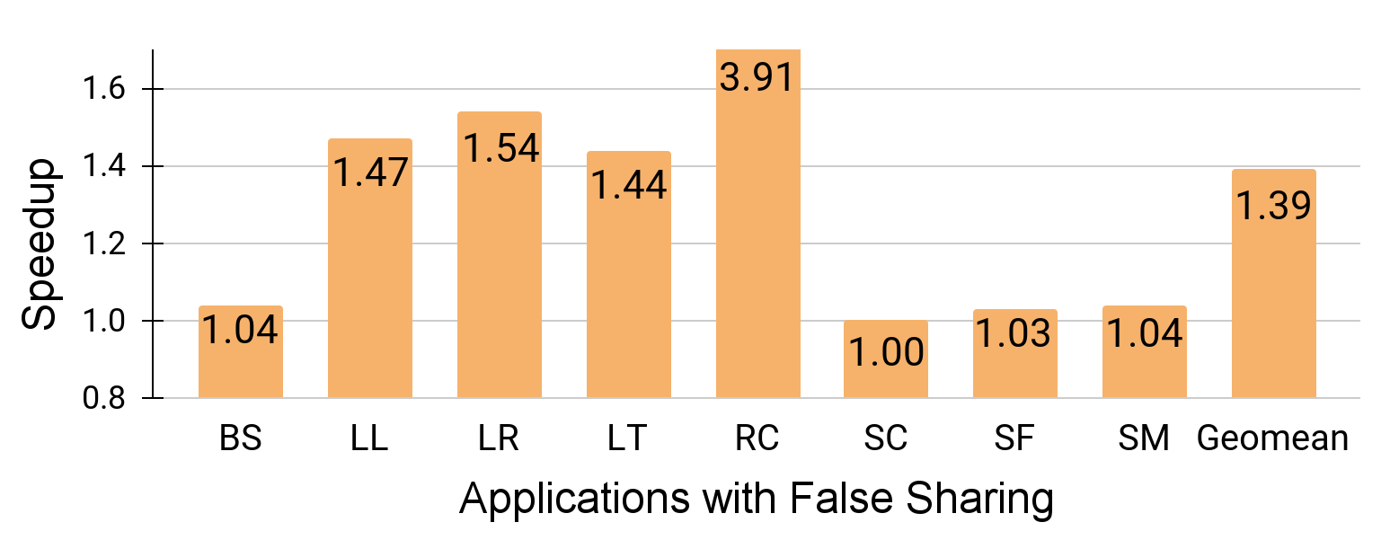
Performance Improvement with FSLite
FSLite achieves on avg 1.39x speedup and a max speedup 3.91x

Slide 74
Performance Improvement with FSLite
FSLite achieves on avg 1.39x speedup and a max speedup 3.91x
27% energy savings and 89% less interconnect messages
Notes:
Conclude by saying the first project using architectural extension

Slide 75
Comparison with Manual Fix
FSLite outperforms manual fix by ~4%
Notes:
Conclude by saying the first project using architectural extension

Slide 76
Comparison with Manual Fix
Padding inflates the memory footprint
Padding introduces additional instructions
Notes:
Conclude by saying the first project using architectural extension

Slide 77
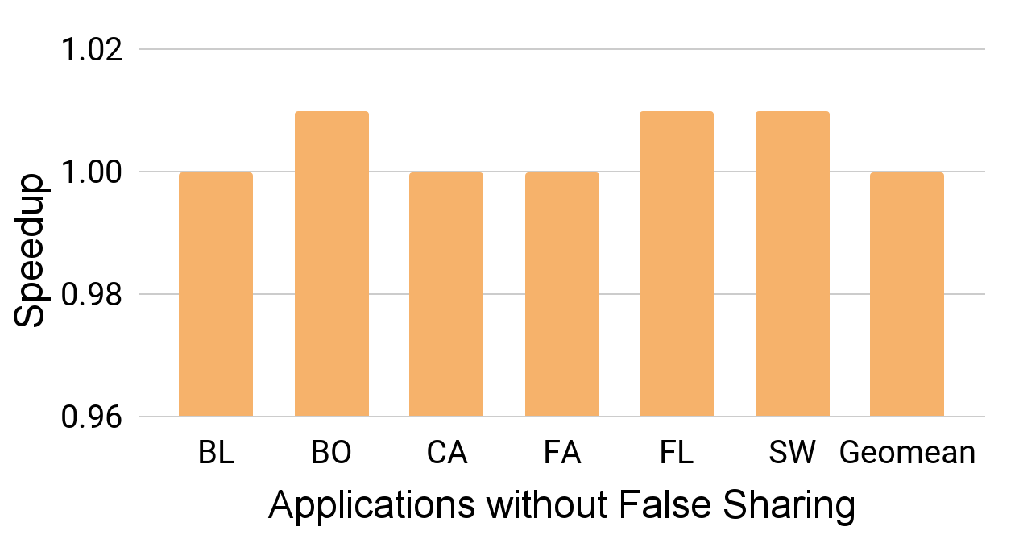
Impact of FSLite on Applications w/o False Sharing
No slowdown for applications without false sharing
Notes:
Discuss why hardware extension are preferable over software solution
Driven by these insight, we plan to explore the heterogeneous applications

Slide 78
Additional Results
FSLite achieves an average speedup of 1.63x for O-o-O cores

Slide 79
Additional Results
FSLite achieves an average speedup of 1.63x for O-o-O cores
FSLite achieves an average speedup of 1.21x over a 128KB L1D cache baseline across all applications (with and without false sharing)
Notes:
For per core and per llc slice iso-storage evaluation, we compare FSLite against a baseline with 128KB L1D cache.

Slide 80
Summary
False sharing: a common performance bug
Notes:
To summarize, we discuss the well-known performance bug of false sharing, which is prevalent in many real world applications.

Slide 81
Summary
False Sharing: a common performance bug
Protocol extensions to detect and mitigate false sharing on-the-fly
Notes:
We highlighted the drawbacks of existing approaches, as they are application dependent, require complex OS, Kernel, and hardware changes

Slide 82
Summary
False Sharing: a common performance bug
Protocol extensions to detect and mitigate false sharing on-the-fly
Independent of application source code and technology stack
Notes:
Discuss why hardware extension are preferable over software solution
Driven by these insight, we plan to explore the heterogeneous applications

Slide 83
Summary
False Sharing: a common performance bug
Protocol extensions to detect and mitigate false sharing on-the-fly
Independent of application source code and technology stack
Outperforms manual fix
Notes:
Discuss why hardware extension are preferable over software solution
Driven by these insight, we plan to explore the heterogeneous applications

Slide 84
Summary
False Sharing: a common performance bug
Protocol extensions to detect and mitigate false sharing on-the-fly
Independent of application source code and technology stack
Outperforms manual fix
No side-effect on applications without false sharing
Notes:
Discuss why hardware extension are preferable over software solution
Driven by these insight, we plan to explore the heterogeneous applications

Slide 85
Leveraging Cache Coherence to Detect and Repair False Sharing On-the-fly
MICRO’24
Vipin Patel, Swarnendu Biswas, and Mainak Chaudhuri
PROSPAR, Computer Science and Engineering,
Indian Institute of Technology Kanpur
Artifact available at: https://zenodo.org/records/13293424
Or Scan the QR code

Slide 86
Backup slides

Slide 87
Simulation Infrastructure and Configurations
CPU Type | In-order CPU with 3GHz Frequency
L1D Cache | 32 KB per core, 8-way, area: 7.43mm²
L2(LLC) | 2 MB per core, 16-way, area: 13.74m²
Cache line size | 64 bytes
Memory | 3 GB DDR3-16000, 8 ranks, 64-bit channel
PAM table | 8 KB (512 entries) per L1D, 8-way
SAM table | 12.7 KB (128 entries) per LLC slice, 16-way
Directory Extension | 76 KB per LLC slice
Conflict Detection | 2 cycles
Thresholds | FC:16, IC:16, and HC:3
Notes:
The protocol are implemented in the Gem5 simulator. Briefly discuss the each structure overhead

Slide 88
Handling Request during Privatization
0 | 1 | 2 | 3
0 | 1 | 2 | 3
PAM entry at Core2
 | 1
Reader BitVector
Writer BitVector
ST
LD
 |  |  | 1
Core C2
Core C3
PAM entry at Core3
4. Data_PRV
1. GetX
3. GetS
LW
Sharers
Byte 0
C2
Directory Controller
Byte 1
C0
Byte 2
1
Byte 3
1
FC
IC
PMMC
Block B0 (PRV)
C0
C1
C2
C3
SAM table entry for a Block B0
18
17
0
Notes:
Transition(meta language) Now I will discuss the experimental setup and key result from our paper.

Slide 89
Termination of Privatization
0 | 1 | 2 | 3
0 | 1 | 2 | 3
FC
IC
PMMC
0 | 1 | 2 | 3
0 | 1 | 2 | 3
0
0
0
ST
ST
LD
ST
LD
Core C0
Core C1
Core C2
Core C3
2. TER_PRV
LW
Sharers
3. WB_PRV
Byte 0
C2
Byte 1
C0
1. GetX_CHK
Directory Controller
Byte 2
1
Byte 3
1
Block B0 (PRV)
C0
C1
C2
C3
SAM table entry for a Block B0
Notes:
Transition(meta language) Now I will discuss the experimental setup and key result from our paper.

Slide 90
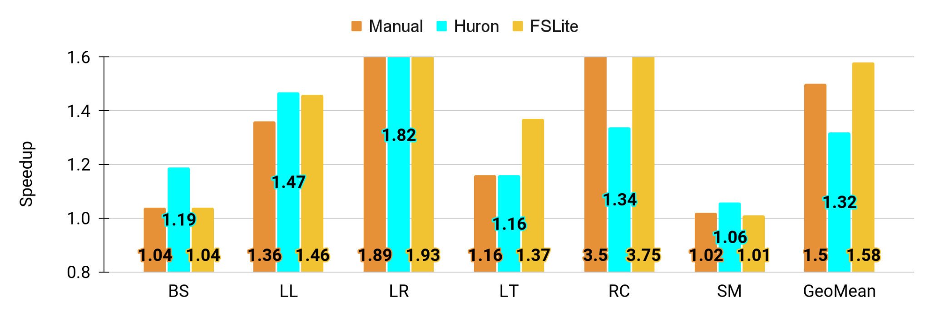
Comparison with Huron¹
15% less committed instruction for BoostSpinlock
The modified binary from Huron contains false sharing instances
1. T. A. Khan, Y. Zhao, G. Pokam, B. Mozafari, and B. Kasikci, “Huron: Hybrid False Sharing Detection and Repair,” in PLDI, 2019.
Notes:
Discuss why hardware extension are preferable over software solution
Driven by these insight, we plan to explore the heterogeneous applications

Slide 91
Advantage of FSLite over existing approaches
The coherence actions for the detection are off the critical path
Application stack agnostic
No access to application source code
Unmodified coherence granularity and software guarantees
Does not inflate memory footprint
No compiler Support
No additional instruction
Notes:
False sharing is an artifact of coherence protocol, hardware should be one the fixing it.
Performance overhead as application and OS binary are unmodified.
Modifying coherence granularity.
Instrumenting the source code.
Different program - Different solution.
In-house testing of application.
OS system call modification.

