Slide 1
Introduction, course logistics
CS771: Introduction to Machine Learning
Nisheeth Srivastava

Slide 2
Course Logistics
Course Name: Introduction to Machine Learning – CS771
An introductory course – supposed to be your first intro to the subject
3 lectures every week on Zoom, MWF 1800-1915 (link)
Classes will be recorded and uploaded to mooKIT for later viewing
mooKIT URL: https://hello.iitk.ac.in/cs771a/ (CC id and password to be used for login)
Friday lecture will double as an interactive discussion session
All material will be posted on the mooKIT page for the course
Q/A and announcements on mooKIT

Slide 3
Course Team
Abhas (ababhas@cse.iitk.ac.in)
Abhishek Jaiswal (abhijais@iitk.ac.in)
Abhishek Krishna (krishnacs20@iitk.ac.in)
Avideep (avideep@iitk.ac.in)
Dhanajit (dhanajit@iitk.ac.in)
Jay (jvora20@iitk.ac.in)

Slide 4
Course Team
Mahesh (maheshak@cse.iitk.ac.in)
Mosab (mosab@iitk.ac.in)
Neeraj (neermat@cse.iitk.ac.in)
Rahul (rsharma@iitk.ac.in)
Yatin (yatind@iitk.ac.in)
Nisheeth (nsrivast@cse.iitk.ac.in)

Slide 5
Workload and Grading Policy
4 homework assignments (theory + programming) worth 60%
Theory part: Derivations/analysis
Programming part: Implement/use ML algos, analysis of results. Must be done in Python (learn if not already familiar)
Must be typeset in LaTeX (learn if not already familiar)
To be submitted via Gradescope (login details will be provided)
Will also involve a viva
Quizzes and exams (mid-sem and end-sem) worth 40%
Will be held online – details later
Quizzes will be worth 5% of the total grade
Mid-sem and end-sem will be worth 10, 20% each of the total grade

Slide 6
Reference materials
Course slides and notebooks will mostly be sourced from previous iterations of CS771
No fixed textbook
Sections from Bishop, Murphy, Stork, Hart & Duda will be assigned as reading from time to time
Different books vary in terms of
Set of topics covered
Flavor (e.g., classical statistics, deep learning, probabilistic/Bayesian, theory)
Terminology and notation (beware of this especially)

Slide 7
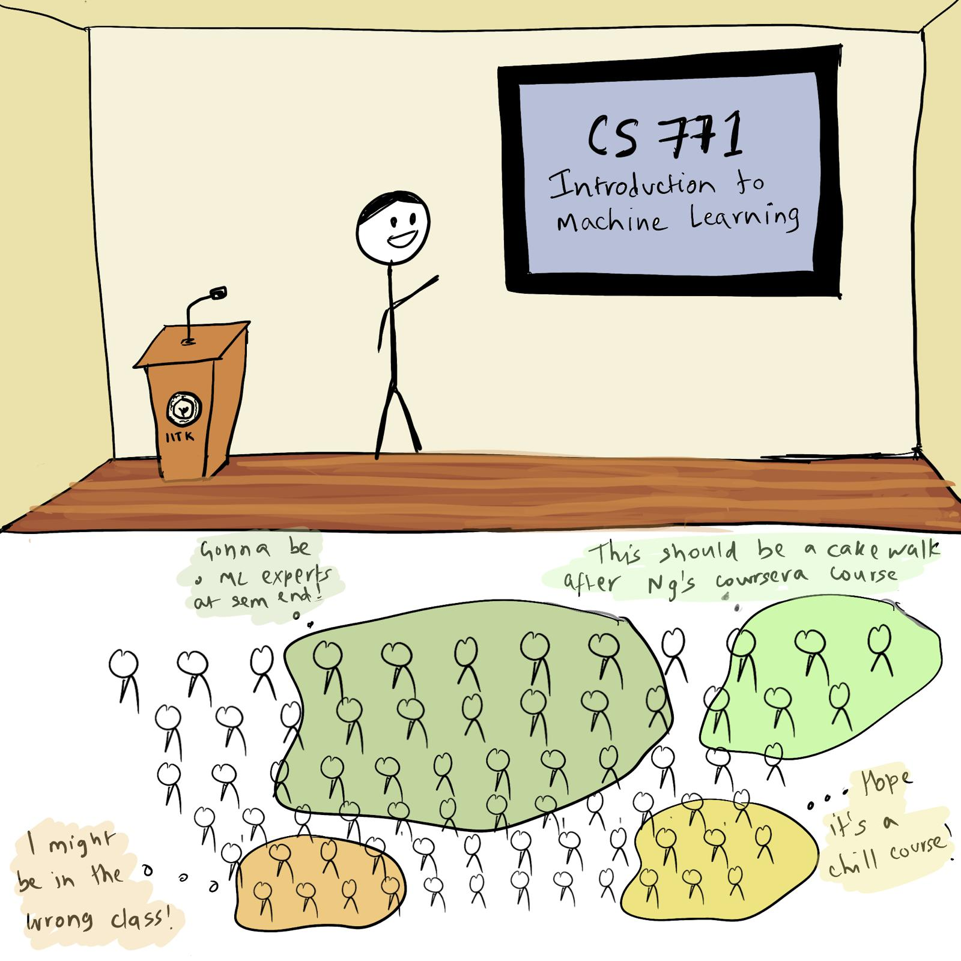
Course Goals
Credit: Rishika Agarwal (EE, graduated 2017)

Slide 8
Course Goals..
Introduction to the foundations of machine learning models
Focus on developing the ability to
Understand the underlying principles behind ML models and algos
Understand how to implement and evaluate them
Understand/develop intuition on choosing the right ML model/algo for your problem
Focus on how to interpret ML algorithms’ outputs in a rigorous manner
Over-optimistic interpretation of ML has led to a reproducibility crisis in the field
Graduates of this course should be able to separate truth from falsehood (and BS) in ML evaluations
Not an introduction to popular software frameworks and libraries, such as scikit-learn, PyTorch, Tensorflow, etc
Can explore once you have some understanding of various ML techniques

Slide 9
What is Machine Learning

Slide 10
How do we classify?
Let's say we want to classify the climate in a region
We may say something like
If the summer temperature is above 35 C for more than 20 days during May-July, the climate is tropical
If the total rainfall is less than 10 cm all year, the climate is desert
Basic principles
Think of simple rules that place thresholds on some measurable attributes of the object
Combine rules to maximize coverage of classification

Slide 11
Classification using expert advice
Who should be screened for COVID-19?
Attributes
History of international travel
Flu-like symptoms
Contact with anyone reporting 1 or 2
Advantages:
Simple to understand and critique
Disadvantages:
Hard to implement without data and actuators

Slide 12
Supervised classification using machine learning
Human
Computer
Instead of asking experts to generate rules
Ask them to say 'wrong' or 'right' whenever a computer program classifies something
Program is programmed to want to make as few mistakes as possible
Revises its internal rules such that the expert has to say 'wrong' less often
Rules are learned using expert supervision
Triangle
Triangle
Triangle
Square
Training
Wrong
Triangle
Testing
Right
Triangle
Right
Triangle

Slide 13
Advantages of ML classification
Rules are learned from data instead of generated by experts so
Rules have a lower chance of being contaminated by an expert's bias
Rules are not restricted in complexity
Rules are more likely to be testable
Rules are likely to have greater predictive accuracy
But, for the same reason,
Rules have a higher chance of missing important aspects of the situation not captured within data
Rules can become over-complex and hard to interpret
Rules become less likely to generalize well to new situations

Slide 14
Machine Learning (ML)
Designing algorithms that use data to programmatically learn a model of it
The learned model can be used to
Detect patterns/structures/themes/trends etc. in the data
Make predictions about future data and make decisions
Modern ML algorithms are heavily “data-driven”
No need to pre-define and hard-code all the rules (infeasible/impossible anyway)
The rules are not “static”; can adapt as the ML algo ingests more and more data

Slide 15
ML: From What It Does to How It Does It?
ML enables intelligent systems to be data-driven rather than rule-driven
How: By supplying training data and building statistical models of data
Pictorial illustration of an ML model for binary classification:
A Linear Classifier (the statistical model)

Slide 16
ML: From What It Does to How It Does It?
ML enables intelligent systems to be data-driven rather than rule-driven
How: By supplying training data and building statistical models of data
Pictorial illustration of an ML model for binary classification:
A Probabilistic Classifier (the statistical model)
P(“cat”|image)
P(“dog”|image)

Slide 17
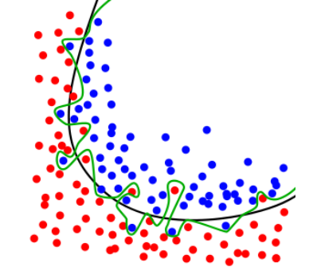
Generalization
The most accurate model for your training data is a lookup table
A good ML model must generalize well on unseen (test data)
To avoid approximating a lookup table for the training data
Simpler models should be preferred over more complex ones!
An article of religious faith

Slide 18
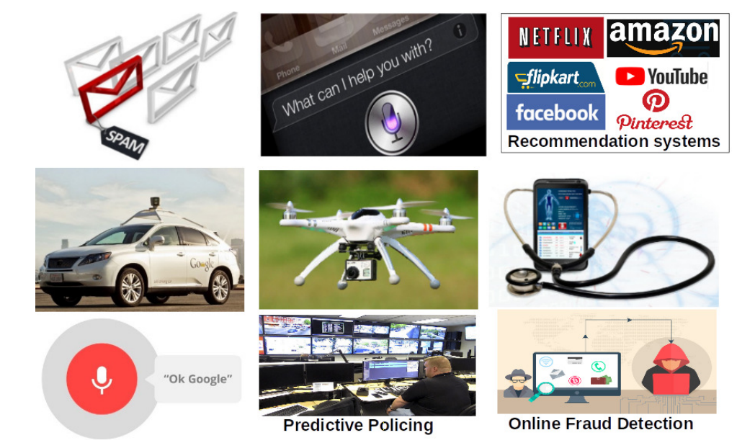
ML Applications Abound..
Picture courtesy: gizmodo.com,rcdronearena.com,www.wiseyak.com,www.charlesdong.com

Slide 19
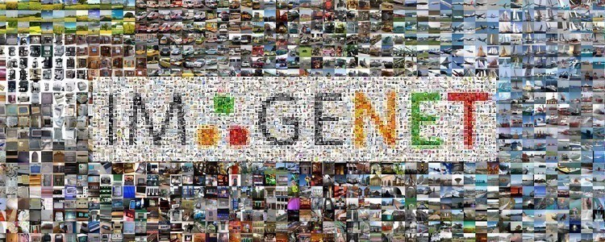
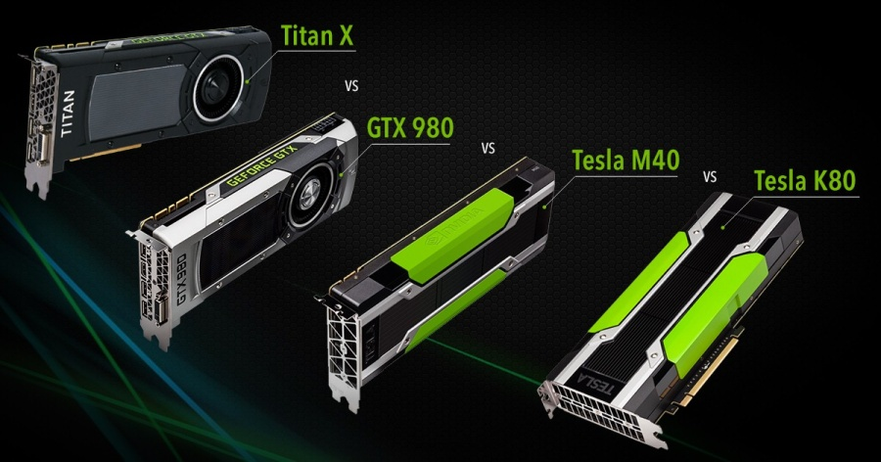
Key Enablers for Modern ML
Availability of large amounts of data to train ML models
Increased computing power (e.g., GPUs)

Slide 20
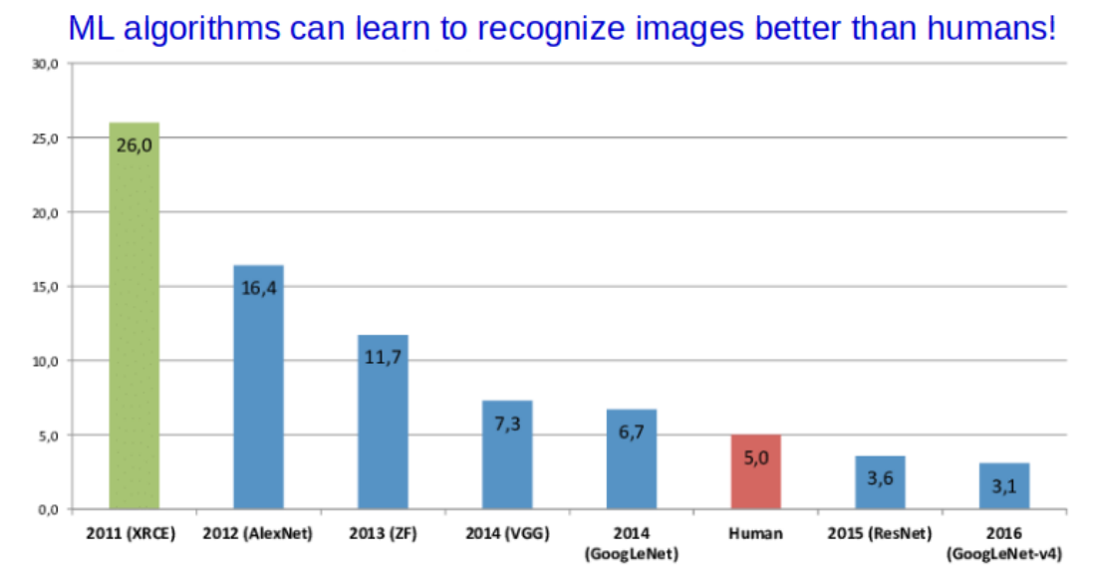
ML: Some Success Stories

Slide 21
ML: Some Success Stories

Slide 22
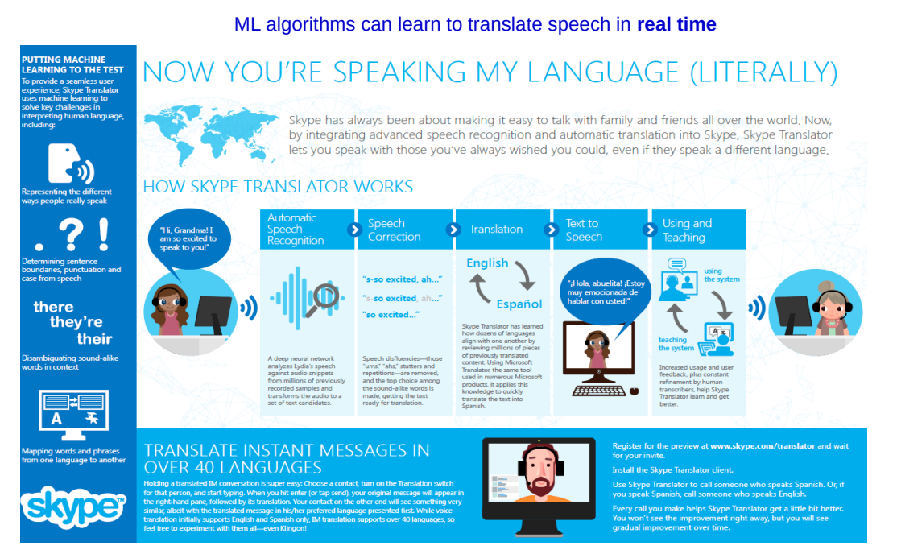
ML: Some Success Stories
Picture courtesy: https://news.microsoft.com/

Slide 23
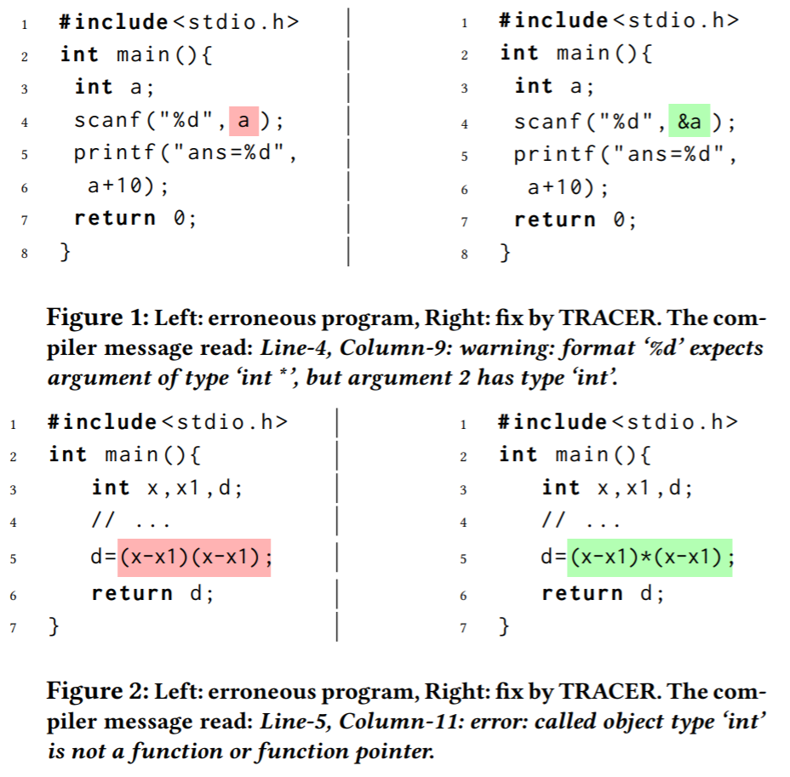
ML: Some Success Stories
Automatic Program Correction
Example from “Compilation error repair: for the student programs, from the student programs”, Ahmed et al (2018)

Slide 24
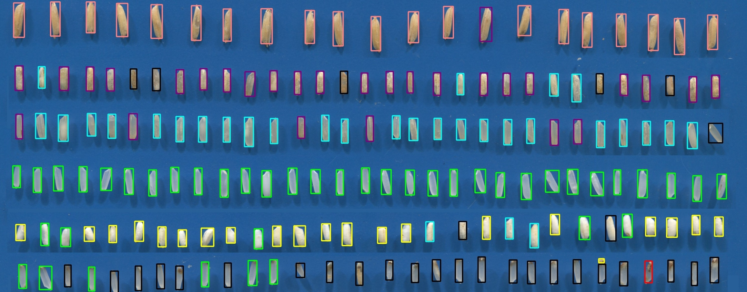
ML: Some success stories
* From Pant, Singh & Srivastava (2021)

Slide 25
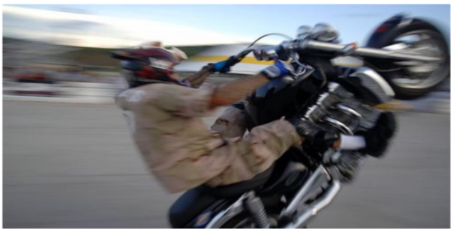
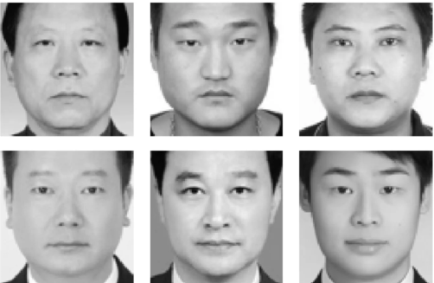
Politically correct ML Systems
Good ML should not just be about getting high accuracies; they are now also expected to be politically correct
Should also ensure that the ML models are fair and unbiased
A lot of recent focus on Fairness and Transparency of ML systems
Criminals?
Not Criminals?
An image captioning system should not always assume a specific gender
Don’t want a self-driving car that is more likely to hit black people than white people
Don’t want a predictive policing system that predicts criminality using facial features
Picture courtesy: Bhargava and Forsyth (2019), https://www.thestranger.com/, Xiaolin Wu and Xi Zhang, “Automated Inference on Criminality Using Face Images”

Slide 26
Learning about ML
We will also focus on these
Data
Representations
Algorithms
Outputs
We will also focus on these
Interpretation

Slide 27
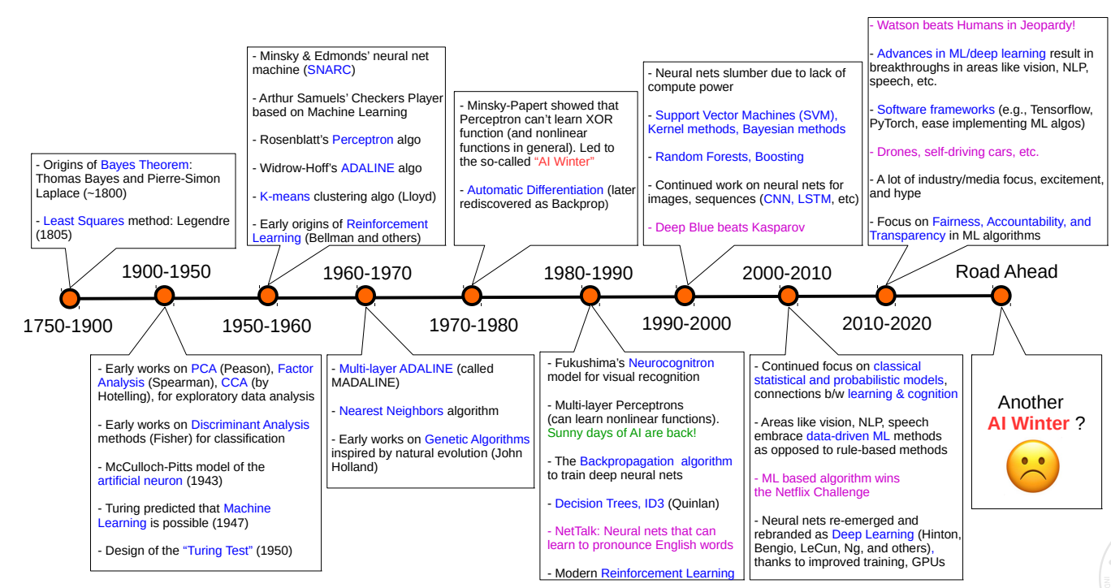
Looking Back Before We Start: History of ML
- Human-like text generators (GPT-3)

Slide 28
Next Class
Various Flavors of ML problems
Data and features
Basic mathematical operations on data and features

