Slide 1
Scaling and optimizing
November 14th 2019

Slide 2
Course logistics
End sem exam syllabus
Everything
Most questions will reference assignments I gave to do in lab
Assignment marks available online
Please ensure there are no discrepancies ASAP
End sem marks will be available on the same portal by 29th November
End sem on 27th November 1600-1900
Venue L7, ERES

Slide 3
Today
How do you get your web service to scale up to millions of users?
How do you optimize user experience?

Slide 4
The simplest web service
A web service is a template hooked up to a database
Template
Routing to API endpoints
Database

Slide 5
Limitations
SQL databases don’t permit more than a few hundred simultaneous web connections
App could potentially get to O(100s)-O(1000s) depending on complexity
No failover
No redundancy
Fragile

Slide 6
Service separation
Not all users want database access
Separate out web and database services?
Template
Routing to API endpoints
Web service
Database
Could use a third party database server, e.g. Oracle, SQL Server, Amazon RDS, DynamoDB etc.

Slide 7
Database server choice
Established technology
Can easily scale to 10 million users
Well-worn scalability templates available
For low latency applications
Highly non-relational data
Need schema-less constructs
Need rapid data ingestion
> 1k records/s

Slide 8
Addressing service fragility
Load balancing
Have multiple instances of service running
Have a controller balance load across instances
Template
Routing to API endpoints
Web service
Database
Load balancer
Web service
Database

Slide 9
A robust, scalable web app
We have scaled both horizontally and vertically
Horizontal = adding multiple instances
Vertical = service separation
Such an app can easily scale to 10k-100ks of users
Containerization offers great possibilities for cheap test horizontal scaling
For production scaling, need infrastructure

Slide 10
A robust, scalable web app
Web
Web
Web
Web
Web
Web
DB read replicas
DB read replicas

Slide 11
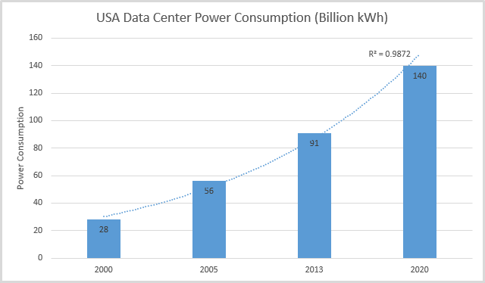
Auto-scaling
Current research effort
Use ML methods to predict demand and spin instances up or down to optimize energy consumption
Power costs are a web-based company’s primary consumable

Slide 12
Getting to a million plus users
Need more tricks beyond what we have seen already
Refactor app to use a service-oriented architecture
Make app demands as asynchronously serviceable and independent as possible
Move to sharded databases
Reduces competition for write access
Adds database query constraints

Slide 13
Performance optimization
The architecture we developed above will scale well to most realistic load sizes
What can we optimize further?
Data flows
User can cache static data?
Cache
Web
DB

Slide 14
Third party caching
Can move static content from the web instance to CDN,
Provided by several web majors e.g. Google CDN, Amazon Cloudfront etc.
Can move session/state and DB caching to database server cache
Provided by big cloud DB providers, e.g. Amazon’s Elasticache
CDN
Web
DBC
DB

Slide 15
Value of third party caching
Reduces response time for requests
Reduces server load
Improves service resilience

Slide 16
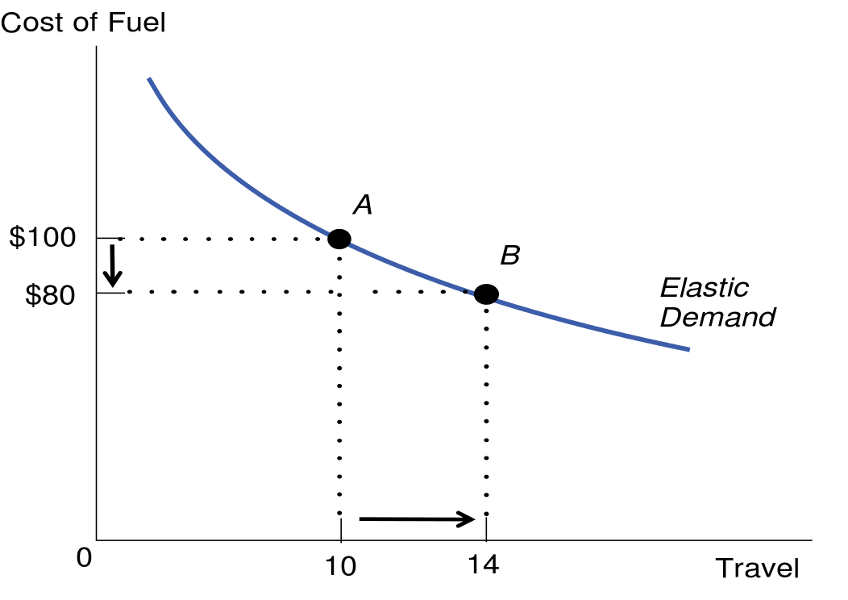
Problem with optimization
When you lower the costs of something, you can oftentimes stimulate greater volume of demand for it. This may not always be useful.

Slide 17
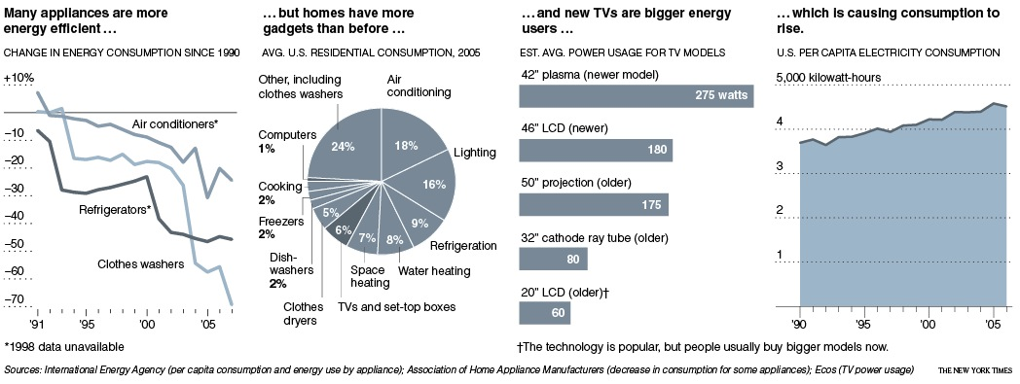
Environmental example

Slide 18
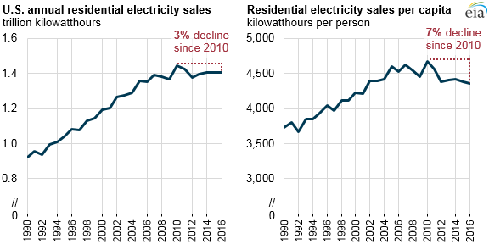
Environmental example

Slide 19
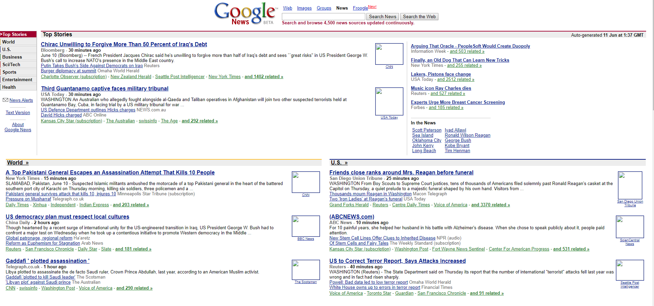
Web service example

Slide 20
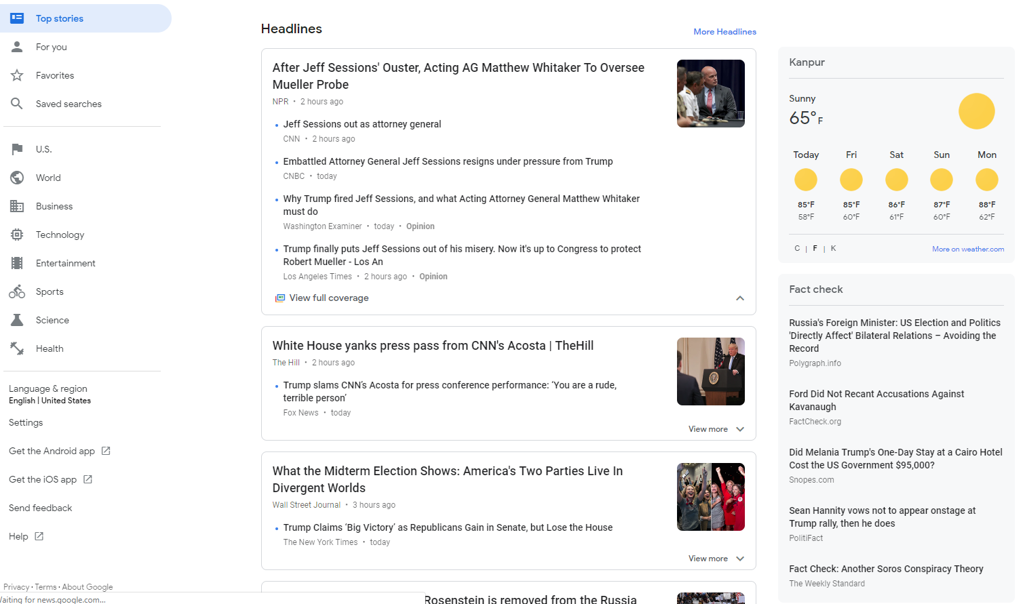
Web service example

Slide 21
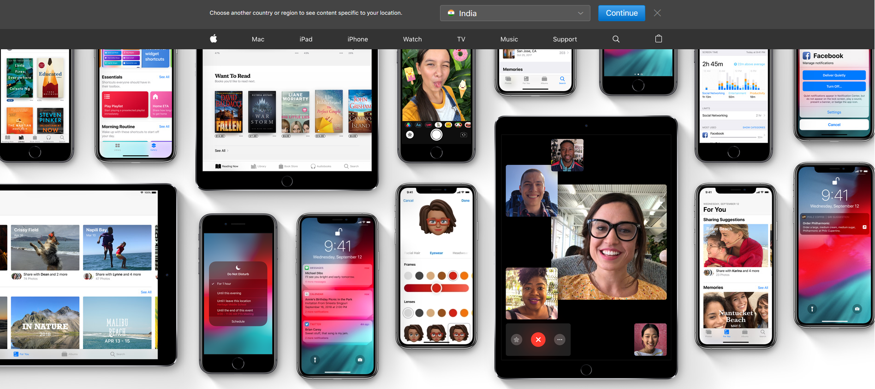
Web asset bloat
This page requires 13 MB of assets to display
The original iMac had 32 MB of memory

Slide 22
Web service bloat
On Firefox, this text-based article requires 271 requests, totalling 8 MB to retrieve

Slide 23
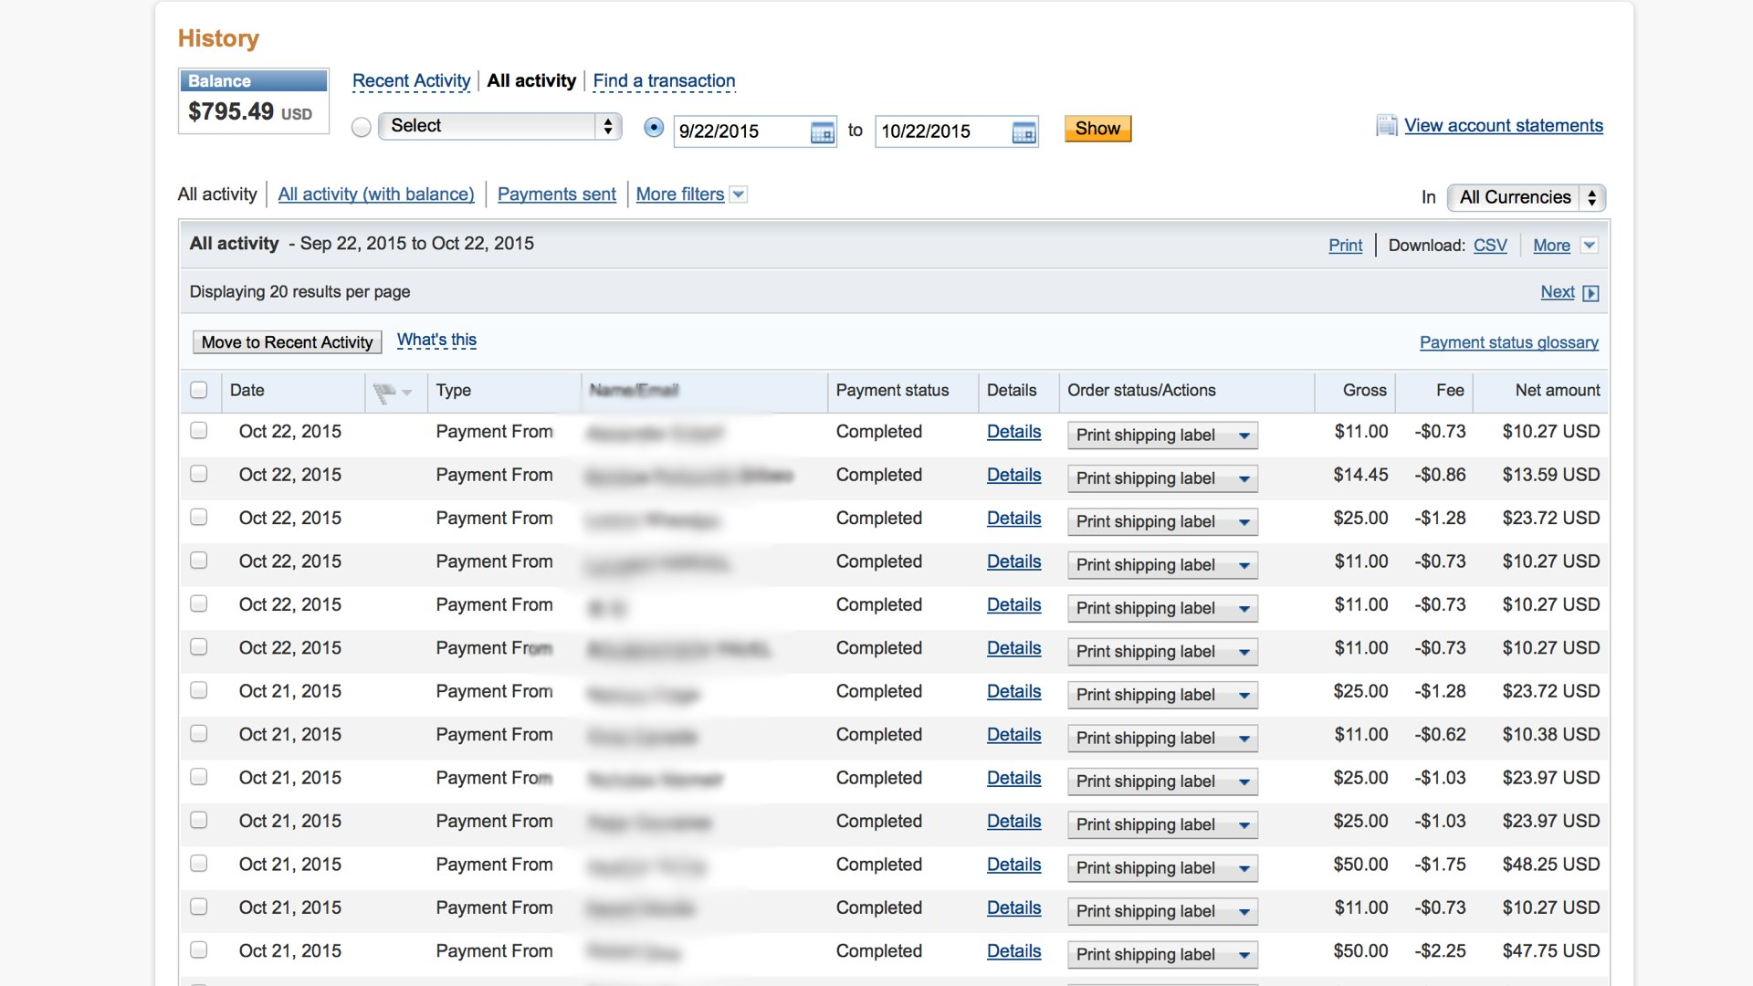
Web layouts for adults

Slide 24
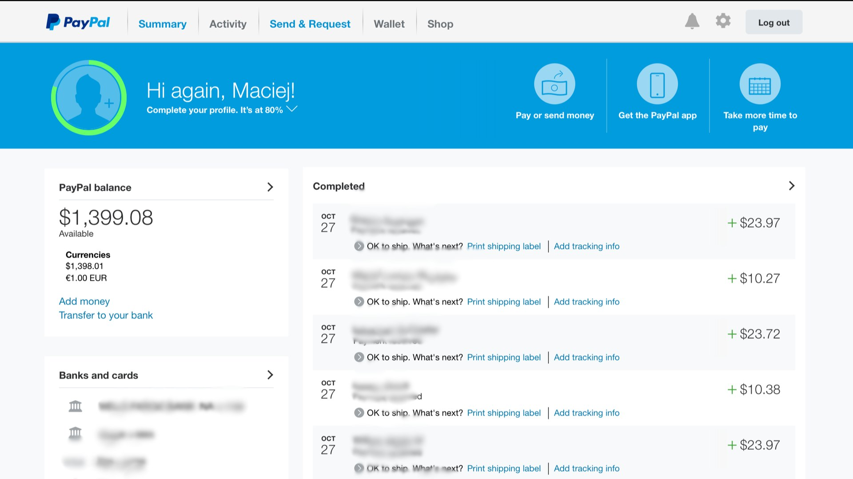
Web layouts for children

Slide 25
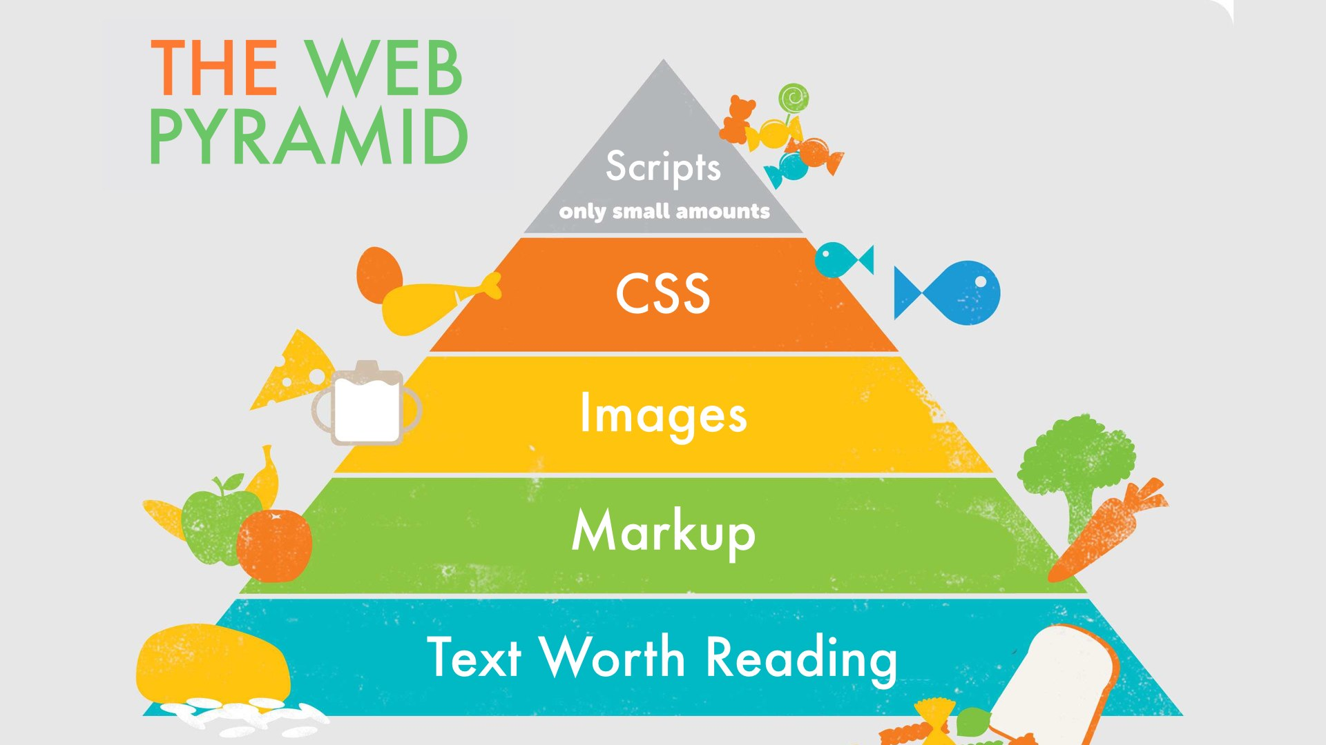
The choice
Borrowed from Maciej Ceglowski’s talk, ‘The website obesity crisis’

Slide 26
Conclusion
Optimize your web service for the user
Not for your designer
Web service design is intensively modular
Anything can connect to anything
With great freedom comes great responsibility
What is the point of each design decision you make for the app?
Is it to show off?
Then eschew it

Slide 27
Course conclusion
In software, there is no friction
Software can help organize many dreary daily functions
It can make data more accessible, and useful
Software development is now web development
Need not reinvent the wheel unless you have to
Develop away

