Slide 1
Memory neurobiology
CS786
Mar 29th 2022

Slide 2
Amnesias = memory disorder
Retrograde amnesia
Cannot remember
events prior to
brain damage
Anterograde amnesia
Cannot later remember
events that occur
after brain damage
Brain
damage
occurs
time

Slide 3
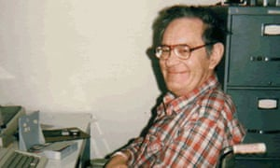
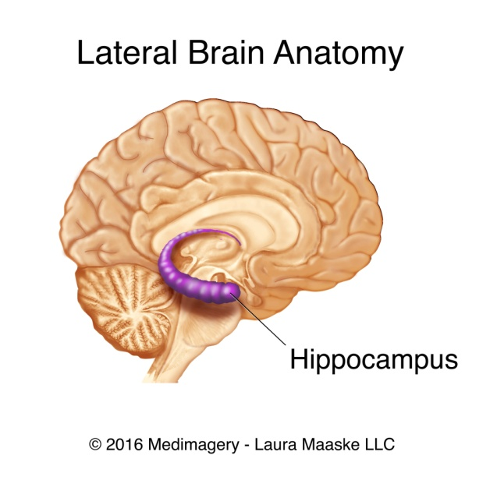
A fortuitous discovery
H.M. suffered from epilepsy from a young age
Operated upon for treatment
Post-op presented with a pure case of anterograde amnesia
Demonstrated criticality of hippocampus for memory formation
https://www.newyorker.com/books/page-turner/the-man-who-forgot-everything

Slide 4
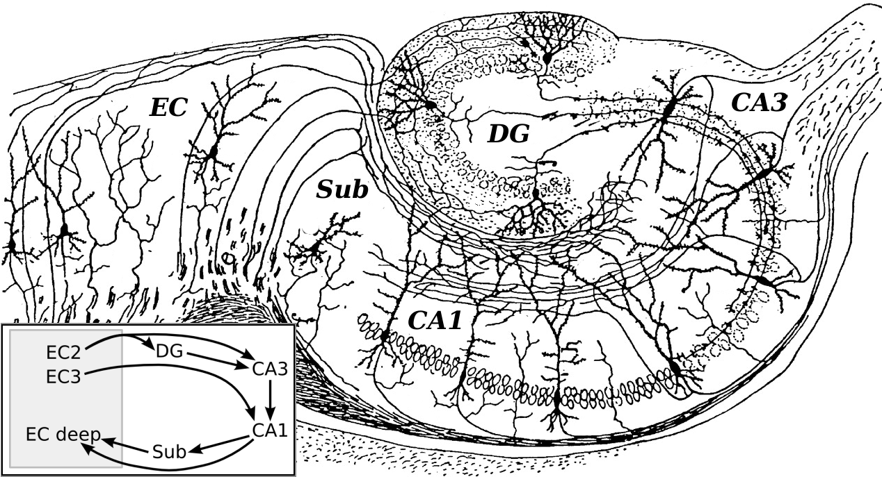
Hippocampus
Phenomenally interesting anatomical structure; crucial for forming representations

Slide 5
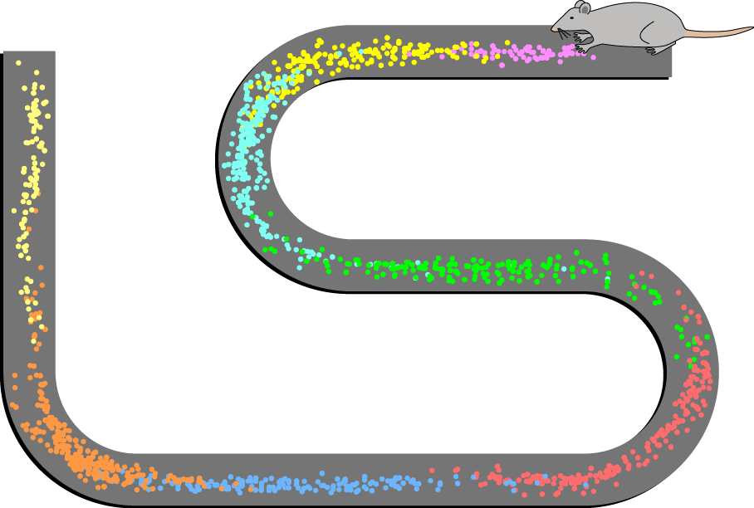
Place cells
Firing patterns of 8 place cells recorded from CA1 in a rat

Slide 6
Hippocampus
Phenomenally interesting anatomical structure; crucial for forming representations

Slide 7
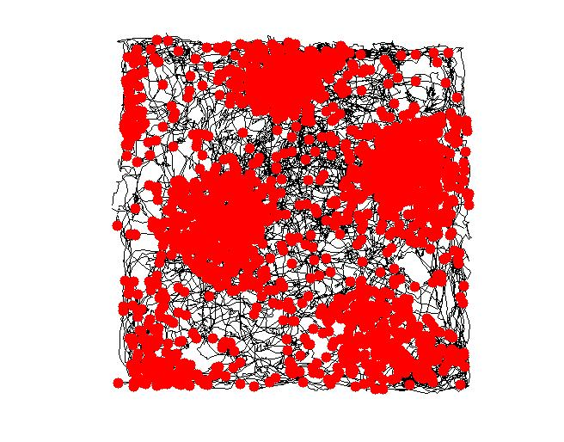
Grid cells
Like place cells, but embed Euclidean space assumptions
Encode spatial firing fields at equal distances from neighbors
As if neurons are sensitive to an underlying triangular coordinate system
Red dots indicate location of rat in physical space when the grid cell fires

Slide 8
Hippocampus
Phenomenally interesting anatomical structure; crucial for forming representations

Slide 9
Head direction cells
Fire when animal’s head turns in a particular direction
Tend to lead the actual head movement by about 100 ms
HD system interacts with place cells to generate spatial map of environment?
Operates coherently during REM sleep

