Slide 1
The Law-Gold model
CS786
4th March 2022

Slide 2
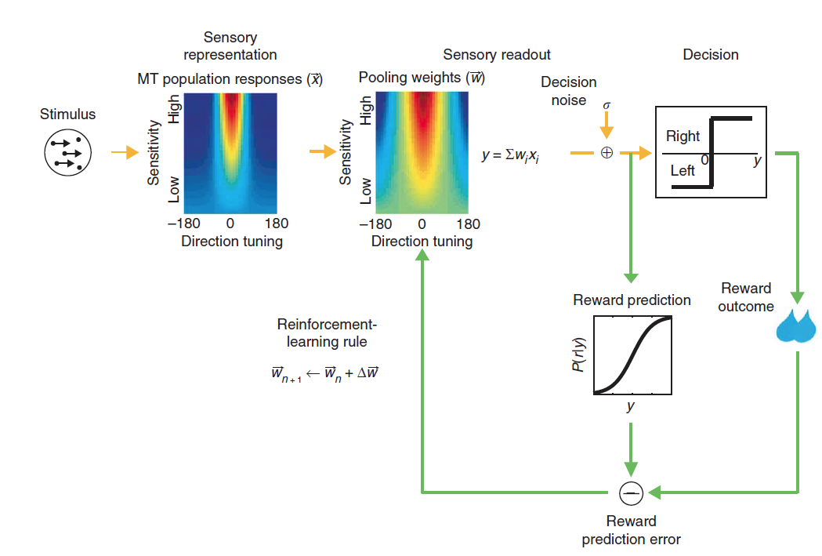
The model
(Law & Gold, 2009)

Slide 3
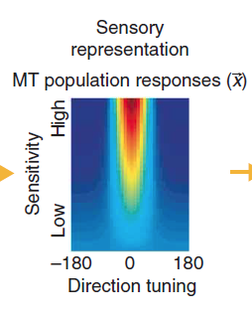
Sensory representation
MT modeled as a population of 7200 neurons
200 for each of 36 evenly spaced directions in the 2D plane
Trial-by-trial stimulus responses fixed using neuronal data

Slide 4
Individual neuron model
Each neuron’s response to a given stimulus modeled as Gaussian with mean m
k₀ is spiking response at 0% coherence
k_{n} is spiking response at 100% coherence in null direction
k_{p} is spiking response at 100% coherence in preferred direction
COH is coherence as a fraction
Θ is the neuron’s preferred direction

Slide 5
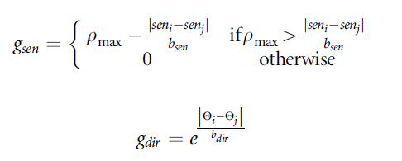
Interneuron correlations
Neurons with shared direction tuning should fire frequently together
Equally excitable neurons should fire frequently together
So neuron spiking rates should be correlated, based on similarity in
directional tuning
motion sensitivity

Slide 6
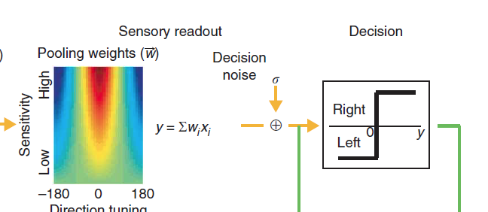
Decision variable construction
Variable constructed by pooling neuronal responses

Slide 7
Pooled neuronal responses
Construct a 7200 bit vector x
Here, r = Uz, z ~ N(0,1) and U is the square root of the correlation matrix
All neuron responses pooled to yield decision variable corrupted by decision noise

Slide 8
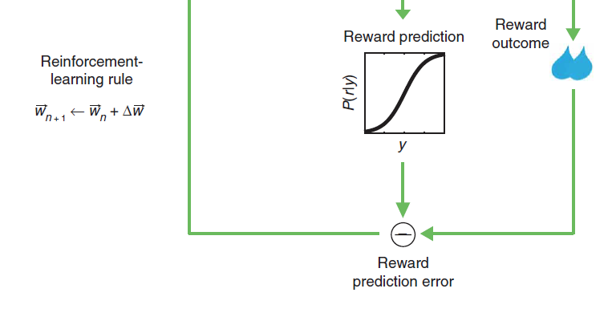
The magic sauce: weight learning
Using reinforcement learning

Slide 9
Reinforcement learning in neurons
Prediction error
C is -1 for left, +1 for right
r is whether there was success or not on the trial
E[r] is the predicted probability of responding correctly given the pooled MT responses y
x is the vector of MT responses
E[x] is the vector of baseline MT responses
M = 1, n = 0 for the most successful rule

Slide 10
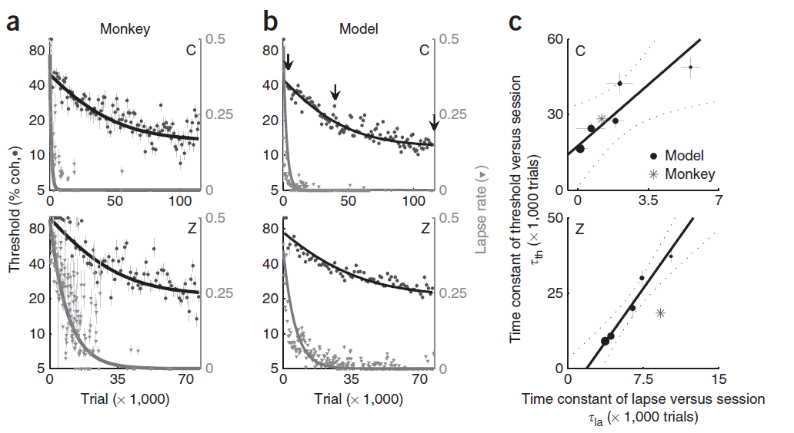
Good fit for the behavioral data

Slide 11
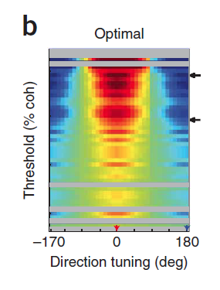
How did the tuning weights vary?
Graph plots neuron weights on y-axis and directional tuning on x-axis
This plot shows the optimal weights to discriminate motion directions 180 degrees apart
Some neurons (not all) learn that direction 0 should get high positive weights and direction 180 should get high negative weights

Slide 12
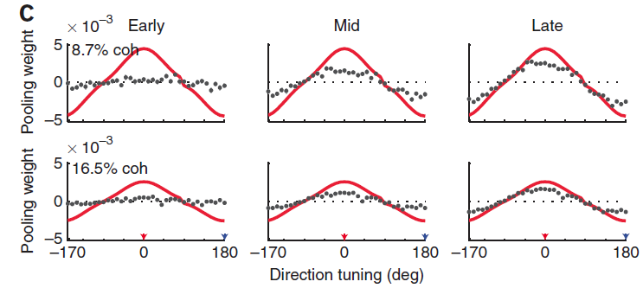
Model LIP headed the right way

Slide 13
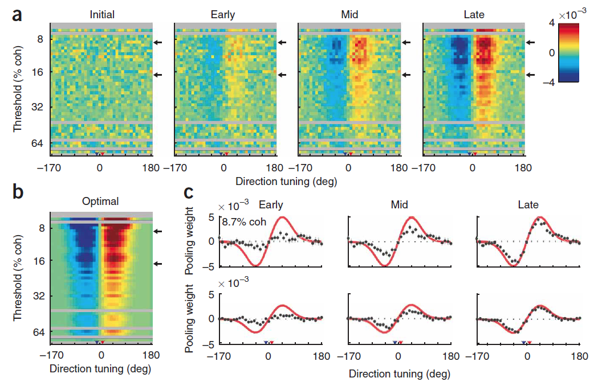
Fine discrimination task

Slide 14
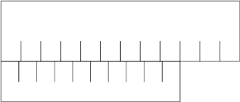
Perceptual learning is hyper-specific
Training with horizontal Vernier scales can improve discrimination threshold 6-fold
But horizontal training does not translate to vertical direction

Slide 15
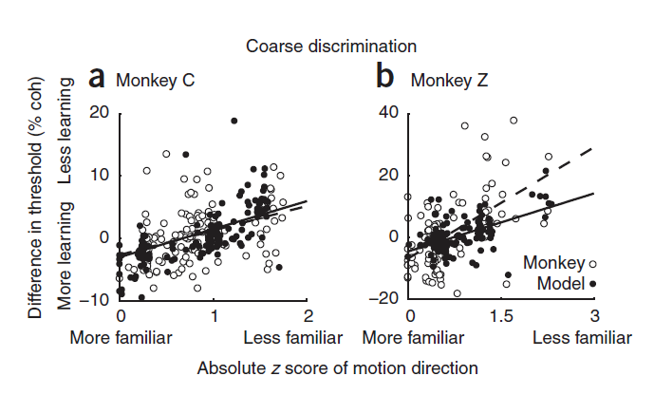
Training specificity predictions
Infrequently seen directions show less learning

Slide 16
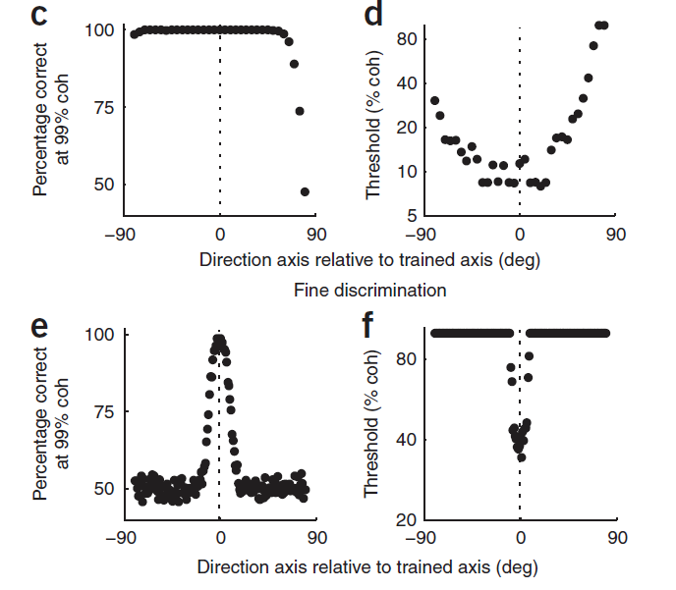
Model predicts differential sensitization
Sensory-motor association
Perceptual sensitivity

Slide 17
The model
(Law & Gold, 2009)

Slide 18
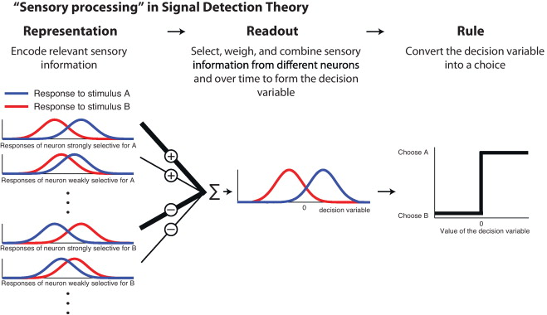
Perceptual learning as decision-making
(Gold & Ding, 2013)

