Slide 1
Randomized Algorithms
CS648
Lecture 9
Random Sampling
part-I
(Approximating a parameter)

Slide 2
Overview of the Lecture
Randomization Framework for estimation of a parameter
Number of balls from a bag
Size of transitive closure of a directed graph
An Inspirational Problem from Continuous probability

Slide 3
An inspirational problem from continuous probability

Slide 4

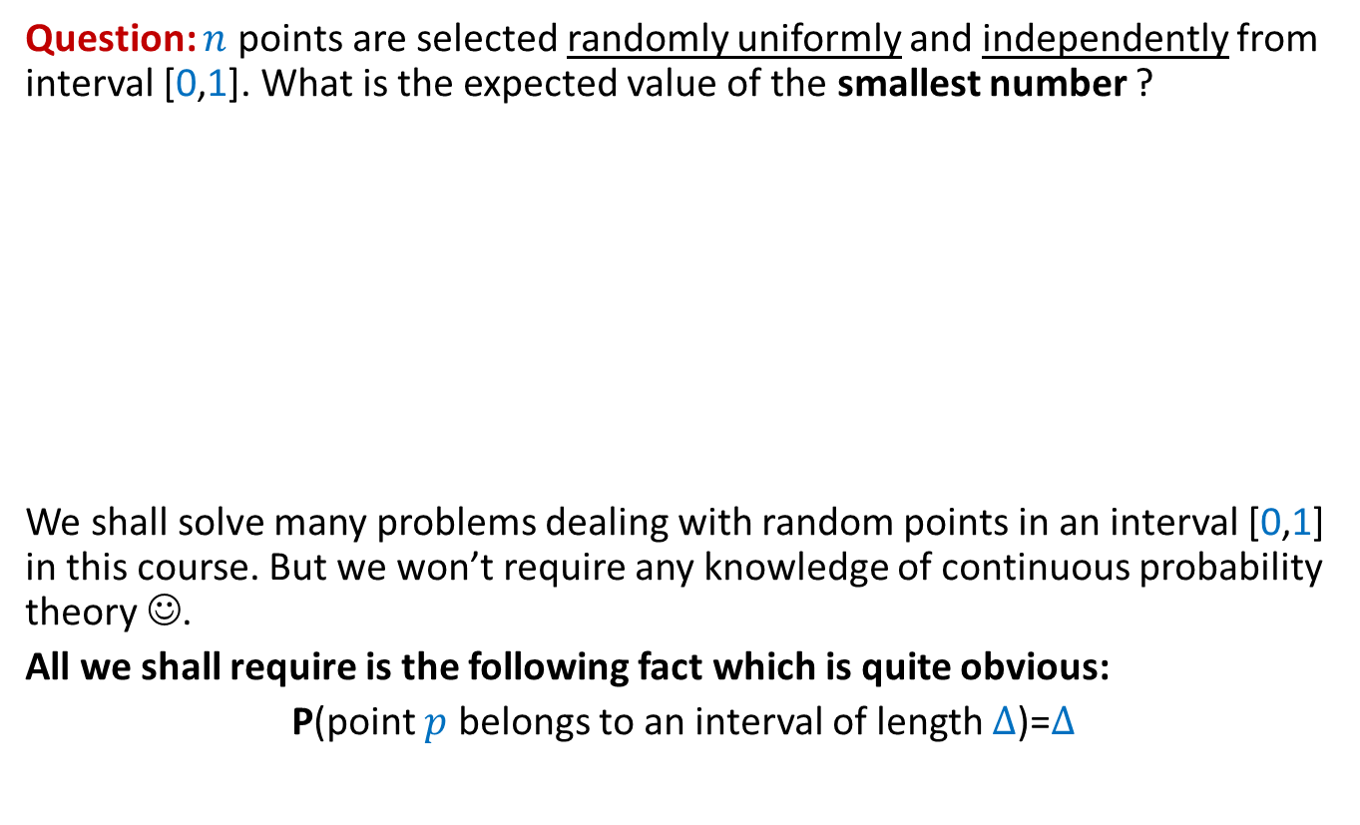



Question: $n$ points are selected randomly uniformly and independently from interval [0,1]. What is the expected value of the smallest number ?
We shall solve many problems dealing with random points in an interval [0,1] in this course. But we won’t require any knowledge of continuous probability theory ☺.
All we shall require is the following fact which is quite obvious:
P(point $p$ belongs to an interval of length $∆$)=$∆$
$$p$$
$$p$$
$$p$$
0
1
$$∆$$

Slide 5







Sampling points on a line segment
Question: What is E[$X_{i}]$ ?
Answer: It appears to depend upon $i$.
1
0
1
0
$$X_{n}$$
$$X_{n+1}$$
$$X_{1}$$
$$X_{2}$$
$$X_{3}$$
$$X_{4}$$

Slide 6








Sampling points on a Circle (of circumference 1)
Question: What is E[$X_{i}]$ ?
By symmetry of the circle, each $X_{i}$ has identical probability distribution.
➔ E[$X_{1}$]=E[$X_{2}$]= … = E[$X_{n}$]
E[$X_{1}$+$X_{2}+…X_{n}$]= ??
➔ E[$X_{1}$]= ??
$$X_{n}$$
$$X_{1}$$
$$X_{n−1}$$
$$X_{2}$$
$$X_{3}$$
$$X_{4}$$
1
$$1/n$$

Slide 7
Transforming a line segment to a circle
(just a different perspective)
The knot formed by joining the ends of the line segment
Give the knot a uniformly random rotation around the circle

Slide 8

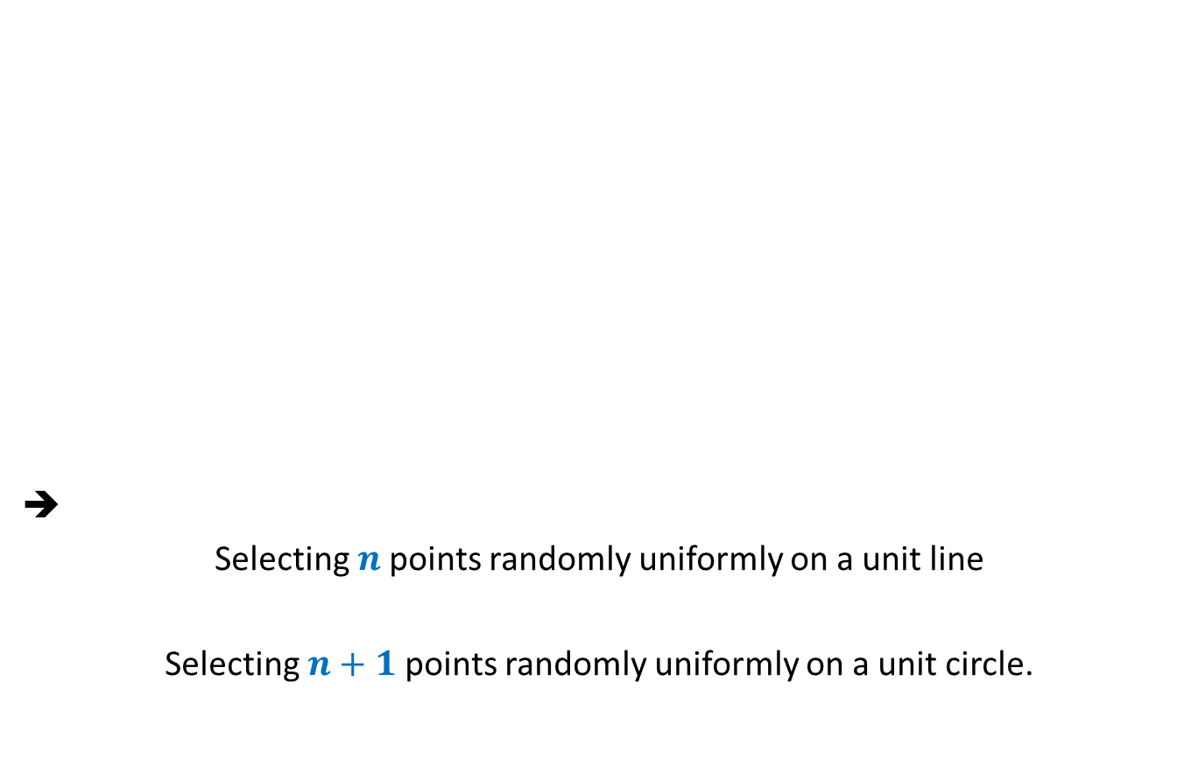

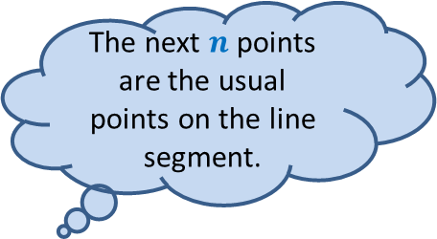
Transforming a line segment to a circle
(just a different perspective)
➔
Selecting $n$points randomly uniformly on a unit line
Selecting $n+1$points randomly uniformly on a unit circle.
$$X_{n+1}$$
The next $n$ points are the usual points on the line segment.
$$X_{n}$$
$$X_{1}$$
$$X_{2}$$
First uniformly random point is the knot.
$$X_{3}$$
$$X_{4}$$

Slide 9
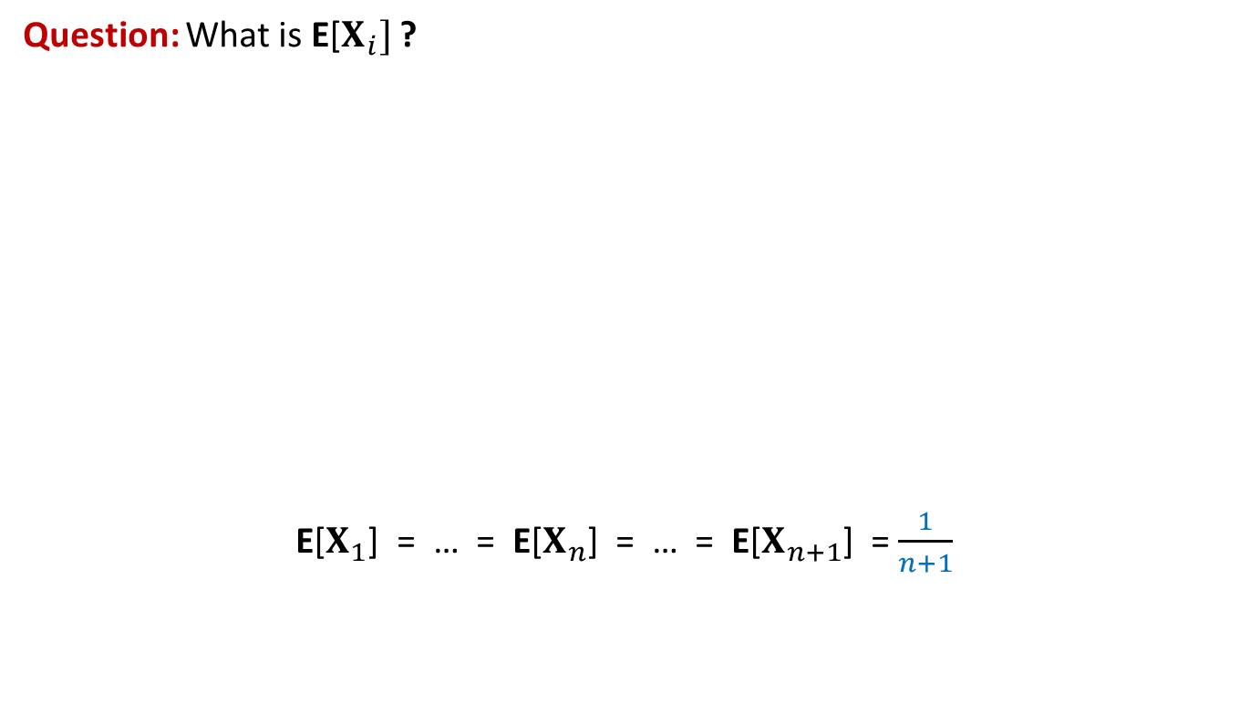
We have got the answer of the problem
(without any knowledge of continuous probability theory)
Question: What is E[$X_{i}]$ ?
E[$X_{1}$] = … = E[$X_{n}$] = … = E[$X_{n+1}$] = $\frac{1}{n+1}$
1
0
1
0
$$X_{n}$$
$$X_{n+1}$$
$$X_{1}$$
$$X_{2}$$
$$X_{3}$$
$$X_{4}$$

Slide 11
Estimating the number of
Balls in a BAG

Slide 12

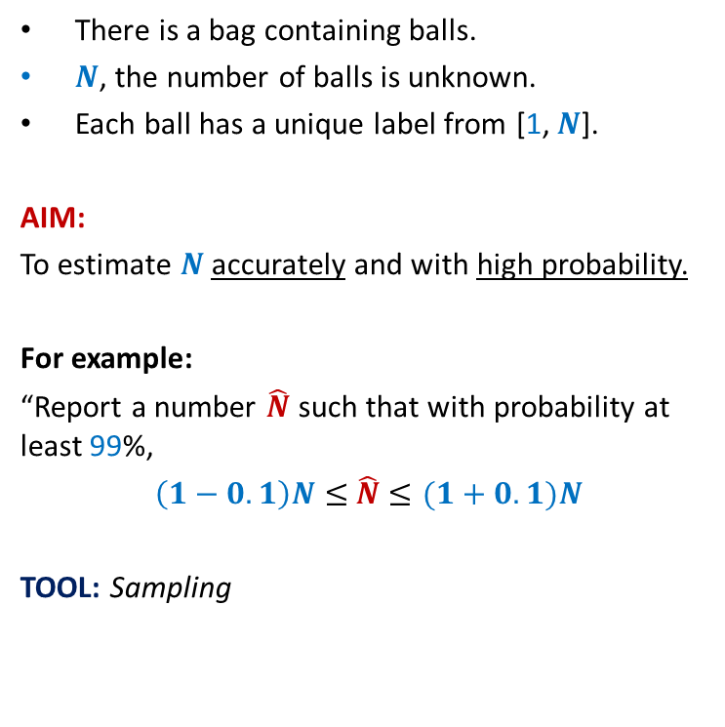
Estimating the number of Balls in a BAG
There is a bag containing balls.
$N$, the number of balls is unknown.
Each ball has a unique label from [1, $N$].
AIM:
To estimate $N$ accurately and with high probability.
For example:
“Report a number $\hat{N}$ such that with probability at least 99%,
$\left(1−0.1\right)N≤$ $\hat{N}$ $≤(1+0.1)N$
TOOL: Sampling
n
:
t
q
l
:c
:
:
l
5
:
2
4
j
3
1
:
i
:
:

Slide 13
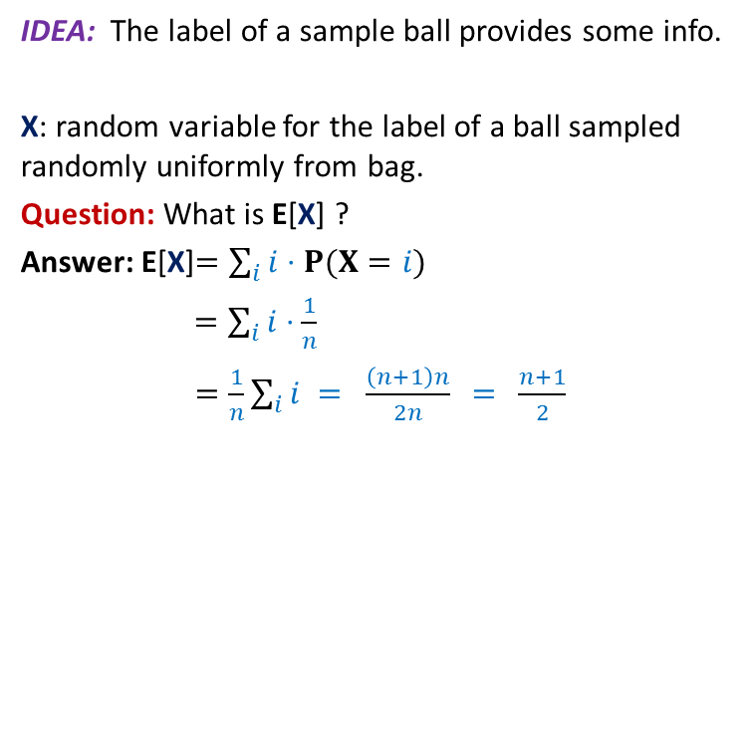
Estimating the number of Balls in a BAG
IDEA: The label of a sample ball provides some info.
X: random variable for the label of a ball sampled randomly uniformly from bag.
Question: What is E[X] ?
Answer: E[X]$=\sum_{i}{i⋅P(X=i)}$
$=\sum_{i}{i⋅\frac{1}{n}}$
$=\frac{1}{n}\sum_{i}{i} = \frac{\left(n+1\right)n}{2n}$ = $\frac{n+1}{2}$
n
:
t
q
l
:c
:
Can we use it to design an algorithm ?
:
l
5
:
2
4
j
3
1
:
i
:
:

Slide 14

Estimating the number of Balls in a BAG
A simple algorithm:
Pick a ball randomly and uniformly from the bag.
Let $t$ be its label.
$\hat{N}$ ←$2t−1$.
Report $\hat{N}$ .
n
:
t
q
l
:c
:
:
l
5
:
2
4
j
3
1
:
i
:
:

Slide 15


How good is the estimate ?
Question: What is P($\hat{N}$ $<N/2$) ?
Answer: $\frac{1}{4}$
Question: How to reduce the error probability ?
Answer:
1
2
$$N/4$$
N-1
N
multiple sampling.

Slide 16

Multiple samplings to improve accuracy and reduce error probability
Question: Which ball among the $k$ sampled balls will have label closest to $(n+1)/2$ ?
Question: How many of $k$ balls are expected to have label $≥(n+1)/2$ ?
Answer: $k/2$ .
1
2
N

Slide 17
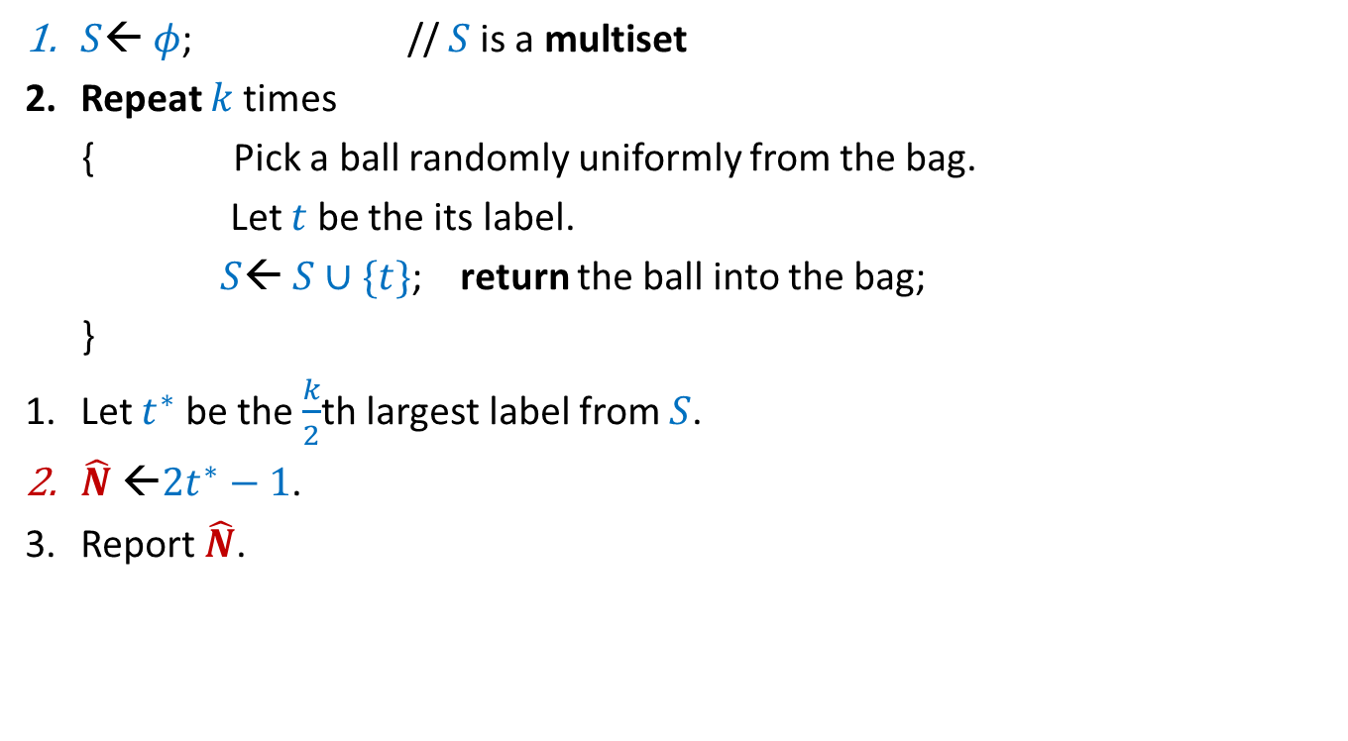
A better algorithm for estimating the number of balls:
$S$← $φ$; // $S$is a multiset
Repeat $k$times
{ Pick a ball randomly uniformly from the bag.
Let $t$ be the its label.
$S$← $S∪\{t\}$; return the ball into the bag;
}
Let $t^{∗}$ be the $\frac{k}{2}$th largest label from $S$.
$\hat{N}$ ←$2t^{∗}−1$.
Report $\hat{N}$.

Slide 18
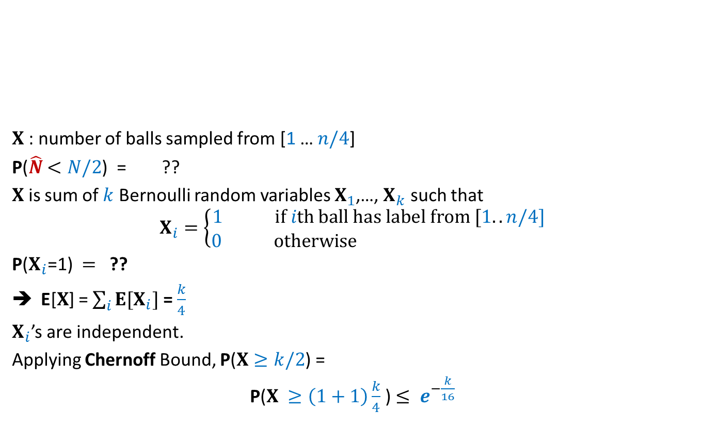




Question: What is P($\hat{N}$ $<N/2$) ?
$X$: number of balls sampled from [1 … $n/4$]
P($\hat{N}$ $<N/2$) = ??
$X$ is sum of $k$ Bernoulli random variables $X_{1}$,…, $X_{k}$ such that
$$X_{i}=\left\{\begin{aligned}1 if ith ball has label from [1..n/4] \\ 0 otherwise \end{aligned}\right.$$
P($X_{i}$=1) $=$ ??
E[$X$] = $\sum_{i}{E[X_{i}]}$ = $\frac{k}{4}$
$X_{i}$’s are independent.
Applying Chernoff Bound, P($X≥k/2$) =
P($X ≥\left(1+1\right)\frac{k}{4}$) $≤ e^{−\frac{k}{16}}$
1
2
$$N/4$$
N
P($X$>$k/2$)
$$¼$$

Slide 19

Final result
Theorem:
The randomized Monte Carlo performs $k$ sampling and reports a number $\hat{N}$ such that with probability at least $e^{−\frac{k}{16}}$ ,
$N/2≤$ $\hat{N}$ $≤2N$

Slide 20

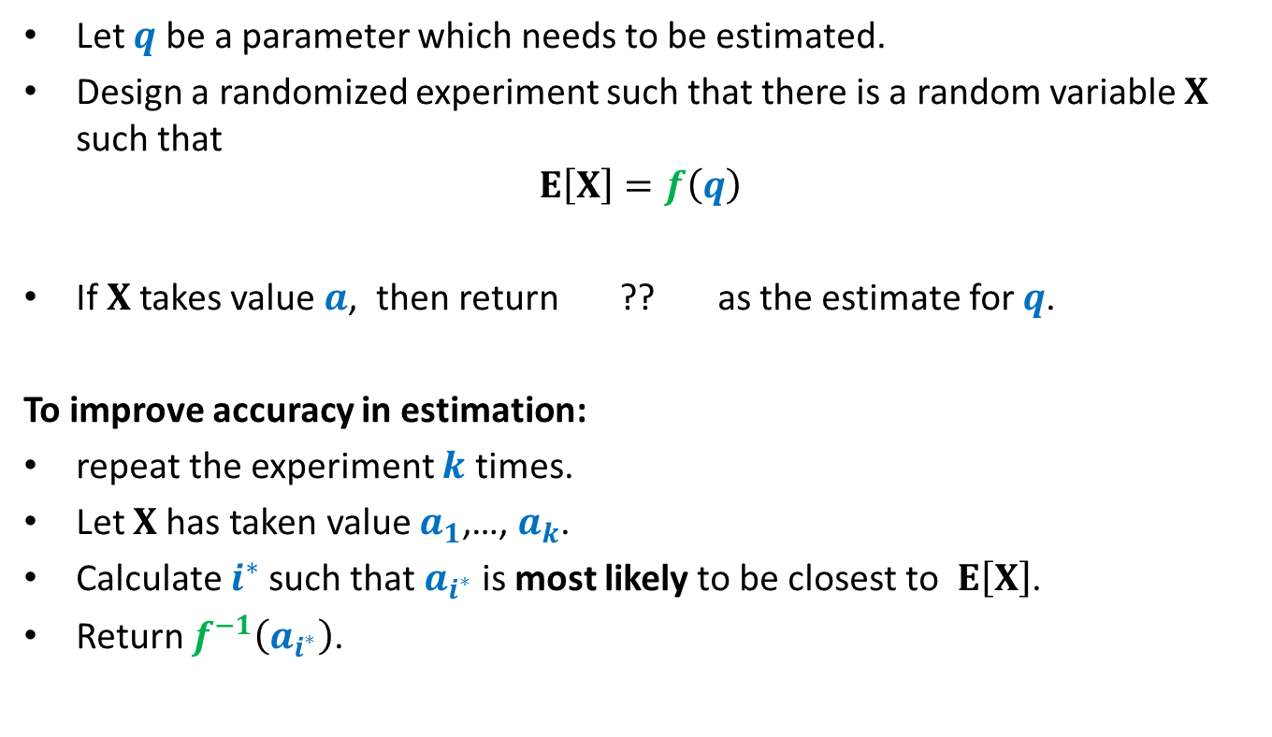
Randomized framework for estimating a parameter
Let $q$ be a parameter which needs to be estimated.
Design a randomized experiment such that there is a random variable $X$ such that
$$E\left[X\right]=f\left(q\right)$$
If $X$takes value $a$, then return ?? as the estimate for $q$.
To improve accuracy in estimation:
repeat the experiment $k$ times.
Let $X$has taken value $a_{1}$,…, $a_{k}$.
Calculate $i^{∗}$such that $a_{i^{∗}}$ is most likely to be closest to $E\left[X\right]$.
Return $f^{−1}\left(a_{i^{∗}}\right)$.
$$f^{−1}\left(a\right)$$

Slide 21
Estimating the size of
Transitive Closure of a Directed Graph

Slide 22
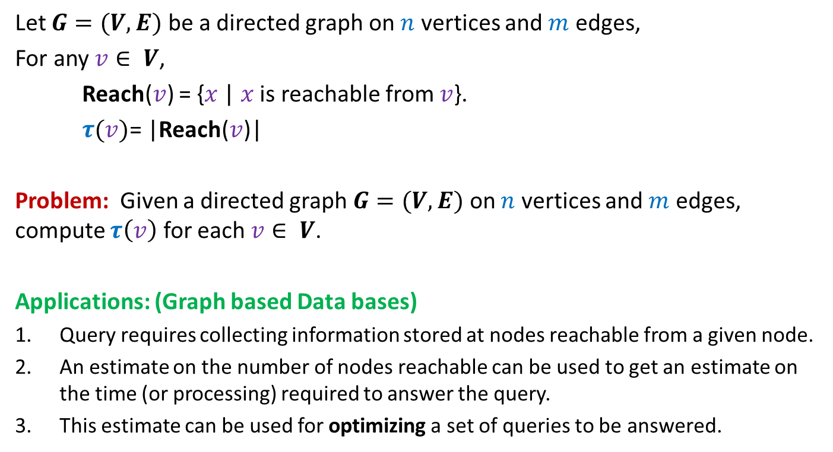
Estimating size of Transitive Closure of a Directed Graph
Let $G=(V,E)$ be a directed graph on $n$ vertices and $m$ edges,
For any $v∈ V$,
Reach($v$) = {$x$ | $x$ is reachable from $v$}.
$τ(v)$= |Reach($v$)|
Problem: Given a directed graph $G=(V,E)$ on $n$ vertices and $m$ edges, compute $τ\left(v\right)$ for each $v∈ V$.
Applications: (Graph based Data bases)
Query requires collecting information stored at nodes reachable from a given node.
An estimate on the number of nodes reachable can be used to get an estimate on the time (or processing) required to answer the query.
This estimate can be used for optimizing a set of queries to be answered.

Slide 23
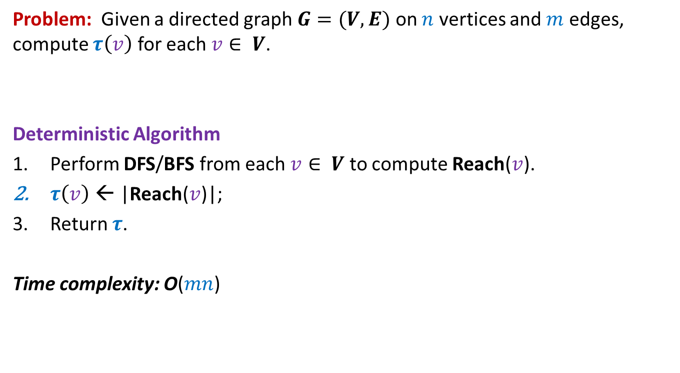
Estimating size of Transitive Closure of a Directed Graph
Problem: Given a directed graph $G=(V,E)$ on $n$ vertices and $m$ edges, compute $τ\left(v\right)$ for each $v∈ V$.
Deterministic Algorithm
Perform DFS/BFS from each $v∈ V$ to compute Reach($v$).
$τ\left(v\right)$ ← |Reach($v$)|;
Return $τ$.
Time complexity: O($mn$)

Slide 24
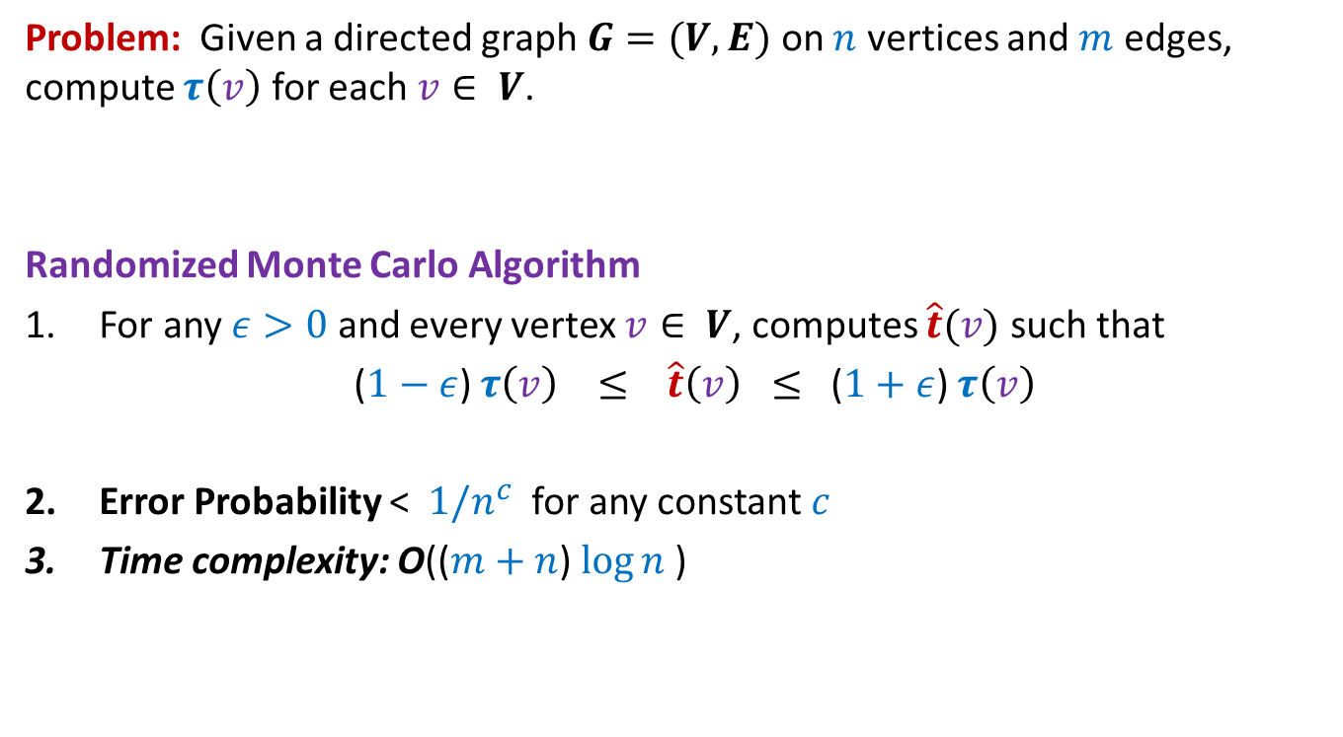
Estimating size of Transitive Closure of a Directed Graph
Problem: Given a directed graph $G=(V,E)$ on $n$ vertices and $m$ edges, compute $τ\left(v\right)$ for each $v∈ V$.
Randomized Monte Carlo Algorithm
For any $ε>0$ and every vertex $v∈ V$, computes $\hat{t}(v)$ such that
($1−ε$) $τ\left(v\right) ≤ \hat{t}\left(v\right) ≤$ ($1+ε$) $τ\left(v\right)$
Error Probability < $1/n^{c}$ for any constant $c$
Time complexity: O(($m+n$) $\log{n}$)

Slide 25
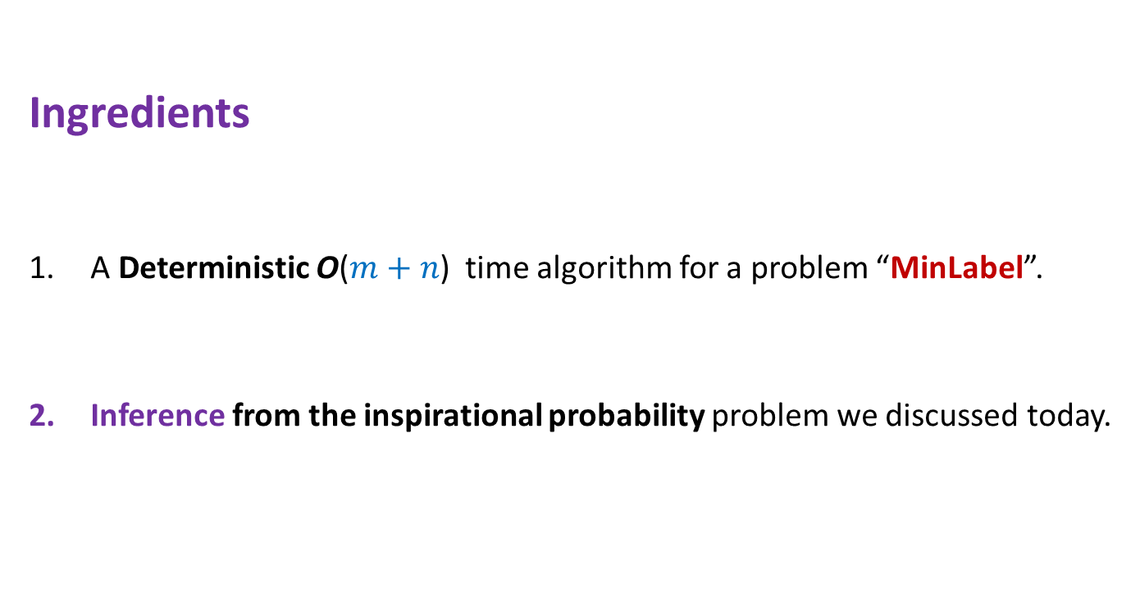
Randomized Monte Carlo Algorithm for estimating the size of transitive closure of directed graph
Ingredients
A Deterministic O($m+n$) time algorithm for a problem “MinLabel”.
Inference from the inspirational probability problem we discussed today.

Slide 26
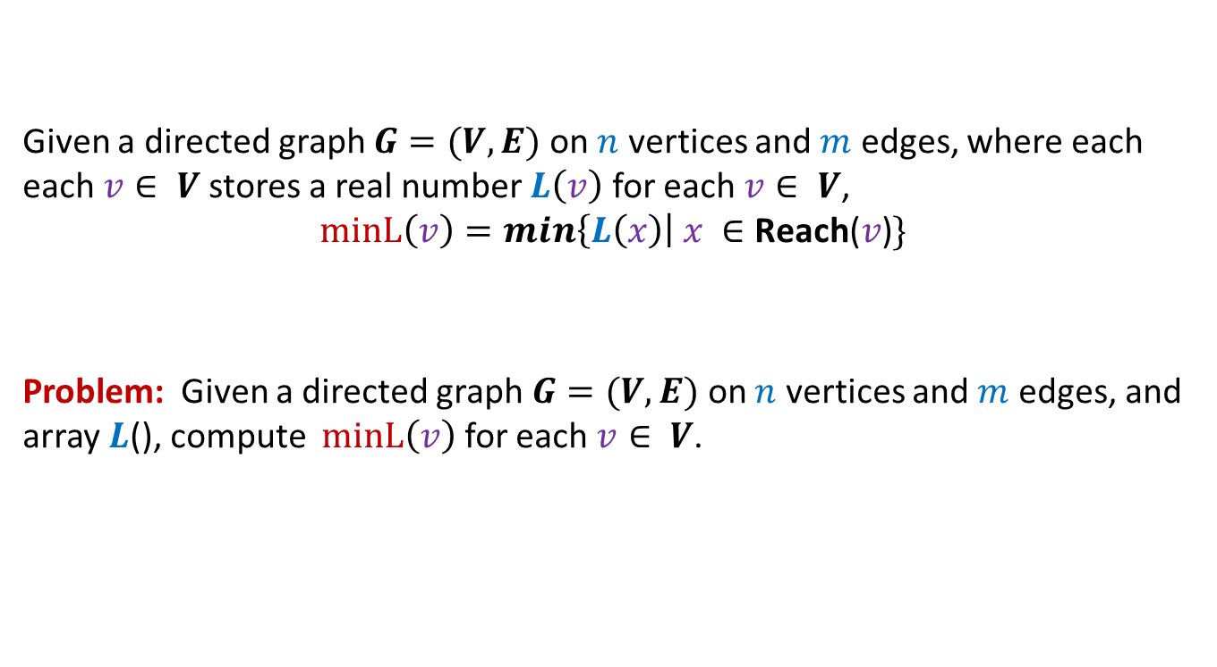
MIN-Label Problem
Given a directed graph $G=(V,E)$ on $n$ vertices and $m$ edges, where each each $v∈ V$stores a real number $L\left(v\right)$ for each $v∈ V$,
$$minL\left(v\right)=min\left\{L\left(x\right)\right| x ∈\text{Reach}\text{(}v\text{)}\}$$
Problem: Given a directed graph $G=(V,E)$ on $n$ vertices and $m$ edges, and array $L$(), compute $minL\left(v\right)$ for each $v∈ V$.

Slide 27

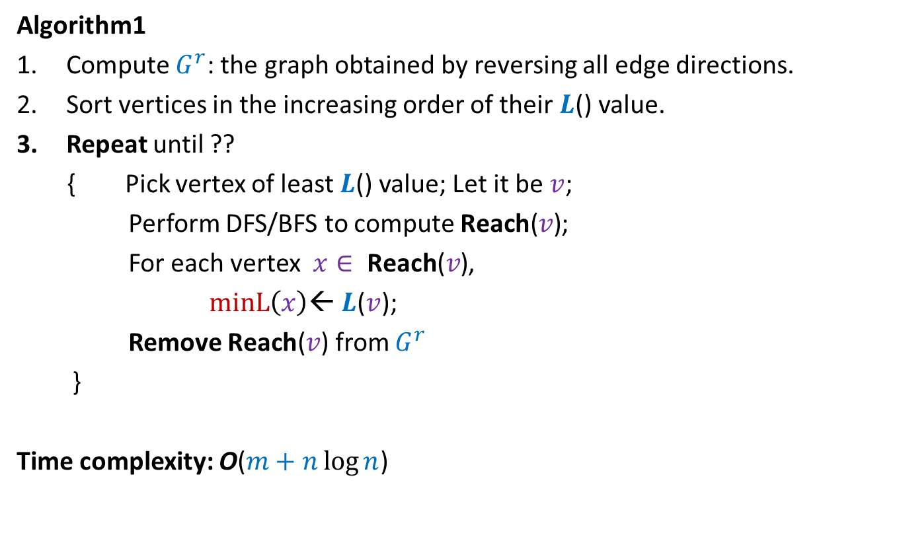
MIN-Label Problem
Algorithm1
Compute $G^{r}$: the graph obtained by reversing all edge directions.
Sort vertices in the increasing order of their $L$() value.
Repeat until ??
{ Pick vertex of least $L$() value; Let it be $v$;
Perform DFS/BFS to compute $\text{Reach}\text{(}v\text{)}$;
For each vertex $x∈ \text{Reach}\text{(}v\text{)}$,
$minL\left(x\right)$← $L$($v$);
Remove $\text{Reach}\text{(}v\text{)}$ from $G^{r}$
}
Time complexity: O($m+n\log{n}$)
$G^{r}$Is empty

Slide 28
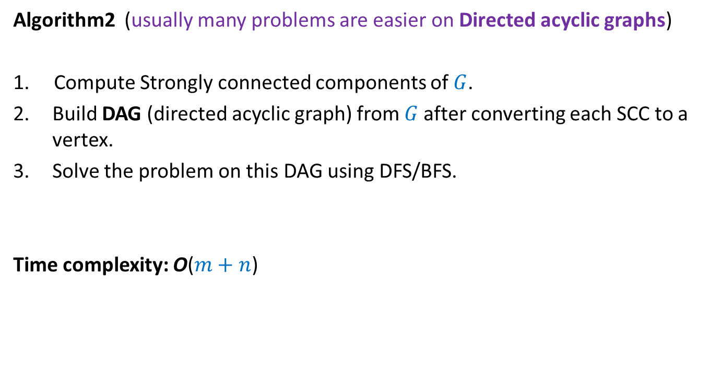
MIN-Label Problem
Algorithm2 (usually many problems are easier on Directed acyclic graphs)
1. Compute Strongly connected components of $G$.
Build DAG (directed acyclic graph) from $G$after converting each SCC to a vertex.
Solve the problem on this DAG using DFS/BFS.
Time complexity: O($m+n$)

Slide 29
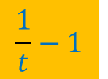
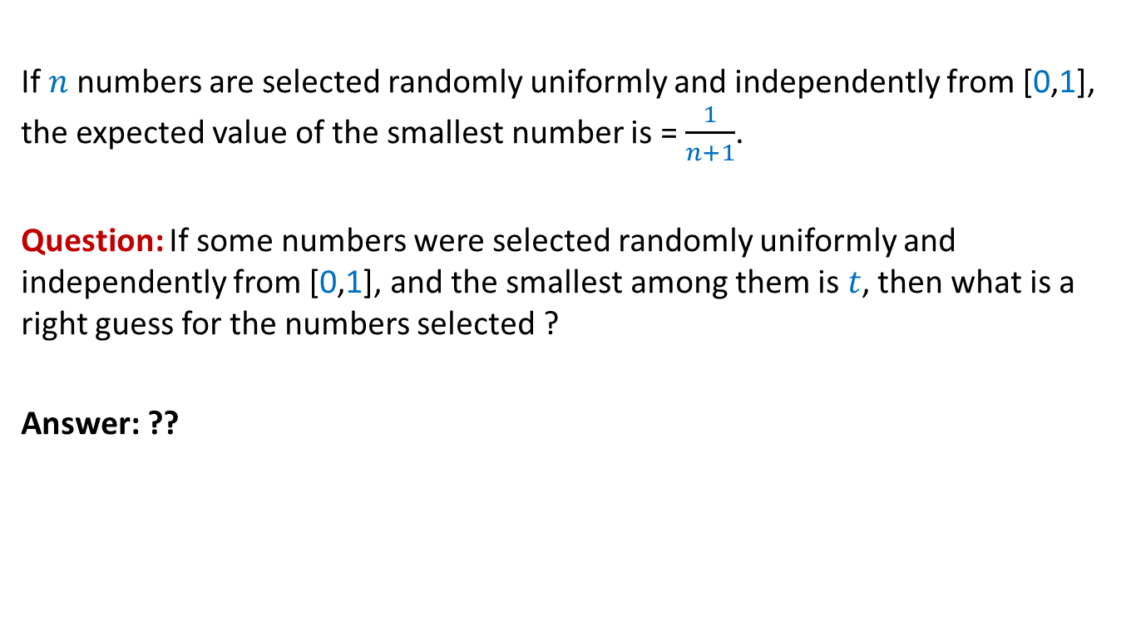
Inference from the inspirational problem
If $n$numbers are selected randomly uniformly and independently from [0,1], the expected value of the smallest number is = $\frac{1}{n+1}$.
Question: If some numbers were selected randomly uniformly and independently from [0,1], and the smallest among them is $t$, then what is a right guess for the numbers selected ?
Answer: ??
$$\frac{1}{t}−1$$

Slide 30
Randomized Monte Carlo algorithm for estimating the size of
Transitive Closure of a Directed Graph

Slide 31

$$x$$

Slide 32
0.38
0.83
$$x$$
0.22
0.53
0.45
0.71

Slide 33
0.65
0.265
0.901
0.81
0.28
0.34
0.49
0.54
0.63
0.38
0.83
0.14
0.74
0.22
0.53
0.45
0.71

Slide 34
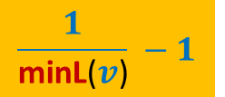

Estimating size of Transitive Closure of a Directed Graph
A simple algorithm:
Assign to each $v$ a random no. $L$($v$) selected uniformly and independently from [0,1].
Compute minL($v$) for each $v∈V$;
$\hat{t}$($v$) ← ??
Return $\hat{t}$.
$$\frac{1}{\text{minL}\text{(}v\text{)}} −1$$

Slide 35
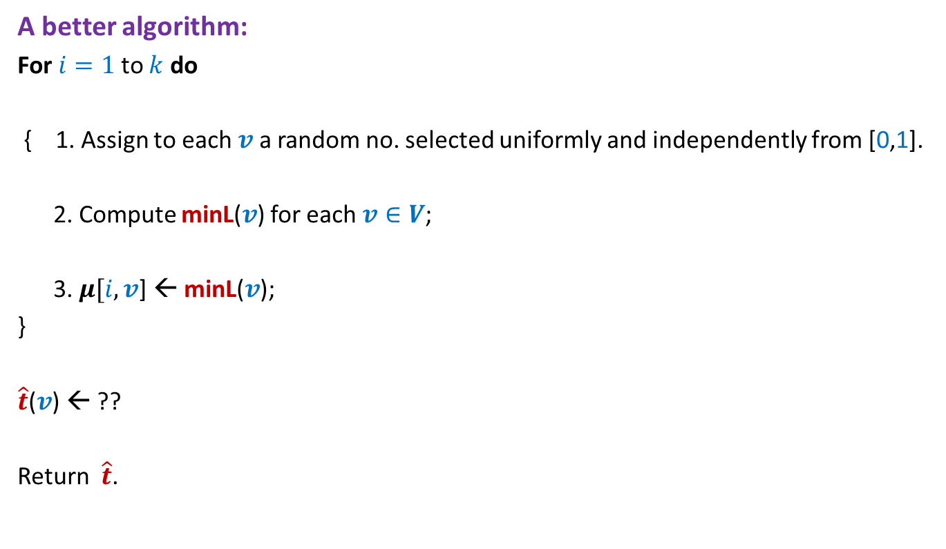
Estimating size of Transitive Closure of a Directed Graph
A better algorithm:
For $i=1$to $k$ do
{ 1. Assign to each $v$ a random no. selected uniformly and independently from [0,1].
2. Compute minL($v$) for each $v∈V$;
3. $μ[i,v$] ← minL($v$);
}
$\hat{t}$($v$) ← ??
Return $\hat{t}$.

Slide 36
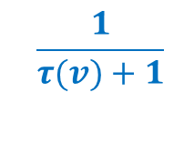
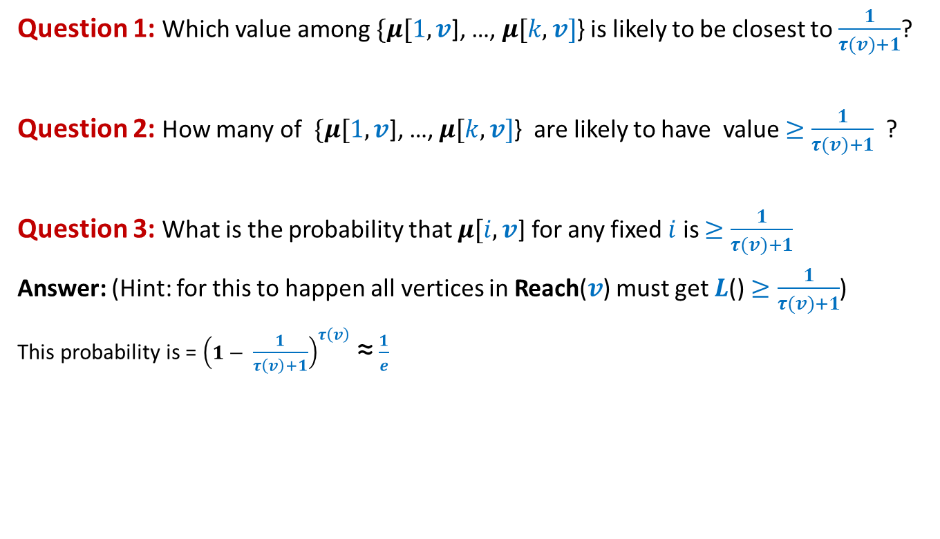

Question 1: Which value among $\{μ[1,v$], …, $μ[k,v]$} is likely to be closest to $\frac{1}{τ(v)+1}$?
Question 2: How many of$\{μ[1,v$], …, $μ[k,v]$} are likely to have value $≥\frac{1}{τ(v)+1}$ ?
Question 3: What is the probability that $μ[i,v$] for any fixed $i$ is $≥\frac{1}{τ(v)+1}$
Answer: (Hint: for this to happen all vertices in Reach($v$) must get $L$() $≥\frac{1}{τ(v)+1}$)
This probability is = ${\left(1− \frac{1}{τ\left(v\right)+1}\right)}^{τ\left(v\right)}$≈ $\frac{1}{e}$
Can you answer Question 2 now ?
$$\frac{k}{e}$$
0
1
$$\frac{1}{τ(v)+1}$$

Slide 37
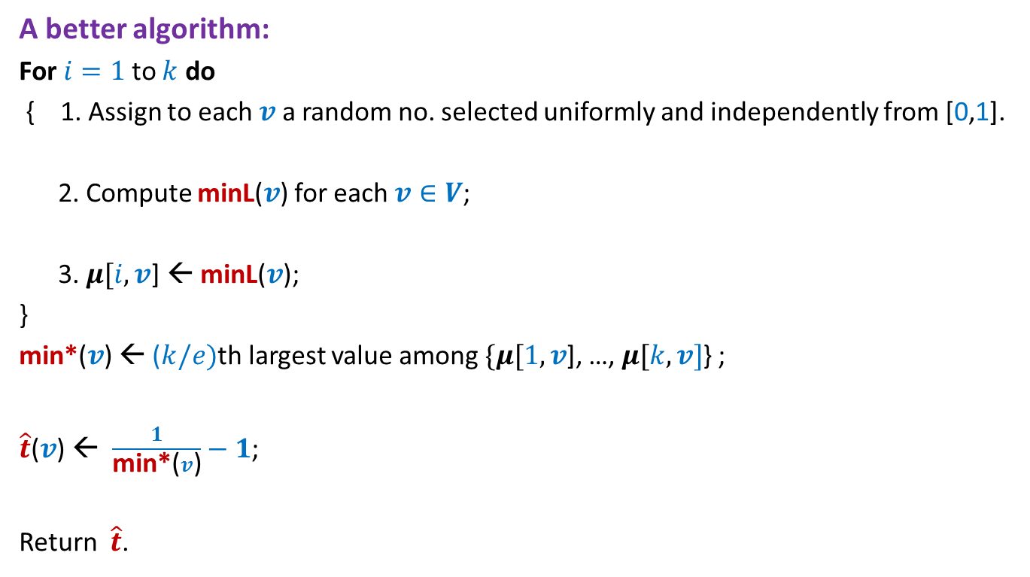
Estimating size of Transitive Closure of a Directed Graph
A better algorithm:
For $i=1$to $k$ do
{ 1. Assign to each $v$ a random no. selected uniformly and independently from [0,1].
2. Compute minL($v$) for each $v∈V$;
3. $μ[i,v$] ← minL($v$);
}
min*($v$) ← ($k/e)$th largest value among $\{μ[1,v$], …, $μ[k,v]$} ;
$\hat{t}$($v$) ← $\frac{1}{\text{min}\text{∗}\text{(}v\text{)}}−1$;
Return $\hat{t}$.

Slide 38
Homework
Use Chernoff bound to get a high probability bound on the error.
Hint:
Proceed along similar lines as in the case of estimating number of balls in a bag.
Make sincere attempts to do this homework. I shall discuss the same briefly in the beginning of the next class.

