Slide 1
Randomized Algorithms
CS648
Lecture 8
Tools for bounding deviation of a random variable
Markov’s Inequality
Chernoff Bound

Slide 2
Markov’s Inequality and Chernoff bound were stated and proved in this lecture class in an interactive manner providing all intuition and reasoning for each step of the proof.

Slide 3
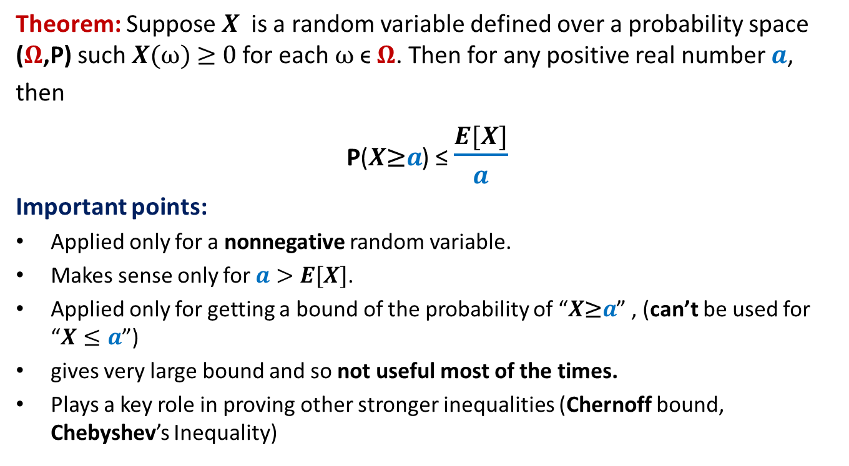
Markov’s Inequality
Theorem: Suppose $X$is a random variable defined over a probability space ($Ω$,P) such $X(ω)$≥ 0 for each $ω$ϵ $Ω$. Then for any positive real number $a$,
then
P($X\text{≥}a$) ≤ $\frac{E[X]}{a}$
Important points:
Applied only for a nonnegative random variable.
Makes sense only for $a>$ $E[X]$.
Applied only for getting a bound of the probability of “$X\text{≥}a$” , (can’t be used for “$X≤a$”)
gives very large bound and so not useful most of the times.
Plays a key role in proving other stronger inequalities (Chernoff bound, Chebyshev’s Inequality)

Slide 4
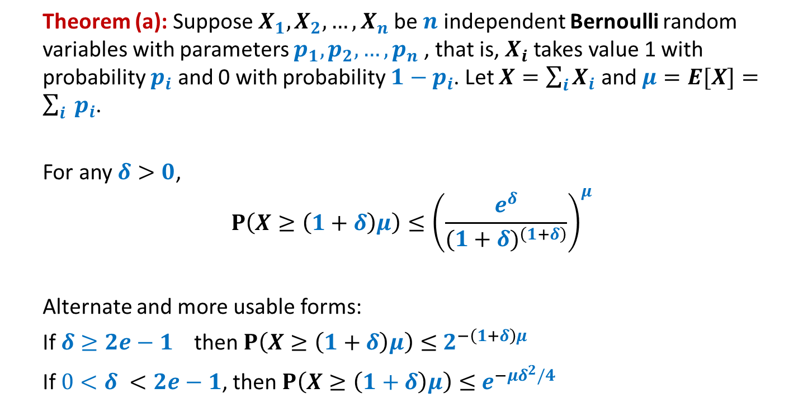
Chernoff’s Bound
Theorem (a): Suppose $X_{1},X_{2},…,X_{n}$be $n$ independent Bernoulli random variables with parameters $p_{1},p_{2},…,p_{n}$, that is, $X_{i}$ takes value 1 with probability $p_{i}$ and 0 with probability ${1−p}_{i}$. Let $X=\sum_{i}{X_{i}}$ and $μ=E[X]=\sum_{i}{ p_{i}}$.
For any $δ>0$,
$$P\left(X≥\left(1+δ\right)μ\right)≤{\left(\frac{e^{δ}}{{(1+δ)}^{\left(1+δ\right)}}\right)}^{μ}$$
Alternate and more usable forms:
If $δ≥2e−1$ then $P\left(X≥\left(1+δ\right)μ\right)≤$ $2^{−\left(1+δ\right)μ}$
If $0<δ <2e−1$, then $P\left(X≥\left(1+δ\right)μ\right)≤$ $e^{−μδ^{2}/4}$

Slide 5
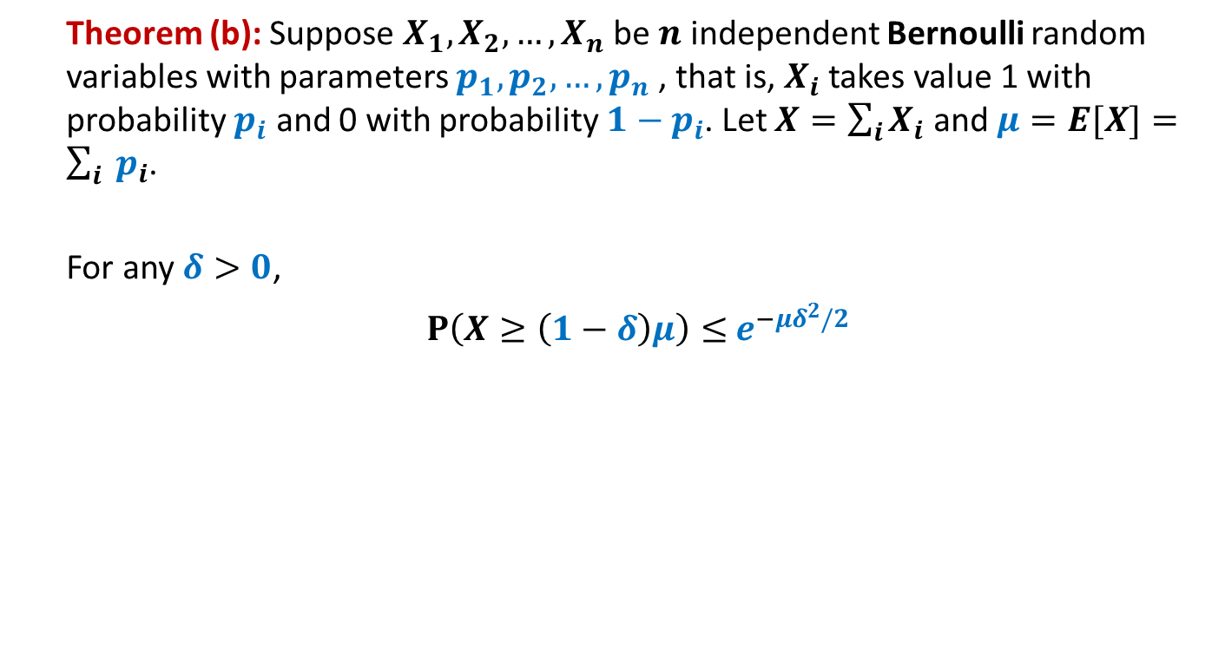
Chernoff’s Bound
Theorem (b): Suppose $X_{1},X_{2},…,X_{n}$be $n$ independent Bernoulli random variables with parameters $p_{1},p_{2},…,p_{n}$, that is, $X_{i}$ takes value 1 with probability $p_{i}$ and 0 with probability ${1−p}_{i}$. Let $X=\sum_{i}{X_{i}}$ and $μ=E[X]=\sum_{i}{ p_{i}}$.
For any $δ>0$,
$P\left(X≥\left(1−δ\right)μ\right)≤$ $e^{−μδ^{2}/2}$

Slide 6
Chernoff’s Bound
Where to use:
If given random variable X can be expressed as a sum of n mutually independent Bernoulli random variables.

Slide 7
Homework
For various problems till now, we used our knowledge of binomial coefficients, elementary probability theory and Stirling’s approximation for getting a bound on the probability of error or probability of deviation from average running time. Try to use Chernoff’s bound to analyze these problems.

