Slide 1
Randomized Algorithms
CS648
Lecture 6
Reviewing the last 3 lectures
Application of Fingerprinting Techniques
    1-dimensional Pattern matching
Preparation for the next lecture.

Slide 2
Randomized Algorithms discussed till now
Randomized algorithm for Approximate Median
Randomized Quick Sort
Frievald’s algorithm for Matrix Product Verification
Randomized algorithm for Equality of two files
Randomly select a sample
Randomly permute the array
Randomly select a vector
Randomly select a prime number

Slide 3

Randomized Algorithms
How does one go about designing a randomized algorithm ?

Slide 4
Randomized Algorithms
Some random idea is required to design a randomized algorithm.

Slide 5
Randomized Algorithms
An idea based on insight into the problem
Difficult/impossible to exploit the idea deterministically
A randomized algorithm
Randomization to materialize the idea

Slide 6
Randomized Quick Sort

Slide 7
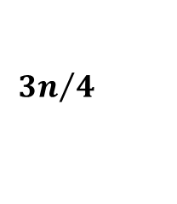
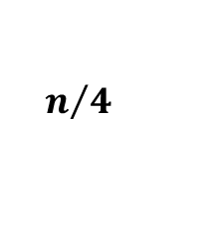


Randomized Quick Sort
$1$ …
$$n$$
A
Elements of A arranged in Increasing order of values
pivot
$$n/4$$
$${3n}/4$$

Slide 8
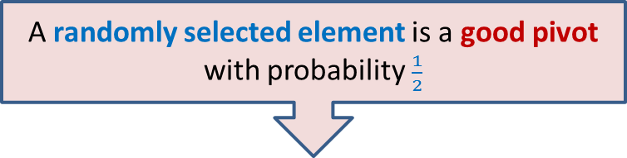
Randomized Quick Sort
Observation: There are many elements in A that are good pivot.
Is it possible to select one good pivot efficiently ?
(not possible deterministically ☹)
We select pivot element randomly uniformly.
A randomly selected element is a good pivot with probability $\frac{1}{2}$

Slide 9
Randomized Algorithm for Approximate median

Slide 10
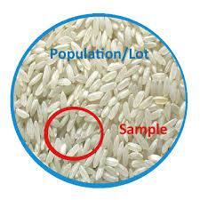
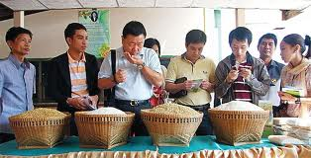
Randomized Algorithm for
Approximate median
A sample captures the essence of the original population.

Slide 11
Randomized Algorithm for
Approximate median
Idea: Is it possible to select a small subset of elements whose median approximates the median ?
(not possible deterministically ☹)
Median of a uniformly random sample will be approximate median.
A random sample captures the essence of the original population.

Slide 12
Frievald’s Technique
Application matrix product verification

Slide 13













Frievald’s Algorithm
$$1$$
0
$$⋮$$
$$1$$
$$1$$
0
$$⨯$$
$$⨯$$
$$A$$
$$≟$$
$$B$$
$$x$$
$$y$$
$$1$$
0
$$⋮$$
$$1$$
$$1$$
0
$$⨯$$
$$C$$
$$x$$
$$z$$

Slide 14
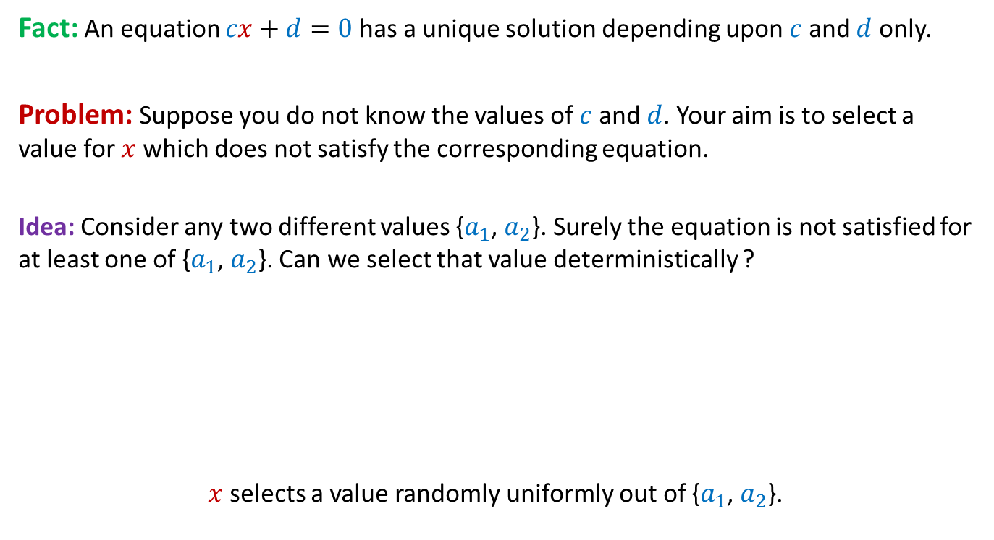
Frievald’s Algorithm
The key idea
Fact: An equation $cx+d=0$ has a unique solution depending upon $c$ and $d$ only.
Problem: Suppose you do not know the values of $c$ and $d$. Your aim is to select a value for $x$ which does not satisfy the corresponding equation.
Idea: Consider any two different values {$a_{1}$, $a_{2}$}. Surely the equation is not satisfied for at least one of {$a_{1}$, $a_{2}$}. Can we select that value deterministically ?
$x$ selects a value randomly uniformly out of {$a_{1}$, $a_{2}$}.
Randomization used to exploit the idea:

Slide 15





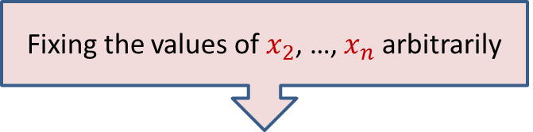


Frievald’s Algorithm
(Analyzing error probability)
$$1 2 … n$$
$$1$$
2
$$⋮$$
$$n$$
$D_{i1}^{}$ $∙x_{1}$ + $D_{i2}^{}$ $∙x_{2}$ … + $D_{in}^{}$ $∙x_{n}$ = 0
$$⨯$$
Fixing the values of $x_{2}$, …, $x_{n}$ arbitrarily
$$D=(A∙B−C)$$
$$x$$
$D_{i1}^{}$ $∙x_{1}$ + $D_{i2}^{}$ $∙a_{2}$ … + $D_{in}^{}$ $∙x_{n}$ = 0

Slide 16
Fingerprinting
Application
Cryptography

Slide 17

Aim: To determine if File A identical to File B by communicating fewest bits ?
File A
File B

Slide 18
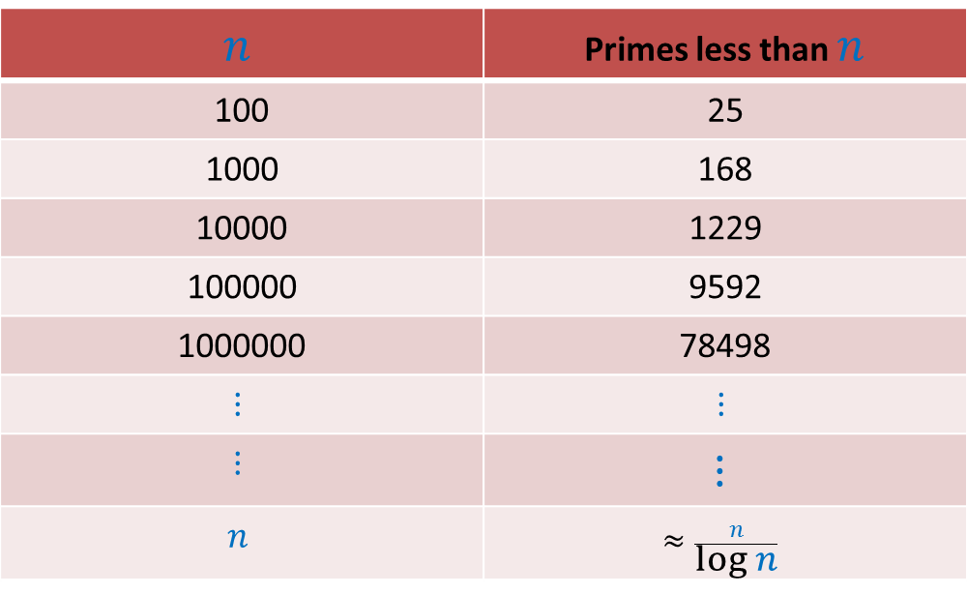

How many primes less than $n$ ?
$$n$$ | Primes less than $n$
100 | 25
1000 | 168
10000 | 1229
100000 | 9592
1000000 | 78498
$$⋮$$ | $$⋮$$
$$⋮$$ | $$⋮$$
$$n$$ | $$≈\frac{n}{\log{n}}$$

Slide 19
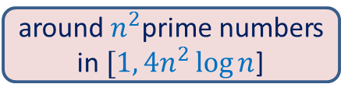

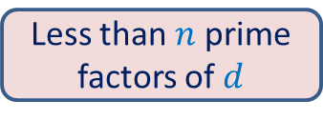




Key idea from prime
$$1$$
$$d$$
$$2^{n}$$
Less than $n$prime factors of $d$
$$1$$
$${4n}^{2}\log{n}$$
around $n^{2}$prime numbers in $[1,{4n}^{2}\log{n}$]

Slide 20

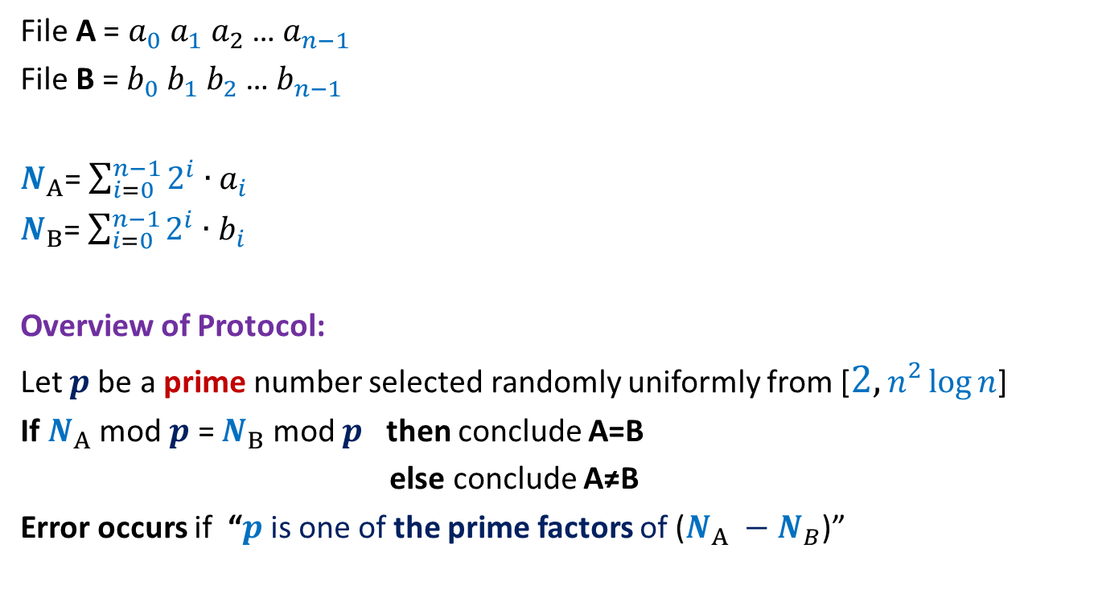
Visualize a file as a binary number
File A = $a_{0} a_{1} a_{2}$… $a_{n−1}$
File B = $b_{0} b_{1} b_{2}$… $b_{n−1}$
$N_{A}$= $\sum_{i=0}^{n−1}{2^{i}∙a_{i}}$
$N_{B}$= $\sum_{i=0}^{n−1}{2^{i}∙b_{i}}$
Overview of Protocol:
Let $p$be a prime number selected randomly uniformly from [$2,n^{2}\log{n}$]
If $N_{A}$ mod $p$ = $N_{B}$ mod $p$ then conclude A=B
else conclude A≠B
Error occurs if “$p$is one of the prime factors of ($N_{A} −N_{B}$)”
${<2}^{n}$
${<2}^{n}$

Slide 21
Fingerprinting
Application 3
Pattern matching

Slide 22
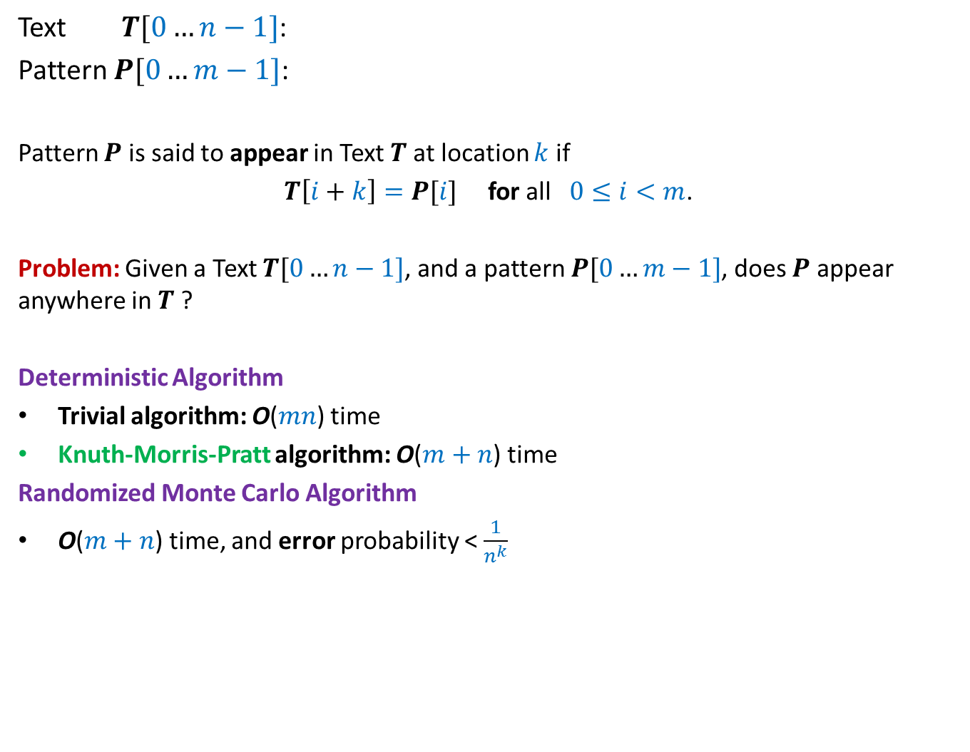
17
Text $T[0…n−1]$:
Pattern $P[0…m−1]$:
Pattern $P$ is said to appear in Text $T$at location $k$ if
$T\left[i+k\right]=P[i]$ for all $0≤i<m$.
Problem: Given a Text $T[0…n−1]$, and a pattern $P[0…m−1]$, does $P$ appear anywhere in $T$ ?
Deterministic Algorithm
Trivial algorithm: O($mn$) time
Knuth-Morris-Pratt algorithm: O($m+n$) time
Randomized Monte Carlo Algorithm
O($m+n$) time, and error probability < $\frac{1}{n^{k}}$
100101100110001101111010101110101010111010000101
011110101011101

Slide 23
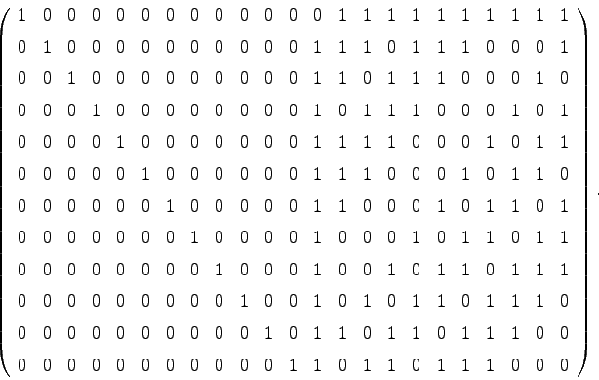

Motivation
Simplicity, real time implementation, streaming environment
Extension to 2-dimensions
Converting Monte Carlo to Las Vegas algorithm
1 1 0
1 1 0 1
1 0 1 1
1 1 1 1
m⨯m
n⨯n
O($n^{2}+m^{2}$) time algorithm

Slide 24
Randomized Algorithm for Fingerprinting

Slide 25
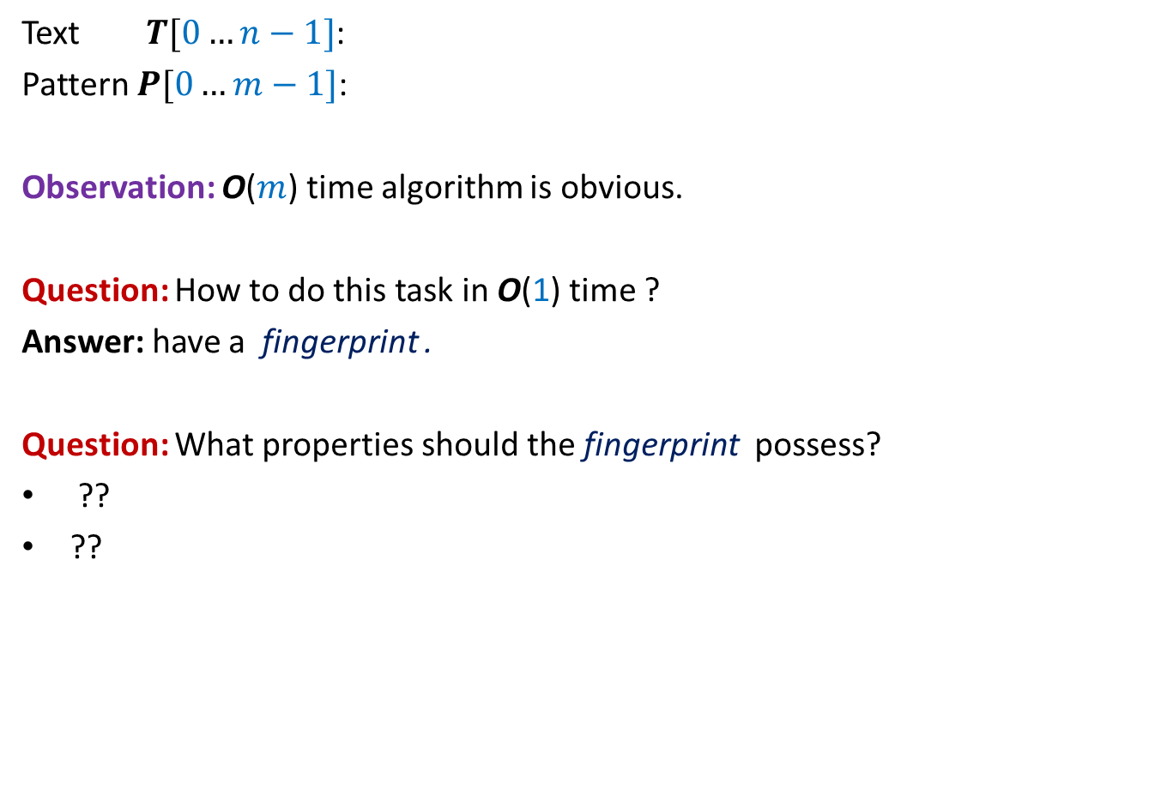


Checking if$P$appears in Text $T$at location $k$
$$k$$
Text $T[0…n−1]$:
Pattern $P[0…m−1]$:
Observation: O($m$) time algorithm is obvious.
Question: How to do this task in O(1) time ?
Answer: have a fingerprint .
Question: What properties should the fingerprint possess?
??
??
100101100110001101111010101010101010111010000101
0111101110110101
Small size
Efficiently computable

Slide 26
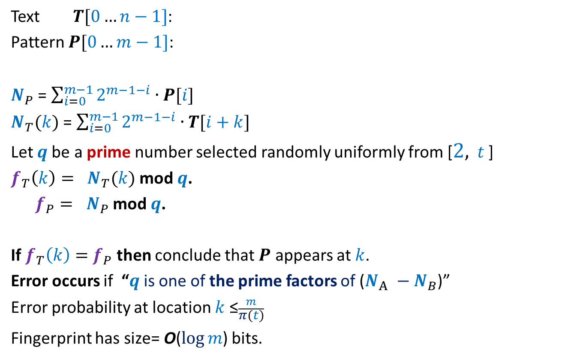
Checking if$P$appears in Text $T$at location $k$
$$k$$
Text $T[0…n−1]$:
Pattern $P[0…m−1]$:
$N_{P}$ = $\sum_{i=0}^{m−1}{2^{m−1−i}∙P[i]}$
$N_{T}(k)$ = $\sum_{i=0}^{m−1}{2^{m−1−i}∙T[i+k]}$
Let $q$be a prime number selected randomly uniformly from [$2,$ $t$ ]
$f_{T}\left(k\right)= N_{T}(k)$ mod $q$.
$f_{P}= N_{P}$ mod $q$.
If $f_{T}\left(k\right)=$ $f_{P}$ then conclude that $P$ appears at $k$.
Error occurs if “$q$is one of the prime factors of ($N_{A} −N_{B}$)”
Error probability at location $k$ ≤$\frac{m}{π(t)}$
Fingerprint has size= O($\log{m}$) bits.
100101100110001101111010101010101010111010000101
0111101110110101
Small size but
Not efficiently computable

Slide 27
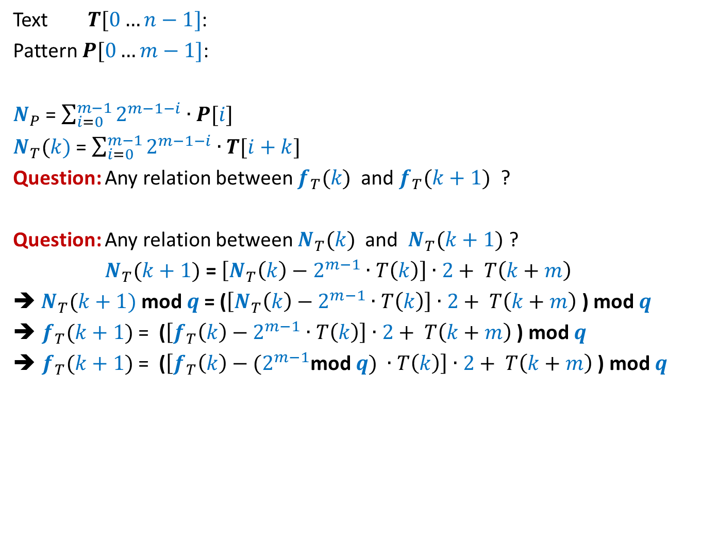



Checking if$P$appears in Text $T$at location $k$
$$k$$
$N_{T}(k+1)$
Text $T[0…n−1]$:
Pattern $P[0…m−1]$:
$N_{P}$ = $\sum_{i=0}^{m−1}{2^{m−1−i}∙P[i]}$
$N_{T}(k)$ = $\sum_{i=0}^{m−1}{2^{m−1−i}∙T[i+k]}$
Question: Any relation between $f_{T}(k)$ and $f_{T}(k+1)$ ?
Question: Any relation between $N_{T}(k)$ and $N_{T}(k+1)$ ?
$N_{T}(k+1)$ = $\left[N_{T}\left(k\right)−2^{m−1}∙T\left(k\right)\right]∙2+ T\left(k+m\right)$
➔ $N_{T}(k+1)$ mod $q$= ($\left[N_{T}\left(k\right)−2^{m−1}∙T\left(k\right)\right]∙2+ T\left(k+m\right)$ ) mod $q$
$f_{T}(k+1)$ = ($\left[f_{T}\left(k\right)−2^{m−1}∙T\left(k\right)\right]∙2+ T\left(k+m\right)$ ) mod $q$
$f_{T}(k+1)$ = ($\left[f_{T}\left(k\right)−{(2}^{m−1}\text{mod} q\text{)} ∙T\left(k\right)\right]∙2+ T\left(k+m\right)$ ) mod $q$
100101100110001101111010101010101010111010000101
0111101110110101
$N_{T}(k)$
< $q$

Slide 28
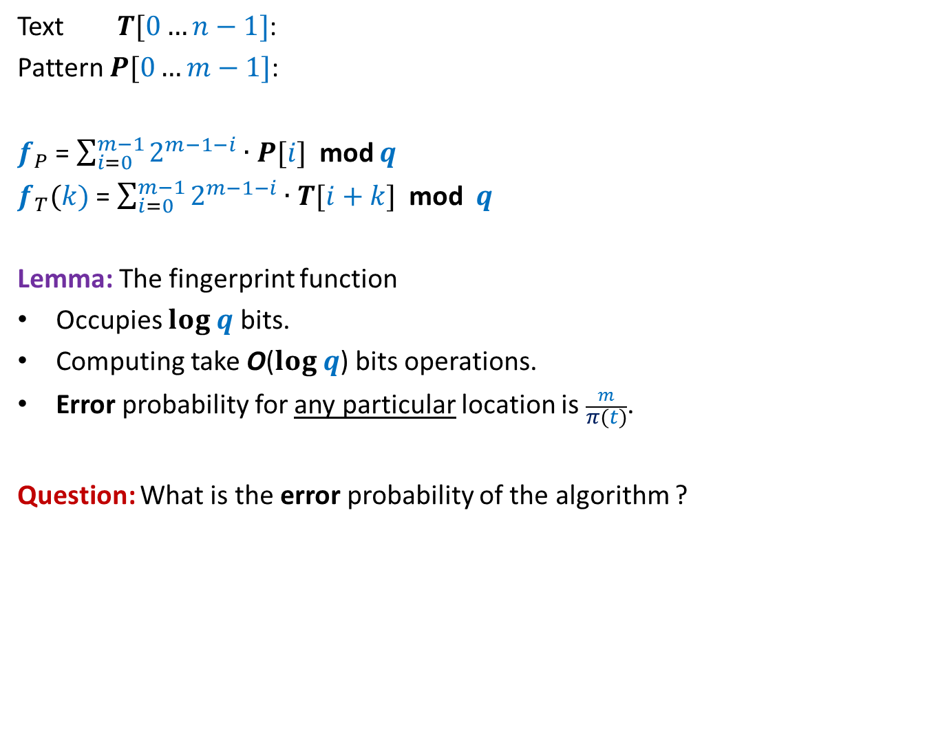
Fingerprint function: how good is it ?
$$k$$
Text $T[0…n−1]$:
Pattern $P[0…m−1]$:
$f_{P}$ = $\sum_{i=0}^{m−1}{2^{m−1−i}∙P[i]}$ mod $q$
$f_{T}(k)$ = $\sum_{i=0}^{m−1}{2^{m−1−i}∙T[i+k]}$ mod $q$
Lemma: The fingerprint function
Occupies $log q$ bits.
Computing take O($log q$) bits operations.
Error probability for any particular location is $\frac{m}{π(t)}$.
Question: What is the error probability of the algorithm ?
100101100110001101111010101010101010111010000101
0111101110110101

Slide 29
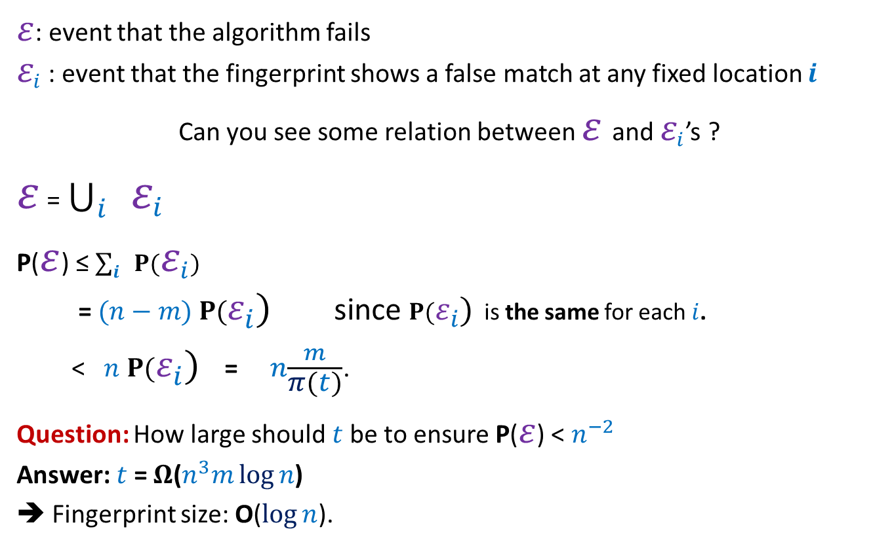
Bounding the error probability of the algorithm
$ε$: event that the algorithm fails
$ε_{i}$ : event that the fingerprint shows a false match at any fixed location $i$
Can you see some relation between $ε$and $ε_{i}$’s ?
$ε$ = $\bigcup_{i}{ ε_{i}}$
P($ε$) ≤ $\sum_{i}{ P(ε_{i})}$
= $(n−m)$ $P(ε_{i})$ since $P(ε_{i})$ is the same for each $i$.
< $n$ $P(ε_{i})$ = $n\frac{m}{π(t)}$.
Question: How large should $t$be to ensure P($ε$) < $n^{−2}$
Answer: $t$ = $Ω$($n^{3}m\log{n}$)
➔ Fingerprint size: O($\log{n}$).

Slide 30
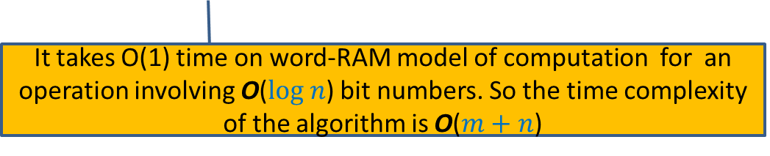
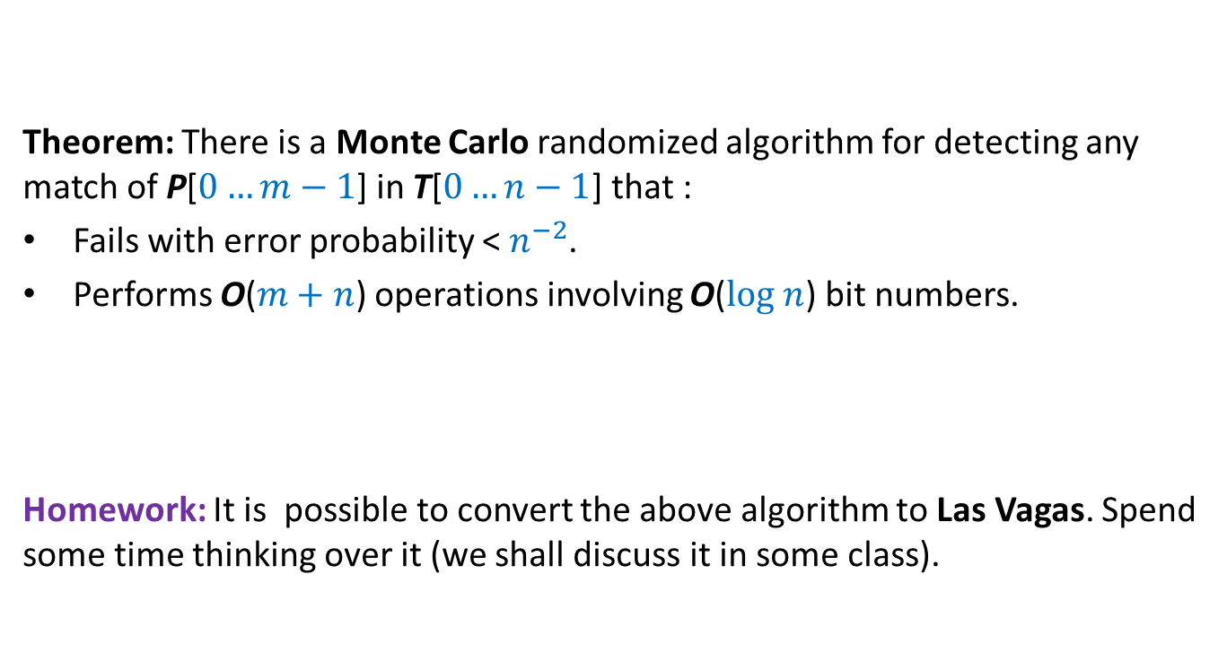
Final result
Theorem: There is a Monte Carlo randomized algorithm for detecting any match of P[$0…m−1$] in T[$0…n−1$] that :
Fails with error probability < $n^{−2}$.
Performs O($m+n$) operations involving O($log n$) bit numbers.
Homework: It is possible to convert the above algorithm to Las Vagas. Spend some time thinking over it (we shall discuss it in some class).
It takes O(1) time on word-RAM model of computation for an operation involving O($log n$) bit numbers. So the time complexity of the algorithm is O($m+n$)

Slide 31
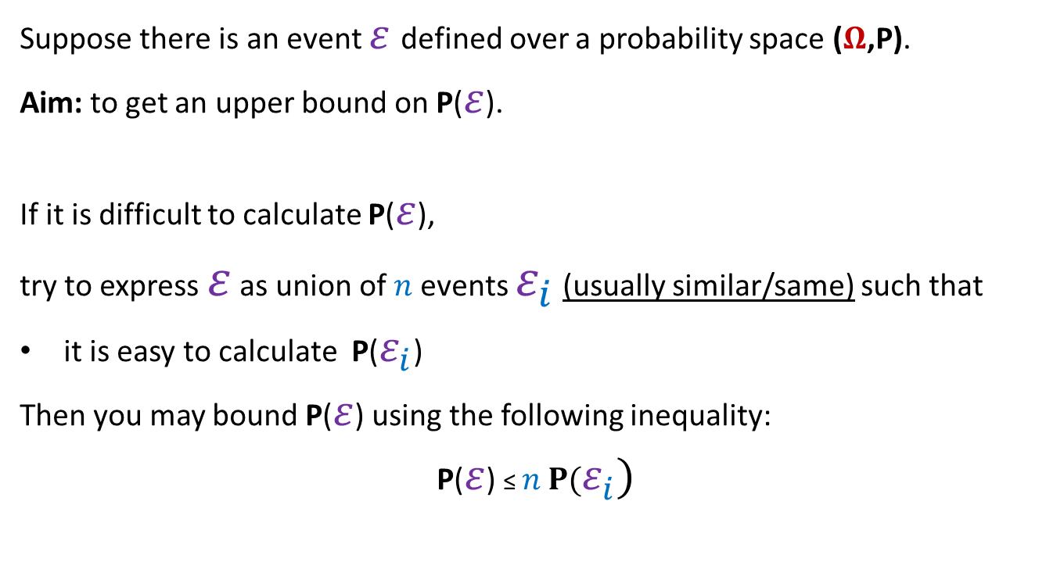
Probability tool (union theorem)
Suppose there is an event $ε$defined over a probability space ($Ω$,P).
Aim: to get an upper bound on P($ε$).
If it is difficult to calculate P($ε$),
try to express $ε$ as union of $n$events $ε_{i}$ (usually similar/same) such that
it is easy to calculate P($ε_{i}$)
Then you may bound P($ε$) using the following inequality:
P($ε$) ≤ $n$ $P(ε_{i})$

Slide 32
Applications of the Union Theorem

Slide 33

Balls into Bins
1 2 3 4 5 … m-1 m
Ball-bin Experiment: There are $m$ balls and $n$ bins. Each ball selects its bin randomly uniformly and independent of other balls and falls into it.
Used in:
Hashing
Load balancing in distributed environment
1 2 3 … i … n

Slide 34
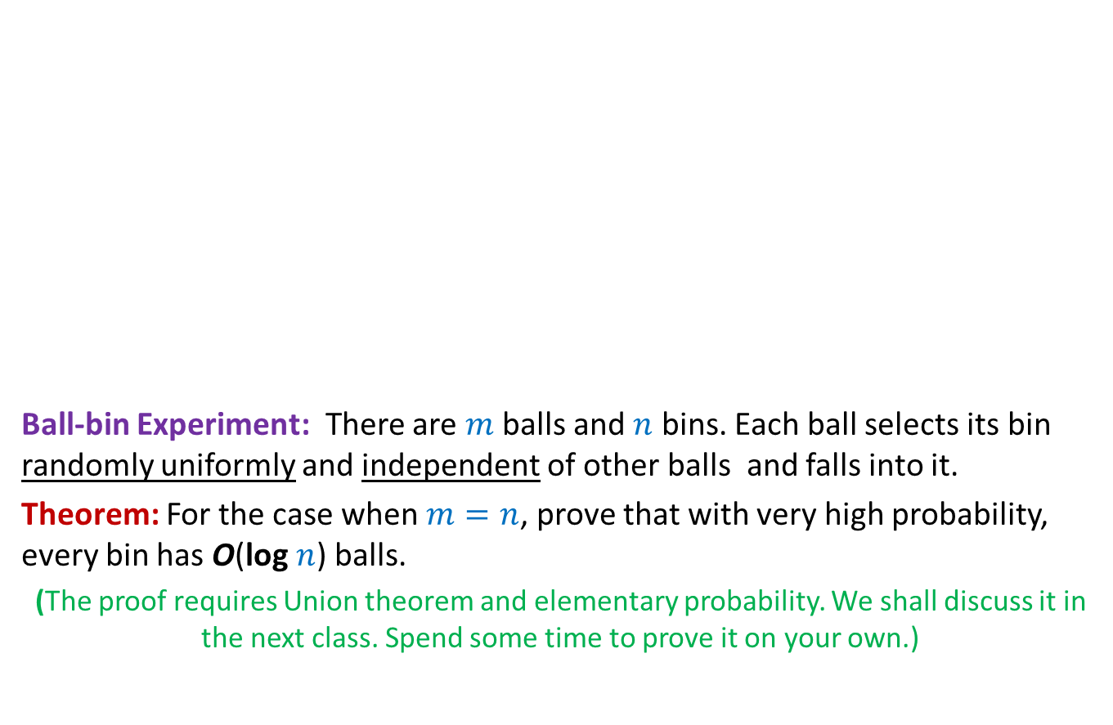
Balls into Bins
1 2 3 4 5 … m-1 m
Ball-bin Experiment: There are $m$ balls and $n$ bins. Each ball selects its bin randomly uniformly and independent of other balls and falls into it.
Theorem: For the case when $m=n$, prove that with very high probability, every bin has O(log $n$) balls.
(The proof requires Union theorem and elementary probability. We shall discuss it in the next class. Spend some time to prove it on your own.)
1 2 3 … i … n

Slide 35
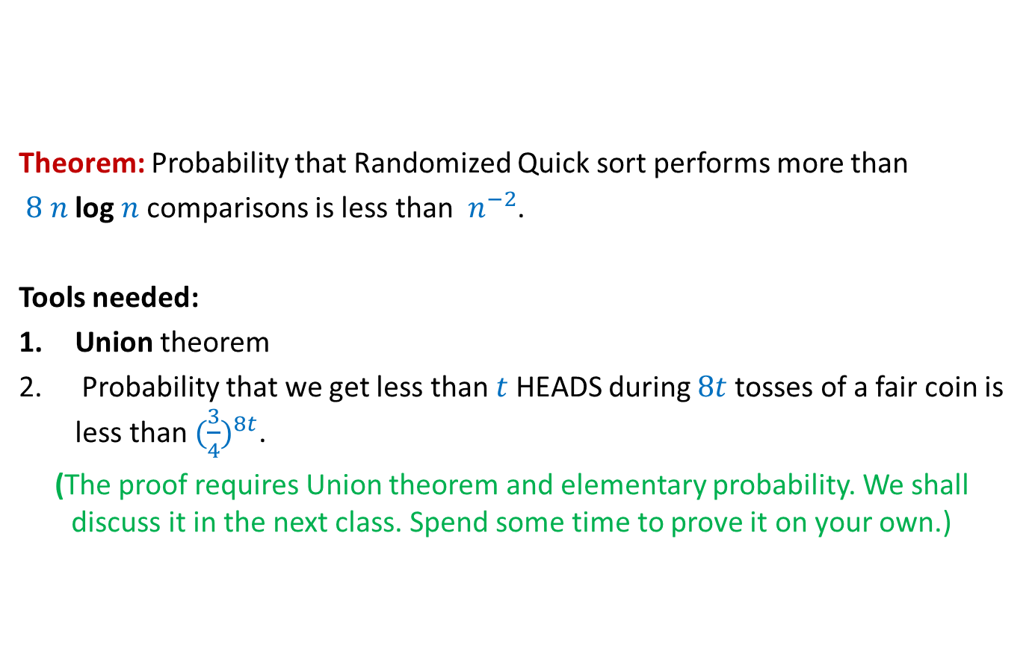
Randomized Quick sort
Theorem: Probability that Randomized Quick sort performs more than
$8 n$log $n$comparisons is less than $n^{−2}$.
Tools needed:
Union theorem
Probability that we get less than $t$ HEADS during $8t$tosses of a fair coin is less than ${(\frac{3}{4})}^{8t}$.
(The proof requires Union theorem and elementary probability. We shall discuss it in the next class. Spend some time to prove it on your own.)

