Slide 1
Randomized Algorithms
CS648
Lecture 5
Algebraic Techniques
  Frievald’s Algorithm
  Fingerprinting Techniques

Slide 2
Frievald’s technique
Application
Matrix Product verification

Slide 3






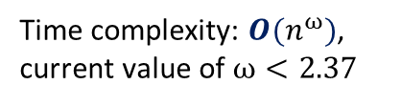


Frievald’s Algorithm
(Rusins Frievald, 1977)
Problem: Given three $n$-by-$n$matrices $A$, $B$, and $C$, determine if $C≟A⨯B$.
Best deterministic algorithm:
$D$ ← $A⨯B$;
Verify if $C=D$ ?
$$1 2 … n$$
$$1$$
2
$$⋮$$
$$n$$
$$≟$$
$$⨯$$
$$C$$
$$A$$
$$B$$
Time complexity: $O(n^{ω})$,
current value of $ω<2.37$

Slide 4













Frievald’s Algorithm
(Rusins Frievald, 1977)
$$1$$
0
$$⋮$$
$$1$$
$$1$$
0
$$⨯$$
$$⨯$$
$$A$$
$$B$$
$$x$$
$$y$$
$$≟$$
$$1$$
0
$$⋮$$
$$1$$
$$1$$
0
$$⨯$$
$$C$$
$$x$$
$$z$$

Slide 5
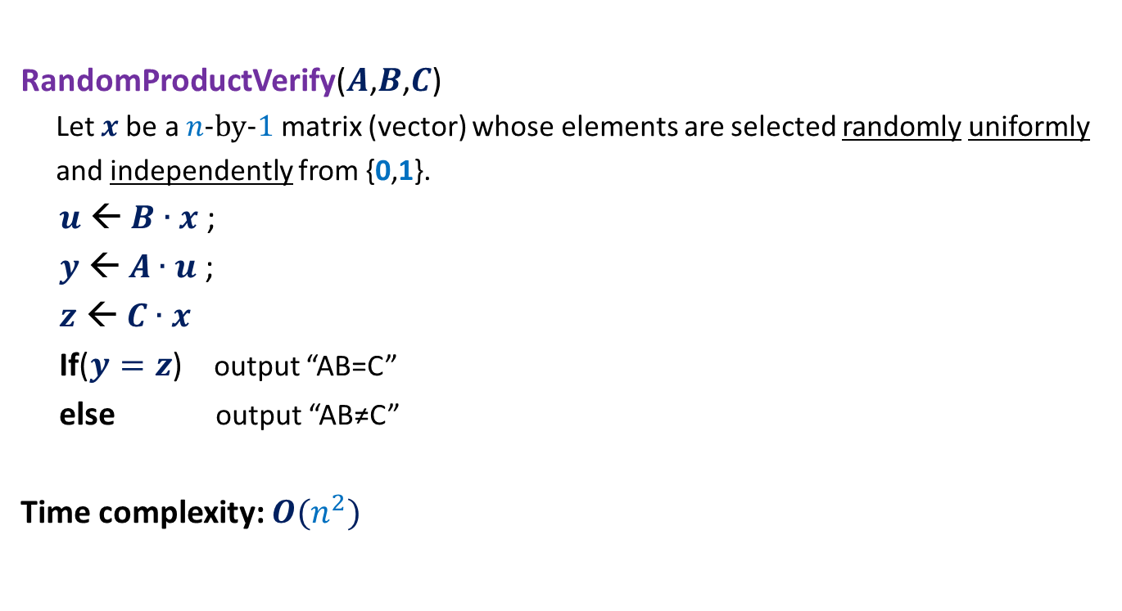
Frievald’s Algorithm
(Rusins Frievald, 1977)
RandomProductVerify($A$,$B$,$C$)
Let $x$be a $n$-by-$1$matrix (vector) whose elements are selected randomly uniformly
and independently from {0,1}.
$u$ ← $B∙x$ ;
$y$ ← $A∙u$ ;
$z$ ← $C∙x$
If($y=z$) output “AB=C”
else output “AB≠C”
Time complexity: $O(n^{2})$

Slide 6

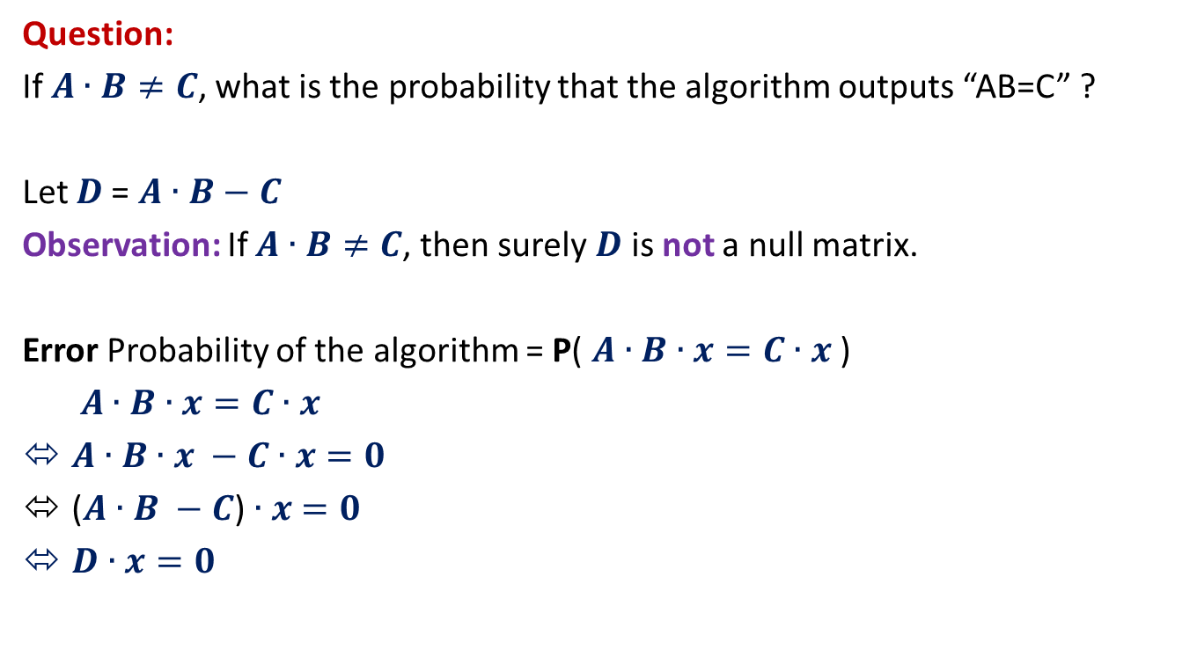
Frievald’s Algorithm
(Analyzing error probability)
Question:
If $A∙B≠C$, what is the probability that the algorithm outputs “AB=C” ?
Let $D$= $A∙B−C$
Observation: If $A∙B≠C$, then surely $D$ is not a null matrix.
Error Probability of the algorithm = P( $A∙B∙x=C∙x$ )
$A∙B∙x=C∙x$
$A∙B∙x −C∙x=0$
($A∙B −C$) $∙x$ $=0$
$D∙x=0$
$$D∙x=0$$
null vector

Slide 7



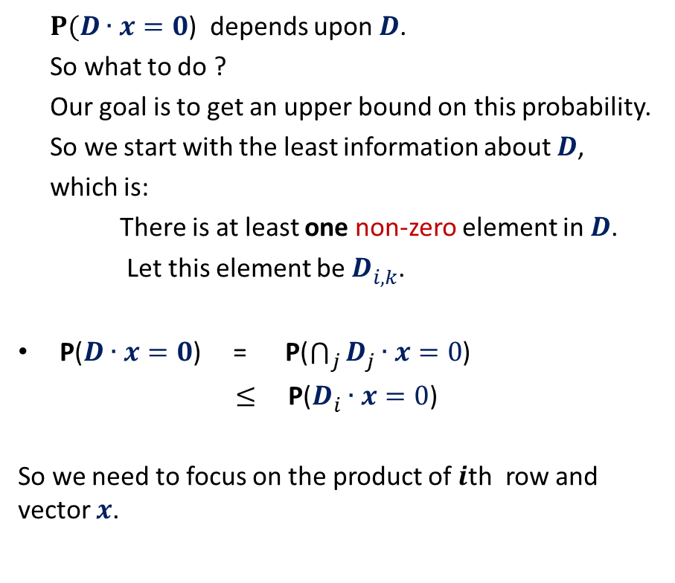


Frievald’s Algorithm
(Analyzing error probability)
$$k$$
$P(D∙x=0$) depends upon $D$.
So what to do ?
Our goal is to get an upper bound on this probability.
So we start with the least information about $D$,
which is:
There is at least one non-zero element in $D$.
Let this element be $D_{i,k}^{}$.
P($D∙x=0$) = P($\bigcap_{j}{D_{j}^{}∙x=0}$)
$≤$ P($D_{i}^{}∙x=0$)
So we need to focus on the product of $i$th row and vector $x$.
$$1 2 … n$$
$$1$$
2
$$⋮$$
$$n$$
$$⨯$$
$$i$$
$$D$$
$$x$$

Slide 8


Frievald’s Algorithm
(Analyzing error probability)
$$k$$
P($D_{i}^{}∙x=0$) = P($D_{i1}^{}$ $∙x_{1}$ + … + $D_{in}^{}$ $∙x_{n}$ = 0)
The underlying sample space has $2^{n}$ elementary events. Convince yourself that it is indeed difficult to calculate this probability from standard tools which you know.
Here we shall introduce a yet another simple but very powerful probability tool…
$$1 2 … n$$
$$1$$
2
$$⋮$$
$$n$$
$$⨯$$
$$i$$
$$D$$
$$x$$

Slide 9



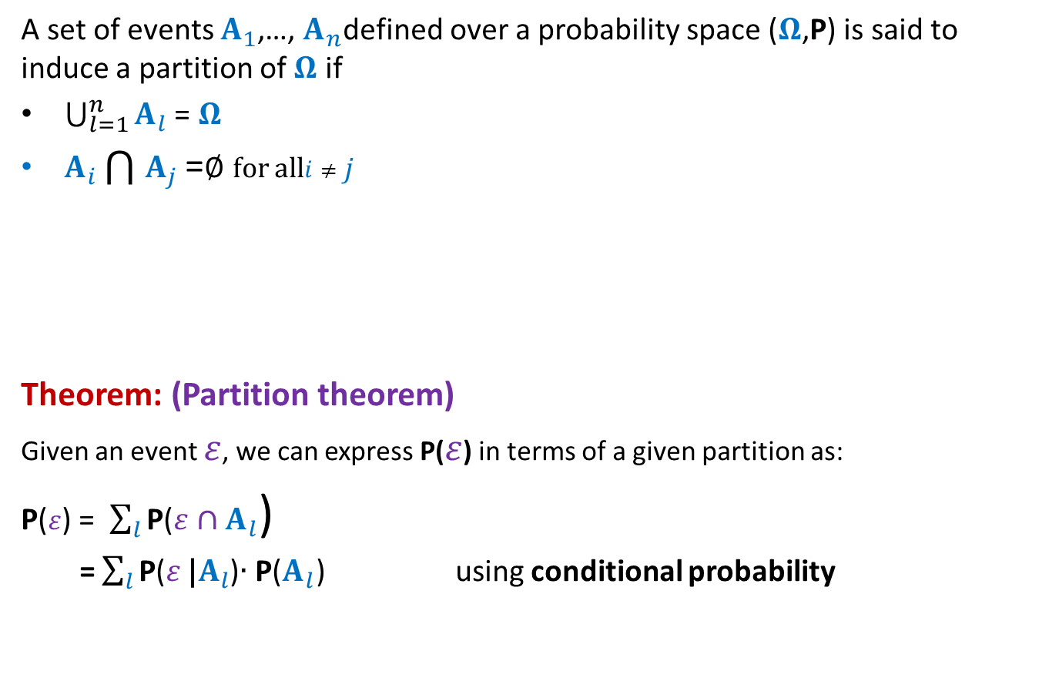




Probability tool:
Partition of sample space
A set of events $A_{1}$,…, $A_{n}$defined over a probability space ($Ω$,P) is said to induce a partition of $Ω$ if
$\bigcup_{l=1}^{n}{A_{l}}$ = $Ω$
$A_{i}\bigcap{A_{j}}$ =∅ for all$i≠j$
Theorem: (Partition theorem)
Given an event $ε$, we can express P($ε$) in terms of a given partition as:
P($ε$) = $\sum_{l}{\text{P}\text{(}ε}∩A_{l}$)
= $\sum_{l}{\text{P}\text{(}ε}\text{|}A_{l}$)∙ $\text{P}\text{(}A_{l}\text{)}$ using conditional probability
$$A_{2}$$
$$A_{3}$$
$$A_{4}$$
$$ε$$
$$A_{5}$$
$$A_{1}$$
Ω
$$A_{6}$$

Slide 10
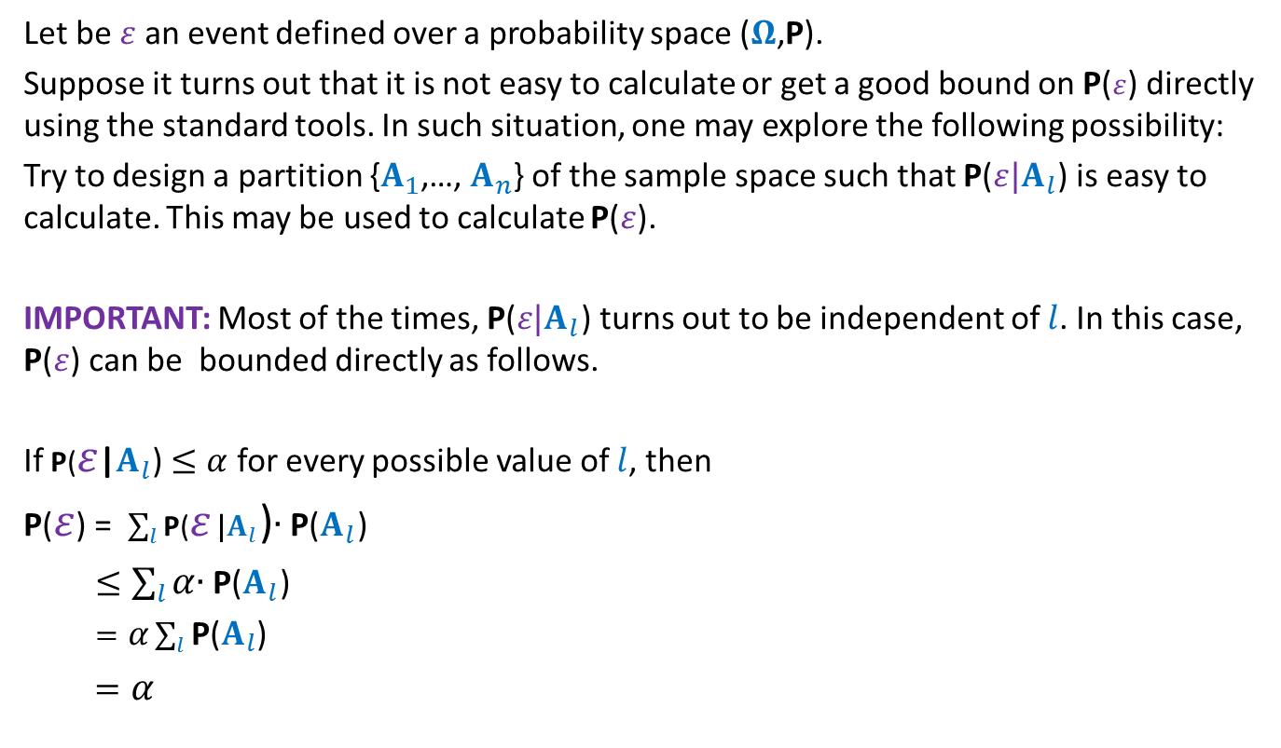
  Question: When to use the Partition theorem ?
Let be $ε$an event defined over a probability space ($Ω$,P).
Suppose it turns out that it is not easy to calculate or get a good bound on P($ε$) directly using the standard tools. In such situation, one may explore the following possibility:
Try to design a partition {$A_{1}$,…, $A_{n}$} of the sample space such that $\text{P}\text{(}ε|A_{l}$) is easy to calculate. This may be used to calculate $\text{P}\text{(}ε$).
IMPORTANT: Most of the times, $\text{P}\text{(}ε|A_{l}$) turns out to be independent of $l$. In this case, $\text{P}\text{(}ε$) can be bounded directly as follows.
If $\text{P}\text{(}ε$|$A_{l}$) $≤α$ for every possible value of $l$, then
  P($ε$) = $\sum_{l}{\text{P}\text{(}ε}\text{|}A_{l}$)∙ $\text{P}\text{(}A_{l}\text{)}$
  $≤\sum_{l}{α}$∙ $\text{P}\text{(}A_{l}\text{)}$
$=α\sum_{l}{\text{P}\text{(}A_{l}\text{) }}$
$=α$

Slide 11

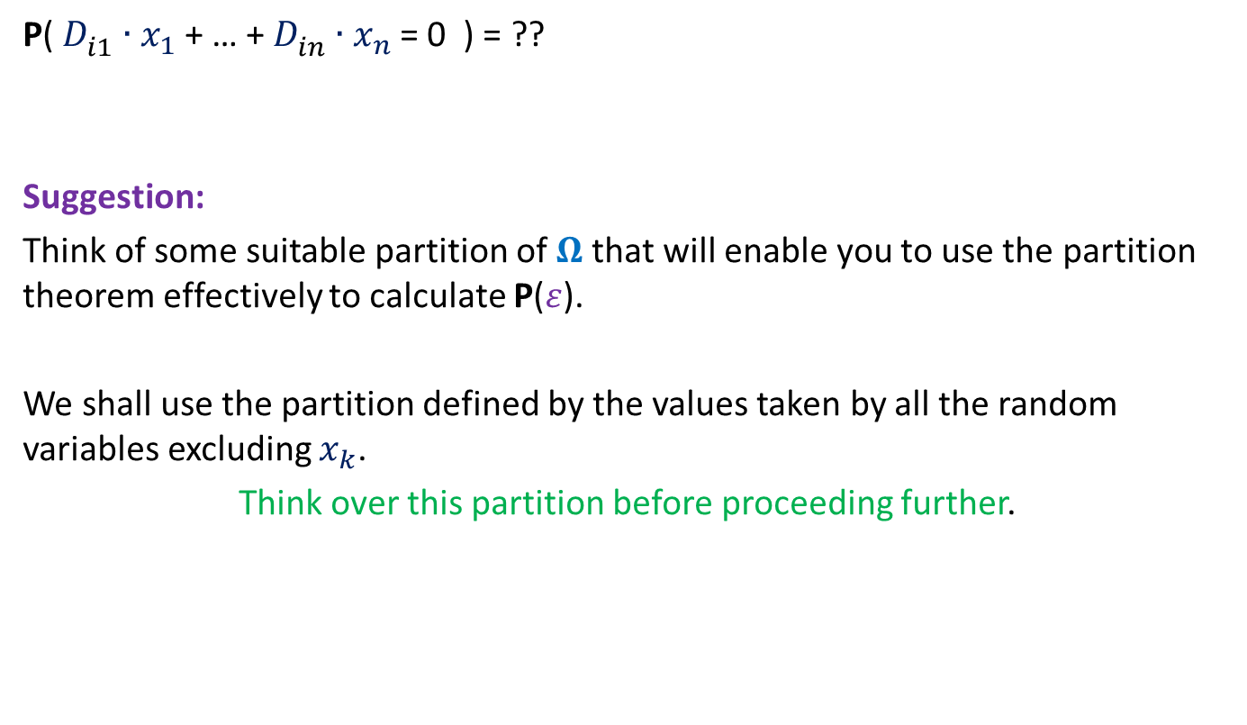
Frievald’s Algorithm
(Analyzing error probability)
$$ε$$
P( $D_{i1}^{}$ $∙x_{1}$ + … + $D_{in}^{}$ $∙x_{n}$ = 0 ) = ??
Suggestion:
Think of some suitable partition of $Ω$that will enable you to use the partition theorem effectively to calculate P($ε$).
We shall use the partition defined by the values taken by all the random variables excluding $x_{k}$.
Think over this partition before proceeding further.

Slide 12

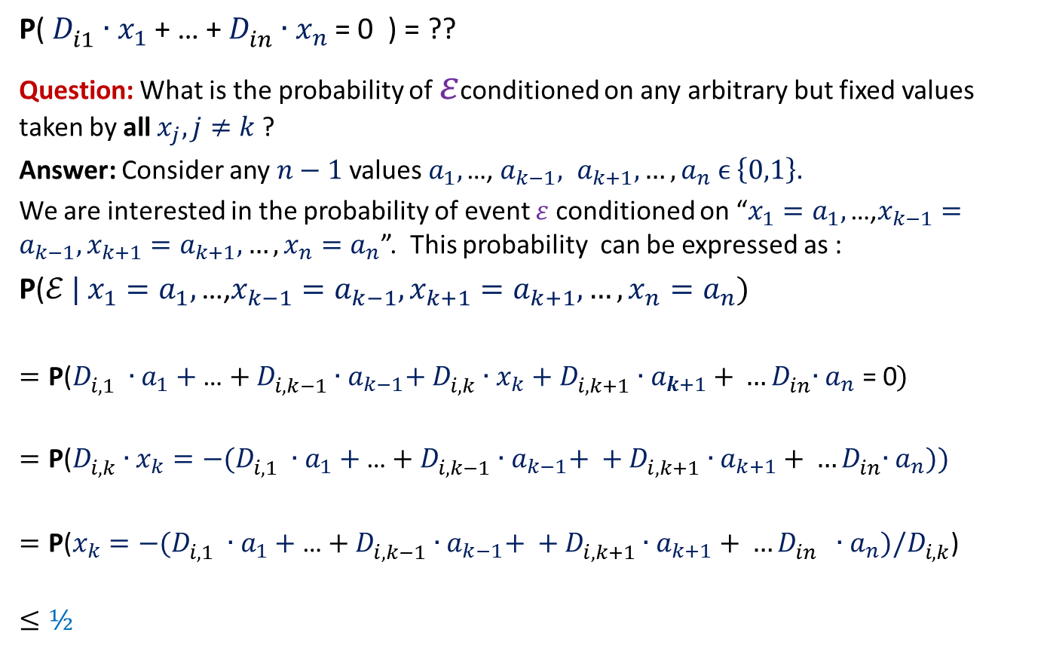

Frievald’s Algorithm
(Analyzing error probability)
$$ε$$
P( $D_{i1}^{}$ $∙x_{1}$ + … + $D_{in}^{}$ $∙x_{n}$ = 0 ) = ??
Question: What is the probability of $ε$conditioned on any arbitrary but fixed values taken by all $x_{j}, j≠k$ ?
Answer: Consider any $n−1$ values $a_{1}, \text{…,} { a}_{k−1}, a_{k+1}, …,a_{n} ϵ \left\{0,1\right\}.$
We are interested in the probability of event $ε$conditioned on “$x_{1}=a_{1}, \text{…,}x_{k−1}=a_{k−1},x_{k+1}=a_{k+1}, …,{x_{n}=a}_{n}$”. This probability can be expressed as :
$\text{P}\text{(}ℰ | x_{1}=a_{1}, \text{…}\text{,}x_{k−1}=a_{k−1},x_{k+1}=a_{k+1}, …,{x_{n}=a}_{n}$)
$=\text{P}\text{(}D_{i,1}^{} ∙a_{1}+\text{…}+D_{i,k−1}^{}∙a_{k−1}\text{+ }D_{i,k}^{}∙x_{k}+D_{i,k+1}^{}∙a_{k+1}{+ …D}_{in}^{}∙a_{n}\text{ = 0}$)
$$=\text{P}\text{(}D_{i,k}^{}∙x_{k}=−(D_{i,1}^{} ∙a_{1}+\text{…}+D_{i,k−1}^{}∙a_{k−1}\text{+ }+D_{i,k+1}^{}∙a_{k+1}{+ …D}_{in}^{}∙a_{n}\text{)}\text{)}$$
$=\text{P}\text{(}x_{k}=−(D_{i,1}^{} ∙a_{1}+\text{…}+D_{i,k−1}^{}∙a_{k−1}\text{+ }+D_{i,k+1}^{}∙a_{k+1}{+ …D}_{in}^{} ∙a_{n}\text{)/}D_{i,k}^{}$)
$$≤½$$
$≤½$
≠0
Could be 0, 1 or some other number

Slide 13
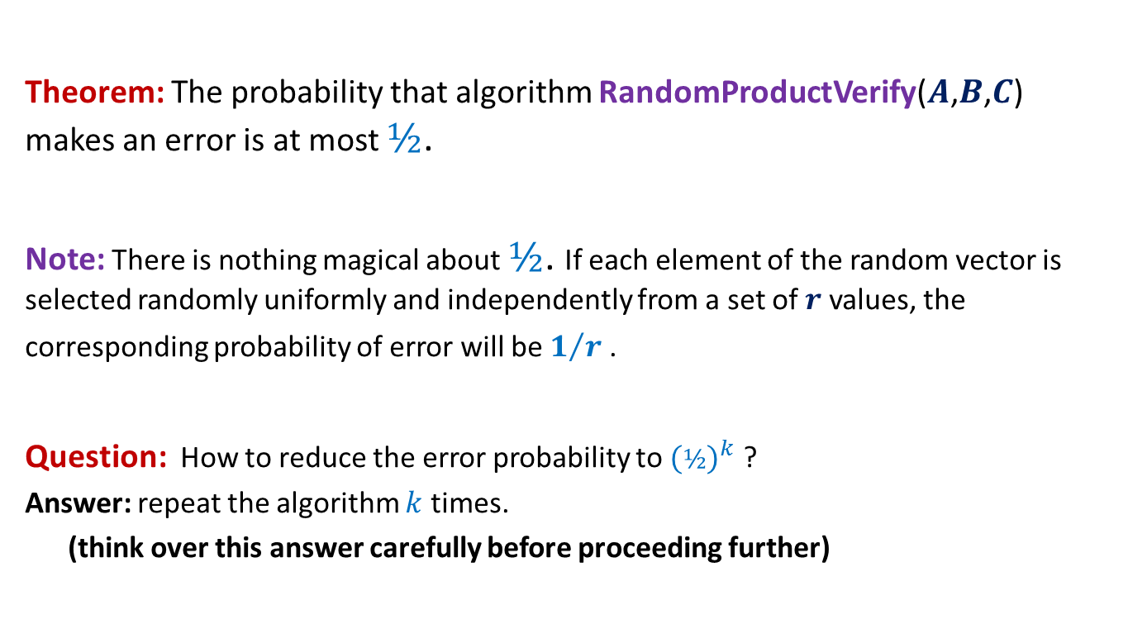
Frievald’s Algorithm
(Analyzing error probability)
Theorem: The probability that algorithm RandomProductVerify($A$,$B$,$C$) makes an error is at most $½$.
Note: There is nothing magical about $½$. If each element of the random vector is selected randomly uniformly and independently from a set of $r$ values, the corresponding probability of error will be $1/r$ .
Question: How to reduce the error probability to ${(½)}^{k}$ ?
Answer: repeat the algorithm $k$ times.
(think over this answer carefully before proceeding further)

Slide 14
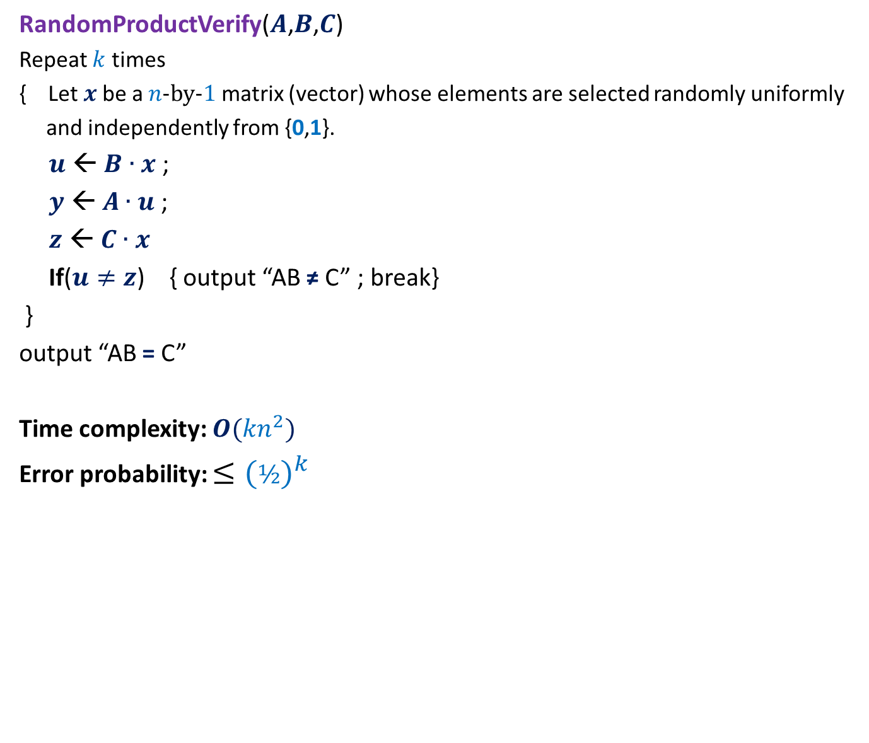
Frievald’s Algorithm
(reducing the error probability)
RandomProductVerify($A$,$B$,$C$)
Repeat $k$ times
{ Let $x$be a $n$-by-$1$matrix (vector) whose elements are selected randomly uniformly
and independently from {0,1}.
$u$ ← $B∙x$ ;
$y$ ← $A∙u$ ;
$z$ ← $C∙x$
If($u≠z$) { output “AB ≠ C” ; break}
}
output “AB = C”
Time complexity: $O({kn}^{2})$
Error probability: $≤{(½)}^{k}$

Slide 15

Frievald’s Algorithm
(final result)
Theorem: Given three $n$-by-$n$matrices $A$, $B$, and $C$, there is a Randomized Monte Carlo algorithm which determines $C≟A⨯B$. The running time is $O(n^{2}log n)$, and the error probability is less than $n^{−2}$.

Slide 16
Fingerprinting
Application
Cryptography

Slide 17
Prime numbers
(some basic facts)

Slide 18
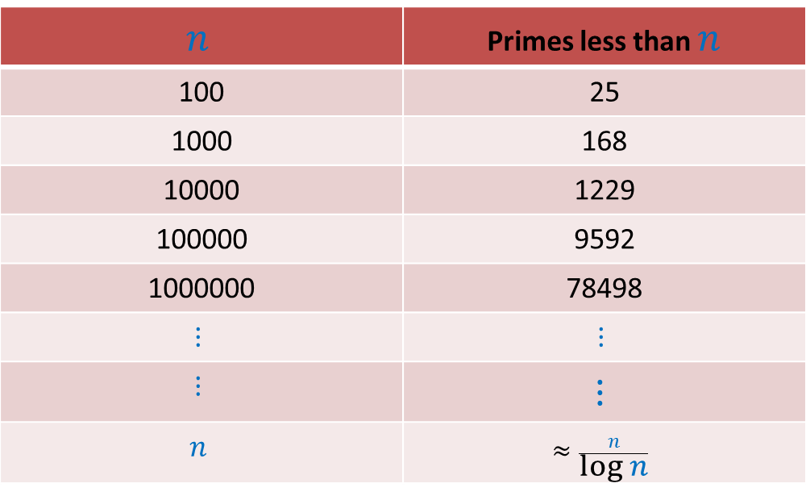

How many primes less than $n$ ?
$$n$$ | Primes less than $n$
100 | 25
1000 | 168
10000 | 1229
100000 | 9592
1000000 | 78498
$$⋮$$ | $$⋮$$
$$⋮$$ | $$⋮$$
$$n$$ | $$≈\frac{n}{\log{n}}$$

Slide 19

How many primes less than $n$ ?
Theorem: The number of primes less than $n$ is $≈$ $\frac{n}{\log{n}}$.
[An elementary proof: Paul Erdӧs, 1949 ]
Notation:
$π\left(n\right):$ the number of primes less than $n$.

Slide 20
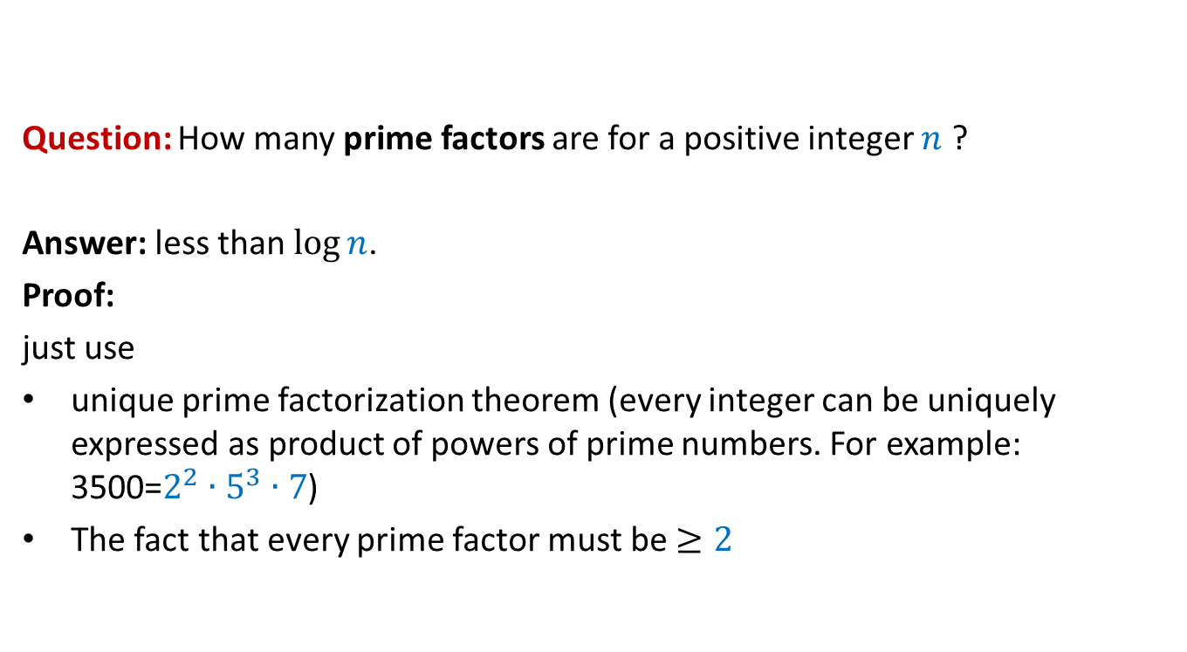

Prime factors of a number $n$?
Question: How many prime factors are for a positive integer $n$ ?
Answer: less than $\log{n}$.
Proof:
just use
unique prime factorization theorem (every integer can be uniquely expressed as product of powers of prime numbers. For example: 3500=$2^{2}∙5^{3}∙7$)
The fact that every prime factor must be $≥2$

Slide 21

Aim: To determine if File A identical to File B by communicating fewest bits ?
File A
File B

Slide 22

Question: What is a File ?
Answer:
A bit string.

Slide 23
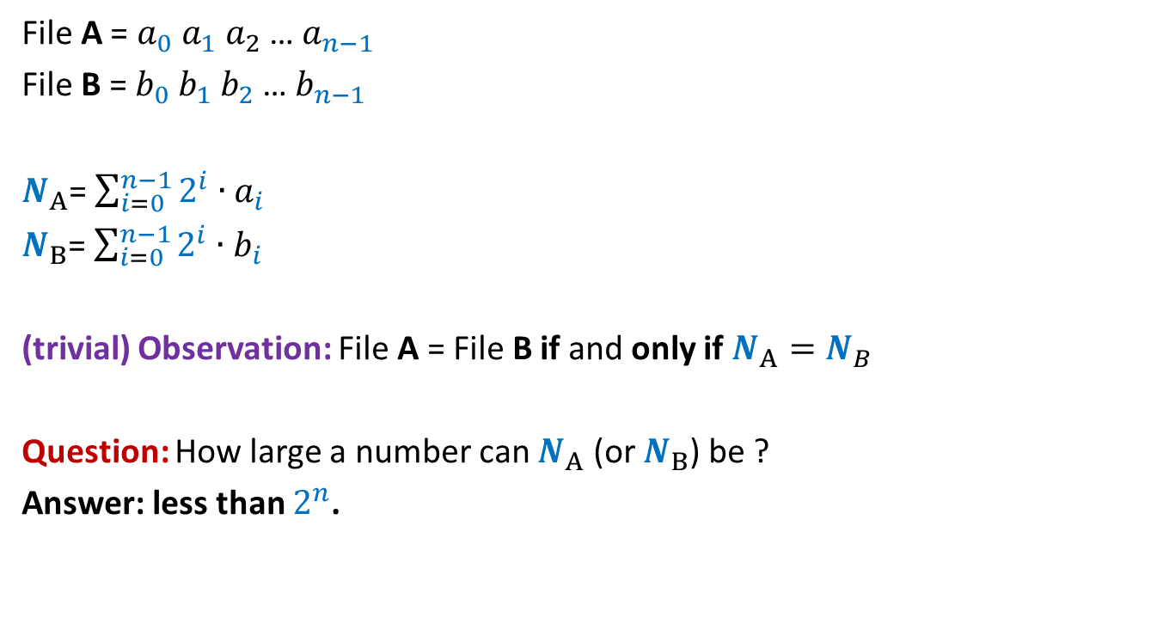
Visualize a file as a binary number
File A = $a_{0} a_{1} a_{2}$… $a_{n−1}$
File B = $b_{0} b_{1} b_{2}$… $b_{n−1}$
$N_{A}$= $\sum_{i=0}^{n−1}{2^{i}∙a_{i}}$
$N_{B}$= $\sum_{i=0}^{n−1}{2^{i}∙b_{i}}$
(trivial) Observation: File A = File B if and only if $N_{A}=N_{B}$
Question: How large a number can $N_{A}$ (or $N_{B}$) be ?
Answer: less than $2^{n}$.

Slide 24
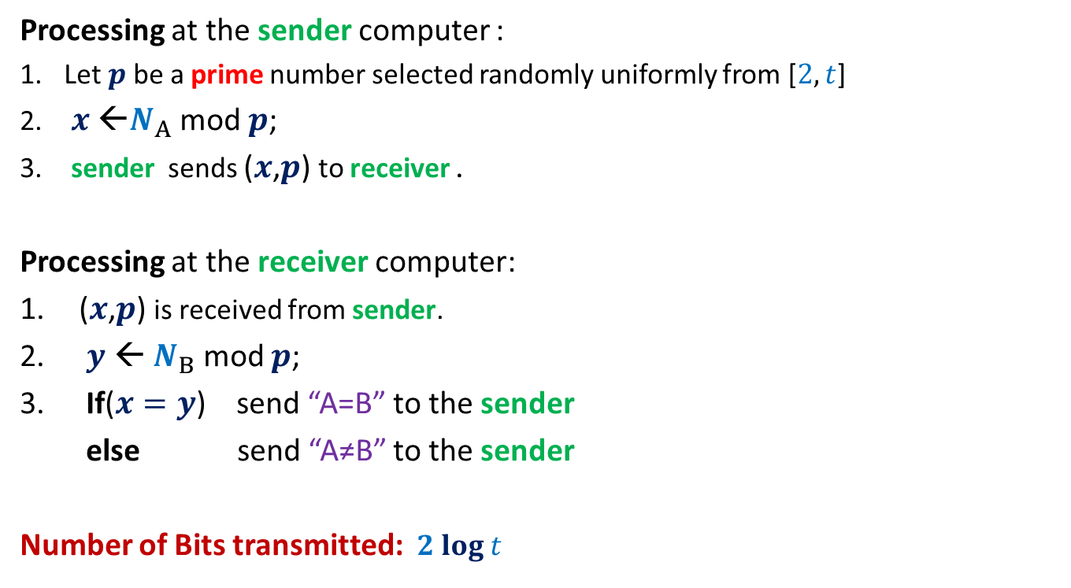

RandomEqualityChecking-Protocol($A$,$B$)
Processing at the sender computer :
Let $p$be a prime number selected randomly uniformly from [$2,t$]
$x$ ←$N_{A}$ mod $p$;
sender sends ($x$,$p$) to receiver .
Processing at the receiver computer:
($x$,$p$) is received from sender.
$y$ ← $N_{B}$ mod $p$;
If($x=y$) send “A=B” to the sender
else send “A≠B” to the sender
Number of Bits transmitted: $2 log t$

Slide 25


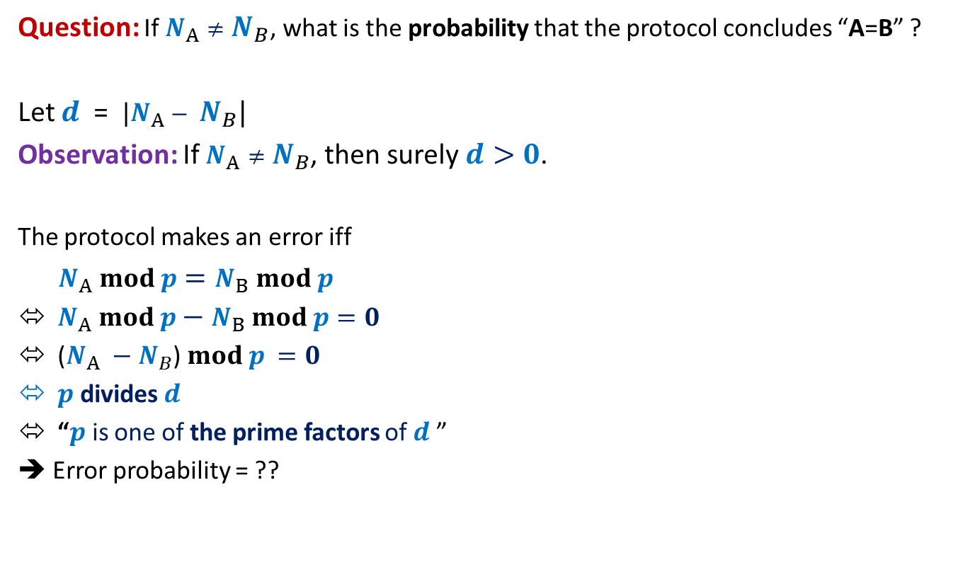

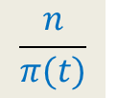

RandomEqualityChecking-Protocol
(bounding the error probability)
Question: If $N_{A}≠N_{B}$, what is the probability that the protocol concludes “A=B” ?
Let $d$ = $|N_{A}− N_{B}|$
Observation: If $N_{A}≠N_{B}$, then surely $d>0$.
The protocol makes an error iff
$N_{A} mod p=N_{B} mod p$
$N_{A} mod p−N_{B} mod p=0$
($N_{A} −N_{B}$) $mod p$ $=0$
$p$divides $d$
“$p$is one of the prime factors of $d$ ”
➔ Error probability = ??
How many prime factors can $d$have ?
How many choices are there for $p$?
at most $n$ since $d$ is less than $2^{n}$.
$π(t )$ since $p$ is a random prime number from $[2,t]$
$$\frac{n}{π(t)}$$

Slide 26
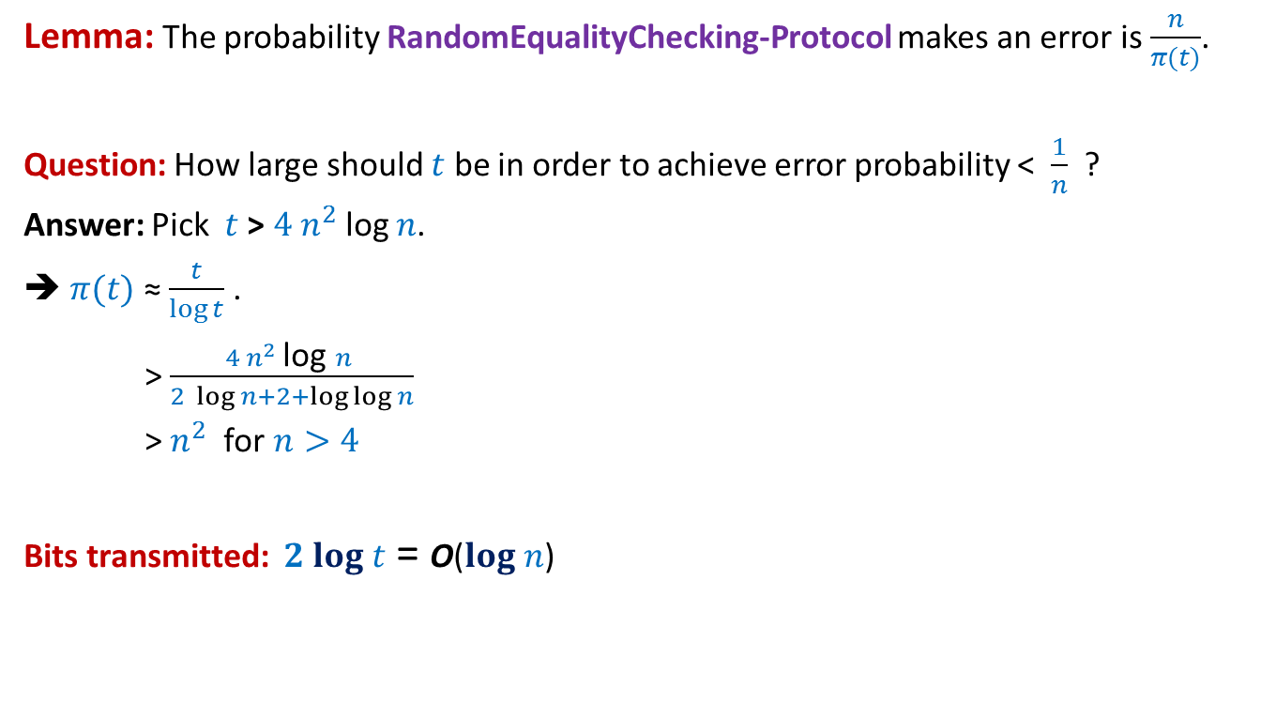
RandomEqualityChecking-Protocol
(bounding the error probability)
Lemma: The probability RandomEqualityChecking-Protocol makes an error is $\frac{n}{π(t)}$.
Question: How large should $t$ be in order to achieve error probability < $\frac{1}{n}$ ?
Answer: Pick $t$ > $4 n^{2}$log $n$.
➔ $π(t)$ ≈ $\frac{t}{\log{t}}$ .
> $\frac{4 n^{2} \text{log} n }{2 \log{n}+2+\log{\log{n}}}$
> $n^{2}$ for $n>4$
Bits transmitted: $2 log t$ = O($log n$)

Slide 27
Please go through the slides of this lecture carefully and patiently. You are welcome to discuss any doubt in the next class (Saturday, 17th August)

