Slide 1
Randomized Algorithms CS648
Lecture 25
Derandomization using conditional expectation
A probability gem

Slide 2
Derandomization using conditional expectation

Slide 3
Problem 1: Large cut in a graph
Problem: Let $G=(V,E)$ be an undirected graph on $n$vertices and $m$ edges. Compute a cut of size at least $m/2$.
A randomized algorithm:
$A$←∅; $B$←∅;
For each vertex $v∈V$
Add $v$ to $A$or $B$ randomly with probability $\frac{1}{2}$ independent of other vertices
return the cut defined by $(A,B)$.
$Z$: size of cut ($A,B$) returned by the randomized algorithm.
E[$Z$] = $m/2$
Question: How to deterministically compute a cut of size $≥m/2$ in $O$($m$) time?
A simple application of conditional expectation ☺

Slide 4
Problem 2: Approximate Distance Oracles
Problem: Let $G=(V,E)$ be an undirected graph on $n$vertices and $m$ edges. Compute a 3-approximate distance oracle of size $O(n^{1+1/2})$.
A randomized algorithm:
$A$←∅;
Add each vertex from $V$to $A$randomly independently with probability $p=\frac{1}{√n}$.
for each $u∈V\backslash A$, compute Ball($u, V$, $A$)
for each $u∈A$, compute distance to all vertices.
$Z$: $\sum_{u∈V\backslash A}{|\text{Ball}\text{(}u, V\text{,} A\text{) }|}$ returned by the randomized algorithm.
E[$Z$] = $n^{1+1/2}$
Question: How to deterministically compute a 3-approximate distance oracle of size O($n^{1+1/2}$) ?
A non-trivial application of conditional expectation (published in ICALP 2005)

Slide 5
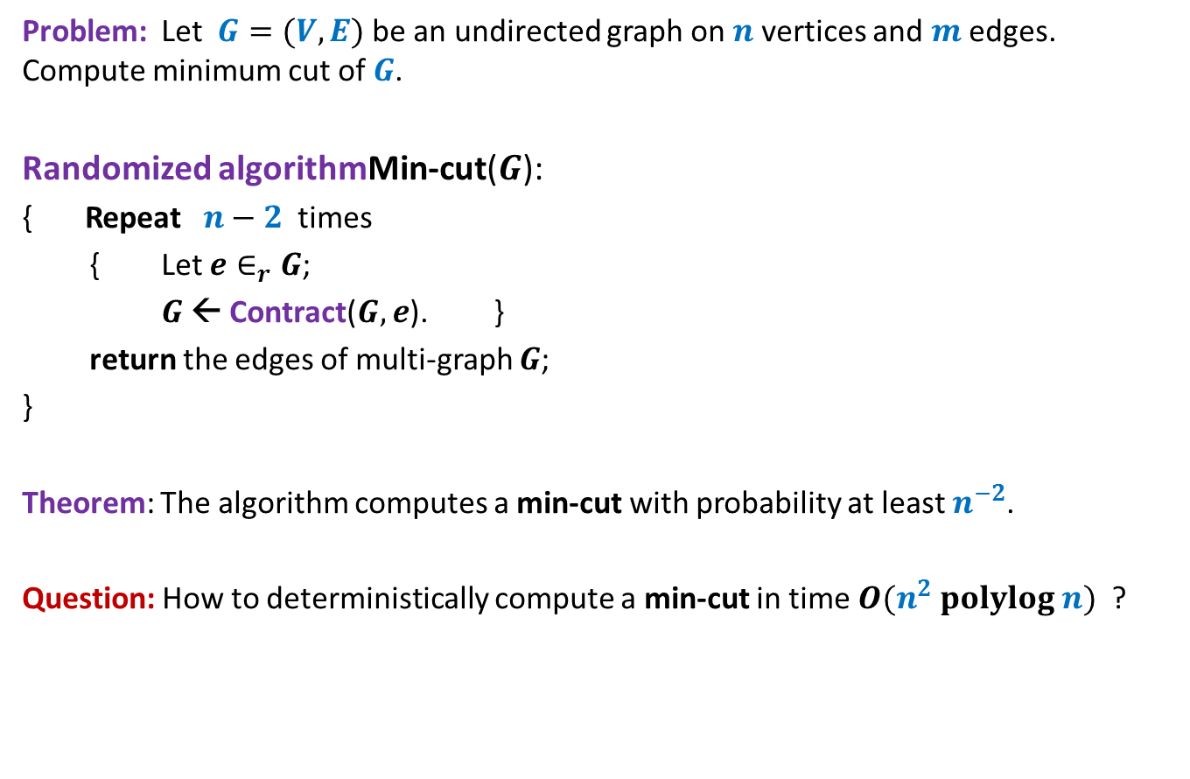
Problem 3: Min-Cut
Problem: Let $G=(V,E)$be an undirected graph on $n$vertices and $m$ edges. Compute minimum cut of $G$.
Randomized algorithmMin-cut($G$):
{ Repeat $n−2$ times
{ Let $e∈_{r}G$;
$G$ ← Contract($G,e$). }
return the edges of multi-graph $G$;
}
Theorem: The algorithm computes a min-cut with probability at least $n^{−2}$.
Question: How to deterministically compute a min-cut in time $O(n^{2} polylog n)$ ?
No idea whether we can use conditional expectation ?☹

Slide 6
Large cut in a graph
A randomized algorithm:
$A$←∅; $B$←∅;
For each vertex $v∈V$
Add $v$ to $A$or $B$ randomly with probability $\frac{1}{2}$ independent of other vertices
return the cut defined by $(A,B)$.
$$v_{1} v_{2} v_{3} … { v}_{i} v_{i+1} v_{n}$$

Slide 7
Notations:
For a given graph $G=(V,E)$, $U,W⊆V$ and $v∈V$,
$E(v)$:
set of all edges from $E$ that have $v$ as one of the endpoint.
$E(U)$:
set of all edges from $E$ that have at least one end point in $U$.
$E(U,W)$:
set of all edges from $E$ with one endpoint in $U$ and another in $W$.
$$E(U,W)\text{=}E∩(U⨯W)$$
$E(v,U)$:
set of all edges from $E$ with one endpoint $v$and another endpoint in $U$.
$$E(v,U)\text{=}E∩(v⨯U)$$

Slide 8
Notations:
$Z$ : random variable denoting the number of edges in a cut output by the algorithm.
$x_{i}$: random variable taking value 1 if $v_{i}∈A$ and 0 otherwise
$X_{i}$: {$x_{1}$, $x_{2}$, …, $x_{i}$}
$C_{i}$: {$c_{1}$, $c_{2}$, …, $c_{i}$} where $c_{j}∈\{0,1\}$ for $1≤j≤i$.
$X_{i}=C_{i}$ means $x_{1}=c_{1}\text{,}…,$ ${x_{i}=c}_{i}$.

Slide 9
conditional expectation
Make sure you understand “Conditional expectation” before using it.
So try to focus on the following slide.

Slide 10
$E\left[Z | X_{i}=C_{i}\right]=?$
$$V_{i}$$
$$v_{1} v_{2} v_{3} … { v}_{i} v_{i+1} v_{n}$$
$$A$$
$$B$$

Slide 11
$E\left[Z | X_{i}=C_{i}\right]=?$
$$V_{i}$$
|$E(V_{i}^{A},V_{i}^{B})$| +
$\text{|}E({V\backslash V}_{i})$|$/2$
$$v_{1} v_{2} v_{3} … { v}_{i} v_{i+1} v_{n}$$
$$V_{i}^{A}$$
$$V_{i}^{B}$$
…
…
$$A$$
$$B$$

Slide 12
Derandomization using conditional expectation

Slide 13
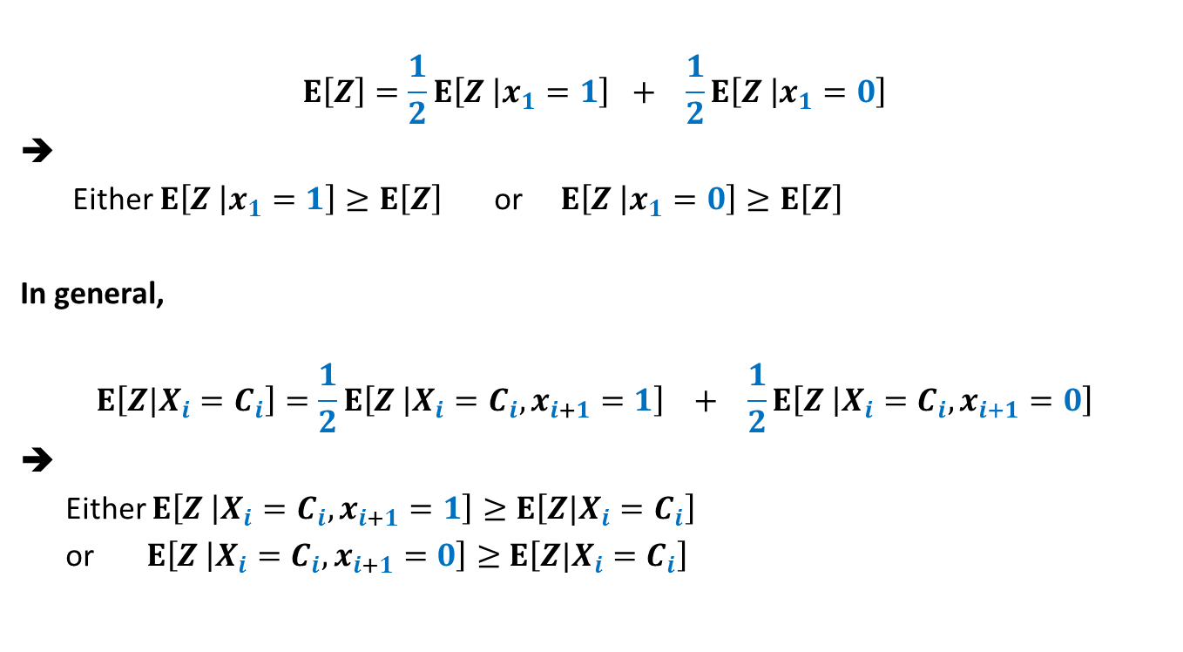
Role of conditional expectation
$$E\left[Z\right]=\frac{1}{2}E\left[Z | x_{1}=1\right] + \frac{1}{2}E\left[Z | x_{1}=0\right]$$
Either $E\left[Z | x_{1}=1\right]≥E\left[Z\right]$ or $E\left[Z | x_{1}=0\right]≥E\left[Z\right]$
In general,
$$E\left[Z|X_{i}=C_{i}\right]=\frac{1}{2}E\left[Z | X_{i}=C_{i}, x_{i+1}=1\right] + \frac{1}{2}E\left[Z | X_{i}=C_{i}, x_{i+1}=0\right]$$
➔
Either $E\left[Z | X_{i}=C_{i}, x_{i+1}=1\right]≥E\left[Z|X_{i}=C_{i}\right]$
or $E\left[Z | X_{i}=C_{i}, x_{i+1}=0\right]≥$ $E\left[Z|X_{i}=C_{i}\right]$

Slide 14
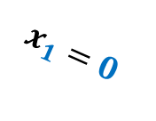
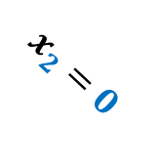
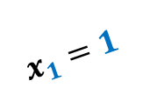
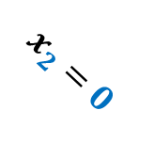
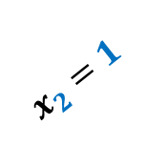
The Binary tree associated with the Randomized algorithm
$$E\left[Z\right]$$
$$x_{1}=1$$
$$x_{1}=0$$
$$E\left[Z | x_{1}=1\right]$$
$$E\left[Z | x_{1}=0\right]$$
$$x_{2}=1$$
$$x_{2}=0$$
$$x_{2}=1$$
$$x_{2}=0$$
$$E\left[Z | x_{2}=1,x_{1}=1\right]$$
$$n$$
…
A cut of value $≥m/2$

Slide 15
Using Conditional expectation
$$\frac{m}{2}=E\left[Z\right]$$
We wish to make choices for $x_{j}$’s such that
$E\left[Z\right] ≤E\left[Z | x_{1}=c_{1}\right]$
$$≤E\left[Z | x_{2}=c_{2},x_{1}=c_{1}\right]$$
$≤E\left[Z|X_{n}=C_{n}\right]$
IDEA:
Given that $E\left[Z|X_{i}=C_{i}\right]$ $≥\frac{m}{2}$, choose $x_{i+1}$ such that
$$E\left[Z|X_{i+1}=C_{i+1}\right]≥E\left[Z|X_{i}=C_{i}\right]$$
…

Slide 16
$E\left[Z | X_{i}=C_{i}\right]≥\frac{m}{2}$

Slide 17
$E\left[Z | X_{i}=C_{i}\right]≥\frac{m}{2}$
$$V_{i}$$
$E\left[Z | X_{i}=C_{i}\right]$=
|$E(V_{i}^{A},V_{i}^{B})$| +
$\text{|}E({V\backslash V}_{i})$|$/2$
$$v_{1} v_{2} v_{3} … { v}_{i} v_{i+1} v_{n}$$
$$V_{i}^{A}$$
$$V_{i}^{B}$$
…
…
$$A$$
$$B$$

Slide 18
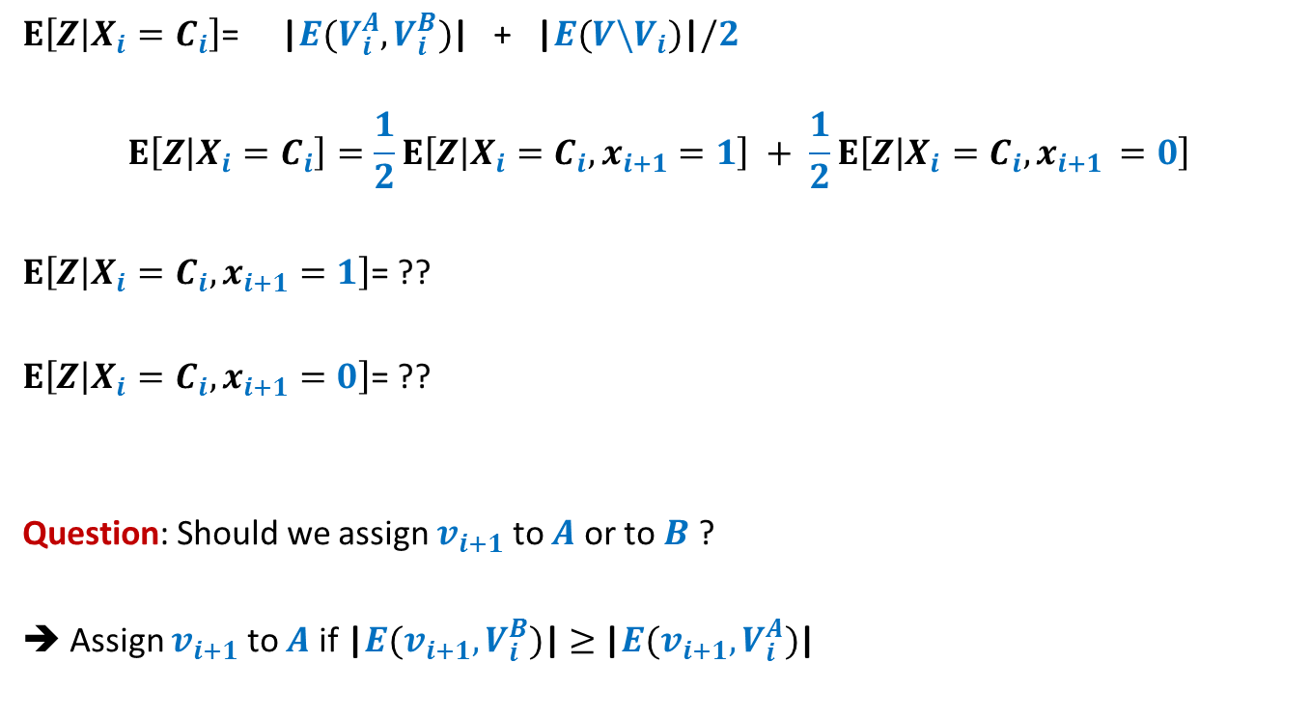
$E\left[Z | X_{i}=C_{i}\right]≥\frac{m}{2}$
$E\left[Z | X_{i}=C_{i}\right]$= |$E(V_{i}^{A},V_{i}^{B})$| + $\text{|}E({V\backslash V}_{i})$|$/2$
$$E\left[Z | X_{i}=C_{i}\right]=\frac{1}{2}E\left[Z | X_{i}=C_{i},x_{i+1}=1\right] + \frac{1}{2}E\left[Z | X_{i}=C_{i},x_{i+1 }=0\right]$$
$E\left[Z | X_{i}=C_{i},x_{i+1}=1\right]$= ??
$E\left[Z | X_{i}=C_{i},x_{i+1}=0\right]$= ??
Question: Should we assign $v_{i+1}$ to $A$ or to $B$ ?
➔ Assign $v_{i+1}$ to $A$ if |$E(v_{i+1},V_{i}^{B})$|$≥$ |$E(v_{i+1},V_{i}^{A})$|
|$E(V_{i}^{A},V_{i}^{B})$| + |$E(v_{i+1},V_{i}^{B})$| + $\text{|}E({V\backslash V}_{i+1})$|$/2$
|$E(V_{i}^{A},V_{i}^{B})$| + |$E(v_{i+1},V_{i}^{A})$| + $\text{|}E({V\backslash V}_{i+1})$|$/2$

Slide 19
Making Choice for $v_{i+1}$
$$V_{i}$$
$$v_{1} v_{2} v_{3} … { v}_{i} v_{i+1} v_{n}$$
$$V_{i}^{A}$$
$$V_{i}^{B}$$
…
…
$$v_{i+1}$$
$$v_{i+1}$$
$$A$$
$$B$$

Slide 20
Deterministic algorithm for Large cut
Input: $G$ = ($V,E$)
$A$←∅; $B$←∅;
For each vertex $v∈V$
{ if |$E(v,B)$|> |$E(v,A)$|
Add $v$ to $A$;
else
Add $v$ to $B$;
}
return the cut defined by $(A,B)$.
Time Complexity: O($m$).
Theorem: There is a deterministic O($m$) time algorithm to compute a cut of size at least $m/2$ in any given undirected graph.
This was a simple example of using conditional expectation to derandomize a randomized algorithm. But it conveys the crux of this powerful method. In order to use it to derandomize any other algorithm, all you might need is creative and analytical skills.
Also remember, we can not hope to derandomized every randomized algorithm. But if it is possible to derandomize and algorithm, conditional expectation may prove to be a useful tool.

Slide 21
An interesting PRoblem

Slide 22
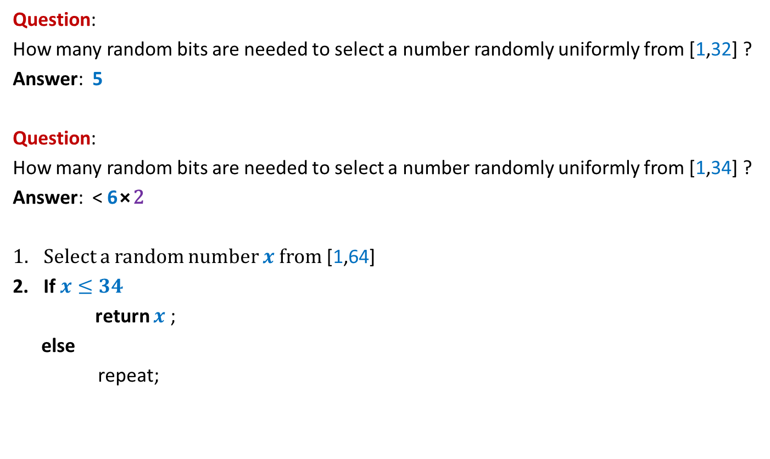
Selecting a random number
Question:
How many random bits are needed to select a number randomly uniformly from [1,32] ?
Answer: 5
Question:
How many random bits are needed to select a number randomly uniformly from [1,34] ?
Answer: < 6⨯2
Select a random number $x$from [1,64]
If $x≤34$
return $x$ ;
else
repeat;

Slide 23
Selecting a random interval
Question: There are $n−1$ rational numbers ${0<a}_{1}<a_{2}< …<a_{n−1}<1$.
➔ $n$ intervals {(${0,a}_{1}$), (${a_{1},a}_{2}$),…,($a_{n−1}<1$)}
How to select an interval randomly with probability proportional to their length?
Example: $n=4$
$a_{1}=\frac{3}{1000000}$ , $a_{2}=\frac{117}{1000000}$, $a_{3}=\frac{351706}{1000000}$,
Answer:
Select a random number $x$from [${1,2}^{20}$]
If $x≤1000000$
{ if $x≤a_{1}$, return I;
if $x≤a_{2}$, return II;
if $x≤a_{3}$, return III;
else return IV;
}
else repeat;

Slide 24
Selecting a random interval
There are $n−1$ rational numbers ${0<a}_{1}<a_{2}< …<a_{n−1}<1$, with common denominator $m$.
➔ $n$ intervals {(${0,a}_{1}$), (${a_{1},a}_{2}$),…,($a_{n−1}<1$)}
Example : $n=10$, $m=10^{21}$.
Question:
How many random bits are needed for selecting an interval randomly with probability proportional to their length?
Answer: $O\left(log m\right)$
Surprise: In fact we just need $O\left(log n\right)$ bits only.

Slide 25
Solution for 2 Intervals

Slide 26
$$a_{1}=\frac{5}{32}$$
0
1
0
1
0
1
$$5$$
1
0
0
1
0
0
1
1
0
0
0
1
……….
0
1
0
1
1
0 1 2 3 4 5 6 7 8 9 10 … 30 31

Slide 27
$$a_{1}=\frac{5}{32}$$
0
1
0
1
0
1
$$5$$
1
0
0
1
0
0
1
1
0
0
0
1
……….
0
1
0
1
1
0 1 2 3 4 5 6 7 8 9 10 … 30 31

Slide 28
$$a_{1}=\frac{5}{32}$$
0
1
$$\frac{1}{2}$$
0
1
$$\frac{1}{4}$$
$$5$$
0
1
$$\frac{1}{8}$$
Show that expected number of random
bits needed to select an interval is $\frac{31}{16}$
$$\frac{1}{16}$$
$$\frac{1}{32}$$
$$\frac{1}{32}$$
0 1 2 3 4 5 6 7 8 9 10 … 30 31

Slide 29
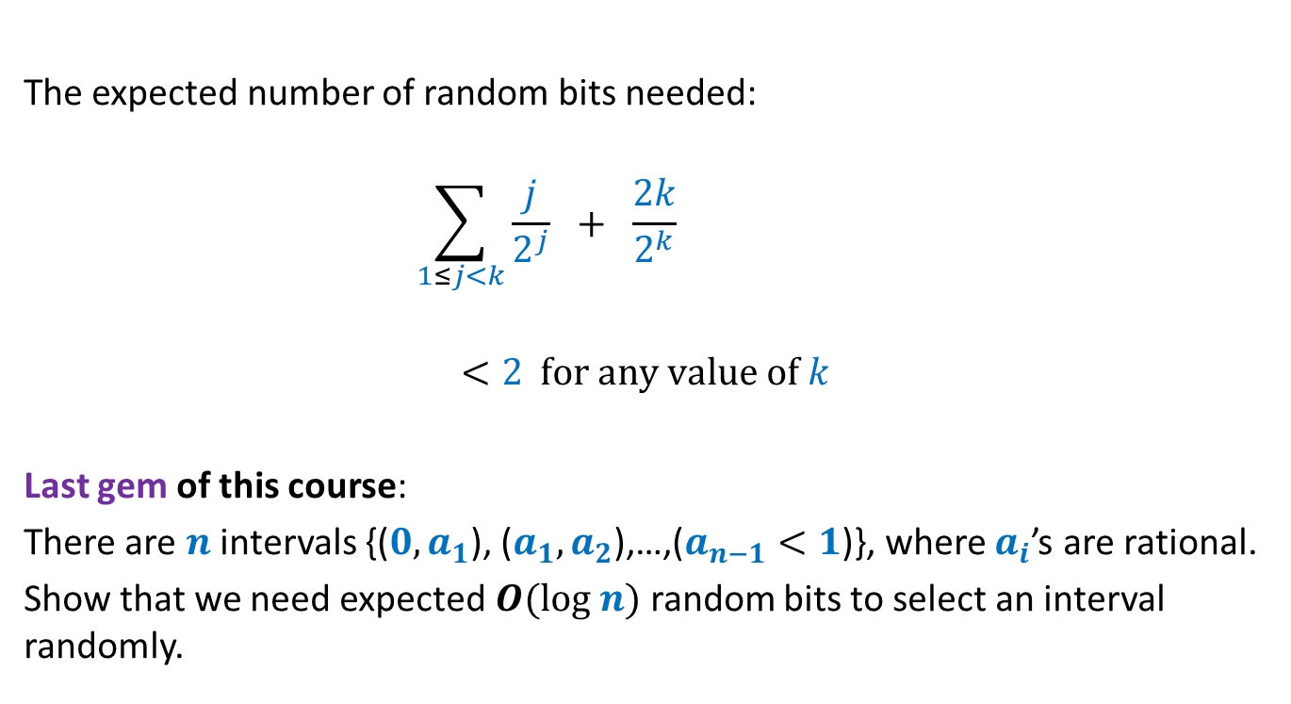
For any $a_{1}=\frac{t}{2^{k}}$
The expected number of random bits needed:
$$\sum_{1≤j<k}{\frac{j}{2^{j}}} + \frac{2k}{2^{k}}$$
$$<2 for any value of k$$
Last gem of this course:
There are $n$ intervals {(${0,a}_{1}$), (${a_{1},a}_{2}$),…,($a_{n−1}<1$)}, where $a_{i}$’s are rational.
Show that we need expected $O(log n)$ random bits to select an interval randomly.

Slide 30
Last slide
Question: Why did the instructor conclude the course with a probability gem ?
Answer: It is the joy of pondering over a probabilistic or algorithmic puzzle that is the strongest driving force to teach this course.
Perhaps the same is the driving force for you to study this course.
You disagree!
You will realize this fact after a few years down the line…
Thanks for the attention you paid to this course☺

