Slide 1
Randomized Algorithms
CS648
Lecture 24
Random bit complexity
Derandomization

Slide 2
Random bit complexity
Definition : The total number of random bits taken from the Random Bit Generator by the algorithm is called its Random bit complexity.
Input
A Randomized Algorithm
(for Min-Cut, QuickSort, RIC,…)
Random Bit generator

Slide 3
Recall the notion of independence

Slide 4

Types of independences
Definition: $ε_{1},…,ε_{n}$ are said to be mutually independent if
$P\left(\bigcap_{i}{ε_{i}}\right)=\prod_{i}{P(ε_{i})}$
Definition: $ε_{1},…,ε_{n}$ are said to be pairwise independent if
for every $1≤i<j≤n$
$P\left(ε_{i}∩ε_{j}\right)=P(ε_{i})$∙ $P(ε_{j})$

Slide 5
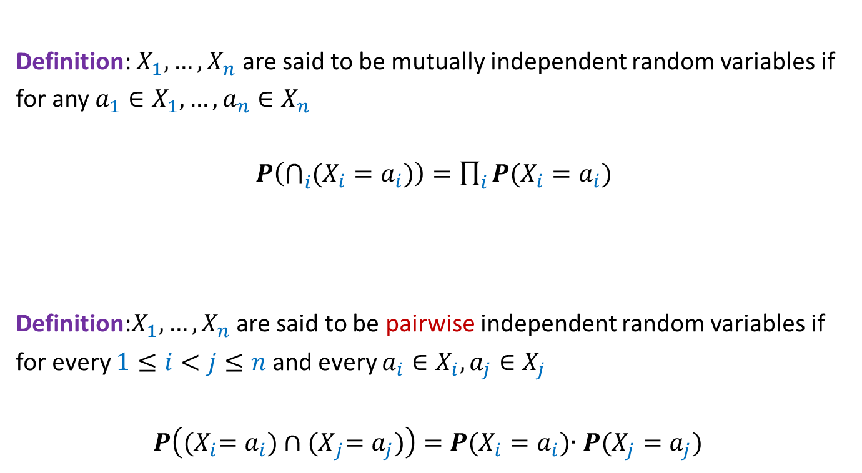
Types of independences
Definition: $X_{1},…,X_{n}$ are said to be mutually independent random variables if
for any $a_{1}∈X_{1},…,a_{n}∈X_{n}$
$P\left(\bigcap_{i}{(X_{i}=a_{i})}\right)=\prod_{i}{P(X_{i}=a_{i})}$
Definition:$X_{1},…,X_{n}$ are said to be pairwise independent random variables if
for every $1≤i<j≤n$ and every $a_{i}∈X_{i},a_{j}∈X_{j}$
$P\left({(X}_{i}=a_{i})∩{(X}_{j}=a_{j})\right)=P(X_{i}=a_{i})$∙ $P(X_{j}=a_{j})$

Slide 6
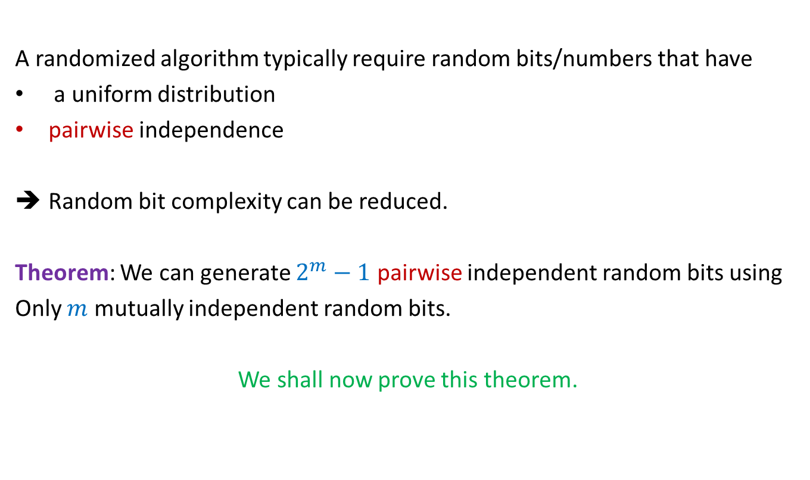
Important facts
A randomized algorithm typically require random bits/numbers that have
a uniform distribution
pairwise independence
Random bit complexity can be reduced.
Theorem: We can generate $2^{m}−1$ pairwise independent random bits using
Only $m$ mutually independent random bits.
We shall now prove this theorem.

Slide 7
Generating
Uniformly Random and pairwise independent Bits
using few truly random bits

Slide 8

















Generating
Uniformly Random and pairwise independent Bits
Let $X_{0},…,X_{m−1}$ be $m$ mutually independent random bits.
Aim: To generate $2^{m}−1$ pairwise independent random bits $\{Y_{i}\}$
Key idea: Generate all non-empty subsets of {$X_{0},…,X_{m−1}$}
Ex:$m=3$
Why the XOR operation $⊕$ ? You should get its answer yourself after a few slides…
2 1 0
0 | 0 | 0
0 | 0 | 1
0 | 1 | 0
0 | 1 | 1
1 | 0 | 0
1 | 0 | 1
1 | 1 | 0
1 | 1 | 1
{ $X_{0}$ }
$$Y_{1}$$
$$Y_{2}$$
$$Y_{3}$$
$$Y_{4}$$
$$Y_{5}$$
$$Y_{6}$$
$$Y_{7}$$
$$X_{0}$$
{ $X_{1}$ }
$$X_{1}$$
{ ${X_{1},X}_{0}$ }
$$X_{1}⊕X_{0}$$
{ $X_{2}$ }
$$X_{2}$$
{ $X_{2}$, $X_{0}$ }
$$X_{2}⊕X_{0}$$
{ $X_{2}$, $X_{1}$ }
$$X_{2}⊕X_{1}$$
{ $X_{2}$, $X_{1}$, $X_{0}$ }
$$X_{2}⊕X_{1}⊕X_{0}$$

Slide 9
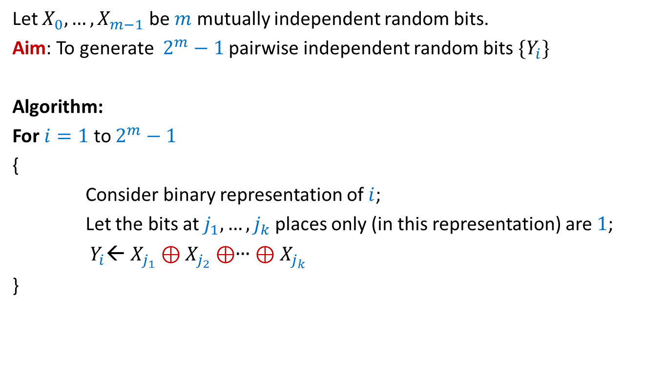
Generating
Uniformly Random and pairwise independent Bits
Let $X_{0},…,X_{m−1}$ be $m$ mutually independent random bits.
Aim: To generate $2^{m}−1$ pairwise independent random bits $\{Y_{i}\}$
Algorithm:
For $i=1$ to $2^{m}−1$
{
Consider binary representation of $i$;
Let the bits at $j_{1},…,j_{k}$ places only (in this representation) are $1$;
$Y_{i}$← $X_{j_{1}}⊕X_{j_{2}}⊕$∙∙∙ $⊕X_{j_{k}}$
}

Slide 10
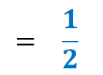
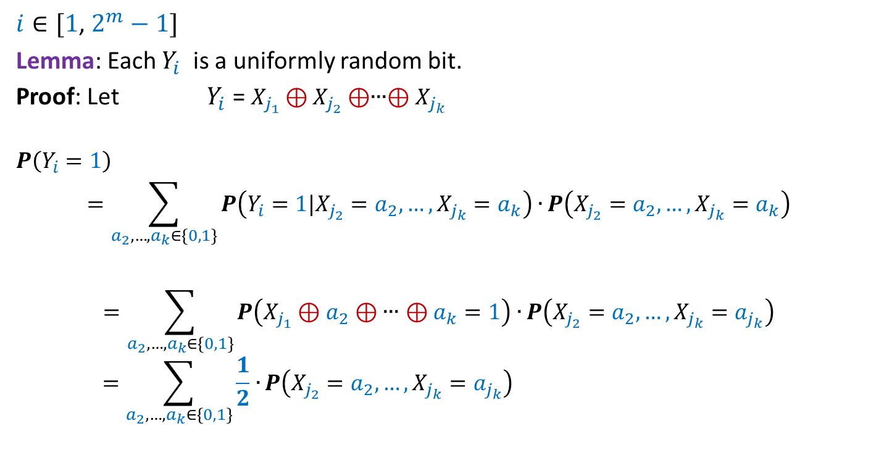
Generating
Uniformly Random and pairwise independent Bits
$i∈[1$, $2^{m}−1]$
Lemma: Each $Y_{i}$ is a uniformly random bit.
Proof: Let $Y_{i}$ = $X_{j_{1}}⊕X_{j_{2}}⊕$∙∙∙$⊕X_{j_{k}}$
$$P\left(Y_{i}=1\right)$$
$$=\sum_{a_{2},…,a_{k}∈\{0,1\}}{P\left(Y_{i}=1|X_{j_{2}}=a_{2},…,X_{j_{k}}=a_{k}\right)∙}P\left(X_{j_{2}}=a_{2},…,X_{j_{k}}=a_{k}\right)$$
$$=\sum_{a_{2},…,a_{k}∈\{0,1\}}{P\left(X_{j_{1}}⊕a_{2}⊕\text{∙∙∙}⊕a_{k}=1\right)∙}P\left(X_{j_{2}}=a_{2},…,X_{j_{k}}=a_{j_{k}}\right)$$
$$=\sum_{a_{2},…,a_{k}∈\{0,1\}}{\frac{1}{2}∙}P\left(X_{j_{2}}=a_{2},…,X_{j_{k}}=a_{j_{k}}\right)$$
$$= \frac{1}{2}$$

Slide 11

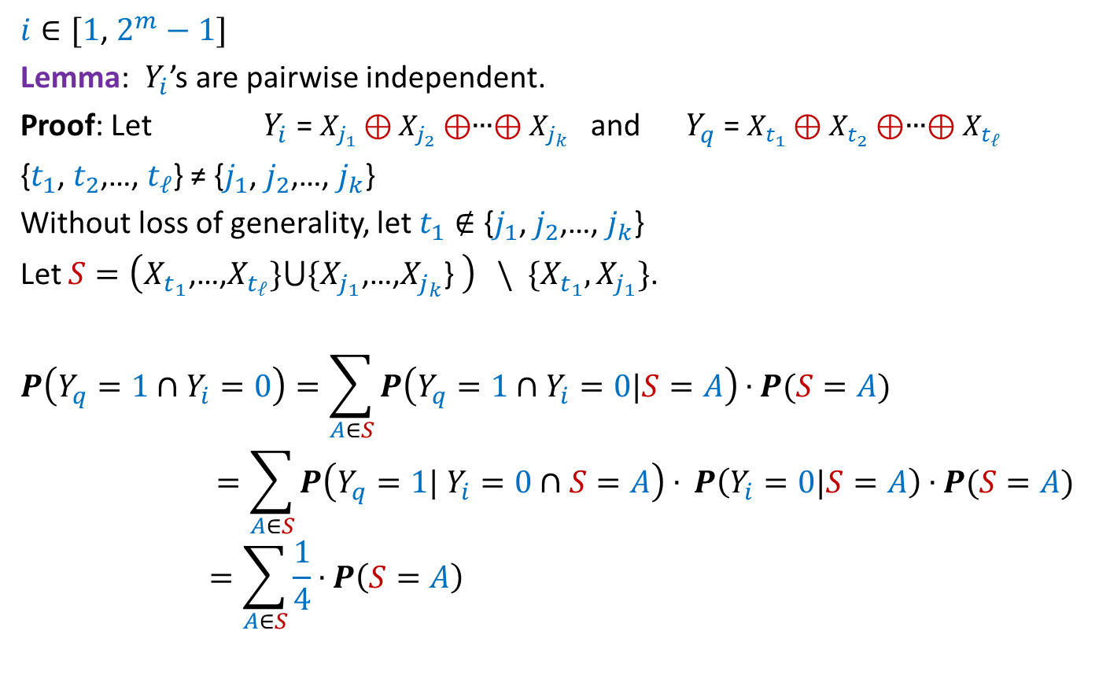
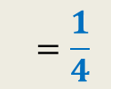

Generating
Uniformly Random and pairwise independent Bits
$i∈[1$, $2^{m}−1]$
Lemma: $Y_{i}$’s are pairwise independent.
Proof: Let $Y_{i}$ = $X_{j_{1}}⊕X_{j_{2}}⊕$∙∙∙$⊕X_{j_{k}}$ and $Y_{q}$ = $X_{t_{1}}⊕X_{t_{2}}⊕$∙∙∙$⊕X_{t_{ℓ}}$
{$t_{1}$, $t_{2}$,…, $t_{ℓ}$} ≠ {$j_{1}$, $j_{2}$,…, $j_{k}$}
Without loss of generality, let $t_{1}∉$ {$j_{1}$, $j_{2}$,…, $j_{k}$}
Let $S=\left(X_{t_{1}}\text{,…,}X_{t_{ℓ}}\}⋃\{X_{j_{1}}\text{,…,}X_{j_{k}}\text{\} }\right) \backslash \{X_{t_{1}},X_{j_{1}}\}$.
$$P\left(Y_{q}=1∩Y_{i}=0\right)=\sum_{A∈S}{P\left(Y_{q}=1∩Y_{i}=0|S=A\right)}∙P(S=A)$$
$$=\sum_{A∈S}{P\left(Y_{q}=1| Y_{i}=0∩S=A\right)}∙ P\left(Y_{i}=0|S=A\right)∙P(S=A)$$
$$=\sum_{A∈S}{\frac{1}{4}}∙P\left(S=A\right)$$
$$\frac{1}{2}$$
$$\frac{1}{2}$$
$$=\frac{1}{4}$$

Slide 12
derandomization
transforming a randomized algorithm into a deterministic algorithm

Slide 13

Large cut in a graph
Theorem: (We proved in Lecture 20)
Let $G$be an undirected graph on $n$vertices and $m$ edges. There exists a cut of size at least $m/2$.

Slide 14
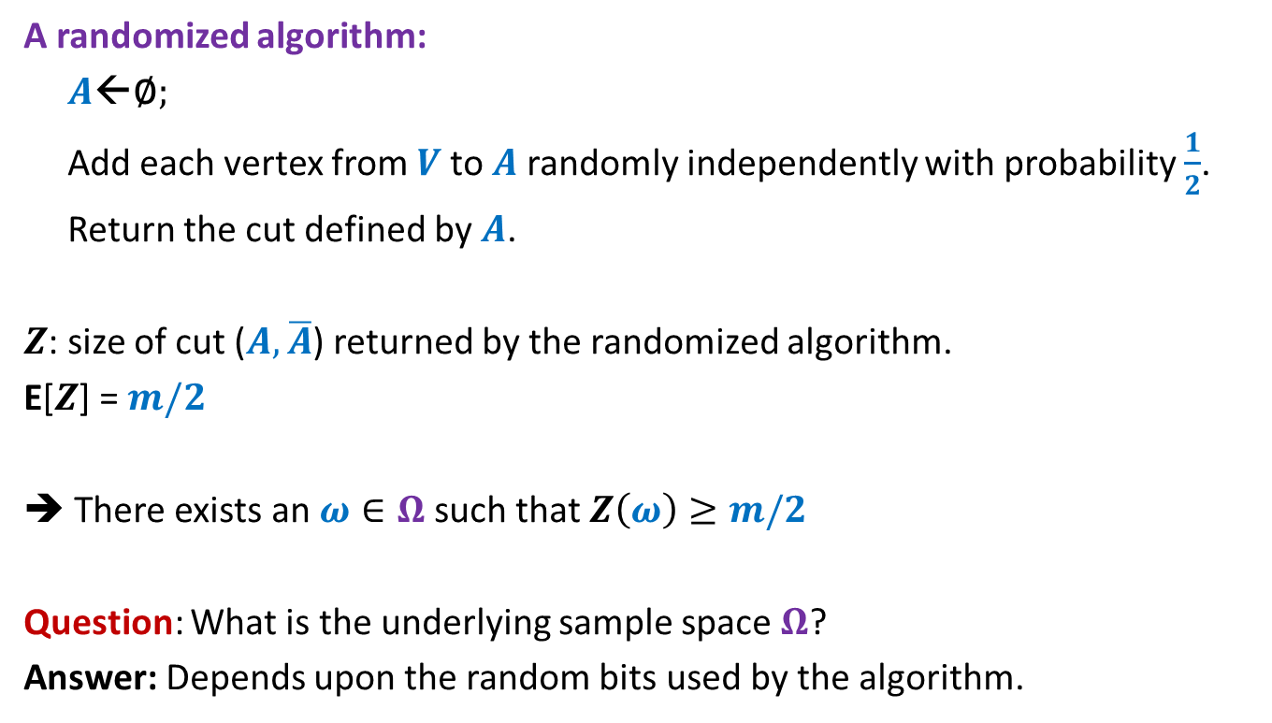
Large cut in a graph
A randomized algorithm:
$A$←∅;
Add each vertex from $V$to $A$randomly independently with probability $\frac{1}{2}$.
Return the cut defined by $A$.
$Z$: size of cut ($A,\overline{A}$) returned by the randomized algorithm.
E[$Z$] = $m/2$
➔ There exists an $ω∈Ω$ such that $Z\left(ω\right)≥m/2$
Question: What is the underlying sample space $Ω$?
Answer: Depends upon the random bits used by the algorithm.

Slide 15
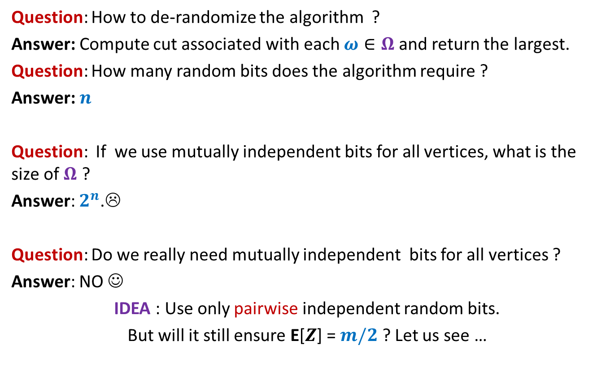
Large cut in a graph
Question: How to de-randomize the algorithm ?
Answer: Compute cut associated with each $ω∈Ω$ and return the largest.
Question: How many random bits does the algorithm require ?
Answer: $n$
Question: If we use mutually independent bits for all vertices, what is the size of $Ω$ ?
Answer: $2^{n}$.☹
Question: Do we really need mutually independent bits for all vertices ?
Answer: NO ☺
IDEA : Use only pairwise independent random bits.
But will it still ensure E[$Z$] = $m/2$ ? Let us see …

Slide 16

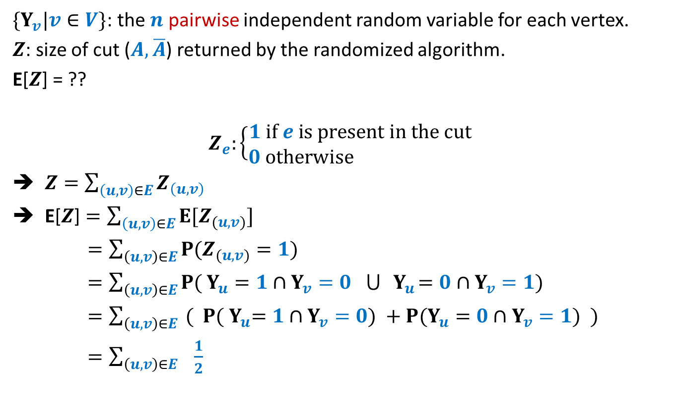


Large cut in a graph
$\{Y_{v}|v∈V\}$: the $n$ pairwise independent random variable for each vertex.
$Z$: size of cut ($A,\overline{A}$) returned by the randomized algorithm.
E[$Z$] = ??
$$Z_{e}:\left\{\begin{aligned}1 if e is present in the cut \\ 0 otherwise \end{aligned}\right.$$
$Z=\sum_{\left(u,v\right)∈E}{Z_{\left(u,v\right)}}$
E[$Z$] $=\sum_{\left(u,v\right)∈E}{{E[Z}_{(u,v)}]}$
$=\sum_{\left(u,v\right)∈E}{{P(Z}_{(u,v)}=1)}$
$=\sum_{\left(u,v\right)∈E}{{P( Y}_{u}=1{ ∩Y}_{v}=0 ⋃{ Y}_{u}=0{ ∩Y}_{v}=1)}$
$=\sum_{\left(u,v\right)∈E}{{ ( P( Y}_{u}=1{ ∩Y}_{v}=0) +{P(Y}_{u}=0{ ∩Y}_{v}=1)} )$
$=\sum_{\left(u,v\right)∈E}{ \frac{1}{2}}$
$$\frac{1}{4}$$
$$\frac{1}{4}$$
$$=\frac{m}{2}$$

Slide 17
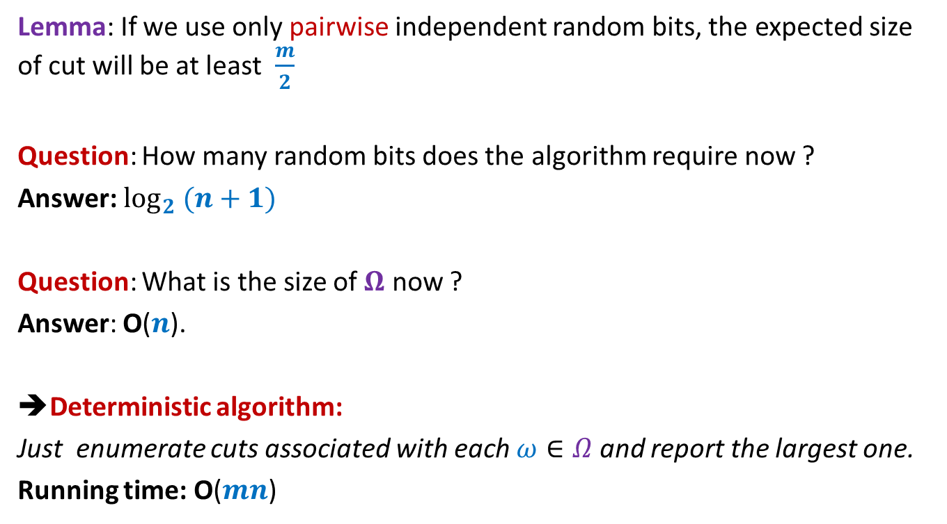
Large cut in a graph
Lemma: If we use only pairwise independent random bits, the expected size of cut will be at least $\frac{m}{2}$
Question: How many random bits does the algorithm require now ?
Answer: $\log_{2} (n+1)$
Question: What is the size of $Ω$ now ?
Answer: O($n$).
➔Deterministic algorithm:
Just enumerate cuts associated with each $ω∈Ω$ and report the largest one.
Running time: O($mn$)

Slide 18
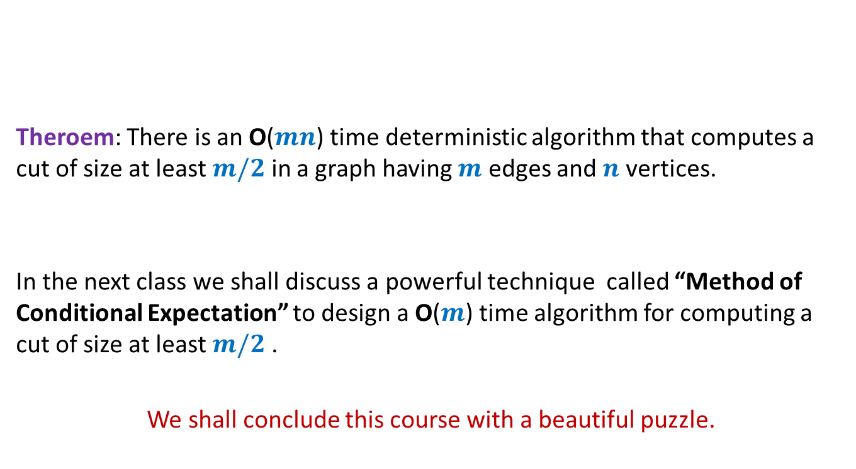
Large cut in a graph
Theroem: There is an O($mn$) time deterministic algorithm that computes a cut of size at least $m/2$ in a graph having $m$ edges and $n$ vertices.
In the next class we shall discuss a powerful technique called “Method of Conditional Expectation” to design a O($m$) time algorithm for computing a cut of size at least $m/2$ .
We shall conclude this course with a beautiful puzzle.

