Slide 1
Randomized Algorithms
CS648
Lecture 22
Chebyshev Inequality
Method of Bounded Difference

Slide 2
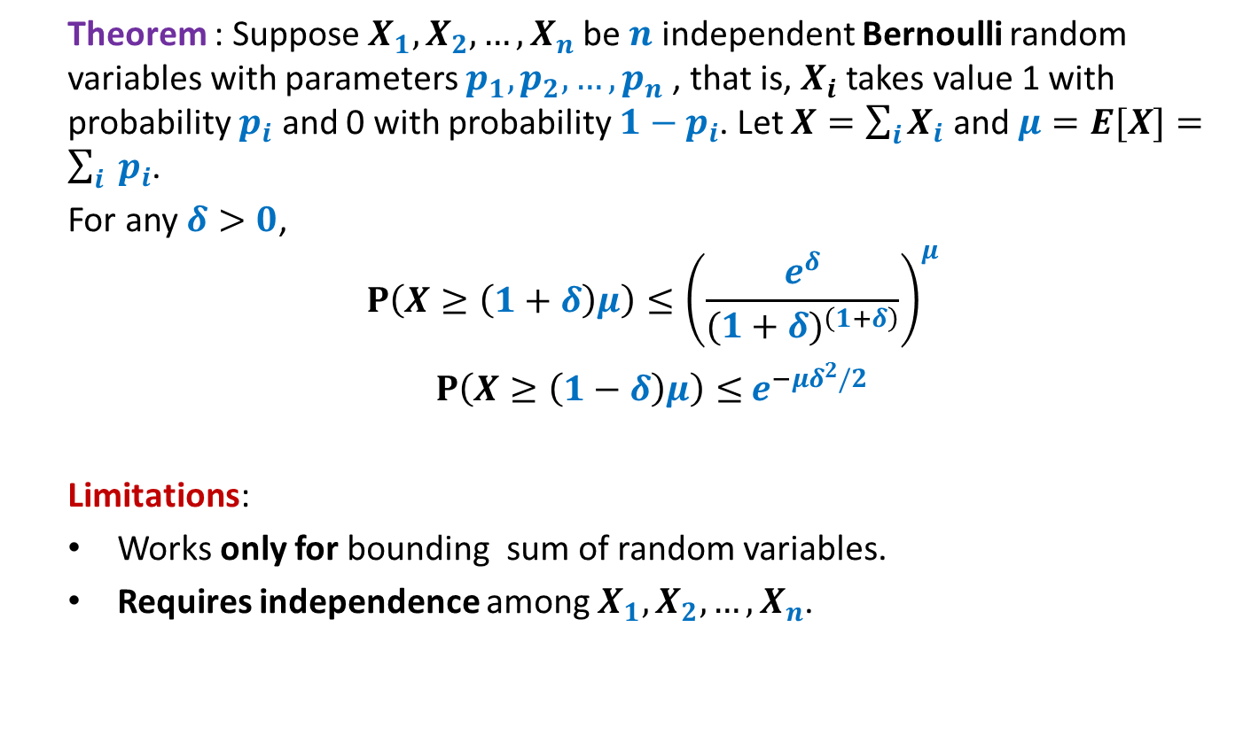
Chernoff Bound
Theorem : Suppose $X_{1},X_{2},…,X_{n}$be $n$ independent Bernoulli random variables with parameters $p_{1},p_{2},…,p_{n}$, that is, $X_{i}$ takes value 1 with probability $p_{i}$ and 0 with probability ${1−p}_{i}$. Let $X=\sum_{i}{X_{i}}$ and $μ=E[X]=\sum_{i}{ p_{i}}$.
For any $δ>0$,
$$P\left(X≥\left(1+δ\right)μ\right)≤{\left(\frac{e^{δ}}{{(1+δ)}^{\left(1+δ\right)}}\right)}^{μ}$$
$P\left(X≥\left(1−δ\right)μ\right)≤$ $e^{−μδ^{2}/2}$
Limitations:
Works only for bounding sum of random variables.
Requires independence among $X_{1},X_{2},…,X_{n}$.

Slide 3
Three examples to illustrate the inapplicability of chernoff bound

Slide 4
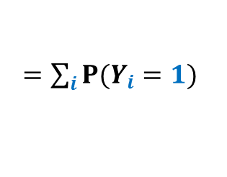
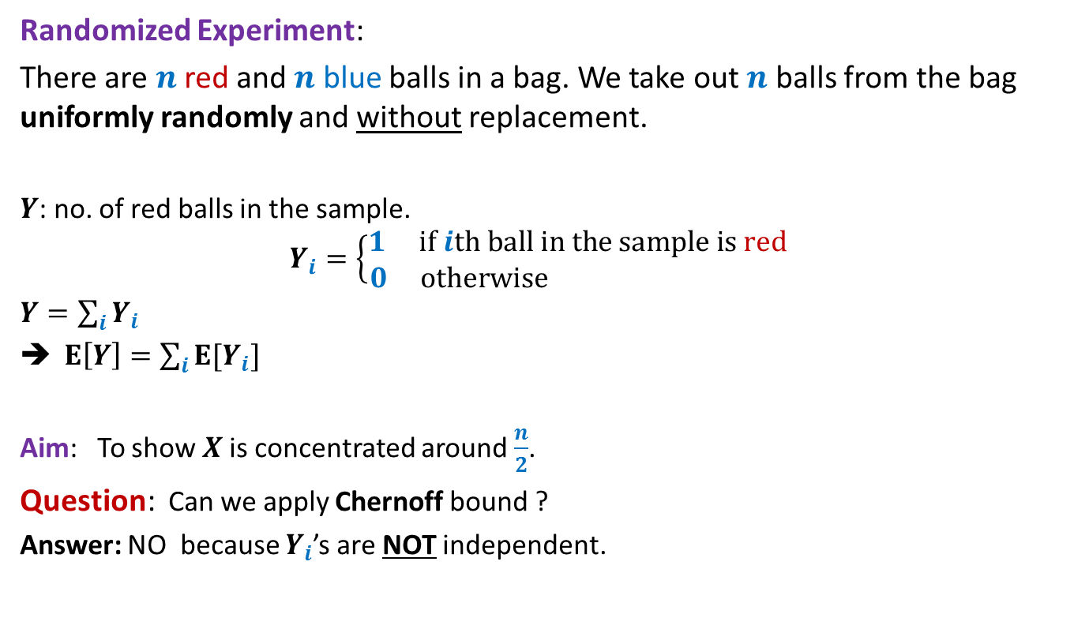

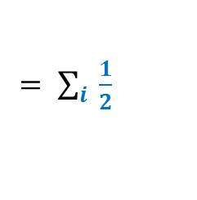
Red-blue balls out of bin
Randomized Experiment:
There are $n$ red and $n$ blue balls in a bag. We take out $n$ balls from the bag uniformly randomly and without replacement.
$Y$: no. of red balls in the sample.
$$Y_{i}=\left\{\begin{aligned}1 if ith ball in the sample is red \\ 0 otherwise \end{aligned}\right.$$
$Y=\sum_{i}{Y_{i}}$
$E\left[Y\right]=\sum_{i}{E[Y_{i}]}$
Aim: To show $X$is concentrated around $\frac{n}{2}$.
Question: Can we apply Chernoff bound ?
Answer: NO because $Y_{i}$’s are NOT independent.
$=\sum_{i}{P(Y_{i}=1)}$
$= \sum_{i}{ \frac{1}{2}}$
$$=\frac{n}{2}$$

Slide 5
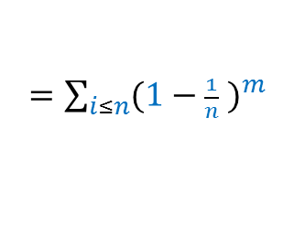
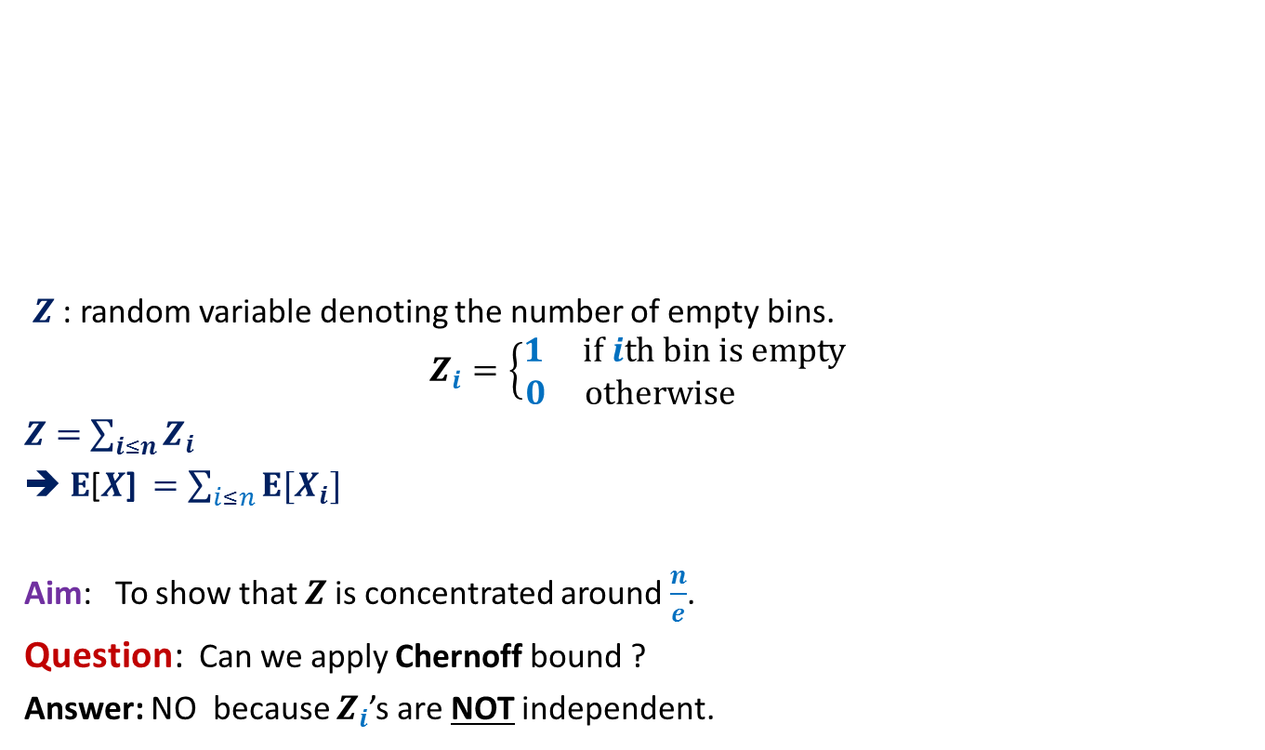


Balls into Bins
(number of empty bins)
1 2 3 4 5 … m-1 m
$Z$ : random variable denoting the number of empty bins.
$$Z_{i}=\left\{\begin{aligned}1 if ith bin is empty \\ 0 otherwise \end{aligned}\right.$$
$Z=$ $\sum_{i≤n}{Z_{i}}$
➔ $E$[$X$] $=\sum_{i≤n}{E[X_{i}]}$
Aim: To show that $Z$is concentrated around $\frac{n}{e}$.
Question: Can we apply Chernoff bound ?
Answer: NO because $Z_{i}$’s are NOT independent.
1 2 3 … … n
$=\sum_{i≤n}{{(1−\frac{1}{n} )}^{m}}$
$$=n{(1−\frac{1}{n} )}^{m}$$
$=$ $n/e$ for $m=n$

Slide 6



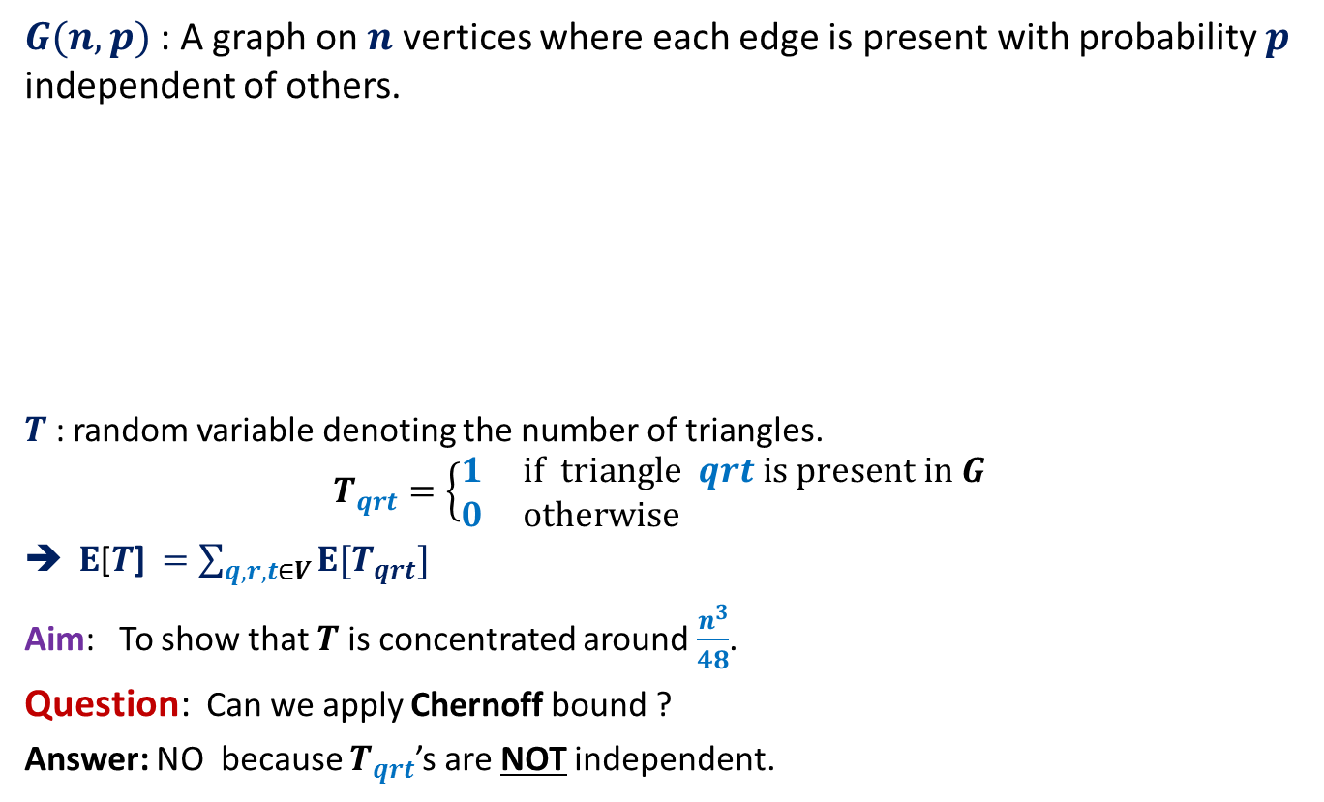




Number of Triangles in a random graph
$G(n,p)$: A graph on $n$ vertices where each edge is present with probability $p$ independent of others.
$T$ : random variable denoting the number of triangles.
$$T_{qrt}=\left\{\begin{aligned}1 if triangle qrt is present in G \\ 0 otherwise \end{aligned}\right.$$
$E$[$T$] $=\sum_{q,r,t∈V}{E[T_{qrt}]}$
Aim: To show that $T$is concentrated around $\frac{n^{3}}{48}$.
Question: Can we apply Chernoff bound ?
Answer: NO because $T_{qrt}$’s are NOT independent.
$$a$$
$$d$$
$$b$$
$$p$$
$$c$$
$=$ $\left({n \atop 3}\right)p^{3}$
$=$ $\frac{n^{3}}{48}$ for $p=\frac{1}{2}$

Slide 7
Chebyshev’s inequality

Slide 8

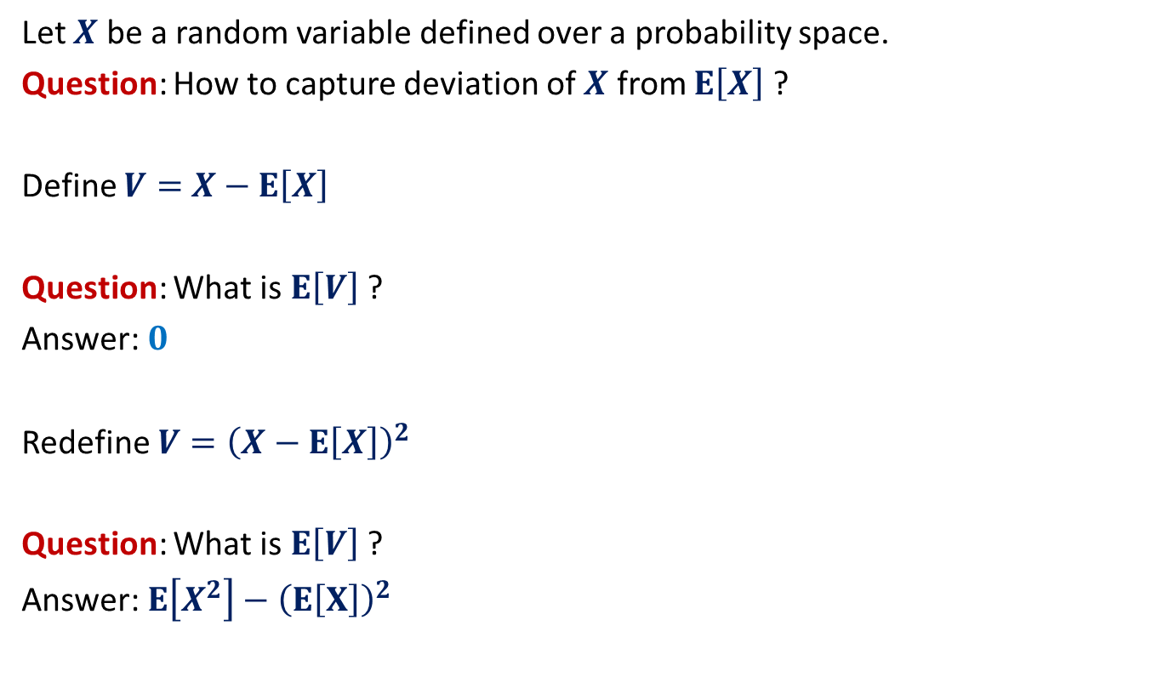
Chebyshev’s inequality
Let $X$ be a random variable defined over a probability space.
Question: How to capture deviation of $X$ from $E\left[X\right]$ ?
Define $V=$ $X−E\left[X\right]$
Question: What is $E\left[V\right]$ ?
Answer: $0$
Redefine $V={\left(X−E\left[X\right]\right)}^{2}$
Question: What is $E\left[V\right]$ ?
Answer: $E\left[X^{2}\right]−{\left(E\left[X\right]\right)}^{2}$
Called variance of $X$

Slide 9
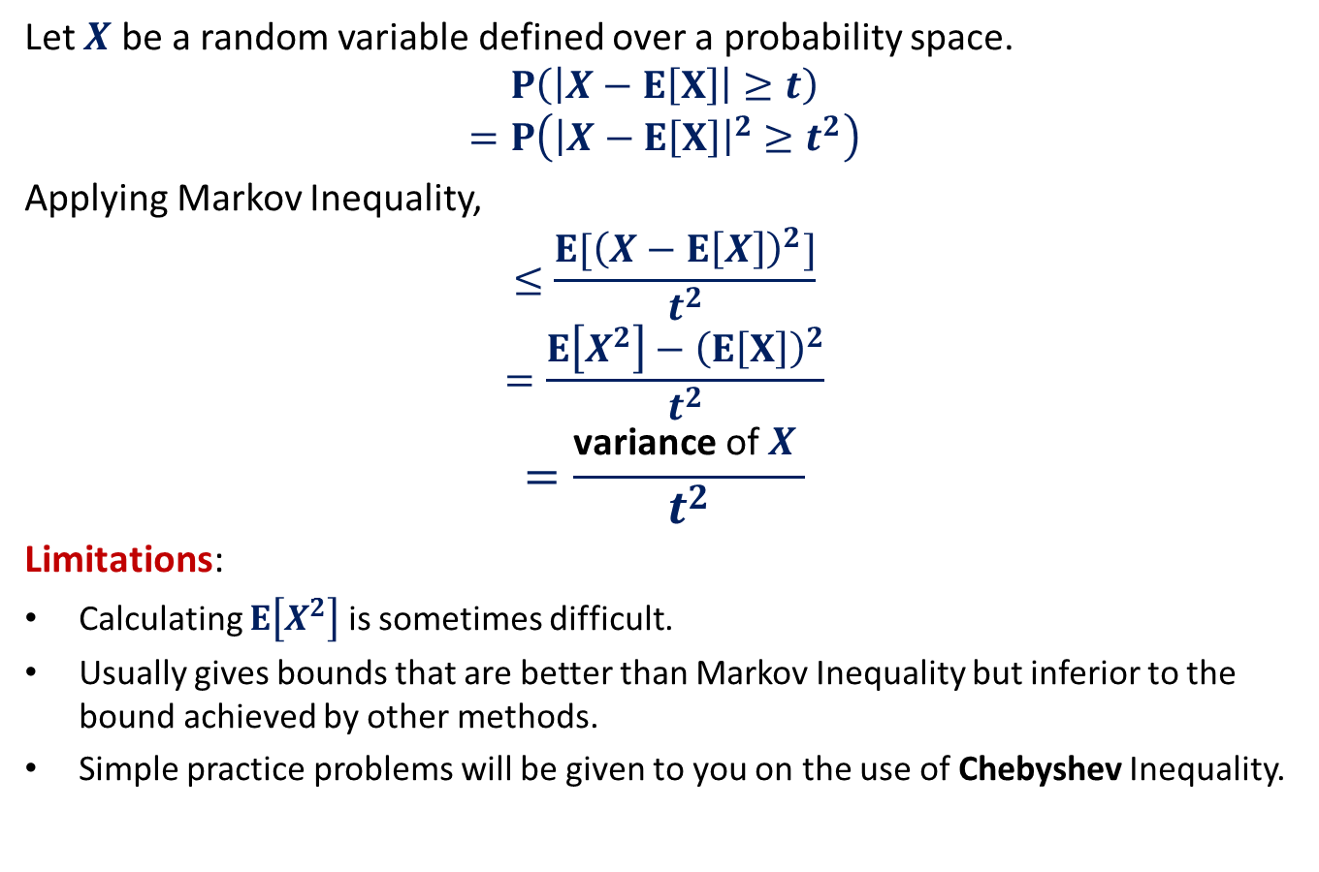
Chebyshev’s inequality
Let $X$ be a random variable defined over a probability space.
$$P\left(\left|X−E\left[X\right]\right|≥t\right)$$
$$=P\left({\left|X−E\left[X\right]\right|}^{2}≥t^{2}\right)$$
Applying Markov Inequality,
$$≤\frac{{E[\left(X−E\left[X\right]\right)}^{2}]}{t^{2}}$$
$$=\frac{E\left[X^{2}\right]−{\left(E\left[X\right]\right)}^{2}}{t^{2}}$$
$$=\frac{\text{variance} \text{of} X }{t^{2}}$$
Limitations:
Calculating $E\left[X^{2}\right]$ is sometimes difficult.
Usually gives bounds that are better than Markov Inequality but inferior to the bound achieved by other methods.
Simple practice problems will be given to you on the use of Chebyshev Inequality.

Slide 10
Method Of Bounded Difference (MOBD)
The most powerful method for bounding
the probability of deviation of a random variable from expected value

Slide 11
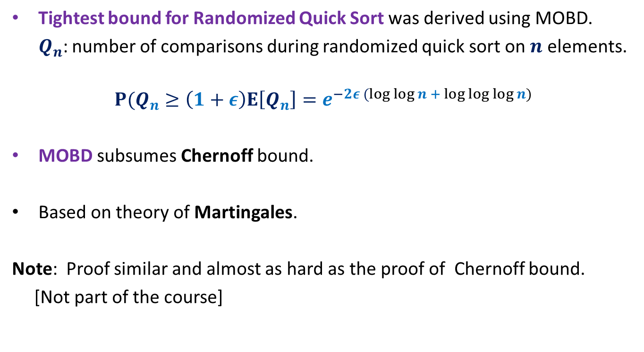
The Power of MOBD
Tightest bound for Randomized Quick Sort was derived using MOBD.
$Q_{n}$: number of comparisons during randomized quick sort on $n$ elements.
$${P(Q}_{n}≥\left(1+ε\right)E\left[Q_{n}\right]=e^{−2ε (log log n + log log log n)}$$
MOBD subsumes Chernoff bound.
Based on theory of Martingales.
Note: Proof similar and almost as hard as the proof of Chernoff bound.
[Not part of the course]

Slide 12
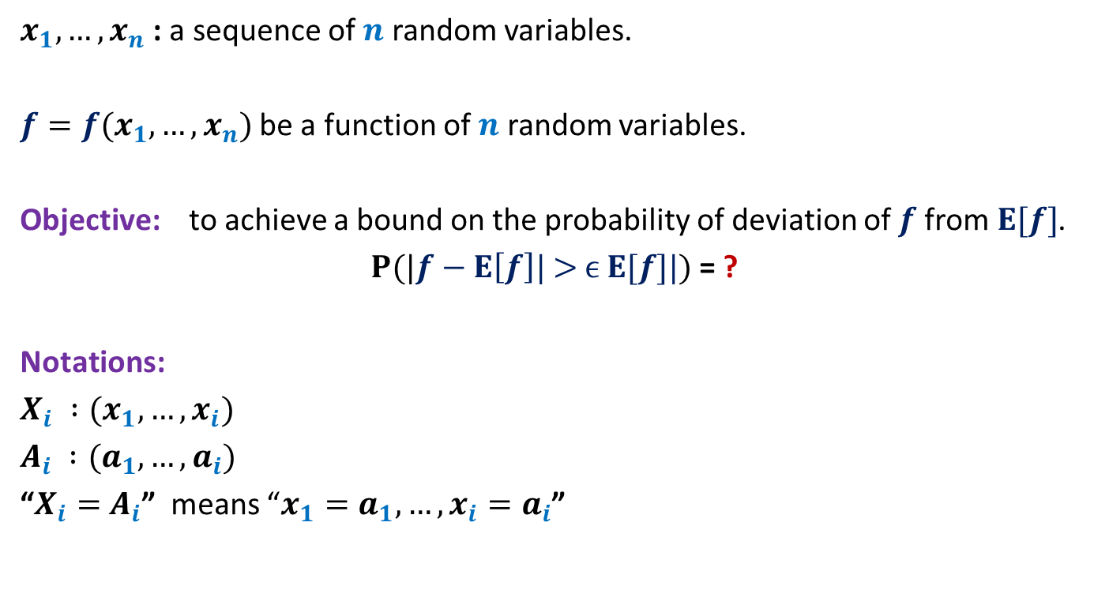
Notations
$x_{1},…,x_{n}$ : a sequence of $n$ random variables.
$f=f(x_{1},…,x_{n})$ be a function of $n$ random variables.
Objective: to achieve a bound on the probability of deviation of $f$from $E[f]$.
$P(|f−E\left[f\right]\text{| > }ϵ E[f]\text{|})$ = ?
Notations:
$X_{i} :(x_{1},…,x_{i})$
$A_{i} :(a_{1},…,a_{i})$
“$X_{i}=$ $A_{i}$” means “$x_{1}=a_{1},…,{x_{i}=a}_{i}$”

Slide 13
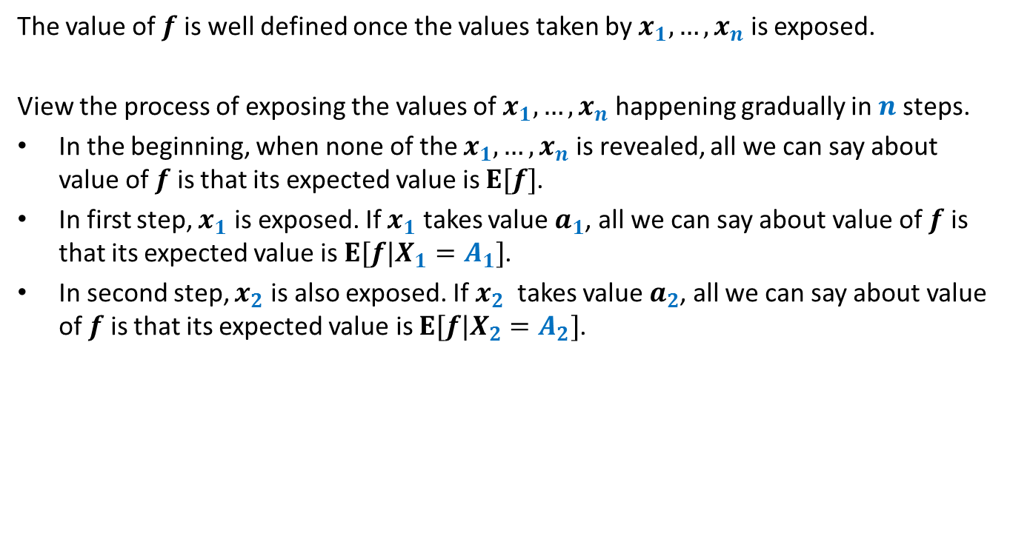
A new perspective
The value of $f$ is well defined once the values taken by $x_{1},…,x_{n}$ is exposed.
View the process of exposing the values of $x_{1},…,x_{n}$ happening gradually in $n$steps.
In the beginning, when none of the $x_{1},…,x_{n}$ is revealed, all we can say about value of $f$ is that its expected value is $E[f]$.
In first step, $x_{1}$ is exposed. If $x_{1}$ takes value $a_{1}$, all we can say about value of $f$ is that its expected value is ${E[f|X}_{1}=A_{1}]$.
In second step, $x_{2}$ is also exposed. If $x_{2}$ takes value $a_{2}$, all we can say about value of $f$ is that its expected value is ${E[f|X}_{2}=A_{2}]$.
…
The next slide will give a visual description of the process mentioned above.
But ponder over this slide before pressing the next button.

Slide 14












The value of $f$and the gradual exposition of $x_{i}$’s
Examples to illustrate the meaning of ${E[f|X}_{i}=A_{i}]$
Algorithm : Quick sort
$f$: no. of comparisons during quick sort on $n$ elements.
${E[f|X}_{i}=A_{i}]$ : Given first $i$ pivot elements, the expected number of comparisons during quick sort on $n$ elements.
…
…
…
…
…
$$x_{1}=a_{1}$$
$$x_{2}=a_{2}$$
$$x_{3}=a_{3}$$
$$x_{n}=a_{n}$$
$${E[f|X}_{2}=A_{2}]$$
$${E[f|X}_{n−1}=A_{n−1}]$$
$$E[f]$$
$${E[f|X}_{1}=A_{1}]$$
$${E[f|X}_{3}=A_{3}]$$
$$f(A_{n})$$

Slide 15

The value of $f$and the gradual exposition of $x_{i}$’s
Examples to illustrate the meaning of ${E[f|X}_{i}=A_{i}]$
Stochastic Process : Ball-Bin problem
$f$: no. of empty bins
${E[f|X}_{i}=A_{i}]$: Given the destination of first $i$ balls, the expected number of empty bins.
…
…
…
…
…
$$x_{1}=a_{1}$$
$$x_{2}=a_{2}$$
$$x_{3}=a_{3}$$
$$x_{n}=a_{n}$$
$${E[f|X}_{2}=A_{2}]$$
$${E[f|X}_{n−1}=A_{n−1}]$$
$$E[f]$$
$${E[f|X}_{1}=A_{1}]$$
$${E[f|X}_{3}=A_{3}]$$
$$f(A_{n})$$

Slide 16


Gradual exposition of $x_{i}$’s
Examples to illustrate the meaning of ${E[f|X}_{i}=A_{i}]$
Random Structure : Random graph
$f$: no. of triangles in $G(n,p)$
${E[f|X}_{i}=A_{i}]$: Given the presence/absence of $e_{1},…,e_{i}$ edges, the expected number of triangles in the random graph.
…
…
…
…
…
$$x_{1}=a_{1}$$
$$x_{2}=a_{2}$$
$$x_{3}=a_{3}$$
$$x_{n}=a_{n}$$
$${E[f|X}_{2}=A_{2}]$$
$${E[f|X}_{n−1}=A_{n−1}]$$
$$E[f]$$
$${E[f|X}_{1}=A_{1}]$$
$${E[f|X}_{3}=A_{3}]$$
$$f(A_{n})$$

Slide 17
The Intuition underlying MOBD

Slide 18




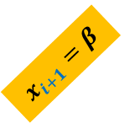



Method of Bounded Difference
$${E[f|X}_{i}=A_{i},x_{i+1}=β]$$
$$x_{i+1}=β$$
…
…
…
…
…
$$x_{1}=a_{1}$$
$$x_{2}=a_{2}$$
$$x_{i+1}=α$$
$${E[f|X}_{i}=A_{i}]$$
$$E[f]$$
$${E[f|X}_{i}=A_{i},x_{i+1}=α]$$
$${f(A}_{n})$$

Slide 19
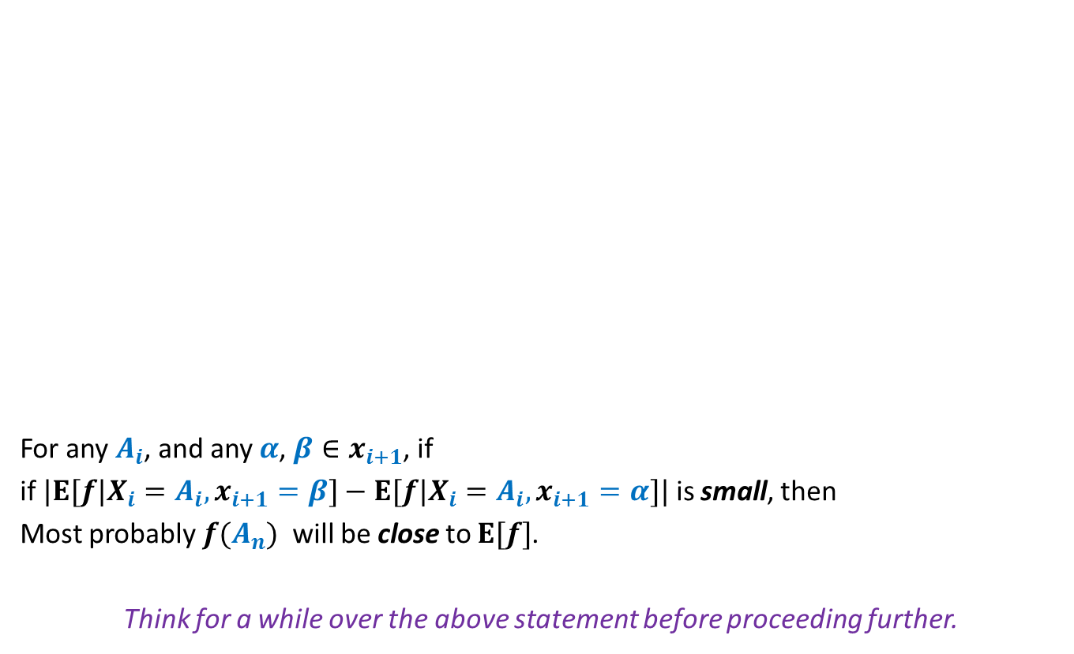


Method of Bounded Difference
$${E[f|X}_{i}=A_{i},x_{i+1}=β]$$
For any $A_{i}$, and any $α$, $β∈x_{i+1}$, if
if ${|E[f|X}_{i}=A_{i},x_{i+1}=β]−{E[f|X}_{i}=A_{i},x_{i+1}=α]|$ is small, then
Most probably ${f(A}_{n})$ will be close to $E[f]$.
Think for a while over the above statement before proceeding further.
$$x_{i+1}=β$$
…
…
…
…
…
$$x_{1}=a_{1}$$
$$x_{2}=a_{2}$$
$$x_{i+1}=α$$
$${E[f|X}_{i}=A_{i}]$$
$$E[f]$$
$${E[f|X}_{i}=A_{i},x_{i+1}=α]$$
$${f(A}_{n})$$

Slide 20

Method of Bounded Difference - I
$${E[f|X}_{i}=A_{i},x_{i+1}=β]$$
Theorem 1:
If there are positive numbers $c_{i}$’s such that for any $A_{i}$, and any $α$, $β∈x_{i+1}$,
$${|E[f|X}_{i}=A_{i},x_{i+1}=β]−{E[f|X}_{i}=A_{i},x_{i+1}=α]|<c_{i}$$
Then
$$P(|f−E\left[f\right]\text{|}≥ \text{t})≤exp\left(−\frac{{2t}^{2}}{\sum_{i}{c_{i}^{2}}}\right)$$
Note: In order to get a meaningful bound using Therem1, you must have small $c_{i}$’s .
$$x_{i+1}=β$$
…
…
…
…
…
$$x_{1}=a_{1}$$
$$x_{2}=a_{2}$$
$$x_{i+1}=α$$
$${E[f|X}_{i}=A_{i}]$$
$$E[f]$$
$${E[f|X}_{i}=A_{i},x_{i+1}=α]$$
$${f(A}_{n})$$

Slide 21
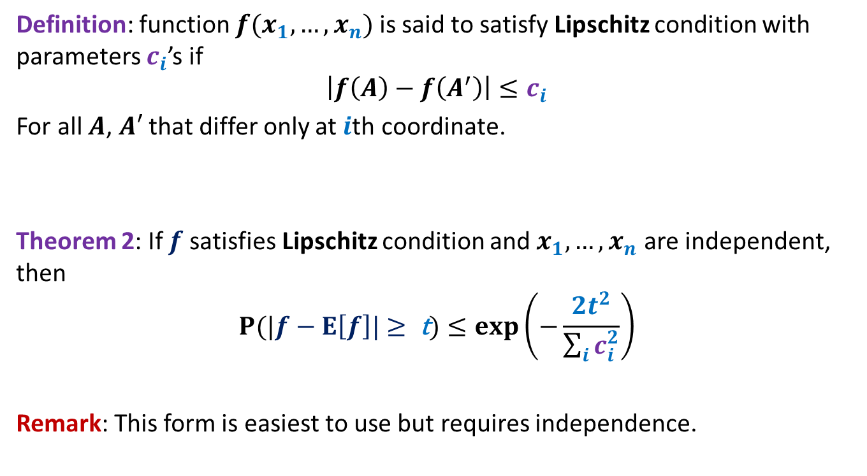
Method of Bounded Difference - II
Definition: function $f(x_{1},…,x_{n})$ is said to satisfy Lipschitz condition with parameters $c_{i}$’s if
$$\left|f\left(A\right)−f\left(A^{′}\right)\right|≤c_{i}$$
For all $A$, $A′$ that differ only at $i$th coordinate.
Theorem 2: If $f$ satisfies Lipschitz condition and $x_{1},…,x_{n}$ are independent, then
$$P(|f−E\left[f\right]\text{|}≥ \text{t})≤exp\left(−\frac{{2t}^{2}}{\sum_{i}{c_{i}^{2}}}\right)$$
Remark: This form is easiest to use but requires independence.

Slide 22
MOBD Subsumes Chernoff Bound

Slide 23
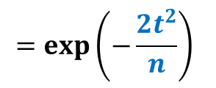



MOBD subsumes Chernoff Bound
$x_{1},…,x_{n}$ are 0-1 independent random variables.
$f=\sum_{i}{x_{i}}$
$f$ satisfies Lipschitz condition with parameters $c_{i}=1$
Hence applying Theorem 2
$$P(|f−E\left[f\right]\text{|}≥ \text{t})≤exp\left(−\frac{2t^{2}}{\sum_{i}{c_{i}^{2}}}\right)$$
$$=exp\left(−\frac{{2t}^{2}}{n}\right)$$
$=e^{−2 ln n}$ for $t=\sqrt{n ln n}$
$=n^{−2}$ for $t=\sqrt{n ln n}$

Slide 24
problem 1
No. of Empty bins

Slide 25
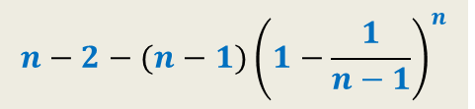
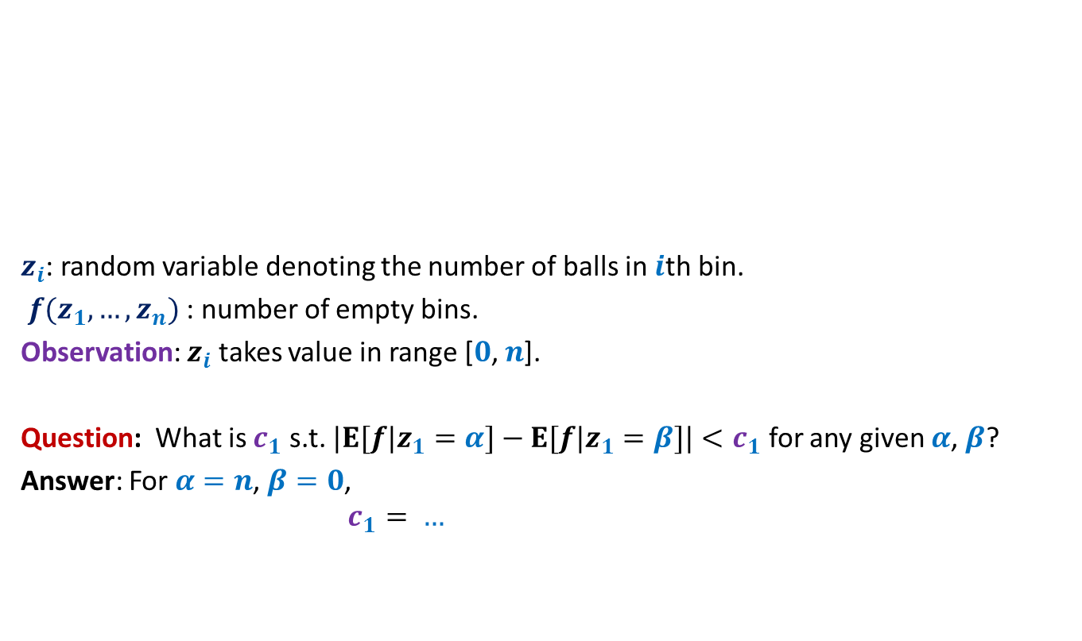
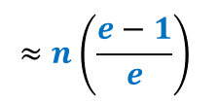
Balls into Bins
(number of empty bins)
1 2 3 4 5 … n-1 n
$z_{i}$: random variable denoting the number of balls in $i$th bin.
$f(z_{1},…,z_{n})$ : number of empty bins.
Observation: $z_{i}$ takes value in range [$0$, $n$].
Question: What is $c_{1}$ s.t. ${|E[f|z}_{1}=α]−{E[f|z}_{1}=β]|<c_{1}$ for any given $α$, $β$?
Answer: For $α=n$, $β=0$,
$$c_{1}= …$$
1 2 3 … … n
$$n−2−(n−1){\left(1−\frac{1}{n−1}\right)}^{n}$$
$$≈n\left(\frac{e−1}{e}\right)$$
This will give very inferior bound

Slide 26

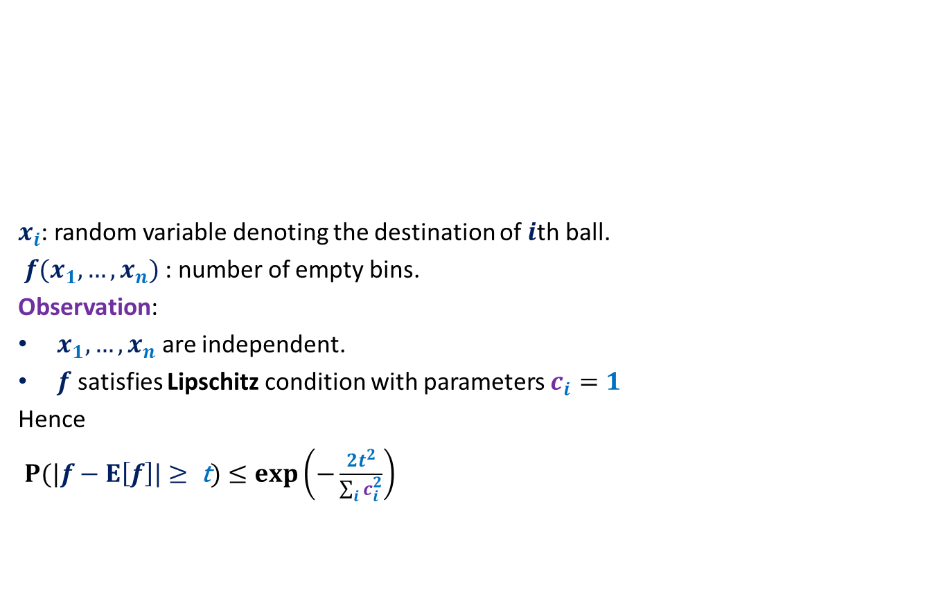


Balls into Bins
(number of empty bins)
1 2 3 4 5 … n-1 n
$x_{i}$: random variable denoting the destination of $i$th ball.
$f(x_{1},…,x_{n})$ : number of empty bins.
Observation:
$x_{1},…,x_{n}$ are independent.
$f$ satisfies Lipschitz condition with parameters $c_{i}=1$
Hence
$P(|f−E\left[f\right]\text{|}≥ \text{t})≤exp\left(−\frac{{2t}^{2}}{\sum_{i}{c_{i}^{2}}}\right)$
1 2 3 … … n
We failed because our choice of random variables $z_{i}$ for defining $f$was bad. Can you think of other random variables such that $f$ is a function of them ?
$$=exp\left(−\frac{{2t}^{2}}{n}\right)$$
$≤n^{−2}$ for $t>\sqrt{n ln n}$

Slide 27
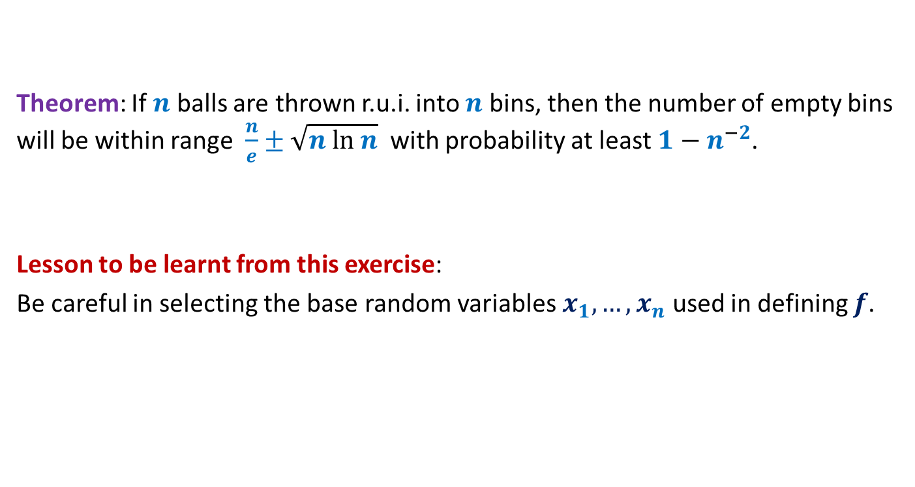
Balls into Bins
(number of empty bins)
Theorem: If $n$ balls are thrown r.u.i. into $n$ bins, then the number of empty bins will be within range $\frac{n}{e}±$ $\sqrt{n ln n}$ with probability at least ${1−n}^{−2}$.
Lesson to be learnt from this exercise:
Be careful in selecting the base random variables $x_{1},…,x_{n}$ used in defining $f$.

Slide 28
problem 2
Red-blue balls out of bin

Slide 29

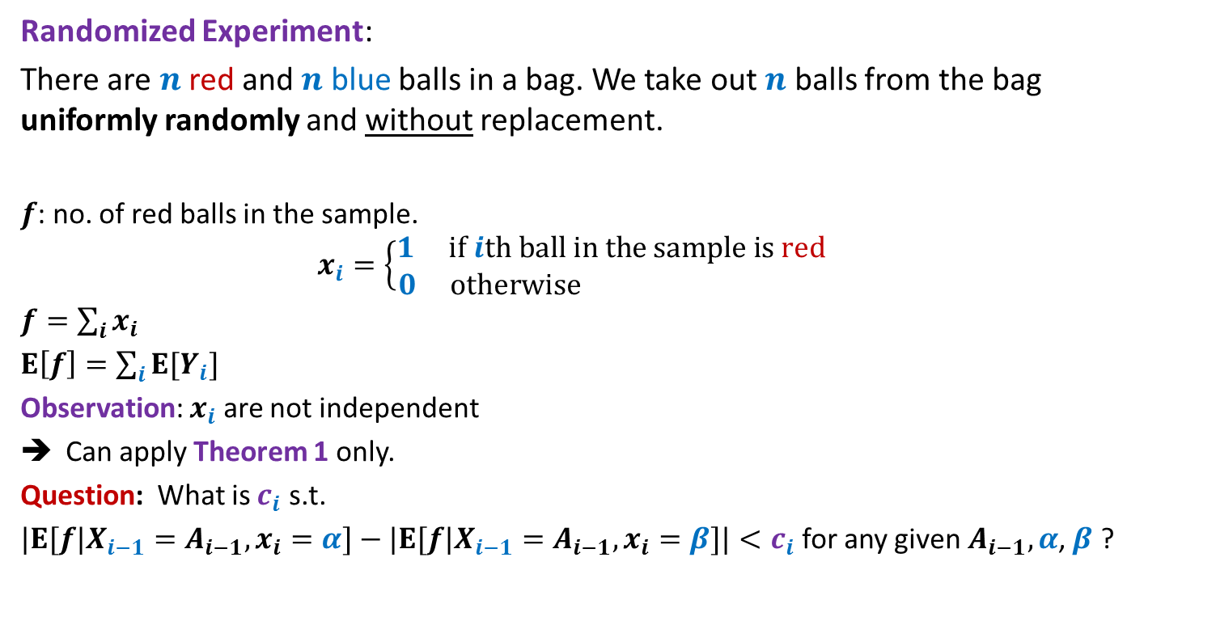
Red-blue balls out of bin
Randomized Experiment:
There are $n$ red and $n$ blue balls in a bag. We take out $n$ balls from the bag uniformly randomly and without replacement.
$f$: no. of red balls in the sample.
$$x_{i}=\left\{\begin{aligned}1 if ith ball in the sample is red \\ 0 otherwise \end{aligned}\right.$$
$f=\sum_{i}{x_{i}}$
$E\left[f\right]=\sum_{i}{E[Y_{i}]}$
Observation: $x_{i}$ are not independent
Can apply Theorem 1 only.
Question: What is $c_{i}$ s.t.
${|E[f|X}_{i−1}=A_{i−1},x_{i}=α]−{|E[f|X}_{i−1}=A_{i−1},x_{i}=β]|<c_{i}$ for any given${ A}_{i−1},α$, $β$ ?
$$=\frac{n}{2}$$

Slide 30




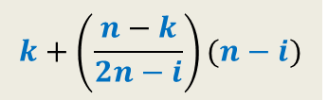
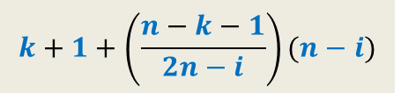


Red-blue balls out of bin
$n−i$ balls
$$A_{i−1}$$
$i$th ball
…
Let $A_{i−1}$has $k$red balls.
$${E[f|X}_{i−1}=A_{i−1},x_{i}=1]= ?$$
$${E[f|X}_{i−1}=A_{i−1},x_{i}=0]= ?$$
➔ $|{E[f|X}_{i−1}=A_{i−1},x_{i}=1]−{E[f|X}_{i−1}=A_{i−1},x_{i}=0]|<1$
$c_{i}<1$
Applying Theorem 1
$P(|f−E\left[f\right]\text{|}≥ \text{t})≤exp\left(−\frac{{2t}^{2}}{\sum_{i}{c_{i}^{2}}}\right)$
…
…
$$k+1+\left(\frac{n−k−1}{2n−i}\right)(n−i)$$
$$k+\left(\frac{n−k}{2n−i}\right)(n−i)$$
$$<exp\left(−\frac{2t^{2}}{n}\right)$$
$≤n^{−2}$ for $t>\sqrt{n ln n}$

Slide 31

Red-blue balls out of bin
Theorem: There are $n$ red and $n$ blue balls in a bag. Suppose we take out $n$ balls from the bag uniformly randomly and without replacement. The number of red balls in the sample is within range $\frac{n}{2}±$ $\sqrt{n ln n}$ with probability at least ${1−n}^{−2}$.

Slide 32
problem 3
No. of Triangles in Random graph
Do it as exercise.
This problem will also be posted in practice sheet.

