Slide 1
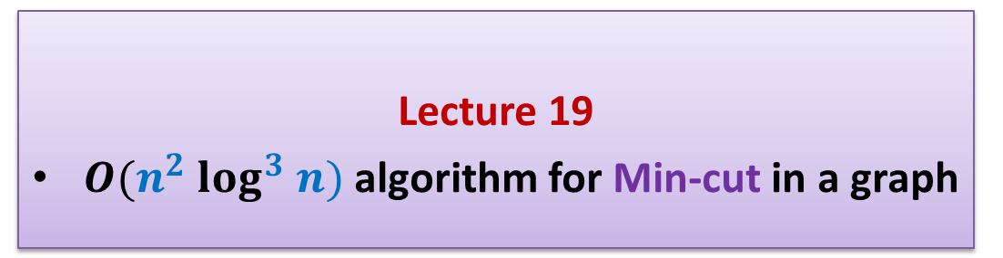
Randomized Algorithms
CS648
Lecture 19
$O(n^{2} log^{3} n)$algorithm for Min-cut in a graph

Slide 2
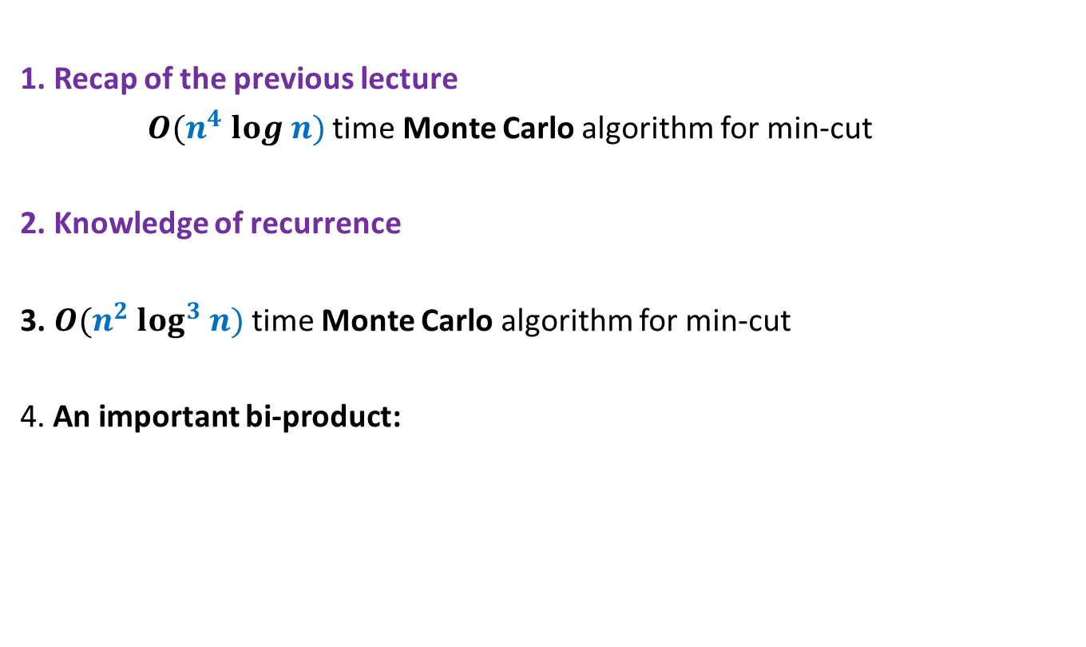
Overview
1. Recap of the previous lecture
$O(n^{4} log n)$time Monte Carlo algorithm for min-cut
2. Knowledge of recurrence
3. $O(n^{2} log^{3} n)$time Monte Carlo algorithm for min-cut
4. An important bi-product:
To design efficient algorithm
A new tool to design an efficient algorithm

Slide 3
Recap of the previous lecture

Slide 4








Graph and Multi-graph
A multi-graph may have:
More than one edge between a pair of vertices
No self loop
$$u$$
$$a$$
$$l$$
$$v$$
$$x$$
$$b$$
$$h$$
$$w$$

Slide 5

Min-Cut
$G=(V,E)$: undirected connected graph
Definition (cut):
A subset $C⊆E$whose removal disconnects the graph.
Definition (min-cut): A cut of smallest size.
Problem Definition: Design algorithm to compute min-cut of a given graph.

Slide 6
some basic facts

Slide 7


Min-Cut
Question: How many cuts ?
Answer: $\frac{2^{n}−2}{2}$
Question : what is relation between degree($u$) and size of min-cut ?
Answer: size of min-cut $≤$ degree($u$)
Question : If size of min-cut is $k$, what can be minimum value of $m$ ?
Answer: $\frac{nk}{2}$
$$u$$
How about cuts in multi-graph ?

Slide 8


















Contract($G,e$)
$$u$$
$$x$$
$$a$$
$$l$$
$$v$$
$$y$$
$$b$$
$$h$$
$$w$$
Contract($G,(x,y))$
$$u$$
$$a$$
$$l$$
$$v$$
$$xy$$
$$b$$
$$h$$
$$w$$

Slide 9
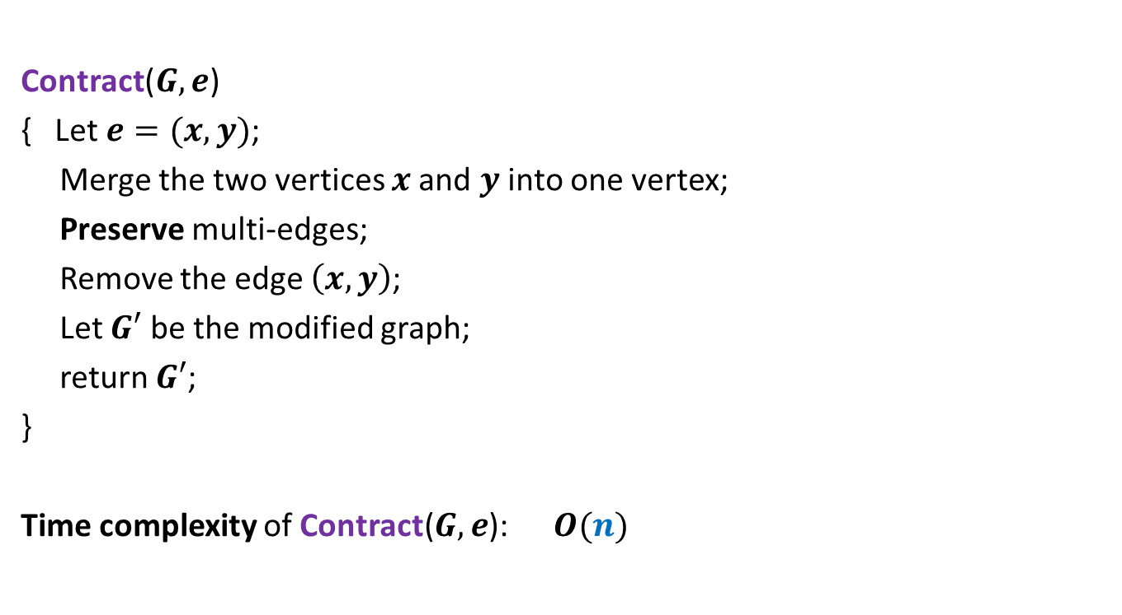


Contract($G,e$)
Contract($G,e$)
{ Let $e=(x,y)$;
Merge the two vertices $x$and $y$ into one vertex;
Preserve multi-edges;
Remove the edge $\left(x,y\right)$;
Let $G′$ be the modified graph;
return $G′$;
}
Time complexity of Contract($G,e$): $O(n)$
Relation between $G$and $G′$?

Slide 10




Relation between $G$and $G′$?
$$u$$
$$x$$
$$a$$
$$l$$
$$G$$
$$v$$
$$y$$
$$b$$
$$h$$
$$w$$
Contract($G,(x,y))$
$$u$$
$$a$$
$$l$$
$$G′$$
$$v$$
$$xy$$
$$b$$
$$h$$
$$w$$

Slide 11
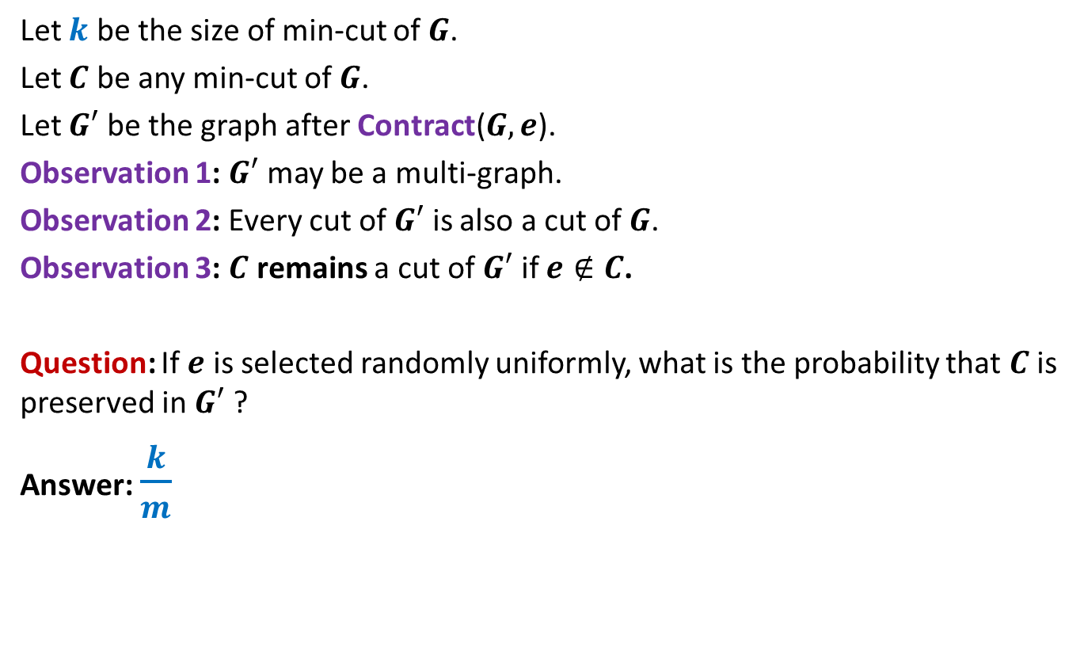


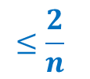
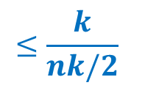
Observations about Contract($G,e$)
Let $k$ be the size of min-cut of $G$.
Let $C$ be any min-cut of $G$.
Let $G′$ be the graph after Contract($G,e$).
Observation 1: $G′$ may be a multi-graph.
Observation 2: Every cut of $G′$ is also a cut of $G$.
Observation 3: $C$ remains a cut of $G′$ if $e∉C$.
Question: If $e$ is selected randomly uniformly, what is the probability that $C$ is preserved in $G′$ ?
Answer: $\frac{k}{m}$
$$≤\frac{k}{nk/2}$$
$$≤\frac{2}{n}$$
Recall that $m≥\frac{nk}{2}$

Slide 12
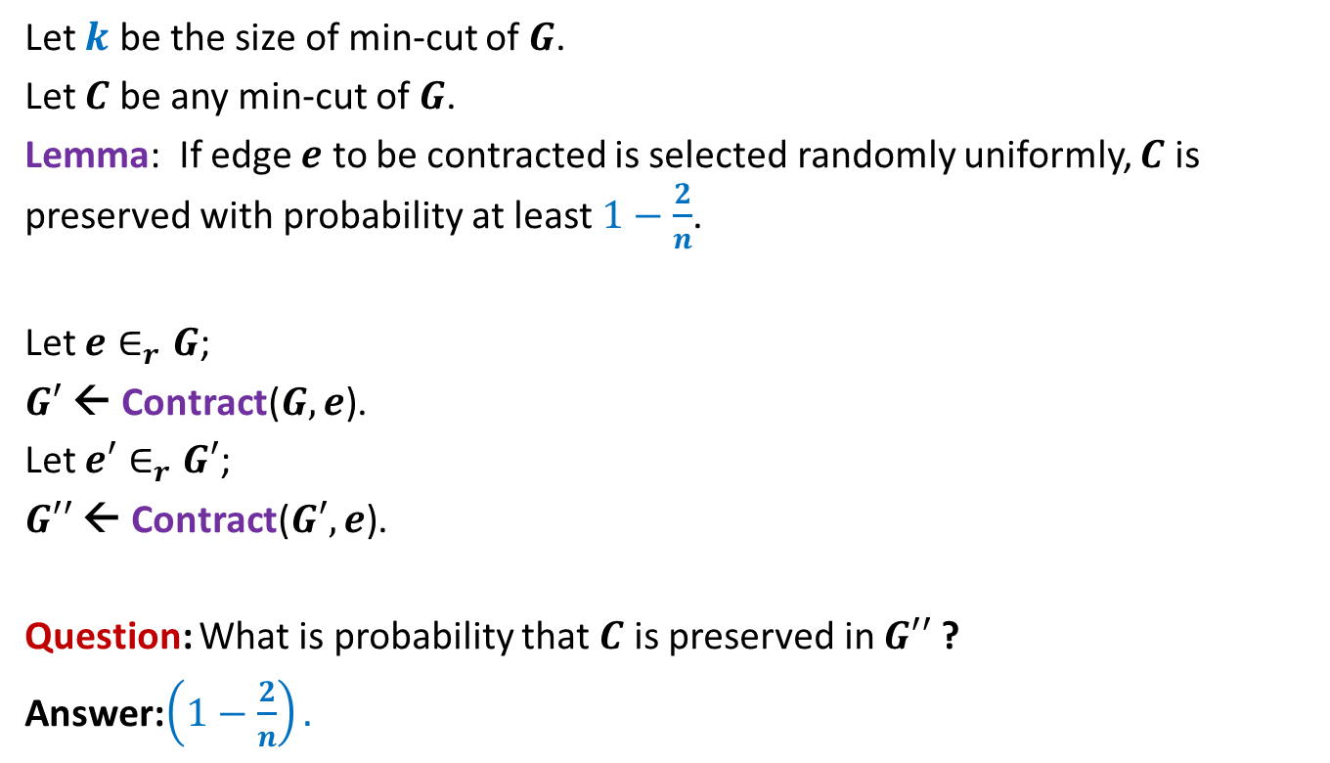

Contract($G,e$)
Let $k$ be the size of min-cut of $G$.
Let $C$ be any min-cut of $G$.
Lemma: If edge $e$ to be contracted is selected randomly uniformly, $C$ is preserved with probability at least $1−\frac{2}{n}$.
Let $e∈_{r}G$;
$G′$ ← Contract($G,e$).
Let $e′∈_{r}G′$;
$G′′$ ← Contract($G′,e$).
Question: What is probability that $C$ is preserved in $G′′$ ?
Answer:$\left(1−\frac{2}{n}\right).$
$$\left(1−\frac{2}{n−1}\right)$$

Slide 13


Algorithm for min-cut
Min-cut($G$):
{ Repeat ?? times
{
Let $e∈_{r}G$;
$G$ ← Contract($G,e$).
}
return the edges of multi-graph $G$;
}
Running time: $O(n^{2})$
$$n−2$$

Slide 14

Algorithm for min-cut
Question: What is probability that $C$ is preserved during the algorithm ?
Answer: $\left(1−\frac{2}{n}\right).\left(1−\frac{2}{n−1}\right).\left(1−\frac{2}{n−2}\right)…\frac{3}{5}.\frac{2}{4}.\frac{1}{3}$
= $\left(\frac{n−2}{n}\right).\left(\frac{n−3}{n−1}\right).\left(\frac{n−4}{n−2}\right)…\frac{3}{5}.\frac{2}{4}.\frac{1}{3}$
= $\frac{2}{n}.\frac{1}{n−1}$
>$\frac{1}{n^{2}}$

Slide 15
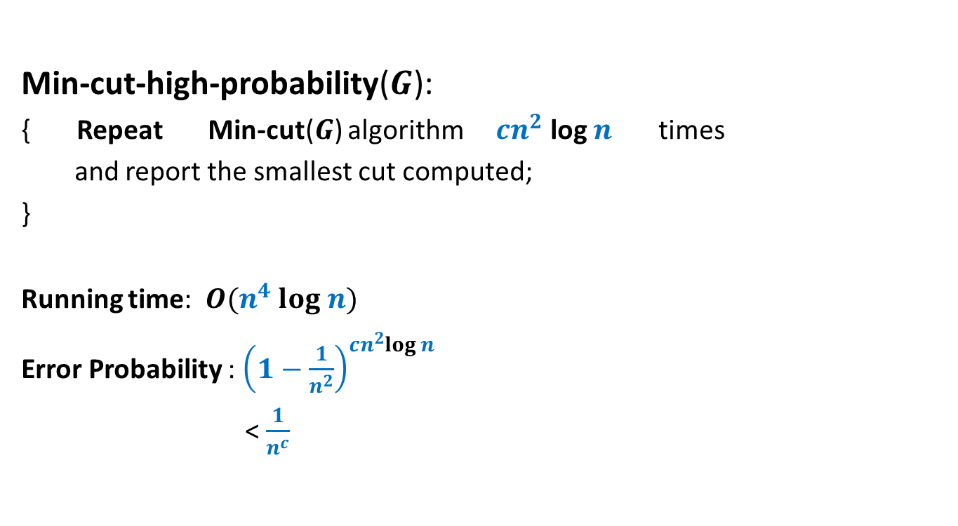
Algorithm for min-cut
Min-cut-high-probability($G$):
{ Repeat Min-cut($G$) algorithm $cn^{2}$ log $n$ times
and report the smallest cut computed;
}
Running time: $O(n^{4} log n)$
Error Probability : ${\left(1−\frac{1}{n^{2}}\right)}^{cn^{2}log n}$
< $\frac{1}{n^{c}}$

Slide 16
Revisiting Recurrences
In the following slides, we shall revisit common recurrences. Try to solve these recurrences in a simple manner instead of using Master’s theorem. This will help you develop a useful insight into recurrences. This insight will help you fine-tune the previous inefficient algorithm and eventually lead to design (and analysis) of a more efficient algorithm for min-cut.

Slide 17

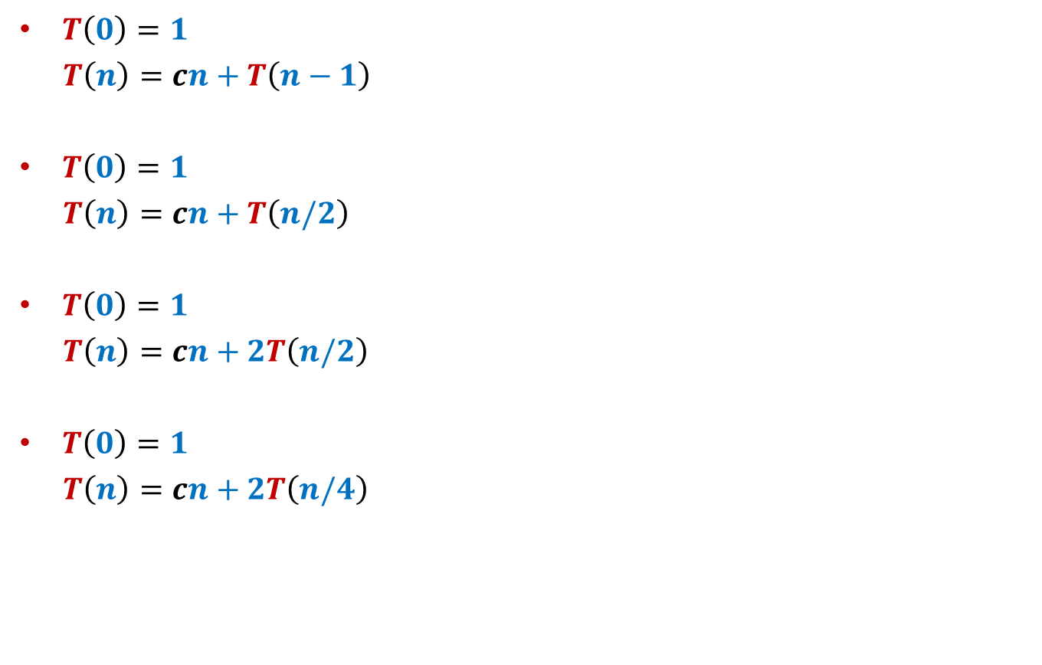



Common recurrences
$T\left(0\right)=1$
$T\left(n\right)=cn+T\left(n−1\right)$
$T\left(0\right)=1$
$T\left(n\right)=cn+T\left(n/2\right)$
$T\left(0\right)=1$
$T\left(n\right)=cn+2T\left(n/2\right)$
$T\left(0\right)=1$
$T\left(n\right)=cn+2T\left(n/4\right)$
$$O(n^{2})$$
$$O(n)$$
$$O(n log n)$$
$$O(n )$$

Slide 18
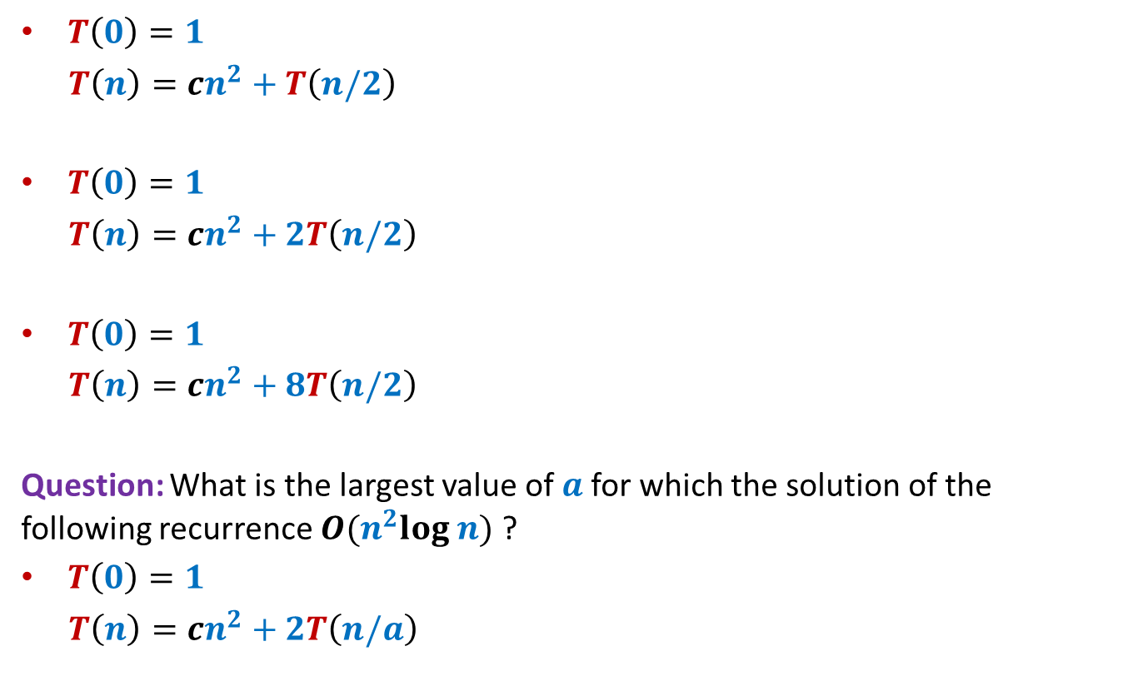



Common recurrences
$T\left(0\right)=1$
$T\left(n\right)=cn^{2}+T\left(n/2\right)$
$T\left(0\right)=1$
$T\left(n\right)=cn^{2}+2T\left(n/2\right)$
$T\left(0\right)=1$
$T\left(n\right)=cn^{2}+8T\left(n/2\right)$
Question: What is the largest value of $a$for which the solution of the following recurrence $O(n^{2}log n)$ ?
$T\left(0\right)=1$
$T\left(n\right)=cn^{2}+2T\left(n/a\right)$
$$O(n^{2})$$
$$O(n^{2})$$
$$O(n^{3})$$
$$a=√2$$

Slide 19
Faster Min-cut algorithm

Slide 20


Revisiting algorithm for min-cut
Min-cut($G$):
{ Repeat ?? times
{
Let $e∈_{r}G$;
$G$ ← Contract($G,e$).
}
return the edges of multi-graph $G$;
}
Running time: $O(n^{2})$
$$n−2$$
We shall modify this algorithm to improve its success probability.
But we shall not allow any significant blow up in the running time.

Slide 21
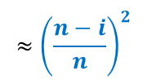
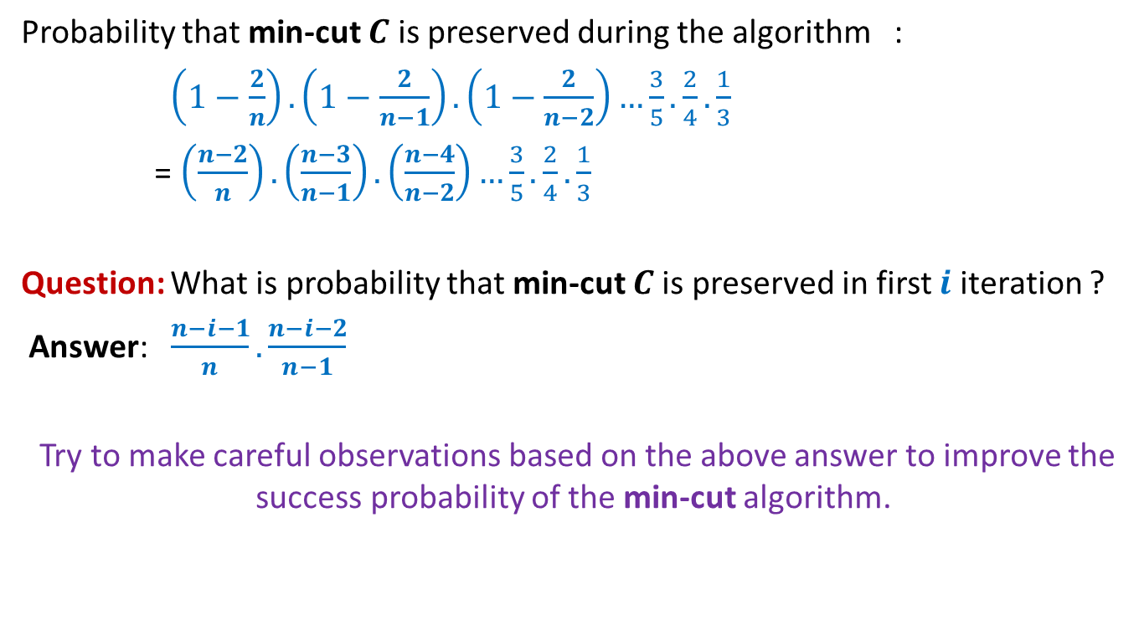
Algorithm for min-cut
Probability that min-cut $C$ is preserved during the algorithm :
$\left(1−\frac{2}{n}\right).\left(1−\frac{2}{n−1}\right).\left(1−\frac{2}{n−2}\right)…\frac{3}{5}.\frac{2}{4}.\frac{1}{3}$
= $\left(\frac{n−2}{n}\right).\left(\frac{n−3}{n−1}\right).\left(\frac{n−4}{n−2}\right)…\frac{3}{5}.\frac{2}{4}.\frac{1}{3}$
Question: What is probability that min-cut $C$is preserved in first $i$ iteration ?
Answer: $\frac{n−i−1}{n}.\frac{n−i−2}{n−1}$
Try to make careful observations based on the above answer to improve the success probability of the min-cut algorithm.
$$≈{\left(\frac{n−i}{n}\right)}^{2}$$

Slide 22

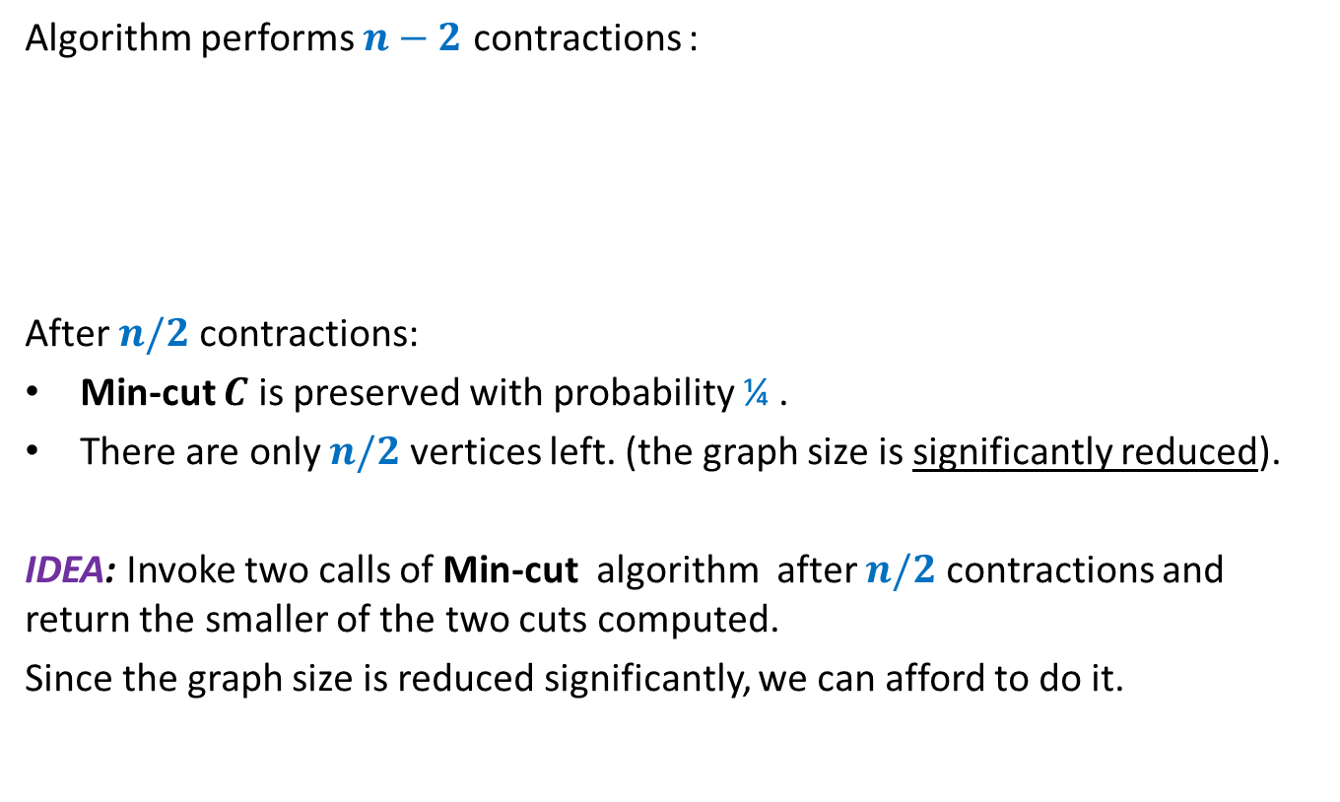
Key observations about
Min-Cut algorithm
Algorithm performs $n−2$ contractions :
After $n/2$ contractions:
Min-cut $C$ is preserved with probability ¼ .
There are only $n/2$ vertices left. (the graph size is significantly reduced).
IDEA: Invoke two calls of Min-cut algorithm after $n/2$ contractions and return the smaller of the two cuts computed.
Since the graph size is reduced significantly, we can afford to do it.
$$n/2$$
recursively

Slide 23
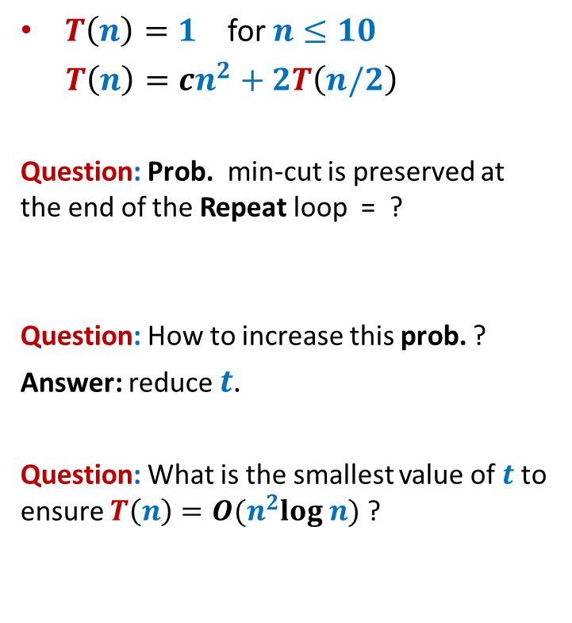
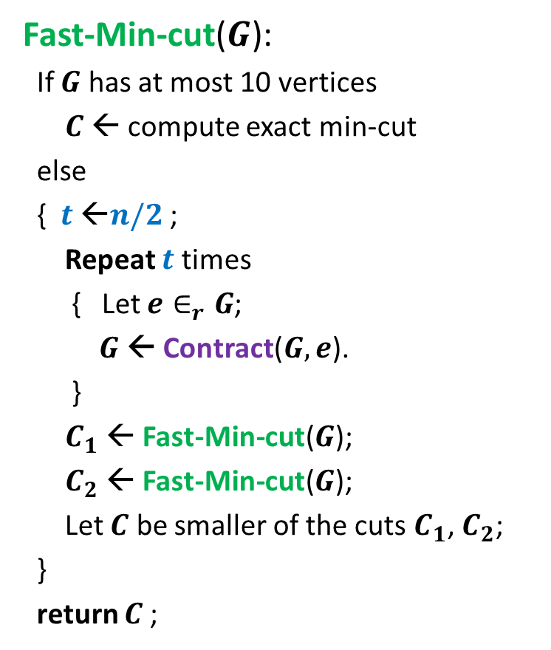


Revised algorithm for min-cut
Fast-Min-cut($G$):
If $G$ has at most 10 vertices
$C$ ← compute exact min-cut
else
{ $t$ ←$n/2$ ;
Repeat $t$ times
{ Let $e∈_{r}G$;
$G$ ← Contract($G,e$).
}
$C_{1}$ ← Fast-Min-cut($G$);
$C_{2}$ ← Fast-Min-cut($G$);
Let $C$ be smaller of the cuts $C_{1}$, $C_{2}$;
}
return $C$;
$T\left(n\right)=1$ for $n≤10$
$T\left(n\right)=cn^{2}+2T\left(n/2\right)$
Question: Prob. min-cut is preserved at the end of the Repeat loop = ?
Question: How to increase this prob. ?
Answer: reduce $t$.
Question: What is the smallest value of $t$to ensure $T\left(n\right)=O(n^{2}log n)$ ?
1/4
$t=$ $n−n/√2$

Slide 24
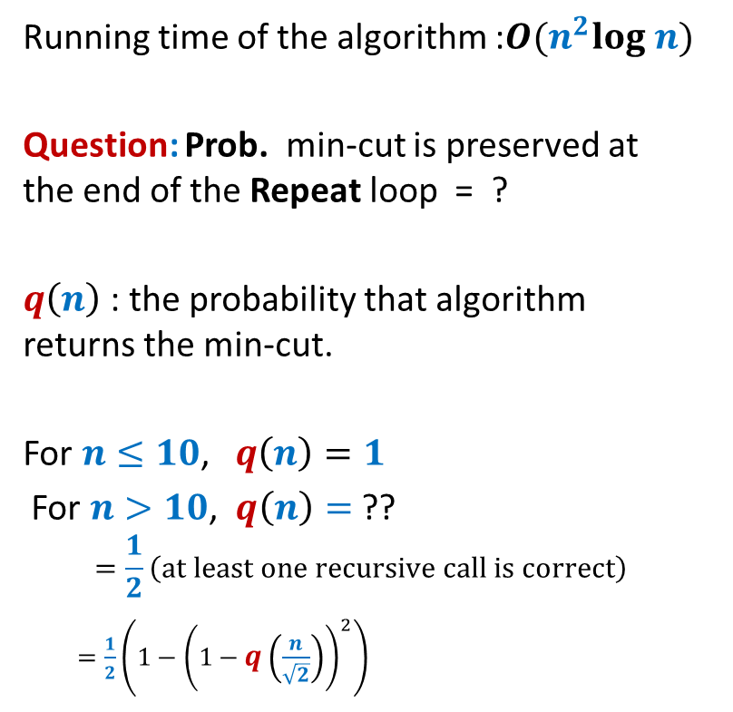
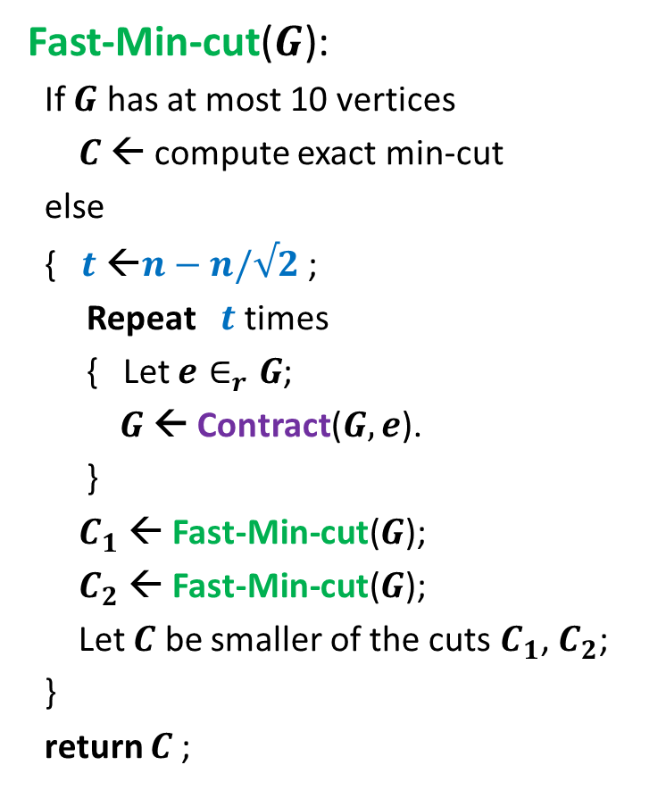

Faster algorithm for min-cut
Fast-Min-cut($G$):
If $G$ has at most 10 vertices
$C$ ← compute exact min-cut
else
{ $t$ ←$n−n/√2$ ;
Repeat $t$ times
{ Let $e∈_{r}G$;
$G$ ← Contract($G,e$).
}
$C_{1}$ ← Fast-Min-cut($G$);
$C_{2}$ ← Fast-Min-cut($G$);
Let $C$ be smaller of the cuts $C_{1}$, $C_{2}$;
}
return $C$;
Running time of the algorithm :$O(n^{2}log n)$
Question: Prob. min-cut is preserved at the end of the Repeat loop = ?
$q\left(n\right)$ : the probability that algorithm returns the min-cut.
For $n≤10$, $q\left(n\right)=1$
For $n>10$, $q\left(n\right)=$ ??
$$=\frac{1}{2}\left(at least one recursive call is correct\right)$$
$=\frac{1}{2}\left(1−{\left(1−q\left(\frac{n}{\sqrt{2}}\right)\right)}^{2}\right)$
1/2

Slide 25
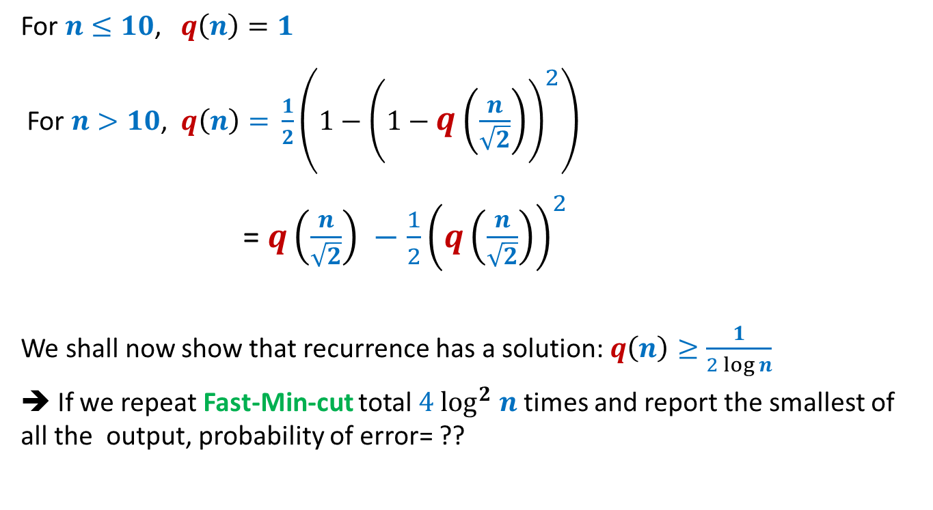


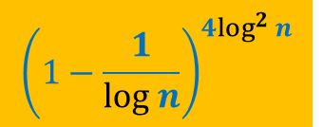
Success probability of Fast-Min-cut($G$)
For $n≤10$, $q\left(n\right)=1$
For $n>10$, $q\left(n\right)=$ $\frac{1}{2}\left(1−{\left(1−q\left(\frac{n}{\sqrt{2}}\right)\right)}^{2}\right)$
= $q\left(\frac{n}{\sqrt{2}}\right) −\frac{1}{2}{\left(q\left(\frac{n}{\sqrt{2}}\right)\right)}^{2}$
We shall now show that recurrence has a solution: $q\left(n\right)≥\frac{1}{2 log n}$
➔ If we repeat Fast-Min-cut total $4 \log^{2} n$ times and report the smallest of all the output, probability of error= ??
$${\left(1−\frac{1}{log n}\right)}^{4\log^{2} n}$$
< $n^{−4}$

Slide 26
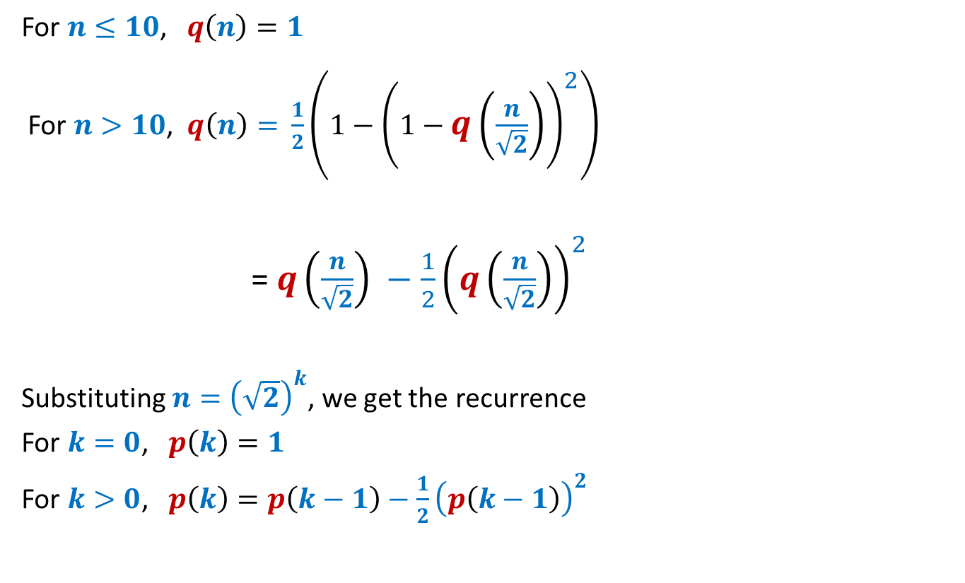
Solving the recurrence
For $n≤10$, $q\left(n\right)=1$
For $n>10$, $q\left(n\right)=$ $\frac{1}{2}\left(1−{\left(1−q\left(\frac{n}{\sqrt{2}}\right)\right)}^{2}\right)$
= $q\left(\frac{n}{\sqrt{2}}\right) −\frac{1}{2}{\left(q\left(\frac{n}{\sqrt{2}}\right)\right)}^{2}$
Substituting $n={\left(\sqrt{2}\right)}^{k}$, we get the recurrence
For $k=0$, $p\left(k\right)=1$
For $k>0$, $p\left(k\right)=p\left(k−1\right)−\frac{1}{2}{\left(p\left(k−1\right)\right)}^{2}$

Slide 27
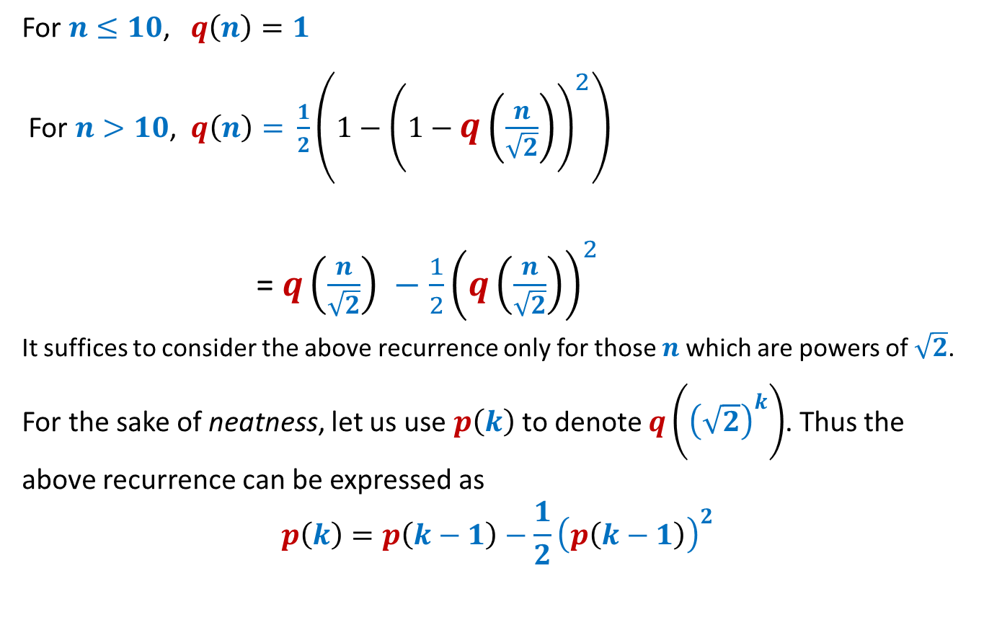
Solving the recurrence
For $n≤10$, $q\left(n\right)=1$
For $n>10$, $q\left(n\right)=$ $\frac{1}{2}\left(1−{\left(1−q\left(\frac{n}{\sqrt{2}}\right)\right)}^{2}\right)$
= $q\left(\frac{n}{\sqrt{2}}\right) −\frac{1}{2}{\left(q\left(\frac{n}{\sqrt{2}}\right)\right)}^{2}$
It suffices to consider the above recurrence only for those $n$which are powers of $\sqrt{2}$.
For the sake of neatness, let us use $p\left(k\right)$to denote $q\left({\left(\sqrt{2}\right)}^{k}\right)$. Thus the above recurrence can be expressed as
$$p\left(k\right)=p\left(k−1\right)−\frac{1}{2}{\left(p\left(k−1\right)\right)}^{2}$$

Slide 28
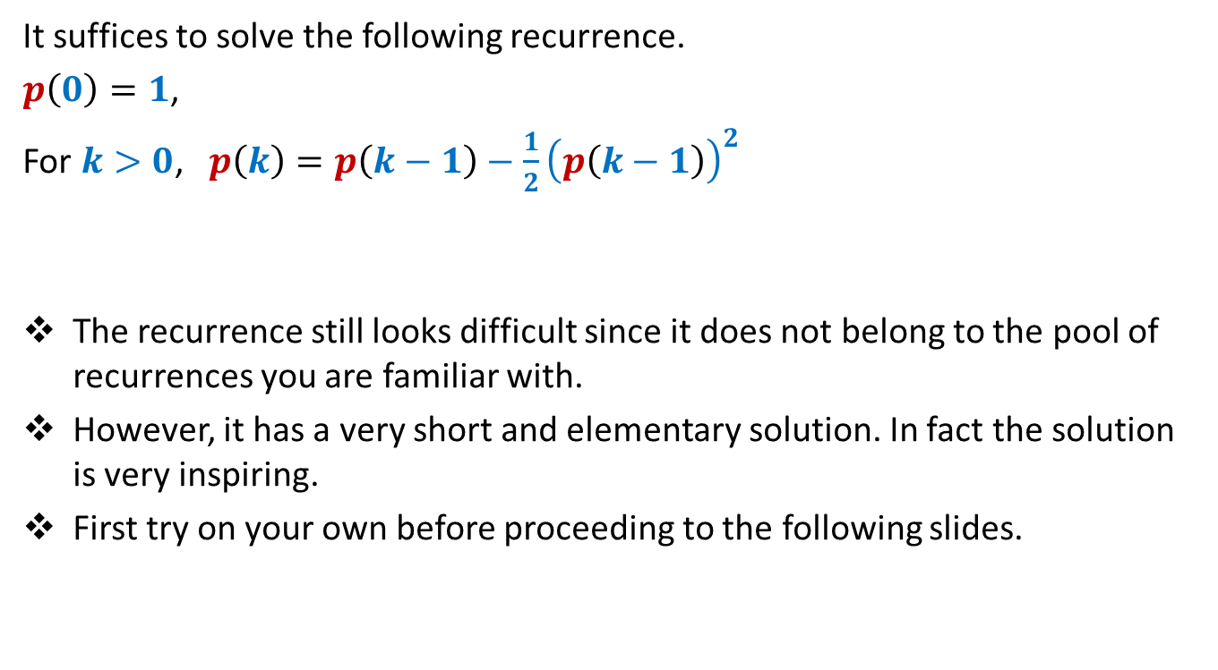
Solving the recurrence
It suffices to solve the following recurrence.
$p\left(0\right)=1$,
For $k>0$, $p\left(k\right)=p\left(k−1\right)−\frac{1}{2}{\left(p\left(k−1\right)\right)}^{2}$
The recurrence still looks difficult since it does not belong to the pool of recurrences you are familiar with.
However, it has a very short and elementary solution. In fact the solution is very inspiring.
First try on your own before proceeding to the following slides.

Slide 29
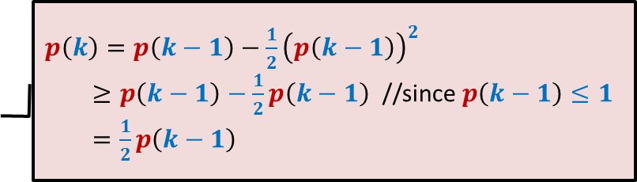
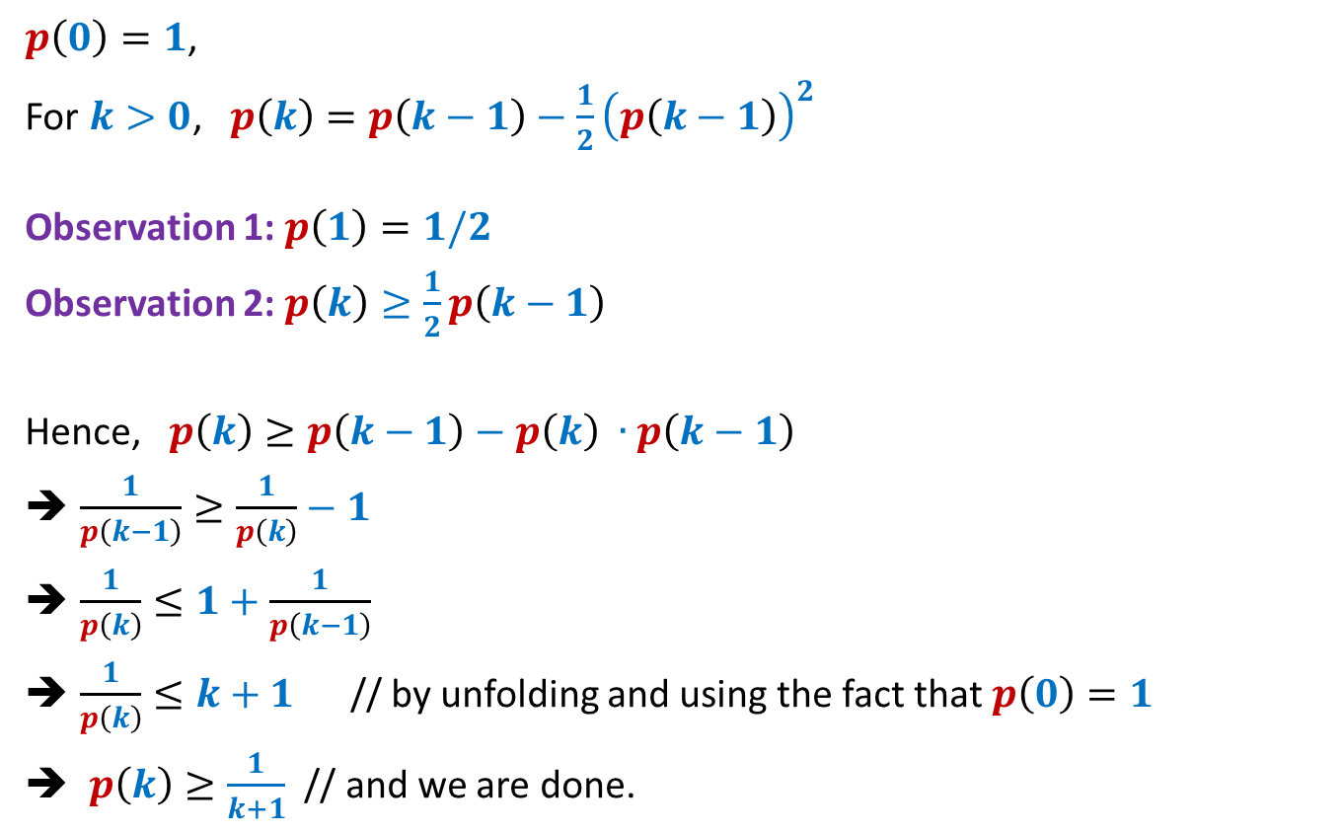
Solving the recurrence
$p\left(0\right)=1$,
For $k>0$, $p\left(k\right)=p\left(k−1\right)−\frac{1}{2}{\left(p\left(k−1\right)\right)}^{2}$
Observation 1: $p\left(1\right)=1/2$
Observation 2: $p\left(k\right)≥\frac{1}{2}p\left(k−1\right)$
Hence, $p\left(k\right)≥p\left(k−1\right)−p\left(k\right) ∙p\left(k−1\right)$
$\frac{1}{p\left(k−1\right)}≥\frac{1}{p\left(k\right)}−1$
$\frac{1}{p\left(k\right)}≤1+\frac{1}{p\left(k−1\right)}$
$\frac{1}{p\left(k\right)}≤k+1$ // by unfolding and using the fact that $p\left(0\right)=1$
$p\left(k\right)≥\frac{1}{k+1}$ // and we are done.
proof
$p\left(k\right)=p\left(k−1\right)−\frac{1}{2}{\left(p\left(k−1\right)\right)}^{2}$
$≥p\left(k−1\right)−\frac{1}{2}p\left(k−1\right)$ //since $p\left(k−1\right)≤1$
$=\frac{1}{2}p\left(k−1\right)$

Slide 30
This lecture introduced many concepts which can be used for design and analysis of efficient randomized algorithms. Try to reflect upon these concept…☺

