Slide 1
Randomized Algorithms
CS648
Lecture 16
Randomized Incremental Construction
(Backward analysis)

Slide 2
problem 1 find-min Problem

Slide 3
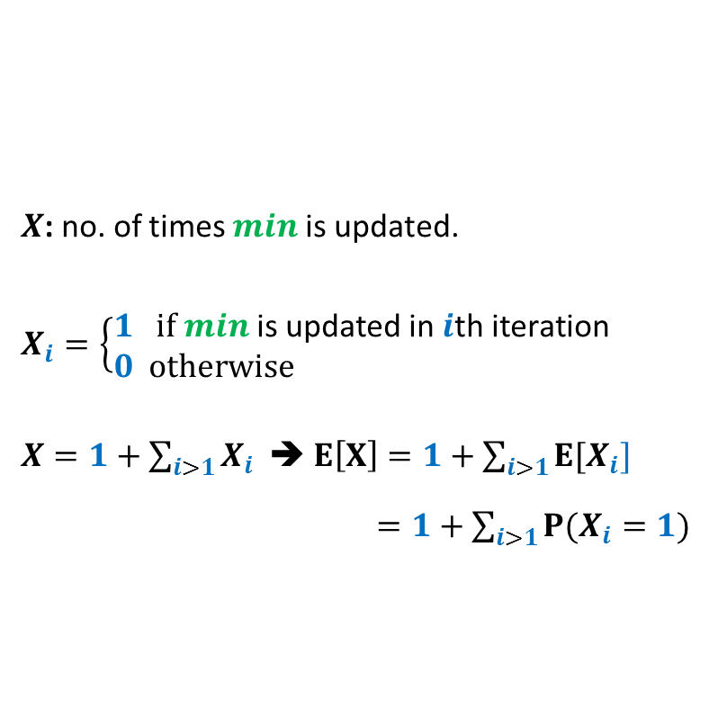

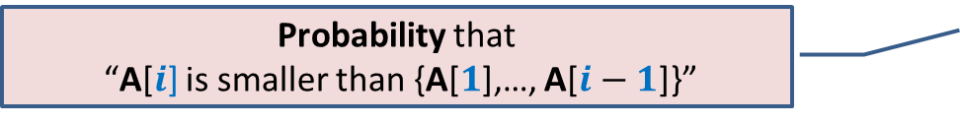

Find-Min algorithm
Find-Min(A[1..$n$])
{ $min$ ← A[1];
For $i=2$ to $n$ do
{ if (A[$i$] $<min$)
$min$ ← A[$i$] ;
}
return $min$;
}
$X$: no. of times $min$is updated.
$X_{i}=\left\{\begin{aligned}1 if min \text{is} \text{updated} \text{in} i\text{th} \text{iteration} \\ 0 otherwise \end{aligned}\right.$
$X=1+\sum_{i>1}{X_{i}}$ ➔ $E\left[X\right]=1+\sum_{i>1}{{E[X}_{i}]}$
$=1+\sum_{i>1}{{P(X}_{i}}=1)$
A
1 2 …
$$n−1$$
Probability that
“A[$i$] is smaller than {A[$1$],…, A[$i−1$]}”
??

Slide 4



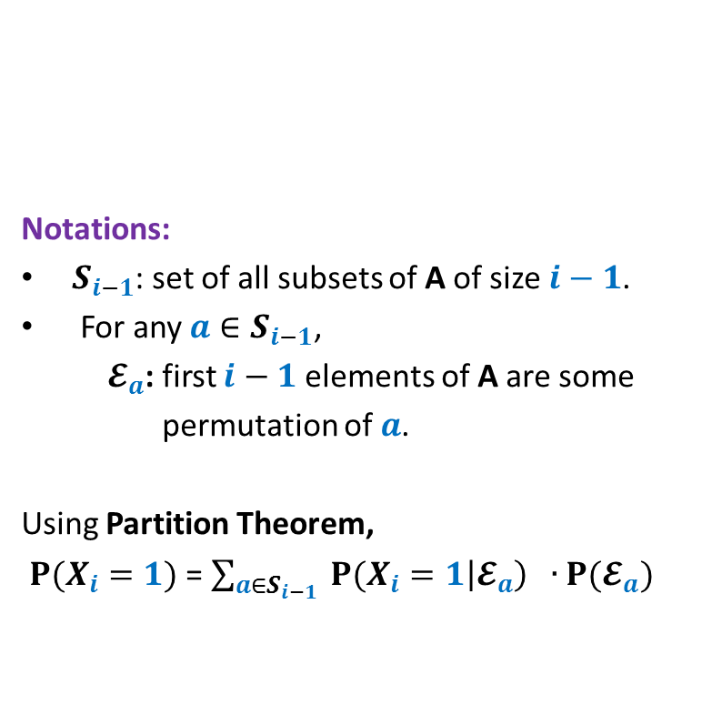
Forward analysis for
${P(X}_{i}=1)$
First $i−1$ elements
Find-Min(A[1..$n$])
{ $min$ ← A[1];
For $i=2$ to $n$ do
{ if (A[$i$] $<min$)
$min$ ← A[$i$] ;
}
return $min$;
}
Notations:
$S_{i−1}$: set of all subsets of A of size $i−1$.
For any $a∈S_{i−1}$,
$𝓔_{a}$: first $i−1$ elements of A are some
permutation of $a$.
Using Partition Theorem,
${P(X}_{i}=1)$ = $\sum_{a∈S_{i−1}}{ {P(X}_{i}=1\left|𝓔_{a}\right) ∙P(𝓔_{a}) }$
A
1 2 …
$$i$$
$$n−1$$

Slide 5
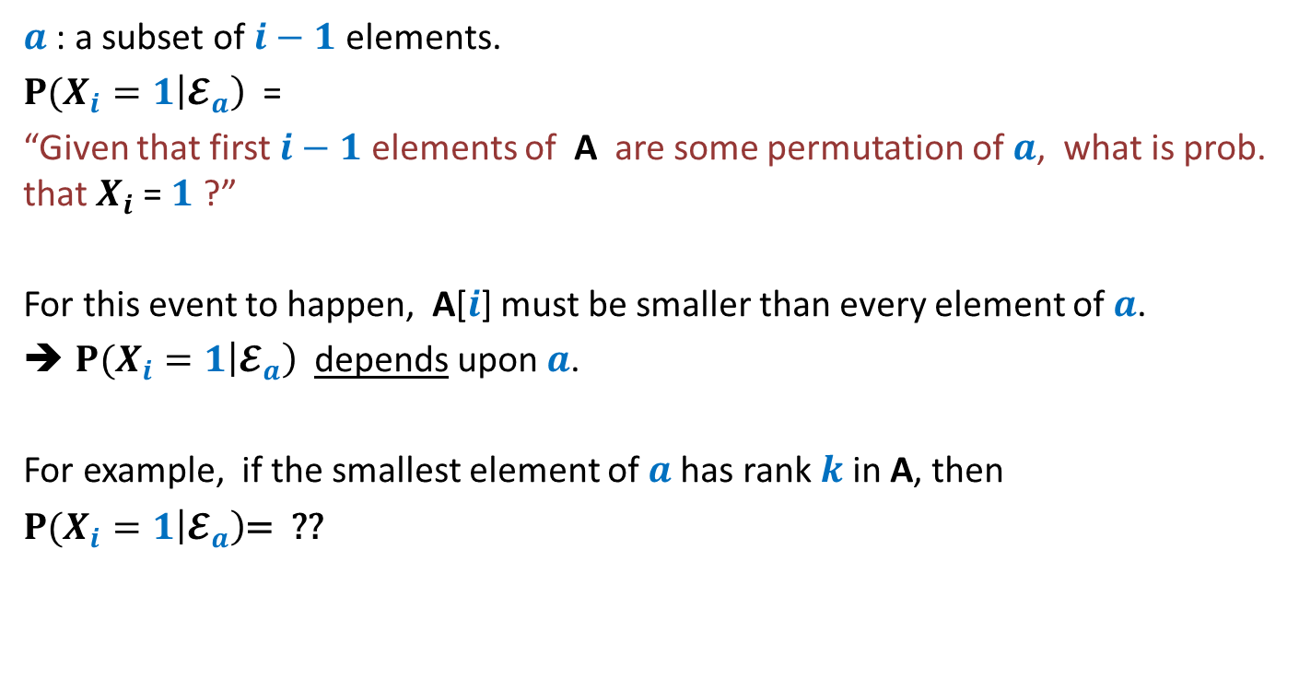
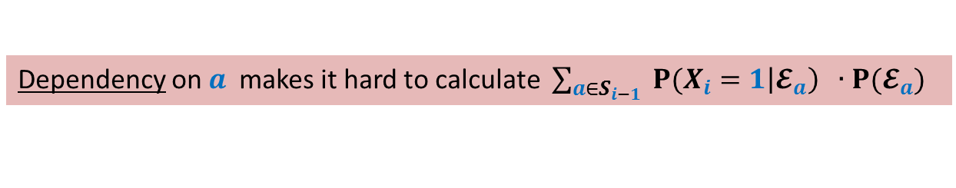
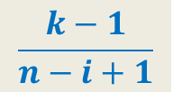
Forward analysis for
${P(X}_{i}=1)$
$a$ : a subset of $i−1$ elements.
${P(X}_{i}=1\left|𝓔_{a}\right)$ =
“Given that first $i−1$ elements of A are some permutation of $a$, what is prob. that $X_{i}$= $1$ ?”
For this event to happen, A[$i$] must be smaller than every element of $a$.
${P(X}_{i}=1\left|𝓔_{a}\right)$ depends upon $a$.
For example, if the smallest element of $a$has rank $k$in A, then
${P(X}_{i}=1\left|𝓔_{a}\right)$= ??
$$\frac{k−1}{n−i+1}$$
Dependency on $a$ makes it hard to calculate $\sum_{a∈S_{i−1}}{ {P(X}_{i}=1\left|𝓔_{a}\right) ∙P(𝓔_{a}) }$

Slide 6


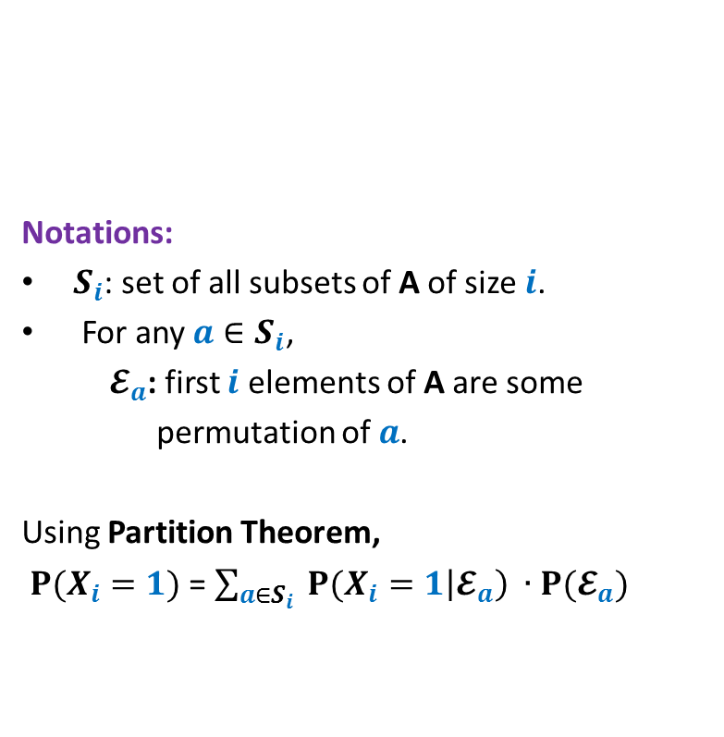
Backward analysis for
${P(X}_{i}=1)$
First $i$ elements
Notations:
$S_{i}$: set of all subsets of A of size $i$.
For any $a∈S_{i}$,
$𝓔_{a}$: first $i$ elements of A are some
permutation of $a$.
Using Partition Theorem,
${P(X}_{i}=1)$ = $\sum_{a∈S_{i}}{ {P(X}_{i}=1\left|𝓔_{a}\right) ∙P(𝓔_{a}) }$
Find-Min(A[1..$n$])
{ $min$ ← A[1];
For $i=2$ to $n$ do
{ if (A[$i$] $<min$)
$min$ ← A[$i$] ;
}
return $min$;
}
A
1 2 …
$$i$$
$$n−1$$

Slide 7
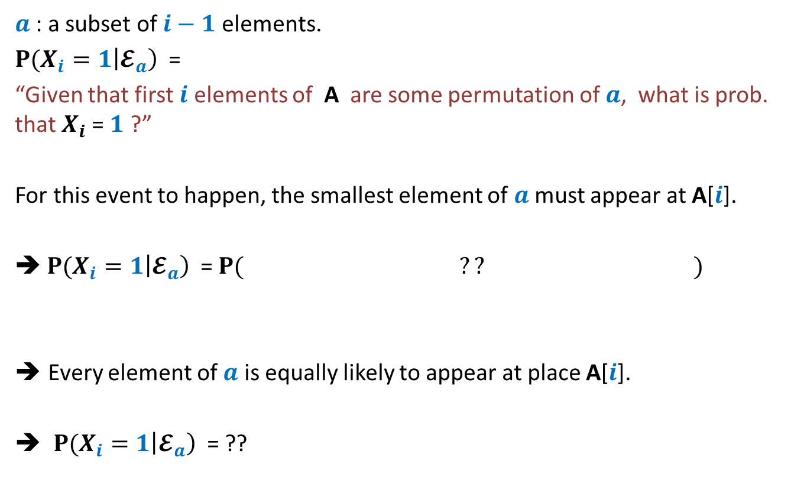



Backward analysis for
${P(X}_{i}=1)$
$a$ : a subset of $i−1$ elements.
${P(X}_{i}=1\left|𝓔_{a}\right)$ =
“Given that first $i$ elements of A are some permutation of $a$, what is prob. that $X_{i}$= $1$ ?”
For this event to happen, the smallest element of $a$ must appear at A[$i$].
➔ ${P(X}_{i}=1\left|𝓔_{a}\right)$ = $P( ?? )$
Every element of $a$ is equally likely to appear at place A[$i$].
${P(X}_{i}=1\left|𝓔_{a}\right)$ = ??
“the smallest element of $a$appear at A[$i$]”
Fact: A is permuted randomly uniformly
$$\frac{1}{i}$$
Same for each $a$

Slide 8


Backward analysis for
${P(X}_{i}=1)$
First $i$ elements
Notations:
$S_{i}$: set of all subsets of A of size $i$.
For any $a∈S_{i}$,
$𝓔_{a}$: first $i$ elements of A are some
permutation of $a$.
Using Partition Theorem,
${P(X}_{i}=1)$ = $\sum_{a∈S_{i}}{ {P(X}_{i}=1\left|𝓔_{a}\right) ∙P(𝓔_{a}) }$
= $\frac{1}{i}$ $\sum_{a∈S_{i}}{ P(𝓔_{a}) }$
= $\frac{1}{i}⋅1$
Find-Min(A[1..$n$])
{ $min$ ← A[1];
For $i=2$ to $n$ do
{ if (A[$i$] $<min$)
$min$ ← A[$i$] ;
}
return $min$;
}
A
1 2 …
$$i$$
$$n−1$$
$\frac{1}{i}$

Slide 9
problem 2
Closest Pair of Points

Slide 10
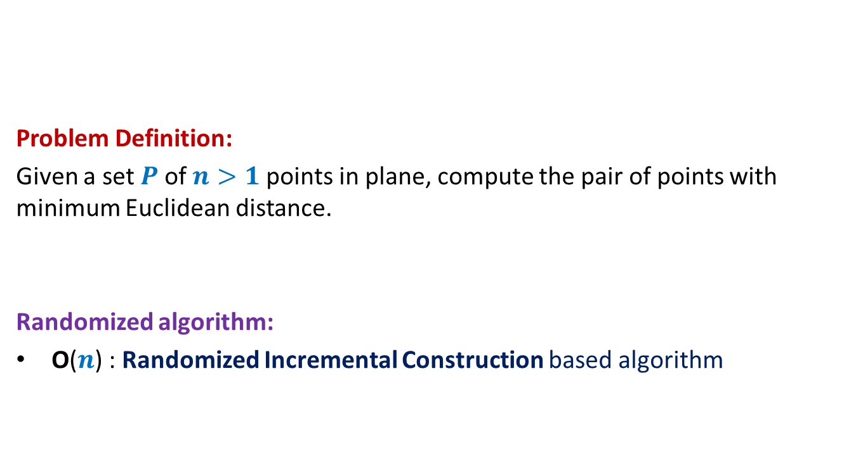
Closest Pair of Points
Problem Definition:
Given a set $P$of $n>1$points in plane, compute the pair of points with minimum Euclidean distance.
Randomized algorithm:
O($n$) : Randomized Incremental Construction based algorithm

Slide 11




$i$th iteration
Grid structure for first $i−1$points
$$δ_{i−1}$$
$$δ_{i−1}$$

Slide 12
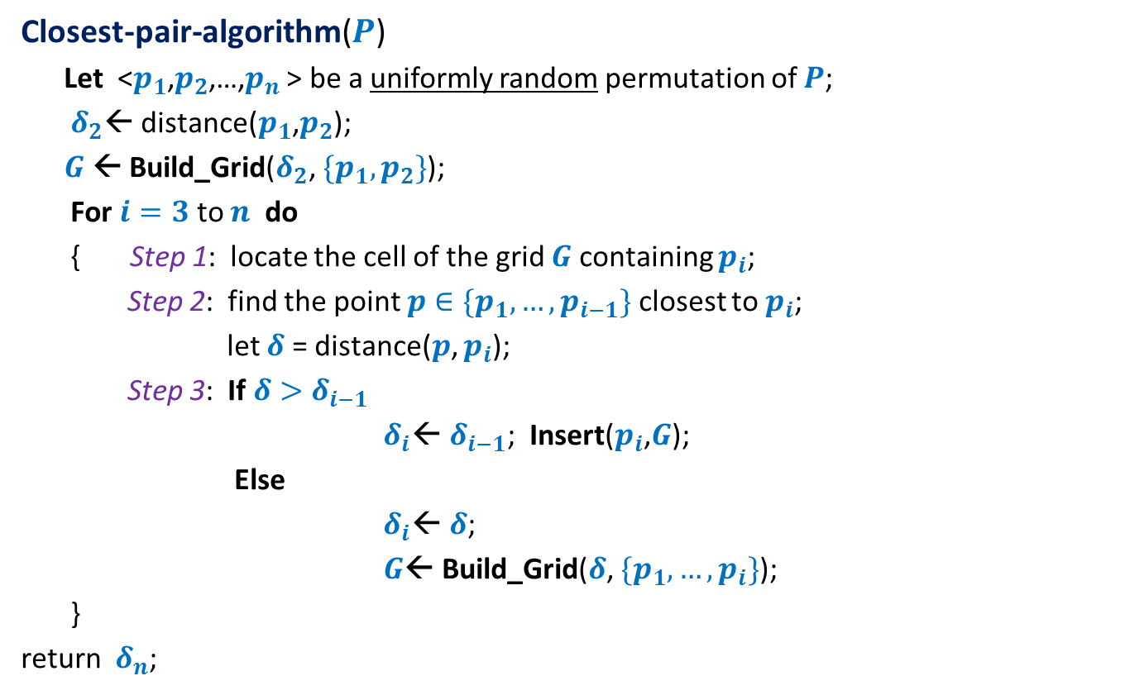


Analysis of $i$th iteration
Closest-pair-algorithm($P$)
Let <$p_{1}$,$p_{2}$,…,$p_{n}$ > be a uniformly random permutation of $P$;
$δ_{2}$← distance($p_{1}$,$p_{2}$);
$G$← Build_Grid($δ_{2}$, ${\{p_{1}, p}_{2}\}$);
For $i=3$ to $n$ do
{ Step 1: locate the cell of the grid $G$containing $p_{i}$;
Step 2: find the point $p∈\{p_{1},…,p_{i−1}\}$ closest to $p_{i}$;
let $δ$ = distance($p$, $p_{i}$);
Step 3: If $δ>δ_{i−1}$
$δ_{i}$← $δ_{i−1}$; Insert($p_{i}$,$G$);
Else
$δ_{i}$← $δ$;
$G$← Build_Grid($δ$, $\{p_{1},…,p_{i}\}$);
}
return $δ_{n}$;
O(1)
O(1)
O(1)
$ci$ for constant $c$

Slide 13



running time of $i$th iteration
$X_{i}$ : running time of $i$th iteration
E[$X_{i}$] = ??
Question: What is ${P(δ}_{i}<δ_{i−1})$ ?
O(1) + $ci$ ∙ ${P(δ}_{i}<δ_{i−1})$

Slide 14

Forward analysis for
$${P(δ}_{i}<δ_{i−1})$$
Closest-pair-algorithm($P$)
Let <$p_{1}$,$p_{2}$,…,$p_{n}$ > be a uniformly random permutation of $P$;
$δ_{2}$← distance($p_{1}$,$p_{2}$);
$G$← Build_Grid($δ_{2}$, ${\{p_{1}, p}_{2}\}$);
For $i=3$ to $n$ do
{ Step 1: locate the cell of the grid $G$containing $p_{i}$;
Step 2: find the point $p∈\{p_{1},…,p_{i−1}\}$ closest to $p_{i}$;
let $δ$ = distance($p$, $p_{i}$);
Step 3: If $δ>δ_{i−1}$
$δ_{i}$← $δ_{i−1}$; Insert($p_{i}$,$G$);
Else
$δ_{i}$← $δ$;
$G$← Build_Grid($δ$, $\{p_{1},…,p_{i}\}$);
}
return $δ_{n}$;

Slide 15
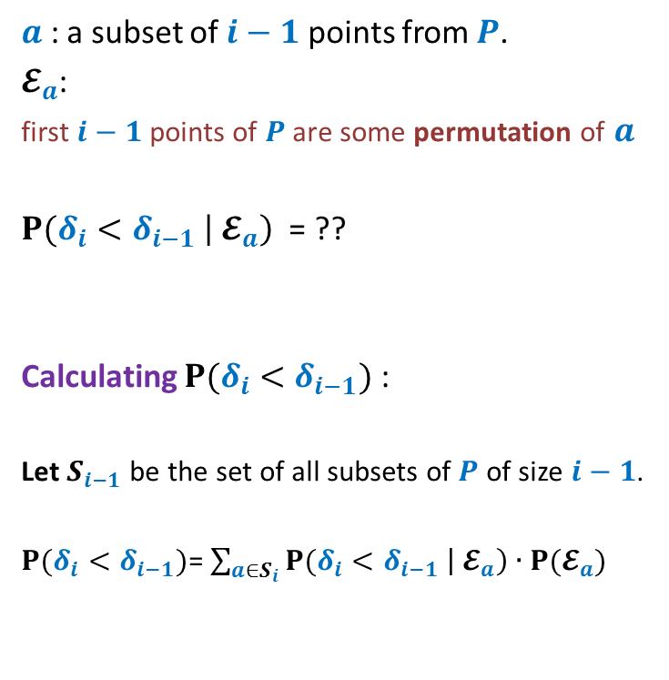




Forward analysis for
$${P(δ}_{i}<δ_{i−1})$$
$a$ : a subset of $i−1$ points from $P$.
$𝓔_{a}$:
first $i−1$ points of $P$ are some permutation of $a$
${P(δ}_{i}<δ_{i−1} \left|{ 𝓔}_{a}\right)$ = ??
Calculating ${P(δ}_{i}<δ_{i−1})$ :
Let $S_{i−1}$ be the set of all subsets of $P$ of size $i−1$.
${P(δ}_{i}<δ_{i−1})$= $\sum_{a∈S_{i}}{{P(δ}_{i}<δ_{i−1} \left|{ 𝓔}_{a}\right)∙P(𝓔_{a}) }$
$$δ_{i−1}$$
Depends upon $a$
$$δ_{i−1}$$
Grid structure for first $i−1$points

Slide 16

Backward analysis for
$${P(δ}_{i}<δ_{i−1})$$
Closest-pair-algorithm($P$)
Let <$p_{1}$,$p_{2}$,…,$p_{n}$ > be a uniformly random permutation of $P$;
$δ_{2}$← distance($p_{1}$,$p_{2}$);
$G$← Build_Grid($δ_{2}$, ${\{p_{1}, p}_{2}\}$);
For $i=3$ to $n$ do
{ Step 1: locate the cell of the grid $G$containing $p_{i}$;
Step 2: find the point $p∈\{p_{1},…,p_{i−1}\}$ closest to $p_{i}$;
let $δ$ = distance($p$, $p_{i}$);
Step 3: If $δ>δ_{i−1}$
$δ_{i}$← $δ_{i−1}$; Insert($p_{i}$,$G$);
Else
$δ_{i}$← $δ$;
$G$← Build_Grid($δ$, $\{p_{1},…,p_{i}\}$);
}
return $δ_{n}$;

Slide 17

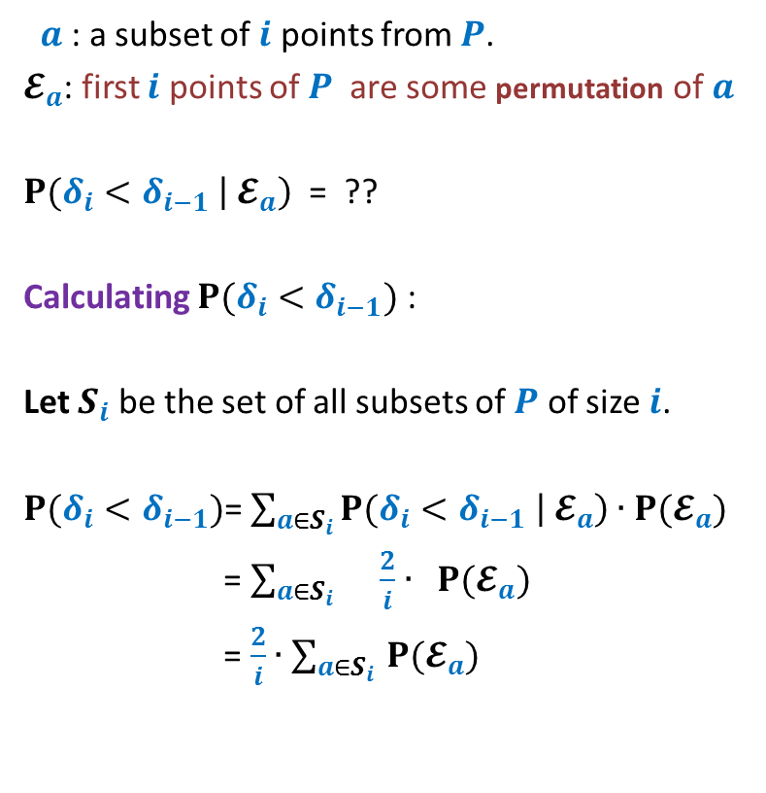





Backward analysis for
$${P(δ}_{i}<δ_{i−1})$$
$a$ : a subset of $i$ points from $P$.
$𝓔_{a}$: first $i$ points of $P$ are some permutation of $a$
${P(δ}_{i}<δ_{i−1} \left|{ 𝓔}_{a}\right)$ = ??
Calculating ${P(δ}_{i}<δ_{i−1})$ :
Let $S_{i}$ be the set of all subsets of $P$ of size $i$.
${P(δ}_{i}<δ_{i−1})$= $\sum_{a∈S_{i}}{{P(δ}_{i}<δ_{i−1} \left|{ 𝓔}_{a}\right)∙P(𝓔_{a}) }$
= $\sum_{a∈S_{i} }{\frac{2}{i}∙ P(𝓔_{a}) }$
= $\frac{2}{i}∙$ $\sum_{a∈S_{i} }{P(𝓔_{a}) }$
$$\frac{2}{i}$$
$$δ_{i}$$
$$δ_{i}$$
= $\frac{2}{i}$
Grid structure for first $i$ points

Slide 18
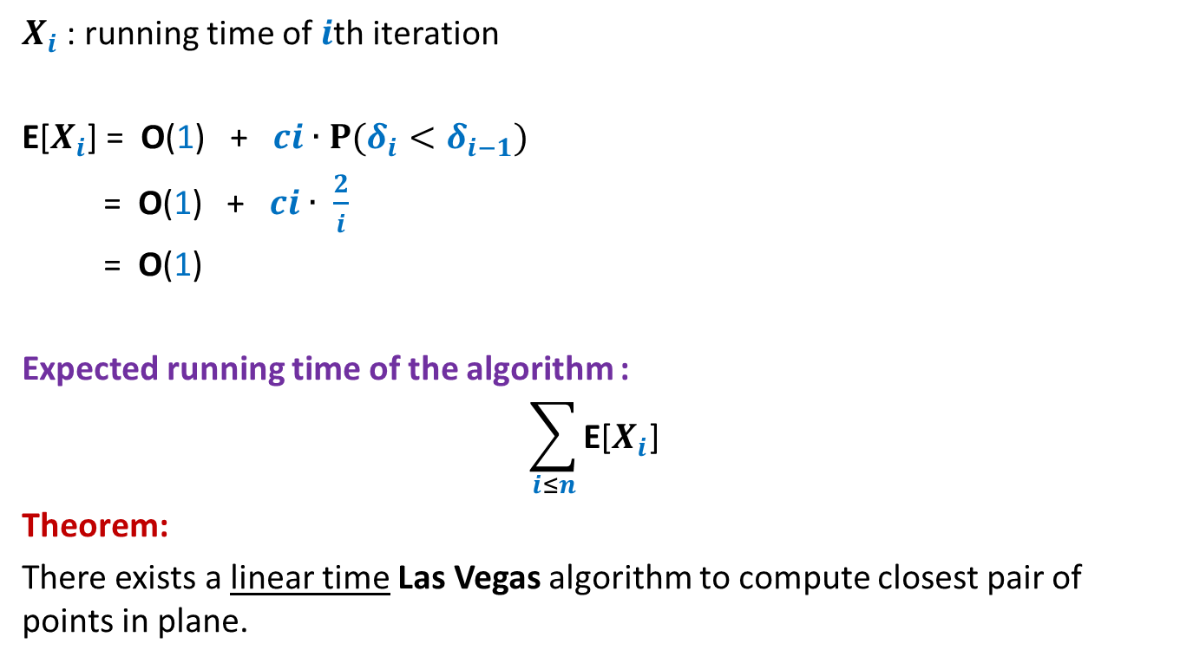

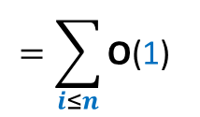
running time of $i$th iteration
$X_{i}$ : running time of $i$th iteration
E[$X_{i}$] = O(1) + $ci$ ∙ ${P(δ}_{i}<δ_{i−1})$
= O(1) + $ci$ ∙ $\frac{2}{i}$
= O(1)
Expected running time of the algorithm :
$$\sum_{i≤n}{\text{E}\text{[}X_{i}\text{]}}$$
Theorem:
There exists a linear time Las Vegas algorithm to compute closest pair of points in plane.
$$=\sum_{i≤n}{\text{O}\text{(}\text{1}\text{)}}$$
= $\text{O}\text{(}n\text{)}$

Slide 19
Randomized Incremental Construction

Slide 20
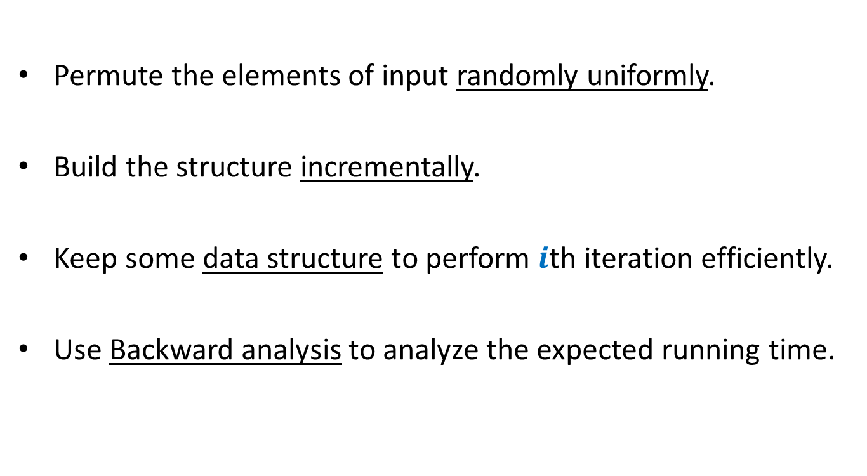
Randomized Incremental Construction
Permute the elements of input randomly uniformly.
Build the structure incrementally.
Keep some data structure to perform $i$th iteration efficiently.
Use Backward analysis to analyze the expected running time.

Slide 21
Randomized Incremental Construction
Convex Hull of a set of points
Trapezoidal decomposition of a set of segments.
Convex polytope of a set of half-planes
Smallest sphere enclosing a set of points.
Linear programming in finite dimensions.

Slide 22
problem 3
Convex hull of Points

Slide 23

Convex hull of Points
Problem definition:
Given $n$ points in a plane, compute a convex polygon of smallest area that encloses all the points.

Slide 24
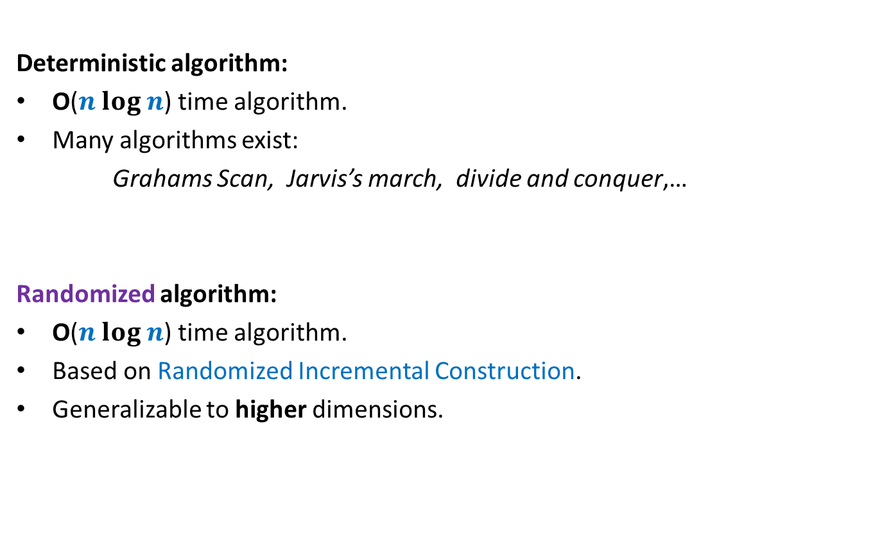
Convex hull of Points
Deterministic algorithm:
O($n log n$) time algorithm.
Many algorithms exist:
Grahams Scan, Jarvis’s march, divide and conquer,…
Randomized algorithm:
O($n log n$) time algorithm.
Based on Randomized Incremental Construction.
Generalizable to higher dimensions.

Slide 25
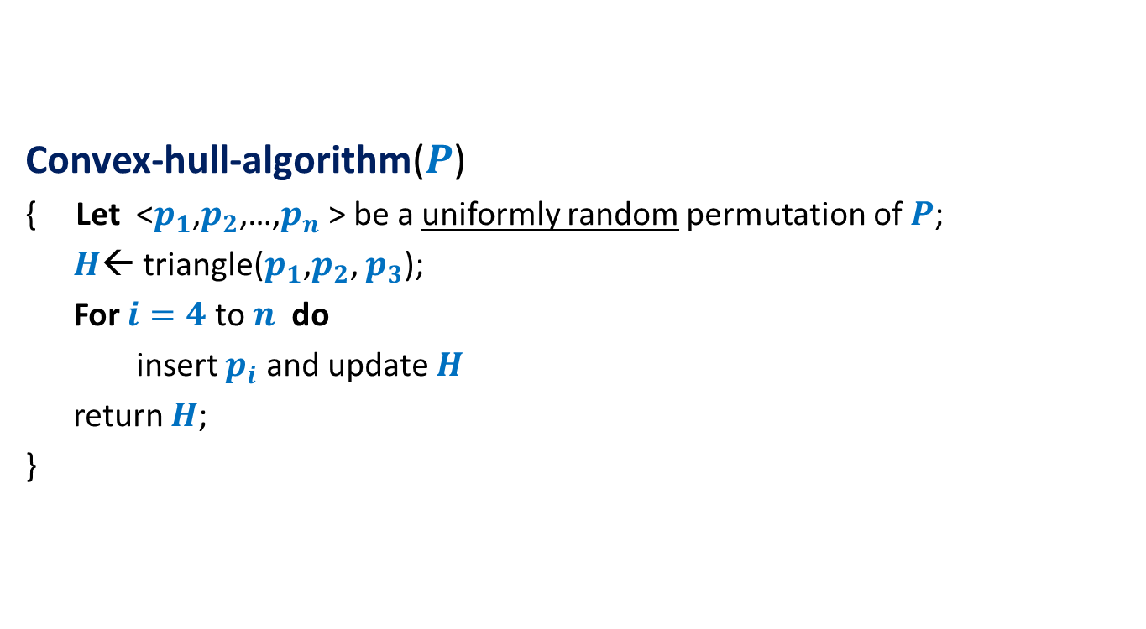
Randomized algorithm for convex hull
Convex-hull-algorithm($P$)
{ Let <$p_{1}$,$p_{2}$,…,$p_{n}$ > be a uniformly random permutation of $P$;
$H$← triangle($p_{1}$,$p_{2}$, $p_{3}$);
For $i=4$ to $n$ do
insert $p_{i}$ and update $H$
return $H$;
}

Slide 26

A simple exercise from geometry
Exercise: Given a line L and two points p and q, determine whether the points lie on the same/different sides of L.
L
p
q
q
$$y=mx+c$$

Slide 27

















Conflict graph : a powerful data structure
$$c_{2}$$
$n−i$points
cones
$$c_{1}$$
$$c_{1}$$
$$c_{8}$$
$$c_{3}$$
$$c_{2}$$
$$c_{3}$$
$$c_{4}$$
$$c_{5}$$
$$c_{7}$$
$$c_{4}$$
$$c_{6}$$
$$c_{7}$$
$$c_{8}$$
$$c_{5}$$
$$c_{6}$$

Slide 28
Before entering the for loop

Slide 29




Before entering the for loop
$n−3$points
cones
$$c_{1}$$
$$c_{1}$$
$$c_{2}$$
$$c_{2}$$
$$c_{3}$$
$$c_{3}$$

Slide 30

Inserting $i$th POINt

Slide 31


$i$th iteration
$$c_{1}$$
$$c_{2}$$
$$c_{8}$$
$$c_{3}$$
$$c_{7}$$
$$c_{4}$$
$$c_{5}$$
$$c_{6}$$

Slide 32
$i$th iteration
$$c_{2}$$
$n−i$points
cones
$$c_{1}$$
$$c_{1}$$
$$c_{8}$$
$$c_{3}$$
$$c_{2}$$
$$c_{3}$$
$$c_{4}$$
$$c_{5}$$
$$c_{7}$$
$$c_{4}$$
$$c_{6}$$
$$c_{7}$$
$$c_{8}$$
$$c_{5}$$
$$c_{6}$$

Slide 33
$i$th iteration
$$c_{2}$$
$n−i$points
cones
$$c_{1}$$
$$c_{1}$$
$$c_{8}$$
$$c_{3}$$
$$c_{2}$$
$$c_{3}$$
$$c_{4}$$
$$c_{5}$$
$$c_{7}$$
$$c_{4}$$
$$c_{6}$$
$$c_{7}$$
$$c_{8}$$
$$c_{5}$$
$$c_{6}$$

Slide 34
$i$th iteration
$$c_{2}$$
$n−i$points
cones
$$c_{1}$$
$$c_{1}$$
$$c_{8}$$
$$c_{3}$$
$$c_{2}$$
$$c_{3}$$
$$c_{4}$$
$$c_{5}$$
$$c_{7}$$
$$c_{4}$$
$$c_{6}$$
$$c_{7}$$
$$c_{8}$$
$$c_{5}$$
$$c_{6}$$

Slide 35
$i$th iteration
$$c_{2}$$
$n−i$points
cones
$$c_{1}$$
$$c_{1}$$
$$c_{8}$$
$$c_{3}$$
$$c_{2}$$
$$c_{3}$$
$$c_{4}$$
$$c_{5}$$
$$c_{7}$$
$$c_{4}$$
$$c_{6}$$
$$c_{7}$$
$$c_{8}$$
$$c_{5}$$
$$c_{6}$$

Slide 36
$i$th iteration
$$c_{2}$$
$n−i$points
cones
$$c_{1}$$
$$c_{1}$$
$$c_{8}$$
$$c_{3}$$
$$c_{2}$$
$$c_{3}$$
$$c_{4}$$
$$c_{5}$$
$$c_{7}$$
$$c_{4}$$
$$c_{6}$$
$$c_{7}$$
$$c_{8}$$
$$c_{5}$$
$$c_{6}$$

Slide 37
$i$th iteration
$$c_{2}$$
$n−i$points
cones
$$c_{1}$$
$$c_{1}$$
$$c_{8}$$
$$c_{3}$$
$$c_{2}$$
$$c_{3}$$
$$c_{4}$$
$$c_{5}$$
$$c_{7}$$
$$c_{4}$$
$$c_{6}$$
$$c_{7}$$
$$c_{8}$$
$$c_{5}$$
$$c_{6}$$

Slide 38
$i$th iteration
$$c_{2}$$
$n−i$points
cones
$$c_{1}$$
$$c_{1}$$
$$c_{8}$$
$$c_{3}$$
$$c_{2}$$
$$c_{3}$$
$$c_{4}$$
$$c_{5}$$
$$c_{7}$$
$$c_{4}$$
$$c_{6}$$
$$c_{7}$$
$$c_{8}$$
$$c_{5}$$
$$c_{6}$$

Slide 39
$i$th iteration
$$c_{2}$$
$n−i$points
cones
$$c_{1}$$
$$c_{1}$$
$$c_{8}$$
$$c_{3}$$
$$c_{2}$$
$$c_{3}$$
$$c_{4}$$
$$c_{5}$$
$$c_{7}$$
$$c_{4}$$
$$c_{6}$$
$$c_{7}$$
$$c_{8}$$
$$c_{5}$$
$$c_{6}$$

Slide 40




$i$th iteration
$n−i$points
cones
$$c_{1}$$
$$c_{1}$$
$$c_{8}$$
$$c′$$
$$c′$$
$$c"$$
$$c_{7}$$
$$c_{6}$$
$$c"$$
$$c_{7}$$
$$c_{8}$$
$$c_{6}$$

Slide 41
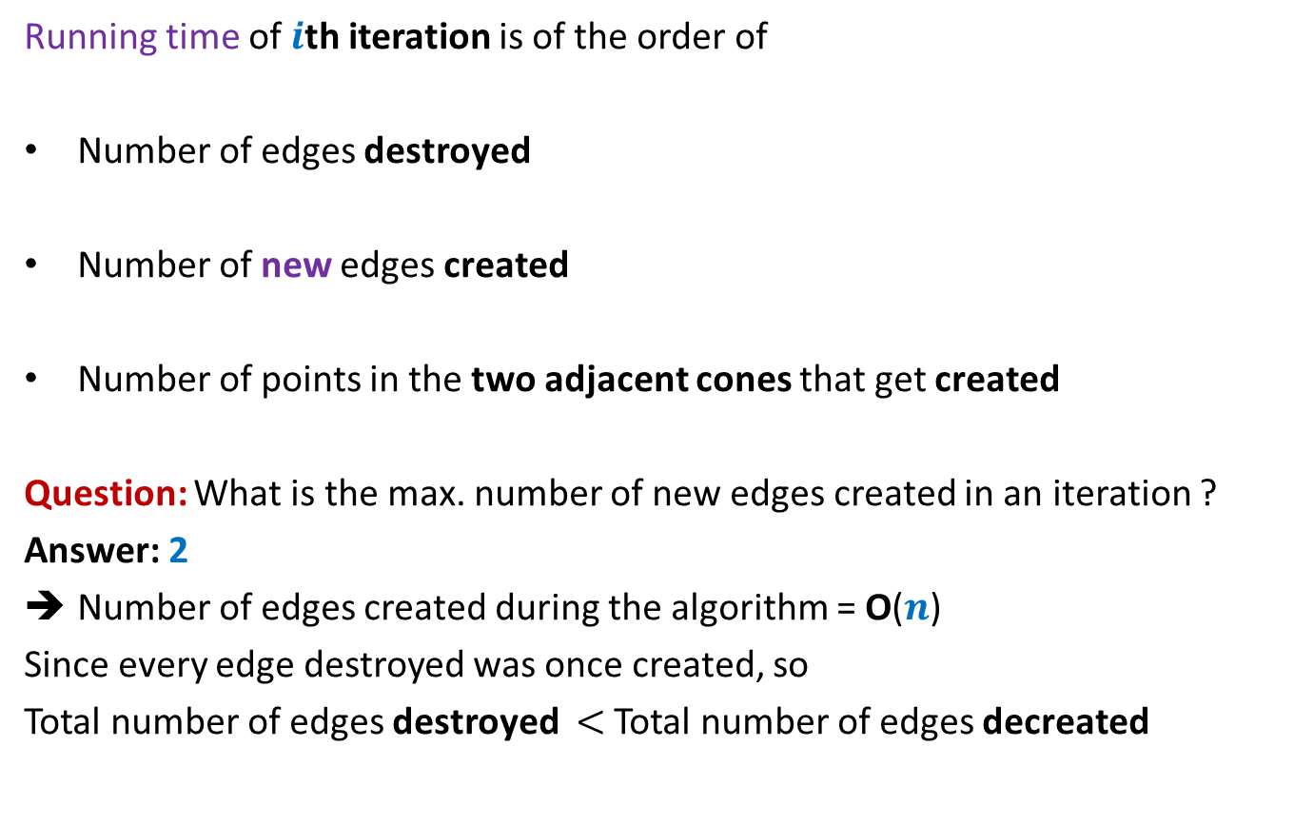



Running time of $i$th iteration
Running time of $i$th iteration is of the order of
Number of edges destroyed
Number of new edges created
Number of points in the two adjacent cones that get created
Question: What is the max. number of new edges created in an iteration ?
Answer: 2
Number of edges created during the algorithm = O($n$)
Since every edge destroyed was once created, so
Total number of edges destroyed $<$ Total number of edges decreated
Total time for $n$iterations = O($n$)
$$X_{i}$$

Slide 42


Backward analysis of $i$th iteration
$a$ : a subset of $i$ points from $P$.
$𝓔_{a}$: first $i$ points of $P$ are some permutation of $a$
${E[X}_{i} \left|{ 𝓔}_{a}\right)$ = ??

Slide 43









Backward analysis of $i$th iteration
$a$ : a subset of $i$ points from $P$.
$𝓔_{a}$: first $i$ points of $P$ are some permutation of $a$
${E[X}_{i} \left|{ 𝓔}_{a}\right)$ = ??
$$c_{1}$$
$$c_{2}$$
$$c_{8}$$
$$p_{1}$$
$$c_{3}$$
$$p_{8}$$
$$p_{2}$$
$$p_{7}$$
$$p_{3}$$
$$c_{7}$$
$$c_{4}$$
$$p_{4}$$
$$p_{6}$$
$$p_{5}$$
$$c_{5}$$
$$c_{6}$$

Slide 44

Backward analysis of $i$th iteration
$a$ : a subset of $i$ points from $P$.
$𝓔_{a}$: first $i$ points of $P$ are some permutation of $a$
${E[X}_{i} \left|{ 𝓔}_{a}\right)$ = ??
$$c_{1}$$
$$c_{2}$$
$$c_{8}$$
$$p_{1}$$
$$c_{3}$$
$$p_{8}$$
$$p_{2}$$
$$p_{7}$$
$$p_{3}$$
$$c_{7}$$
$$c_{4}$$
$$p_{4}$$
$$p_{6}$$
$$p_{5}$$
$$c_{5}$$
$$c_{6}$$

Slide 45
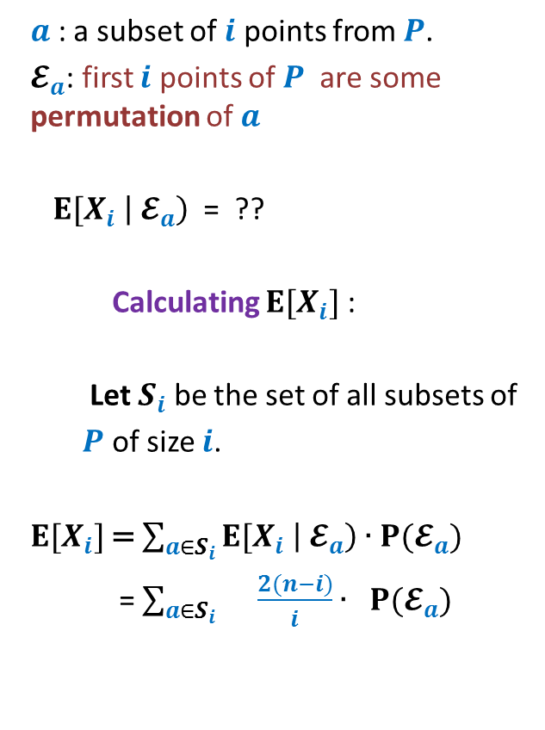

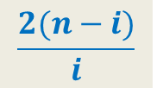
Backward analysis of $i$th iteration
$a$ : a subset of $i$ points from $P$.
$𝓔_{a}$: first $i$ points of $P$ are some permutation of $a$
${E[X}_{i} \left|{ 𝓔}_{a}\right)$ = ??
Calculating ${E[X}_{i}]$ :
Let $S_{i}$ be the set of all subsets of
$P$ of size $i$.
${E[X}_{i}]$= $\sum_{a∈S_{i}}{{E[X}_{i} \left|{ 𝓔}_{a}\right)∙P(𝓔_{a}) }$
= $\sum_{a∈S_{i} }{\frac{2(n−i)}{i}∙ P(𝓔_{a}) }$
$$c_{1}$$
$$c_{2}$$
$$c_{8}$$
$$p_{1}$$
$$c_{3}$$
$$p_{8}$$
$$\frac{2(n−i)}{i}$$
$$p_{2}$$
$$p_{7}$$
$$p_{3}$$
$$c_{7}$$
$$c_{4}$$
$$p_{4}$$
$$p_{6}$$
$$p_{5}$$
$$c_{5}$$
$$c_{6}$$
= $\frac{2(n−i)}{i}$

Slide 46
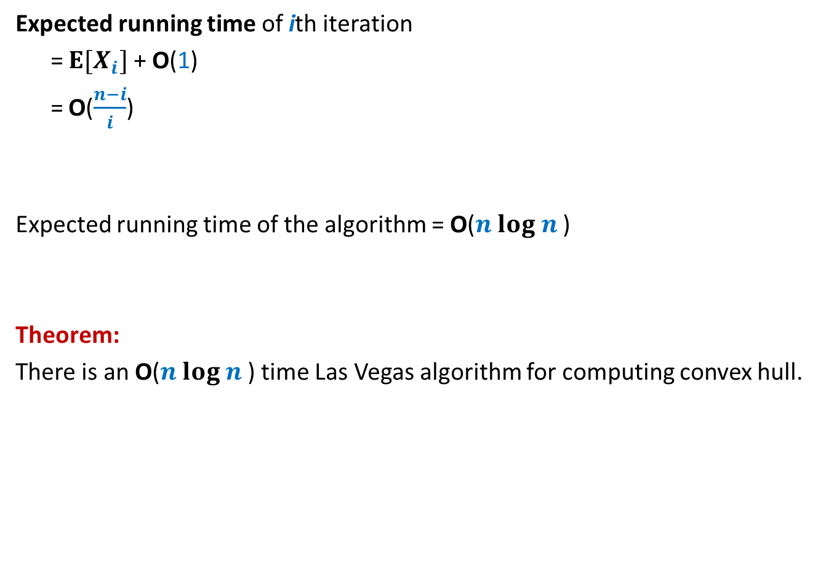
Running time of the algorithm
Expected running time of ith iteration
= ${E[X}_{i}]$ + O(1)
= O($\frac{n−i}{i}$)
Expected running time of the algorithm = O($n log n$)
Theorem:
There is an O($n log n$) time Las Vegas algorithm for computing convex hull.

