Slide 1
Randomized Algorithms CS648
Lecture 15
Randomized Incremental Construction
(building the background)

Slide 2
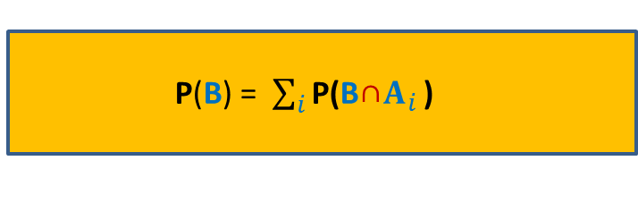
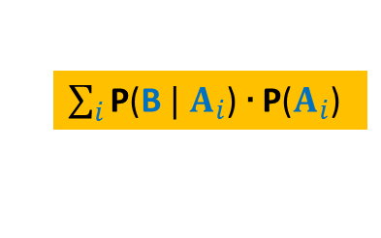
Partition Theorem
A set of events $A_{1}$,…, $A_{n}$defined over a probability space ($Ω$,P) is said to induce a partition of $Ω$ if
$\bigcup_{i=1}^{n}{A_{i}}$ = $Ω$
$A_{i}\bigcap{A_{j}}$ =∅ for all$i≠j$
Partition Theorem:
B
Ω
This theorem solves many difficult problems magically. But one needs some experience in order to apply it effectively. You will realize it soon.
P(B) = $\sum_{i}{\text{P}\text{(}{\text{B}\text{∩}A}_{i}}$ )
$\sum_{i}{\text{P}\text{(}\text{B} | A_{i}}$) ∙ $\text{P}\text{(}A_{i}$)

Slide 3
problem 1 find-min Problem

Slide 4

Find-Min algorithm
Find-Min(A[1..$n$])
{ $min$ ← A[1];
For $i=2$ to $n$ do
{ if ( ?? )
??
}
return $min$;
}
Question: If elements of A are permuted randomly uniformly, what is the expected number of times variable $min$is updated ?
$X$: no. of times $min$is updated.
$X_{i}=\left\{\begin{aligned}1 if min \text{is} \text{updated} \text{in} i\text{th} \text{iteration} \\ 0 otherwise \end{aligned}\right.$
$X=1+\sum_{i>1}{X_{i}}$ ➔ $E\left[X\right]=1+\sum_{i>1}{{E[X}_{i}]}$
$=1+\sum_{i>1}{{P(X}_{i}}=1)$
A[$i$] $<min$
$min$ ← A[$i$] ;
??
A
8 5 16 11 32 4 57 6 19 82 7 42 2 23
1 2 3 4 5 6 7 8 9 10 11 12 13 14

Slide 5
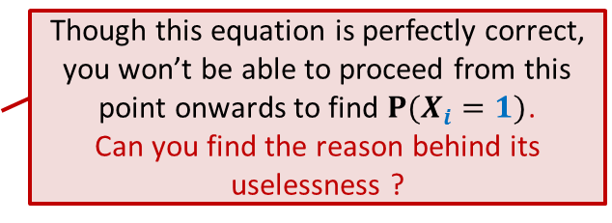
Find-Min algorithm
First $i−1$ elements
${P(X}_{i}=1)$ = Probability that A[$i$] is smaller than {A[$1$],…, A[$i−1$]}
Notations:
$S_{i−1}$: set of all subsets of A of size $i−1$.
For any $a∈S_{i−1}$,
$𝓔_{a}$: first $i−1$ elements of A are (some permutation of) $a$.
Using Partition Theorem,
${P(X}_{i}=1)$ = $\sum_{a∈S_{i−1}}{ ? ⋅ ?}$
A
1 2 …
$$i$$
$$n−1$$
Though this equation is perfectly correct, you won’t be able to proceed from this point onwards to find ${P(X}_{i}=1)$.
Can you find the reason behind its uselessness ?
$${P(X}_{i}=1|𝓔_{a})$$
$$P(𝓔_{a})$$

Slide 6
problem 2 Closest Pair of Points

Slide 7
Closest Pair of Points
Problem Definition:
Given a set $P$of $n>1$points in plane, compute the pair of points with minimum Euclidean distance.
Deterministic algorithms:
O($n^{2}$) : Trivial algorithm
O($n log n$) : Divide and Conquer based algorithm
Randomized algorithm:
O($n$) : Randomized Incremental Construction based algorithm

Slide 8
Notations and assumptions
Notations:
$P$ : set of $n$points in plane.
Coordinates of each point are positive integers.
distance($p$,$q$) : Euclidean distance between $p$and $q$.
Assumption:
Distance between each pair of points is distinct.

Slide 9
A discrete math exercise
Exercise:
What is the maximum number of points that can be placed in a unit square such that the minimum distance is at least 1 ?
Answer: 4.
This exercise is used is deterministic algorithm as well the randomized algorithm that we shall discuss now.
If there are more than 4 points, at least one of the four small squares will have more than 1 points.
$$\frac{1}{\sqrt{2}}$$
1

Slide 10
Overview of the randomized algorithm
Incremental algorithm:
starts with a set of 2 points, computes their distance;
inserts 3rd point and updates the closest pair distance;
inserts 4th point and updates the closest pair distance;
…
Uses an efficient data structure, called Grid, to facilitate efficient processing during ith step:
- To determine if ith point is going to change the closest pair distance.

Slide 11
Grid($S,δ$)
A data structure $G$with operations:
Locate_cell($p$, $G$):
Locates the cell to which $p$belongs.
Report_points($c$, $G$):
Report all points belonging to cell $c$.
Insert_point($p$, $G$):
Insert point $p$ in grid $G$.
Build_Grid($S,δ$):
Build grid for $S$with parameter $δ$.
$$δ$$
$$δ$$
$S$ : set of points
$δ$ : distance between closest
pair of points in $S$.

Slide 12
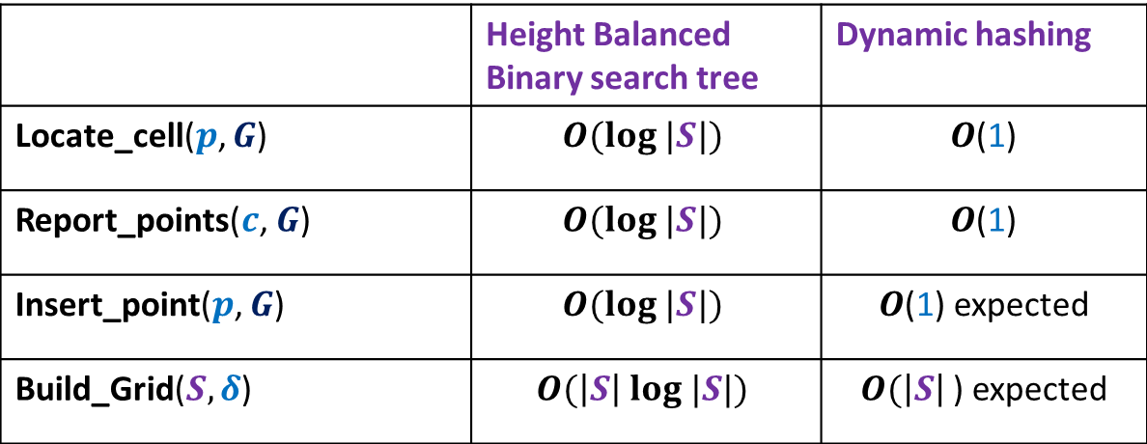
Grid($S,δ$)
The following time bounds are possible.
 | Height Balanced Binary search tree | Dynamic hashing
Locate_cell($p$, $G$) | $$O(log |S|)$$ | $O$(1)
Report_points($c$, $G$) | $$O(log |S|)$$ | $O$(1)
Insert_point($p$, $G$) | $$O(log |S|)$$ | $O$(1) expected
Build_Grid($S,δ$) | $$O(\left|S\right| log |S|)$$ | $O(\left|S\right|$) expected
Excluding Insert_point() operation, show as a homework, that
we can achieve all other bounds using static hashing discussed in this course.

Slide 13
Closest Pair of Points
Closest-pair-algorithm($P$)
Let <$p_{1}$,$p_{2}$,…,$p_{n}$ > be a uniformly random permutation of $P$;
$δ_{2}$← distance($p_{1}$,$p_{2}$);
Build_Grid($δ_{2}$, ${\{p_{1}, p}_{2}\}$);
For $i=3$ to $n$ do
{ Step 1: locate the cell of the grid $G_{i−1}$ containing $p_{i}$;
Step 2: find the point $p∈\{p_{1},…,p_{i−1}\}$ closest to $p_{i}$;
let $δ$ = distance($p$, $p_{i}$);
Step 3: If $δ>δ_{i−1}$
$δ_{i}$← $δ_{i−1}$; Insert($p_{i}$, $G_{i−1}$);
Else
$δ_{i}$← $δ$;
$G$← Build_Grid($δ$, $\{p_{1},…,p_{i}\}$);
}
return $δ_{n}$;

Slide 14
$i$th iteration
$$δ_{i−1}$$
$${ :p}_{i}$$
We just need to insert $p_{i}$ ☺
$$δ_{i−1}$$

Slide 15
$i$th iteration
$$δ_{i−1}$$
$${ :p}_{i}$$
We need to rebuild the grid ☹
$$δ_{i−1}$$
$$δ_{i}$$

Slide 16
$i$th iteration
$$δ_{i}$$
$${ :p}_{i}$$
$$δ_{i}$$

Slide 17
Analysis of $i$th iteration
Closest-pair-algorithm($P$)
Let <$p_{1}$,$p_{2}$,…,$p_{n}$ > be a uniformly random permutation of $P$;
$δ_{2}$← distance($p_{1}$,$p_{2}$);
Build_Grid($δ_{2}$, ${\{p_{1}, p}_{2}\}$);
For $i=3$ to $n$ do
{ Step 1: locate the cell of the grid $G_{i−1}$ containing $p_{i}$;
Step 2: find the point $p∈\{p_{1},…,p_{i−1}\}$ closest to $p_{i}$;
let $δ$ = distance($p$, $p_{i}$);
Step 3: If $δ>δ_{i−1}$
$δ_{i}$← $δ_{i−1}$; Insert($p_{i}$, $G_{i−1}$);
Else
$δ_{i}$← $δ$;
$G$← Build_Grid($δ$, $\{p_{1},…,p_{i}\}$);
}
return $δ_{n}$;
O(1)
O(1)
O(1)
$ci$ for constant $c$

Slide 18
running time of $i$th iteration
$X_{i}$ : running time of $i$th iteration
E[$X_{i}$] = ??
Question: What is ${P(δ}_{i}<δ_{i−1})$ ?
${P(δ}_{i}<δ_{i−1})$ depends upon $δ_{i−1}$ which depends upon the first $i−1$ points.
So we need to use Partition theorem to calculate ${P(δ}_{i}<δ_{i−1})$.
O(1) + $ci$ ∙ ${P(δ}_{i}<δ_{i−1})$

Slide 19
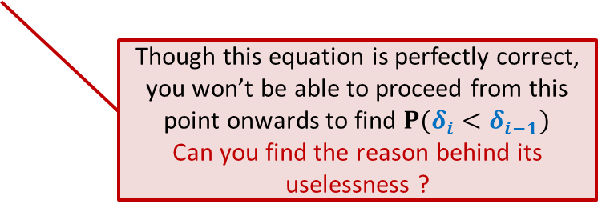
Calculating ${P(δ}_{i}<δ_{i−1})$
Notations:
$S_{i−1}$: set of all subsets of $P$of size $i−1$.
For any $a∈S_{i−1}$,
$𝓔_{a}$: first $i−1$ points are (some permutation of) $a$.
${P(δ}_{i}<δ_{i−1})$ = $\sum_{a∈S_{i−1}}{ ? ⋅ ?}$
$${P(δ}_{i}<δ_{i−1}|𝓔_{a})$$
$$P(𝓔_{a})$$
Though this equation is perfectly correct, you won’t be able to proceed from this point onwards to find ${P(δ}_{i}<δ_{i−1})$
Can you find the reason behind its uselessness ?

Slide 20
Homework Exercise
Investigate the cause of problem in our forward analysis for each of the two problems.
Try to find alternate approach for analysis.
(Backward analysis ☺ )
Provide efficient implementation of Grid data structure.
I am hopeful that at least one of you will reinvent this technique on his/her own before next class.

