Slide 1
Randomized Algorithms
CS648
Lecture 14
Expected duration of a randomized experiment
Part II

Slide 2
Revisiting
Some discrete mathematics

Slide 3

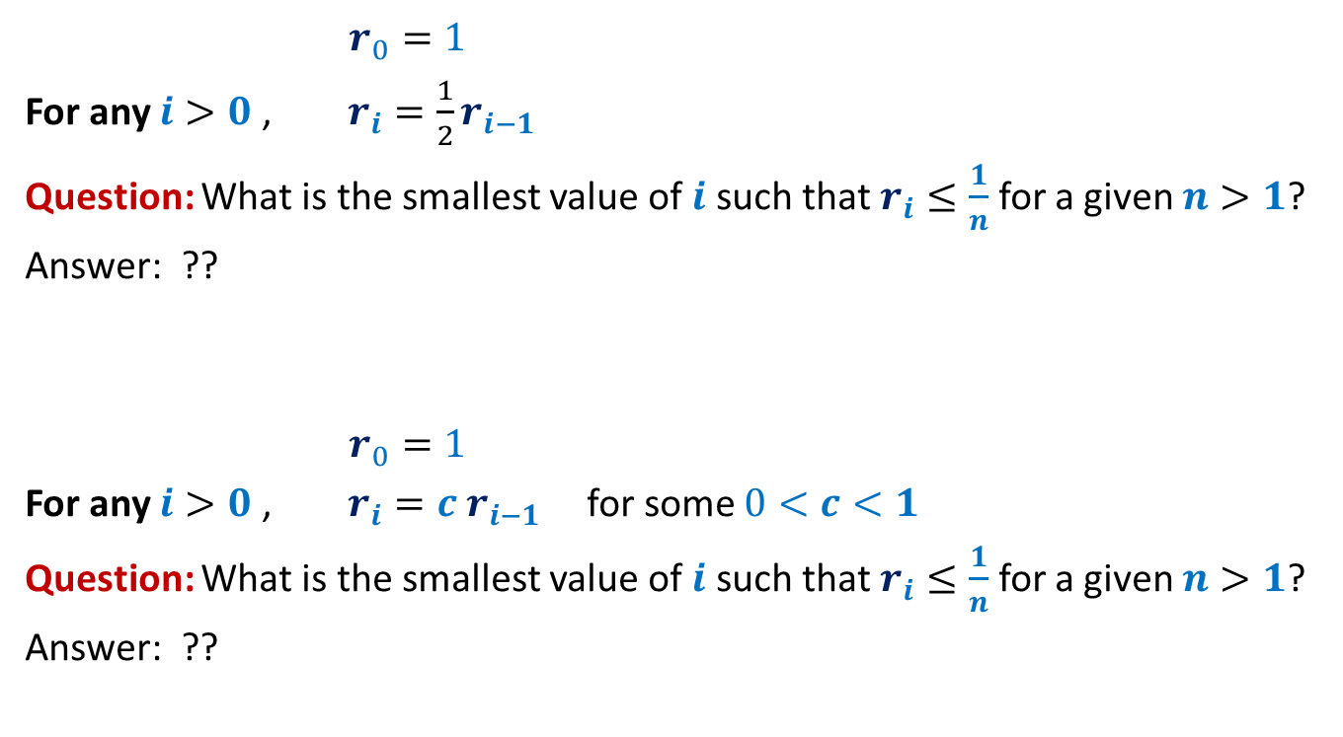

Recurrence 1
$r_{0}=1$
For any $i>0$, $r_{i}=\frac{1}{2}r_{i−1}$
Question: What is the smallest value of $i$ such that $r_{i}≤\frac{1}{n}$ for a given $n>1$?
Answer: ??
$r_{0}=1$
For any $i>0$, $r_{i}=c r_{i−1}$ for some $0<c<1$
Question: What is the smallest value of $i$ such that $r_{i}≤\frac{1}{n}$ for a given $n>1$?
Answer: ??
$$\log_{2}{n}$$
$$\log_{1/c}{n}$$

Slide 4

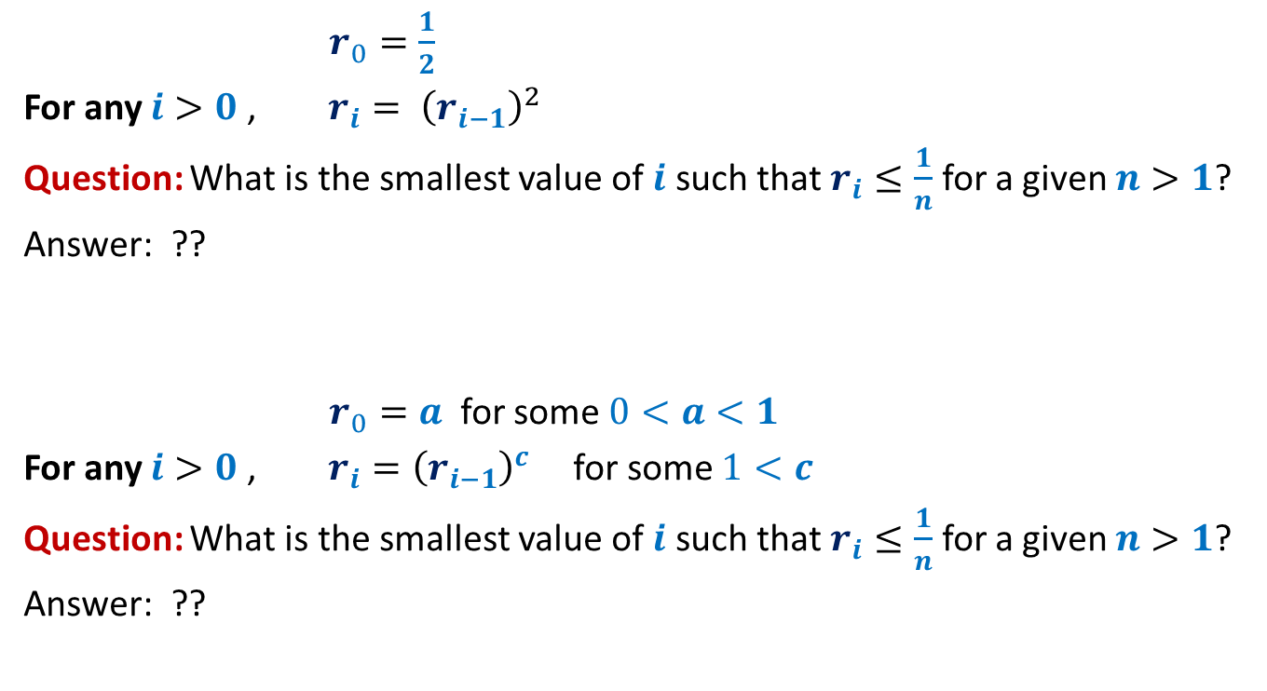

Recurrence 2
$r_{0}=\frac{1}{2}$
For any $i>0$, $r_{i}= {\left(r_{i−1}\right)}^{2}$
Question: What is the smallest value of $i$ such that $r_{i}≤\frac{1}{n}$ for a given $n>1$?
Answer: ??
$r_{0}=a$ for some $0<a<1$
For any $i>0$, $r_{i}={\left(r_{i−1}\right)}^{c}$ for some $1<c$
Question: What is the smallest value of $i$ such that $r_{i}≤\frac{1}{n}$ for a given $n>1$?
Answer: ??
$$\log_{2}log_{2}{n}$$
$$\log_{c}{\log_{1/a}{n}}$$

Slide 5
Distributed Client-serveR Problem

Slide 6
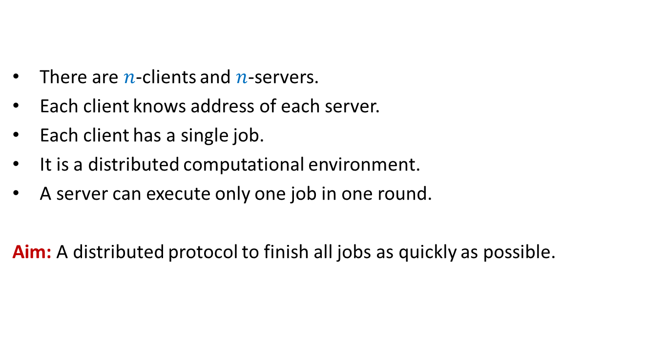
Distributed Client-Server Problem
There are $n$-clients and $n$-servers.
Each client knows address of each server.
Each client has a single job.
It is a distributed computational environment.
A server can execute only one job in one round.
Aim: A distributed protocol to finish all jobs as quickly as possible.

Slide 7
Distributed Client-Server Problem
Randomized protocol (one round)
Each client sends a request to a server selected randomly uniformly and independently.
Each server which receives one or more requests, accepts only one request and finishes the corresponding job.
Each client, whose job is finished, leaves the system.
The remaining clients repeat the same procedure in next round.
Question: what is the expected number of rounds to finish all jobs?

Slide 8
Distributed Client-Server problem
Randomized protocol
1
2
3
4
5
6
7
8
Clients
It can be framed as our familiar
ball-bin problem.
☺
Servers
1 2 3 4 5 6 7 8

Slide 9
Distributed Client-Server problem
Randomized protocol
1
2
3
4
5
6
7
8
Balls
Bins
1 2 3 4 5 6 7 8

Slide 10
Distributed Client-Server problem
Randomized protocol
Round 1
1
2
3
4
5
6
7
8
1 2 3 4 5 6 7 8

Slide 11
Distributed Client-Server problem
Randomized protocol
3
4
7
8
1 2 3 4 5 6 7 8

Slide 12
Distributed Client-Server problem
Randomized protocol
Round 2
3
4
7
8
1 2 3 4 5 6 7 8

Slide 13
Distributed Client-Server problem
Randomized protocol
Round 3
8
1 2 3 4 5 6 7 8

Slide 14
Calculating expected no. of rounds
FIRST Approach

Slide 15

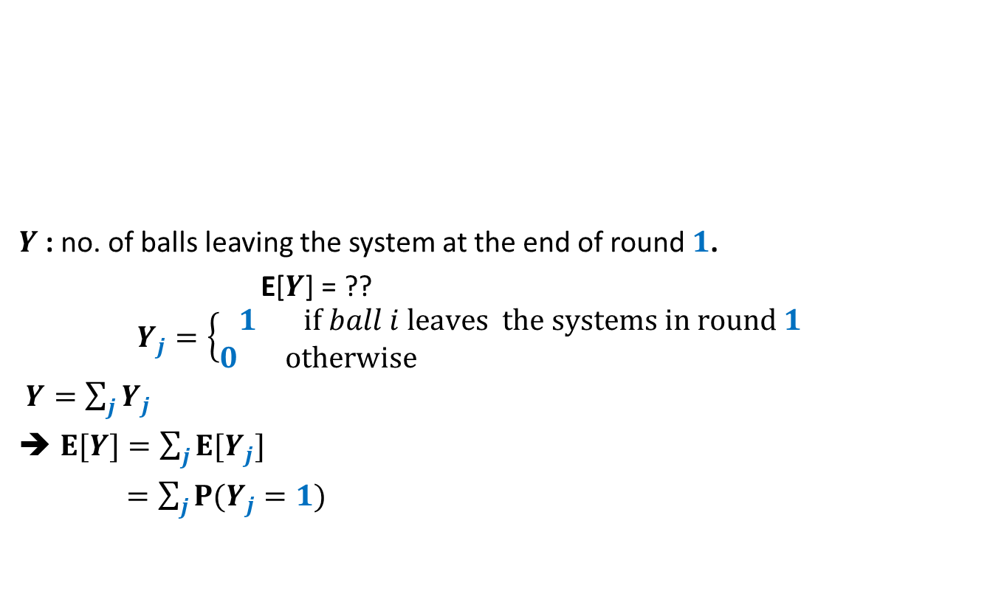

Distributed Client-Server problem
Randomized protocol
Round 1
1
2
3
$$n−1$$
$$n$$
$Y$ : no. of balls leaving the system at the end of round $1$.
E[$Y$] = ??
$$Y_{j}=\left\{\begin{aligned}1 if ball i leaves the systems in round 1 \\ 0 otherwise \end{aligned}\right.$$
$Y=\sum_{j}{Y_{j}}$
$E[Y]=\sum_{j}{E[Y_{j}]}$
$=\sum_{j}{P(Y_{j}=1)}$
1 2 3 … $n$-1 $n$
Not so easy to find

Slide 16


Distributed Client-Server problem
Randomized protocol
Round 1
1
2
3
$$n−1$$
$$n$$
$Y$ : no. of balls leaving the system in round $1$.
E[$Y$] = ??
= $n−n{\left(1−\frac{1}{n}\right)}^{n}$
= $\left(1−\frac{1}{e}\right)n$
$X_{1}$: no. of balls remaining in the system after round $1$.
E[$X_{1}$] = $\frac{n}{e}$
1 2 3 … $n$-1 $n$
$$n −expected no. of empty bins$$
Is there any relation between
no. of empty bins and
no. of balls leaving the system in round 1 ?

Slide 17




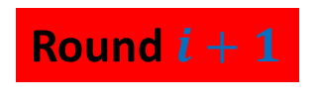
Distributed Client-Server problem
Randomized protocol
Round $i+1$
1
2
$$m$$
E[$X_{1}$] = $\frac{n}{e}$
$X_{i}$: no. of balls at the end of round $i$.
E[$X_{i+1}$| $X_{i}=m$] = ??
$$m$$
1 2 … $n$-1 $n$
$$≤\frac{m}{e}$$

Slide 18
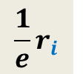
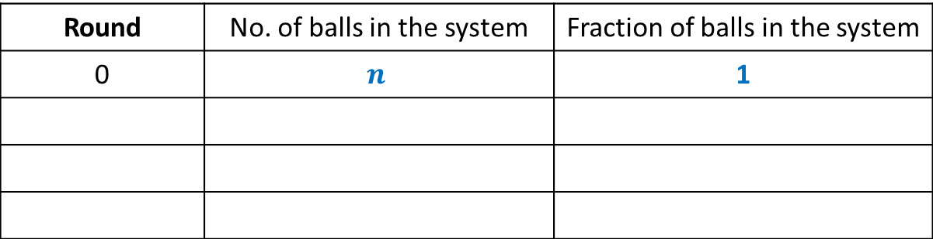





Distributed Client-Server problem
Randomized protocol
Lemma1 : After round $i+1$, the expected number of balls left is less than $\frac{1}{e}$th fraction of the balls after round $i$.
$r_{i}=\frac{X_{i}}{n}$: fraction of balls in the system after round $i$.
Lemma 1 implies E[$r_{i+1}$]$≤ ??$
➔ If everything goes as expected, then
$${\frac{1}{e}r}_{i}$$
Round | No. of balls in the system | Fraction of balls in the system
0 | $$n$$ | 1
1
$$n/e$$
$$1/e$$
2
$$<n/e^{2}$$
$$<1/e^{2}$$
This table gives the intuition for the expected no. of rounds but it directly does not help us to calculate the expected no. of rounds ? It also does not directly help to get a high prob. Bound. Convince yourself before proceeding further.

Slide 19

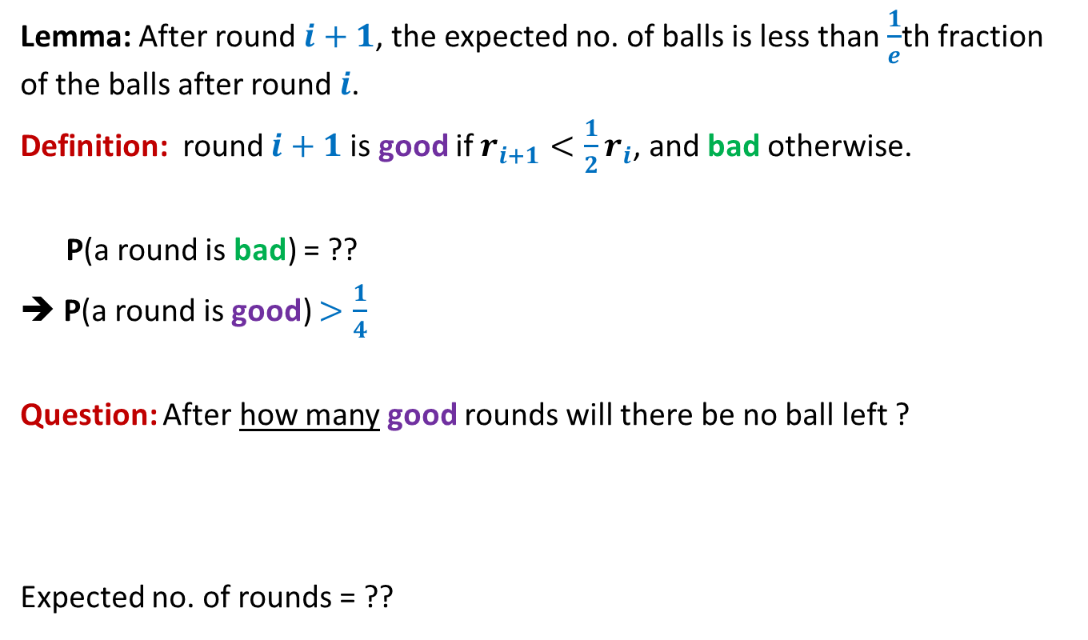

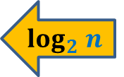

Distributed Client-Server problem
Randomized protocol
Lemma: After round $i+1$, the expected no. of balls is less than $\frac{1}{e}$th fraction of the balls after round $i$.
Definition: round $i+1$is good if $r_{i+1}<{\frac{1}{2}r}_{i}$, and bad otherwise.
P(a round is bad) = ??
➔ P(a round is good) $>\frac{1}{4}$
Question: After how many good rounds will there be no ball left ?
Expected no. of rounds = ??
Use Markov’s Inequality
$$≤\frac{2}{e}$$
$$≤\frac{3}{4}$$
$$log_{2} n$$
Use Recurrence 1
Each round is good independent of other rounds.
$$≤4 \log_{2}n$$

Slide 20

Distributed Client-Server problem
Randomized protocol
Theorem: The Randomized protocol will terminate in expected O($\log_{2}n$) rounds.
This bound is very loose.
Can you see why ?

Slide 21
An important insight that we missed
Question: What is the cause of multiple rounds for a ball ?
Answer: presence of other competing balls
INSIGHT
As the algorithm proceeds:
The number of these competing balls reduce
but the number of bins remain unchanged
➔
Chances of a ball to leave the system increases as the algorithm proceeds.

Slide 22
Calculating expected no. of rounds with NEW insight

Slide 23

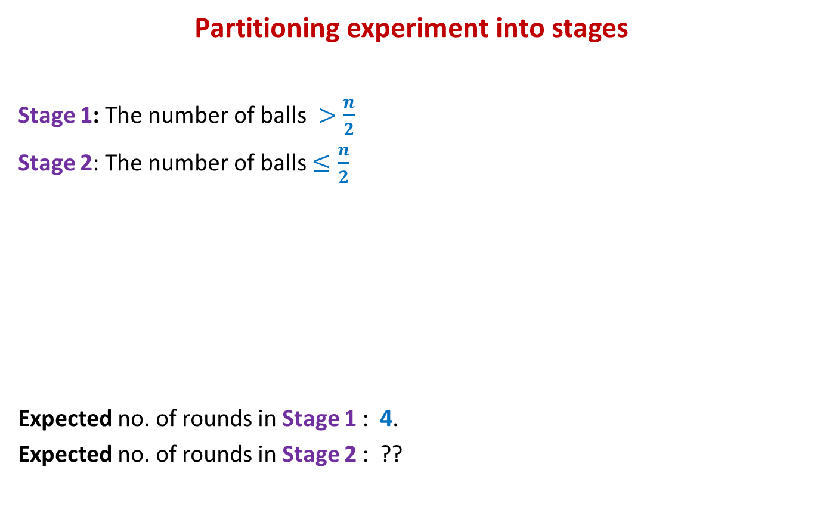
Distributed Client-Server problem
Randomized protocol
Partitioning experiment into stages
Stage 1: The number of balls $>\frac{n}{2}$
Stage 2: The number of balls $≤\frac{n}{2}$
Expected no. of rounds in Stage 1 : 4.
Expected no. of rounds in Stage 2 : ??
Stage 1
Stage 2
$$no. of balls≤\frac{n}{2}$$

Slide 24
Calculating expected no. of rounds in stage 2

Slide 25



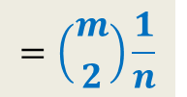

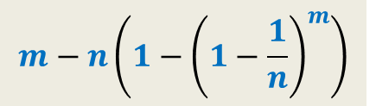
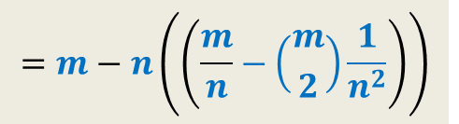

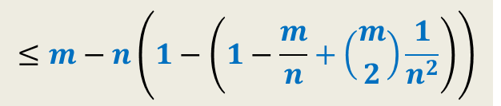

Distributed Client-Server problem
Randomized protocol
Round $i+1$
1
2
$$m$$
$X_{i}$: no. of balls at the end of round $i$.
E[$X_{i+1}$| $X_{i}=m$] = ??
1 2 3 … $n$-1 $n$
$$m−n\left(1−{\left(1−\frac{1}{n}\right)}^{m}\right)$$
$$m−no. of nonempty bins$$
$$≤m−n\left(1−\left(1−\frac{m}{n}+\left({m \atop 2}\right)\frac{1}{n^{2}}\right)\right)$$
$$=m−n\left(\left(\frac{m}{n}−\left({m \atop 2}\right)\frac{1}{n^{2}}\right)\right)$$
We need a reasonably good upper bound for this expression
${\left(1−\frac{1}{n}\right)}^{m}$
$=1−\frac{m}{n}+\left({m \atop 2}\right)\frac{1}{n^{2}}−\left({m \atop 3}\right)\frac{1}{n^{3}}+ …$
$≤1−\frac{m}{n}+\left({m \atop 2}\right)\frac{1}{n^{2}}$
$$=\left({m \atop 2}\right)\frac{1}{n}$$

Slide 26

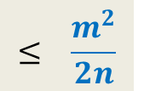
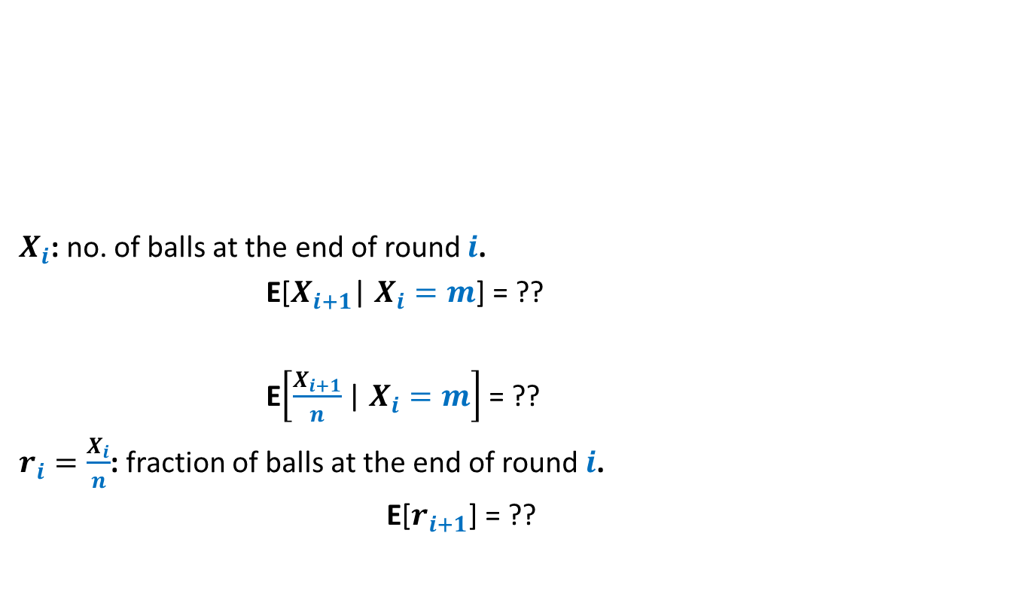

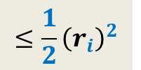
Distributed Client-Server problem
Randomized protocol
Round $i+1$
1
2
$$m$$
$X_{i}$: no. of balls at the end of round $i$.
E[$X_{i+1}$| $X_{i}=m$] = ??
E$\left[\frac{X_{i+1}}{n}\text{| }X_{i}=m\right]$ = ??
$r_{i}=\frac{X_{i}}{n}$: fraction of balls at the end of round $i$.
E[$r_{i+1}$] = ??
1 2 3 … $n$-1 $n$
$$≤\left({m \atop 2}\right)\frac{1}{n}$$
$$≤ \frac{m^{2}}{2n}$$
$$≤{\frac{1}{2}\left(\frac{m}{n}\right)}^{2}$$
$$≤{\frac{1}{2}\left(r_{i}\right)}^{2}$$

Slide 27

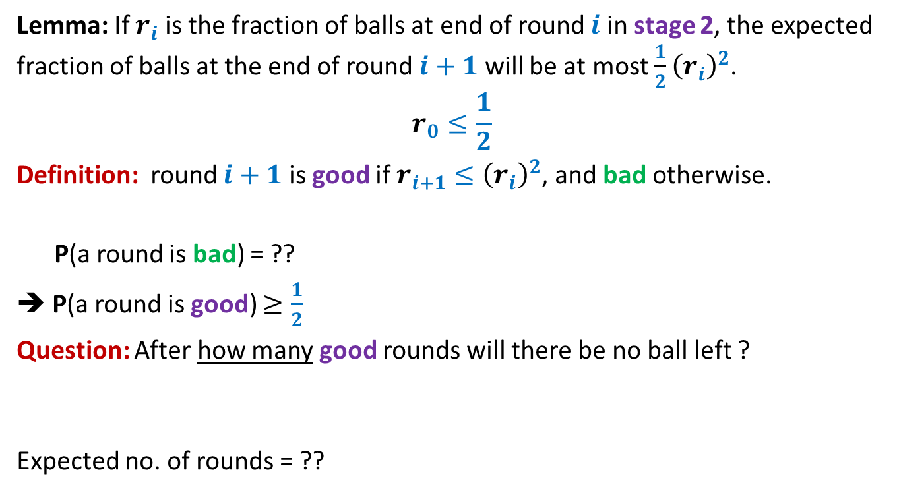

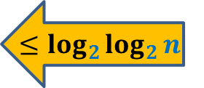
Distributed Client-Server problem
Randomized protocol
Lemma: If $r_{i}$ is the fraction of balls at end of round $i$ in stage 2, the expected fraction of balls at the end of round $i+1$ will be at most ${\frac{1}{2}\left(r_{i}\right)}^{2}$.
$$r_{0}≤\frac{1}{2}$$
Definition: round $i+1$ is good if $r_{i+1}≤{\left(r_{i}\right)}^{2}$, and bad otherwise.
P(a round is bad) = ??
➔ P(a round is good) $≥\frac{1}{2}$
Question: After how many good rounds will there be no ball left ?
Expected no. of rounds = ??
Use Markov’s Inequality
$<\frac{1}{2}$
$$≤\log_{2}{\log_{2}{n}}$$
Use Recurrence 2
$$≤2\log_{2}{\log_{2}{n}}$$

Slide 28

Distributed Client-Server problem
Randomized protocol
Theorem: The expected number of rounds taken by the Randomized protocol is at most $4+2\log_{2}{\log_{2}{n}}$.

Slide 29
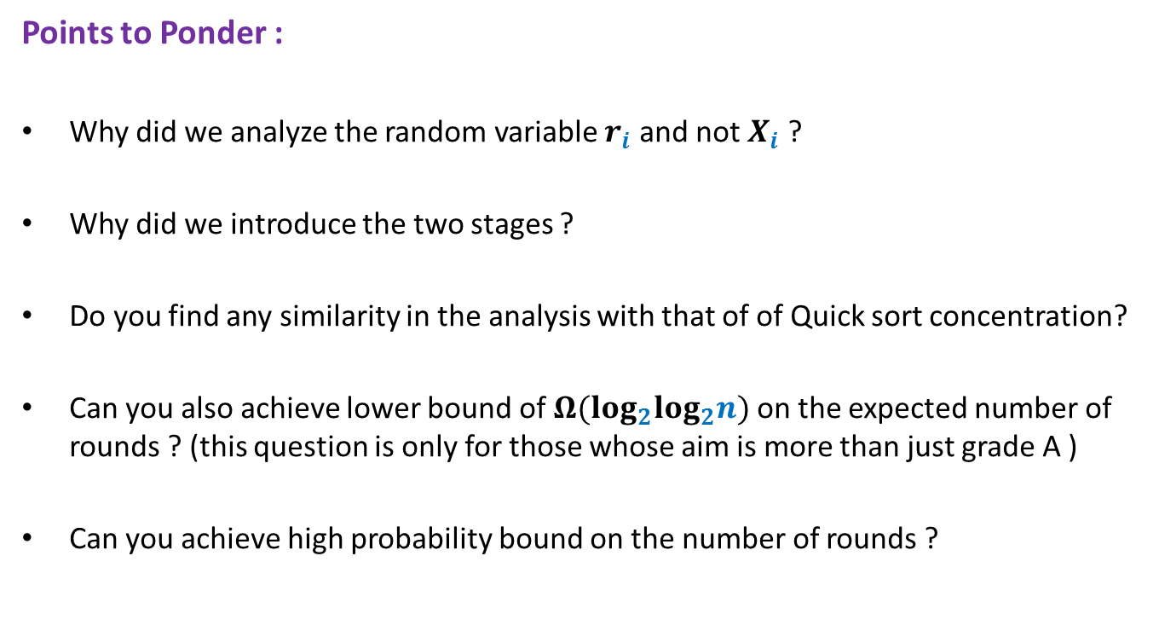
Distributed Client-Server problem
Randomized protocol
Points to Ponder :
Why did we analyze the random variable $r_{i}$ and not $X_{i}$ ?
Why did we introduce the two stages ?
Do you find any similarity in the analysis with that of of Quick sort concentration?
Can you also achieve lower bound of $Ω(log_{2}log_{2}n)$ on the expected number of rounds ? (this question is only for those whose aim is more than just grade A )
Can you achieve high probability bound on the number of rounds ?

Slide 30
Rumor spreading

Slide 31
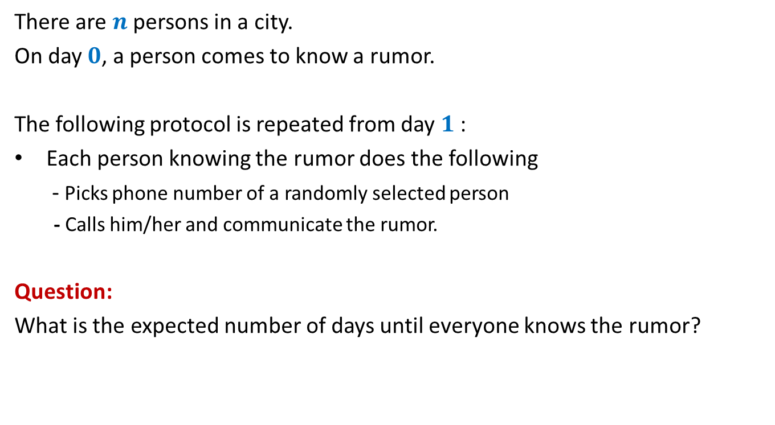
Rumor Spreading
There are $n$ persons in a city.
On day $0$, a person comes to know a rumor.
The following protocol is repeated from day $1$:
Each person knowing the rumor does the following
- Picks phone number of a randomly selected person
- Calls him/her and communicate the rumor.
Question:
What is the expected number of days until everyone knows the rumor?

Slide 32

Rumor Spreading
Question:
What is the minimum number of days until everyone knows the rumor?
Answer: $log_{2}n$
Number of people knowing the rumor can only double in a day.

Slide 33

Rumor Spreading
Theorem (it should surprise you):
The entire city comes to know the rumor in O($log_{2}n$) expected days.
The entire city comes to know the rumor in O($log_{2}n$) days with high probability.

Slide 34
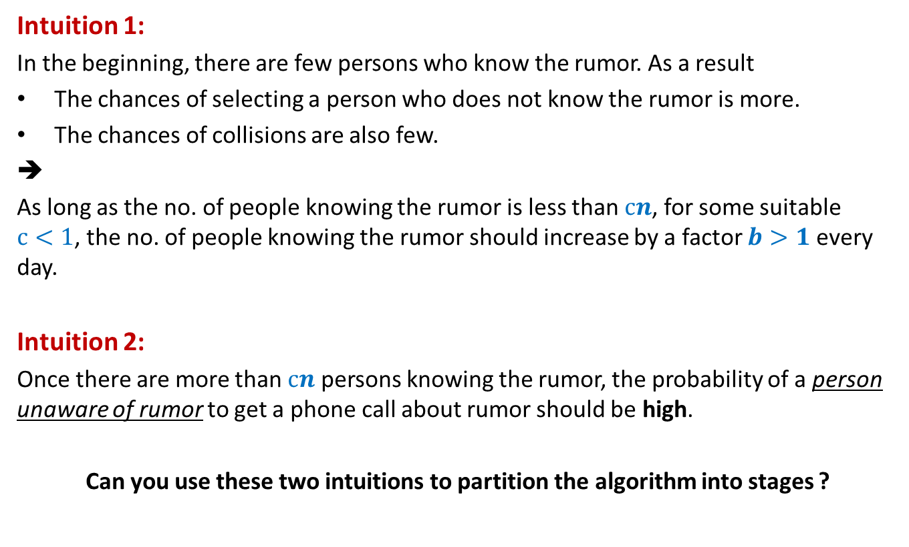
Rumor Spreading
Intuition 1:
In the beginning, there are few persons who know the rumor. As a result
The chances of selecting a person who does not know the rumor is more.
The chances of collisions are also few.
➔
As long as the no. of people knowing the rumor is less than $cn$, for some suitable $c<1$, the no. of people knowing the rumor should increase by a factor $b>1$ every day.
Intuition 2:
Once there are more than $cn$ persons knowing the rumor, the probability of a person unaware of rumor to get a phone call about rumor should be high.
Can you use these two intuitions to partition the algorithm into stages ?

Slide 35

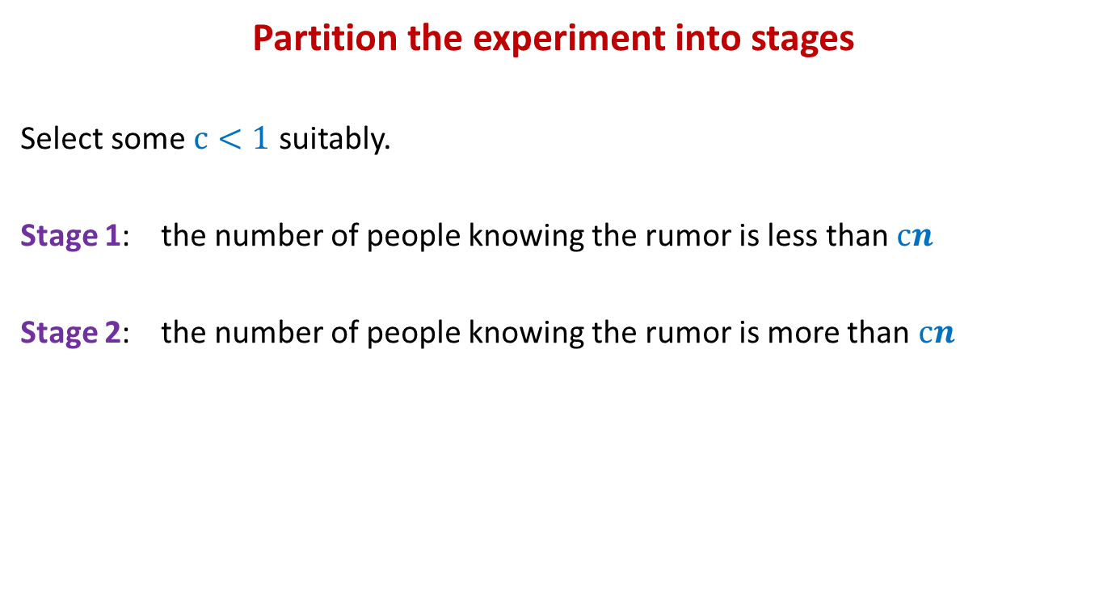
Rumor Spreading
Partition the experiment into stages
Select some $c<1$ suitably.
Stage 1: the number of people knowing the rumor is less than $cn$
Stage 2: the number of people knowing the rumor is more than $cn$
Stage 1
Stage 2
$$no. of people knowing rumor>cn$$

Slide 36
Expected no. of days in stage 2

Slide 37
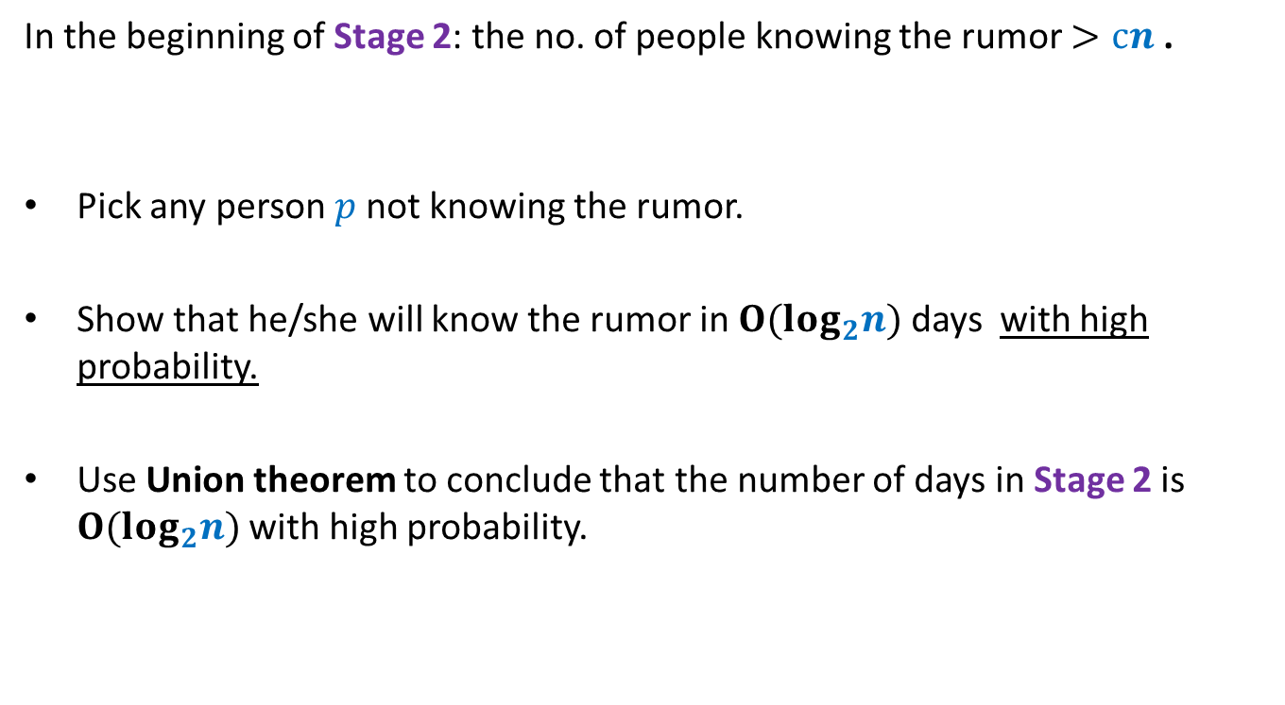
Rumor Spreading
In the beginning of Stage 2: the no. of people knowing the rumor $>cn$ .
Pick any person $p$not knowing the rumor.
Show that he/she will know the rumor in $O(log_{2}n)$ days with high probability.
Use Union theorem to conclude that the number of days in Stage 2 is $O(log_{2}n)$ with high probability.

Slide 38
Expected no. of days in stage 1

Slide 39
It is left as a home work to be discussed in some future class.
I shall be happy to see a correct solution by some of you in the next class.

