Slide 1
Randomized Algorithms CS648
Lecture 13
Expected duration of a randomized experiment
Part I

Slide 2
coupon Collector Problem

Slide 3
Coupon Collector Problem
There is a bag containing $n$ distinct coupons.
Each coupon has a unique label from $∈$ [$n$].
Experiment:
Repeat
1. Select a coupon randomly uniformly from the bag
2. Note down its label
3. Place the coupon back into the bag
Until every coupon has appeared at least once
$X$: the number of iterations of the loop (number of coupons drawn).
Question: What is E[$X$] ?

Slide 4
Example
$n$=5
1
4
5
3
2
3
1
3
3
1
2
2
1
5
1
3
5
3
4
Done in 14 samplings
5
5
1
2
1
2
5
4
4
1
2
3
Done in 12 samplings
3
2
2
3
3
3
1
1
5
1
3
5
3
2
2
5

Slide 5
Coupon Collector Problem
$X$: the number of iterations of the loop (number of coupons drawn).
Question: What is E[$X$] ?
Standard method:
E[$X$] = $\sum_{k≥n}{k ∙P(X=k)}$
?
No easy way !!

Slide 6
Coupon Collector Problem
no
coupon
seen
all
coupons
seen
This transition is not sudden. In fact it is a gradual transition through various discrete stages. Can you see these discrete stages ?

Slide 7
Coupon Collector Problem
no
coupon
seen
all
coupons
seen
1
2
3
4
This transition is not sudden. In fact it is a gradual transition through various discrete stages. Can you see these discrete stages ?

Slide 8
Reviewing Example
$n$=5
1
4
5
3
2
0
5
3
1
3
3
1
2
2
1
5
1
3
5
3
4

Slide 9
Reviewing Example
Each instance of coupon collector problem has to pass through these stages. Does it give you some inspiration to calculate E[X] ?
$n$=5
1
4
5
3
2
0
1
2
3
4
5
3
1
3
3
1
2
2
1
5
1
3
5
3
4
0
1
2
3
4
5
5
5
1
2
1
2
5
4
4
1
2
3
0
1
2
3
4
3
2
2
3
3
3
1
1
5
1
3
5
3
2
2
5

Slide 10
Coupon Collector Problem
$X$: the number of iterations of the loop (number of coupons drawn).
Question: What is E[$X$] ?
$$X=\sum_{0≤i<n}{X_{i}}$$
$X_{i}=$ no. of coupons sampled from the moment ??
to the moment ??
$i$ th distinct coupon was selected
$i+1$ th distinct coupon was selected

Slide 11
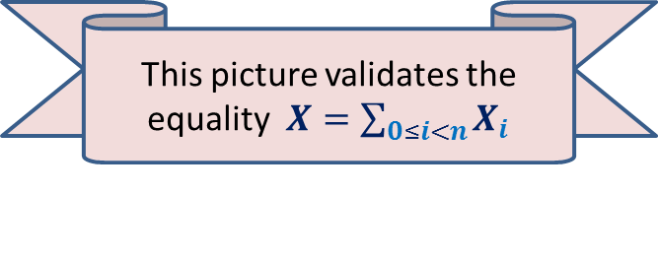
Reviewing Example
$n$=5
1
4
5
3
2
$X_{0}$=1
$X_{1}$=1
$X_{2}$=4
$X_{3}$=3
$X_{4}$=5
0
1
2
3
5
4
3
1
3
3
1
2
2
1
5
1
3
5
3
4
This picture validates the equality $X=\sum_{0≤i<n}{X_{i}}$

Slide 12
Coupon Collector Problem
$X$: the number of iterations of the loop (number of coupons drawn).
$$X=\sum_{0≤i<n}{X_{i}}$$
➔
$$E[X]=\sum_{0≤i<n}{{E[X}_{i}]}$$
Question: What is ${E[X}_{i}$] ?

Slide 13
Calculating E[$X_{i}$]
Experiment (in $(i+1)$th stage):
Repeat
1. Select a coupon randomly uniformly
from the bag
2. Note down its label
3. Place the coupon back into the bag
Until $(i+1)$th distinct coupon appears.
$$n$$

Slide 14
Calculating E[$X_{i}$]
Experiment (in $(i+1)$th stage):
Repeat
1. Select a coupon randomly uniformly
from the bag
2. Note down its label
3. Place the coupon back into the bag
Until $(i+1)$th distinct coupon appears.
$p$ =Probability an iteration is successful
Question: What is $p$ ?
E[$X_{i}$] = $\sum_{k>0}{kP(X_{i}=k)}$
= $\sum_{k>0}{k{\left(1−p\right)}^{k−1}p}$
= $1/p$
= $n/(n−i)$
$$n$$
$$(n−i)/n$$
$$i$$

Slide 15
Coupon Collector Problem
$X$: the number of iterations of the loop (number of coupons drawn).
$X=\sum_{0≤i<n}{X_{i}}$
➔
$E[X]=\sum_{0≤i<n}{{E[X}_{i}]}$
$=\sum_{0≤i<n}{ \frac{n}{n−i}}$
$=n\sum_{0≤i<n}{ \frac{1}{n−i}}$
$=nH_{n}$
$=O(n log n)$
Theorem: Expected duration of coupon collector experiment is $O(n log n)$ .

Slide 16
Discrete Random Walk on a LINE

Slide 17
Discrete Random Walk
Particle starts from origin
In each second, particle moves 1 unit to the left or to the right with equal probability.
While at origin, the particle moves to 1 always.
Question: What is the expected number of steps of the random walk to reach milestone n ?
0 1 2 3 4 5 6 7 8 … n n+1

Slide 18
An example
0 1 2 3 4 5 6 7 8 …
I, and perhaps you too,
could not notice the walk. So let us trace the walk slowly.

Slide 19
Formalism
$X_{i→j}$:
No. of steps of a random walk which starts at $i$and terminates on reaching $j$ for the first time.
Aim: To calculate E[$X_{0→n}$]

Slide 20
Careful look at the example
0 1 2 3 4 5 6 7 8 …
Can you break the walk 0→8 into stages ? Think carefully …

Slide 21
Careful look at the example
0 1 2 3 4 5 6 7 8 …
Walk starting from 0 and terminating at 5

Slide 22
Careful look at the example
0 1 2 3 4 5 6 7 8 …
Walk starting from 0 and terminating at 5
Walk starting from 5 and terminating at 8

Slide 23

Relation among $X_{i→j}$’s
For any $i<k<j$
$X_{i→j}$ = $X_{i→k}$+ $X_{k→j}$
Breaking $X_{0→n}$ down to the limits, we get
$X_{0→n}$ = $\sum_{0≤i<n}{X_{i→i+1}}$
Hence using linearity of expectation
E[$X_{0→n}$] = $\sum_{0≤i<n}{{\text{E}\text{[}X}_{i→i+1}}$]

Slide 24
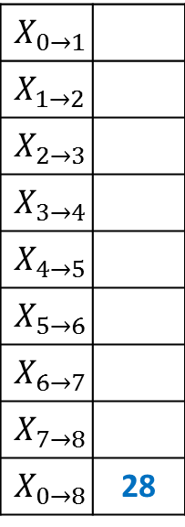
Relation among $X_{i→j}$’s
0 1 2 3 4 5 6 7 8 …
$$X_{0→1}$$
$$X_{1→2}$$
$$X_{2→3}$$
$$X_{3→4}$$
$$X_{4→5}$$
$$X_{5→6}$$
$$X_{6→7}$$
$$X_{7→8}$$
$$X_{0→8}$$ | 28
1
1
3
1
5
1
5
11

Slide 25
How to calculate E[$X_{i→i+1}$] ?

Slide 26
Conditional Expectation
Given any event $ε$and a random variable $Y$ defined over a probability space ($Ω$,P).
E[$Y$] = E[$Y$| $ε$] $∙$ P($ε$) + E[$Y$| $\overline{ε}$] $∙$P($\overline{ε}$)
E[$Y$| $\overline{ε}$]
E[$Y$| $ε$]
$$ε$$
$$\overline{ε}$$
Ω
A useful tool to calculate expected value of a random variable

Slide 27

Calculating E[$X_{i→i+1}$]
E[$X_{i→i+1}$] = ??
= ½ $∙$E[$X_{i→i+1}$| first move is L] + ½ . 1
= ½ $∙$E[$X_{i→i+1}$| first move is L] + ½
0 1 …
$$i$$
$i$+1
½ $∙$E[$X_{i→i+1}$| first move is L] + ½ $∙$E[$X_{i→i+1}$| first move is R]
?

Slide 28
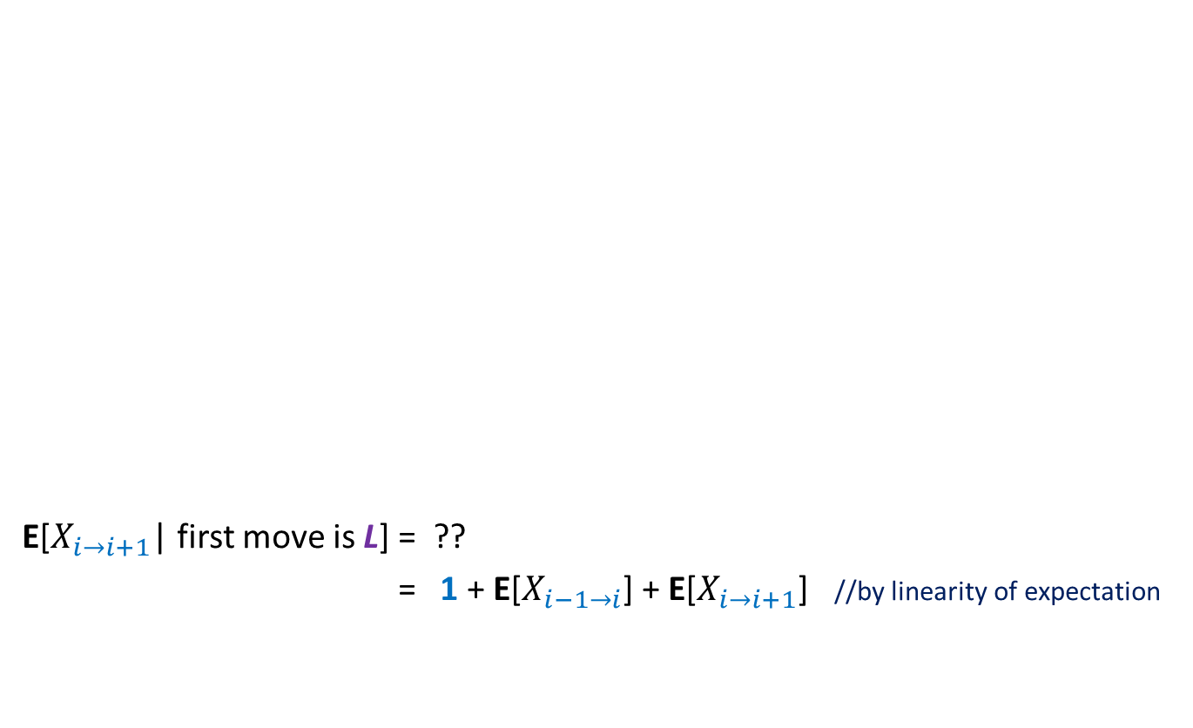
Calculating E[$X_{i→i+1}$| first move is L]
E[$X_{i→i+1}$| first move is L] = ??
= 1 + E[$X_{i−1→i}$] + E[$X_{i→i+1}$] //by linearity of expectation
0 1 …
$$i$$
$i$+1
1 + E[$X_{i−1→i+1}$]

Slide 29
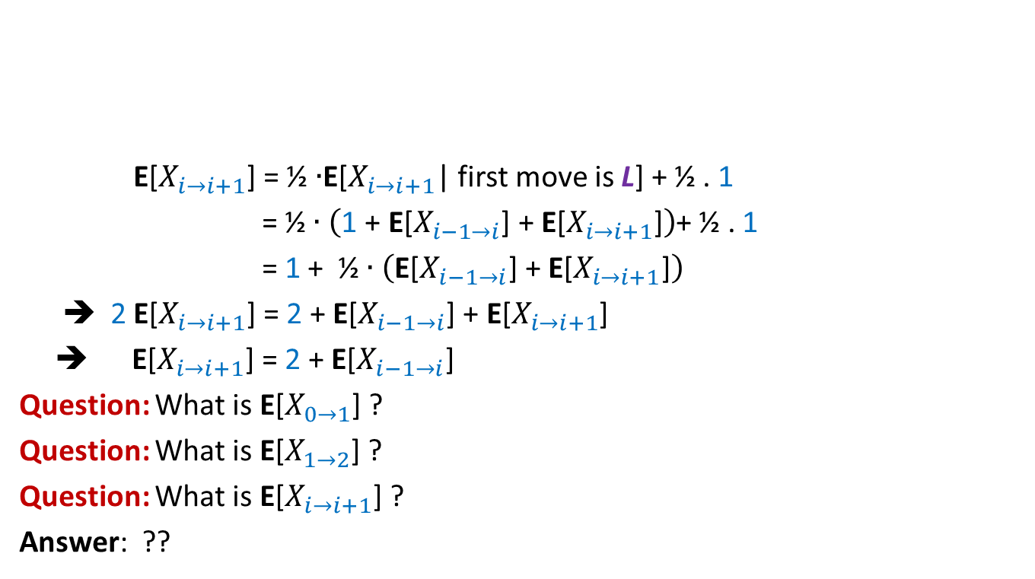
Calculating E[$X_{i→i+1}$]
E[$X_{i→i+1}$] = ½ $∙$E[$X_{i→i+1}$| first move is L] + ½ . 1
= ½ $∙\left(\text{1}\text{ + }\text{E}\text{[}X_{i−1→i}\text{] +} \text{E}\text{[}X_{i→i+1}\text{]}\right)$+ ½ . 1
= 1 + ½ $∙\left(\text{E}\text{[}X_{i−1→i}\text{] +} \text{E}\text{[}X_{i→i+1}\text{]}\right)$
➔ 2 E[$X_{i→i+1}$] = 2 + $\text{E}\text{[}X_{i−1→i}\text{]}$ $\text{+} \text{E}\text{[}X_{i→i+1}$]
➔ E[$X_{i→i+1}$] = 2 + $\text{E}\text{[}X_{i−1→i}\text{]}$
Question: What is E[$X_{0→1}$] ?
Question: What is E[$X_{1→2}$] ?
Question: What is E[$X_{i→i+1}$] ?
Answer: ??
0 1 …
$$i$$
$i$+1
$$1$$
3
$$2i+1$$

Slide 30
Calculating E[$X_{0→n}$]

Slide 31

Calculating E[$X_{0→n}$]
Lemma (just proved): E[$X_{i→i+1}$] = $2i+1$
E[$X_{0→n}$] = $\sum_{0≤i<n}{\text{E}\text{[}X_{i→i+1}]}$
= $\sum_{0≤i<n}{(2i+1)}$
= $2\sum_{0≤i<n}{i}+\sum_{0≤i<n}{1}$
= $n\left(n−1\right) + n$
= $n^{2}$
0 1 2 3 4 5 6 7 …
$$n$$
$n$+1

Slide 32
Theorem: Expected number of steps of a random walk starting from 0 and terminating on reaching $n$ is $n^{2}$.

Slide 33
Expected duration of a random experiment
Let X denote the random variable for the duration of a randomized experiment.
To calculate E[X], the following approach is sometimes useful:
Partition the experiment into stages carefully.
Calculate expected duration of each stage.
Using linearity of expectation, calculate E[X].
In the next class, we shall discuss more non-trivial randomized algorithms which are analyzed using this method.

