Slide 1
Randomized Algorithms
CS648
Lecture 12
Hashing - II

Slide 2
Recap of Last Lecture

Slide 3

Problem Definition
$U=\left\{1,2,…,m\right\}$ called universe
$S⊆U$ and $s=|S|$
$s≪$ $m$
Examples:
$m={10}^{18}$, $s={10}^{3}$
Aim
Given a set $S$, build a data structure storing $S$s.t. we can answer in O(1) time :
“Does $i∈$ $S$ ?” for any given $i∈U$.

Slide 4


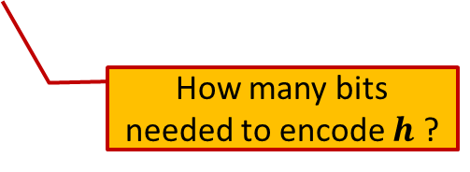
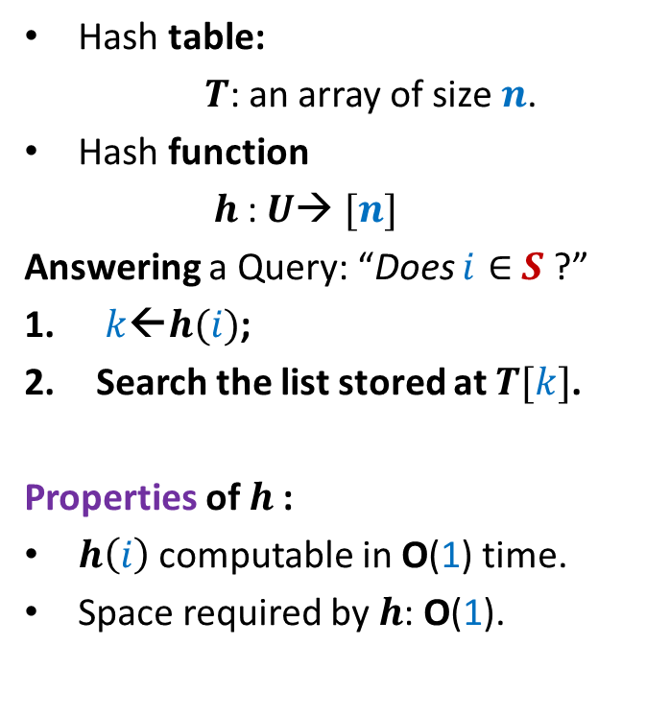

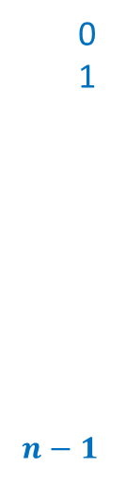

Hashing
Hash table:
$T$: an array of size $n$.
Hash function
$h$: $U$→ $[n]$
Answering a Query: “Does $i∈$ $S$ ?”
$k$←$h(i)$;
Search the list stored at $T[k]$.
Properties of $h$:
$h\left(i\right)$ computable in O(1) time.
Space required by $h$: O(1).
Elements of $S$
$$T$$
0
1
$$n−1$$
$$⋮$$
$$⋮$$
How many bits needed to encode $h$ ?

Slide 5

Collision
Definition: Two elements $i,j∈U$ are said to collide under hash function $h$ if
$$h\left(i\right)=h\left(j\right)$$
Worst case time complexity of searching an item $i$:
No. of elements in $S$ colliding with $i$.
$$T$$
0
1
$$n−1$$
$$⋮$$
$$⋮$$

Slide 6

Universal Hash Family
Definition: A collection $H$of hash-functions is said to be universal if there exists a constant $c$such that for any $i,j∈U$,
$P_{h∈_{r}H} \left(h\left(i\right)=h\left(j\right)\right)≤\frac{c}{n}$
This definition appears strange in the beginning! But we shall soon see that there is a very natural way to arrive at this definition.

Slide 7
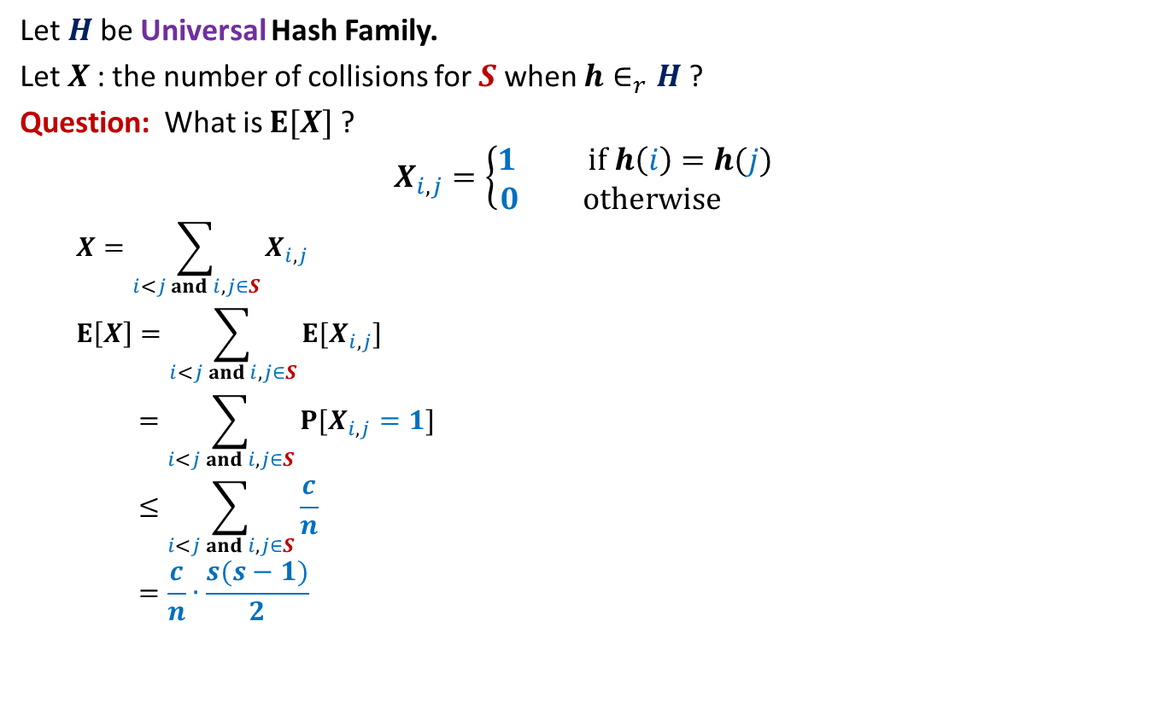

Perfect hashing using O($s^{2}$) space
Let $H$be Universal Hash Family.
Let $X$: the number of collisions for $S$ when $h∈_{r}H$?
Question: What is $E[X]$?
$$X_{i,j}=\left\{\begin{aligned}1 if h\left(i\right)=h(j) \\ 0 otherwise \end{aligned}\right.$$
$$X=\sum_{i<j and i,j∈S}{X_{i,j}}$$
$$E\left[X\right]=\sum_{i<j and i,j∈S}{E[X_{i,j}]}$$
$$=\sum_{i<j and i,j∈S}{P[X_{i,j}=1]}$$
$$≤\sum_{i<j and i,j∈S}{\frac{c}{n}}$$
$$=\frac{c}{n}∙\frac{s(s−1)}{2}$$

Slide 8
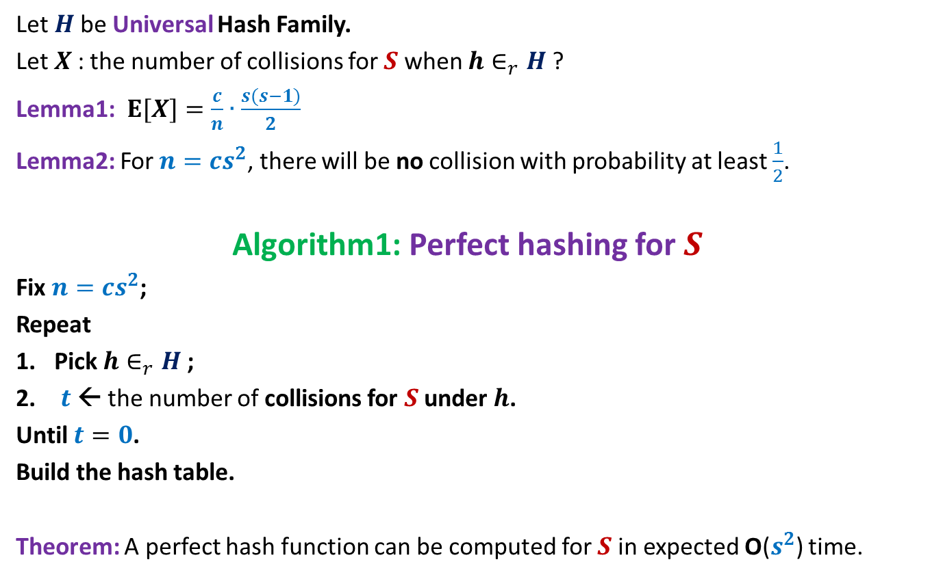
Perfect hashing using O($s^{2}$) space
Let $H$be Universal Hash Family.
Let $X$: the number of collisions for $S$ when $h∈_{r}H$?
Lemma1:$E[X]=\frac{c}{n}∙\frac{s(s−1)}{2}$
Lemma2: For $n=cs^{2}$, there will be no collision with probability at least $\frac{1}{2}$.
Algorithm1: Perfect hashing for $S$
Fix $n=cs^{2}$;
Repeat
Pick $h∈_{r}H$;
$t$← the number of collisions for $S$ under $h$.
Until $t=0$.
Build the hash table.
Theorem: A perfect hash function can be computed for $S$in expected O($s^{2}$) time.

Slide 9
Hashing with Optimal space And Worst case O(1) search time

Slide 10

Optimal space hashing with worst case O(1) search time
$H$be Universal Hash Family.
$X$: no. of collisions for $S$ when $h∈_{r}H$?
Lemma1:$E[X]=\frac{c}{n}∙\frac{s(s−1)}{2}$.
Question: What is $E[X$] when $n$ = $s$ ?
Answer: $c\frac{(s−1)}{2}$.

Slide 11
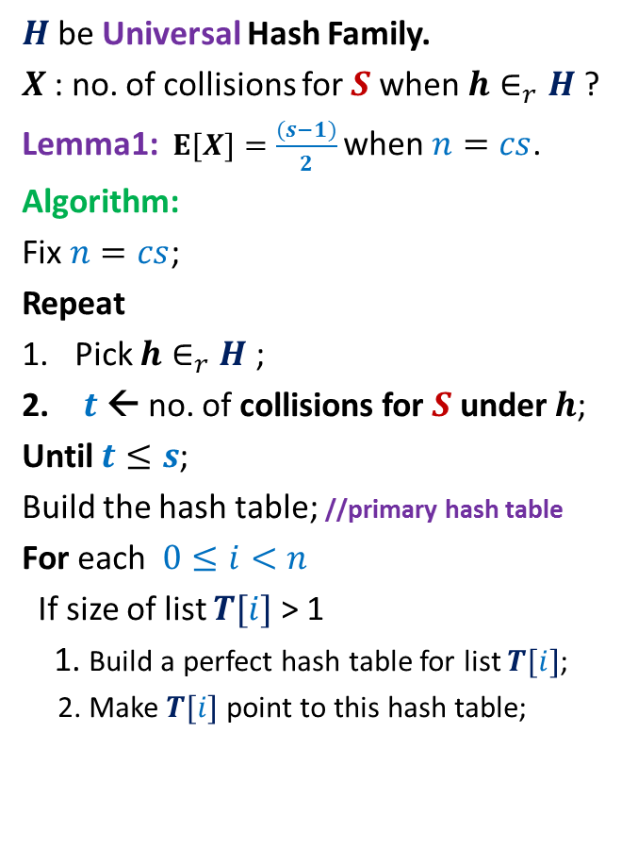
Optimal space hashing with worst case O(1) search time
$H$be Universal Hash Family.
$X$: no. of collisions for $S$ when $h∈_{r}H$?
Lemma1:$E[X]=\frac{(s−1)}{2}$ when $n=cs$.
Algorithm:
Fix $n=cs$;
Repeat
Pick $h∈_{r}H$;
$t$← no. of collisions for $S$ under $h$;
Until $t≤s$;
Build the hash table; //primary hash table
For each $0≤i<n$
If size of list $T[i]$ > 1
1. Build a perfect hash table for list $T[i]$;
2. Make $T[i]$ point to this hash table;
$$T$$
0
1
$$n−1$$

Slide 12
Optimal space hashing with worst case O(1) search time
$H$be Universal Hash Family.
$X$: no. of collisions for $S$ when $h∈_{r}H$?
Lemma1:$E[X]=\frac{(s−1)}{2}$ when $n=cs$.
Algorithm:
Fix $n=cs$;
Repeat
Pick $h∈_{r}H$;
$t$← no. of collisions for $S$ under $h$;
Until $t≤s$;
Build the hash table; //primary hash table
For each $0≤i<n$
If size of list $T[i]$ > 1
1. Build a perfect hash table for list $T[i]$;
2. Make $T[i]$ point to this hash table;
$$T$$
0
1
$$n−1$$

Slide 13
Optimal space hashing with worst case O(1) search time
$H$be Universal Hash Family.
$X$: no. of collisions for $S$ when $h∈_{r}H$?
Lemma1:$E[X]=\frac{(s−1)}{2}$ when $n=cs$.
Algorithm:
Fix $n=cs$;
Repeat
Pick $h∈_{r}H$;
$t$← no. of collisions for $S$ under $h$;
Until $t≤s$;
Build the hash table; //primary hash table
For each $0≤i<n$
If size of list $T[i]$ > 1
1. Build a perfect hash table for list $T[i]$;
2. Make $T[i]$ point to this hash table;
$$T$$
0
1
$$n−1$$

Slide 14
Optimal space hashing with worst case O(1) search time
$H$be Universal Hash Family.
$X$: no. of collisions for $S$ when $h∈_{r}H$?
Lemma1:$E[X]=\frac{(s−1)}{2}$ when $n=cs$.
Algorithm:
Fix $n=cs$;
Repeat
Pick $h∈_{r}H$;
$t$← no. of collisions for $S$ under $h$;
Until $t≤s$;
Build the hash table; //primary hash table
For each $0≤i<n$
If size of list $T[i]$ > 1
1. Build a perfect hash table for list $T[i]$;
2. Make $T[i]$ point to this hash table;
$$T$$
0
1
$$n−1$$

Slide 15

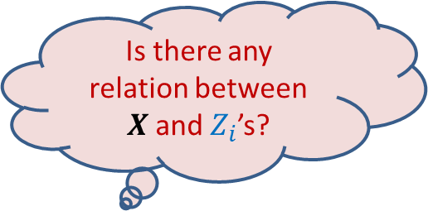
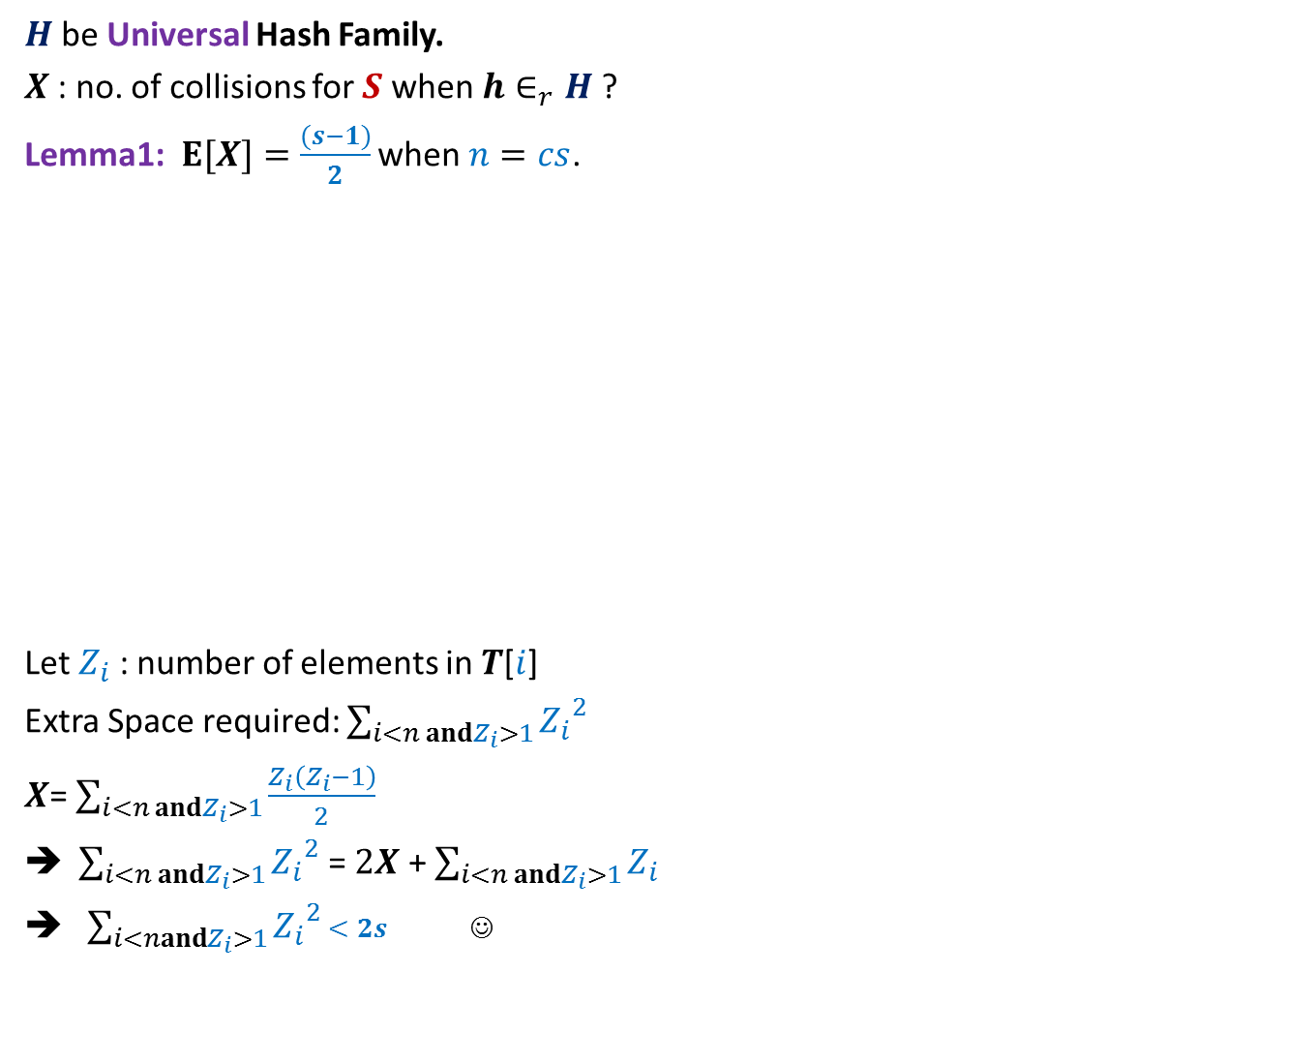
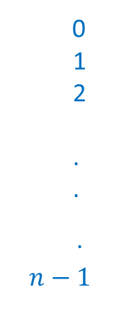
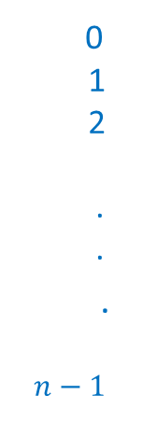

$H$be Universal Hash Family.
$X$: no. of collisions for $S$ when $h∈_{r}H$?
Lemma1:$E[X]=\frac{(s−1)}{2}$ when $n=cs$.
Let $Z_{i}$ : number of elements in $T$[$i$]
Extra Space required: $\sum_{i<n andZ_{i}>1}{{Z_{i}}^{2}}$
$X$= $\sum_{i<n andZ_{i}>1}{\frac{Z_{i}\left(Z_{i}−1\right)}{2}}$
$\sum_{i<n andZ_{i}>1}{{Z_{i}}^{2}}$ = $2X$ + $\sum_{i<n andZ_{i}>1}{Z_{i}}$
$\sum_{i<nandZ_{i}>1}{{Z_{i}}^{2}}$ $<2s$ ☺
$$T$$
$$T$$
0
1
2
.
.
.
$$n−1$$
0
1
2
.
.
.
$$n−1$$
Is there any relation between $X$and $Z_{i}$’s?

Slide 16
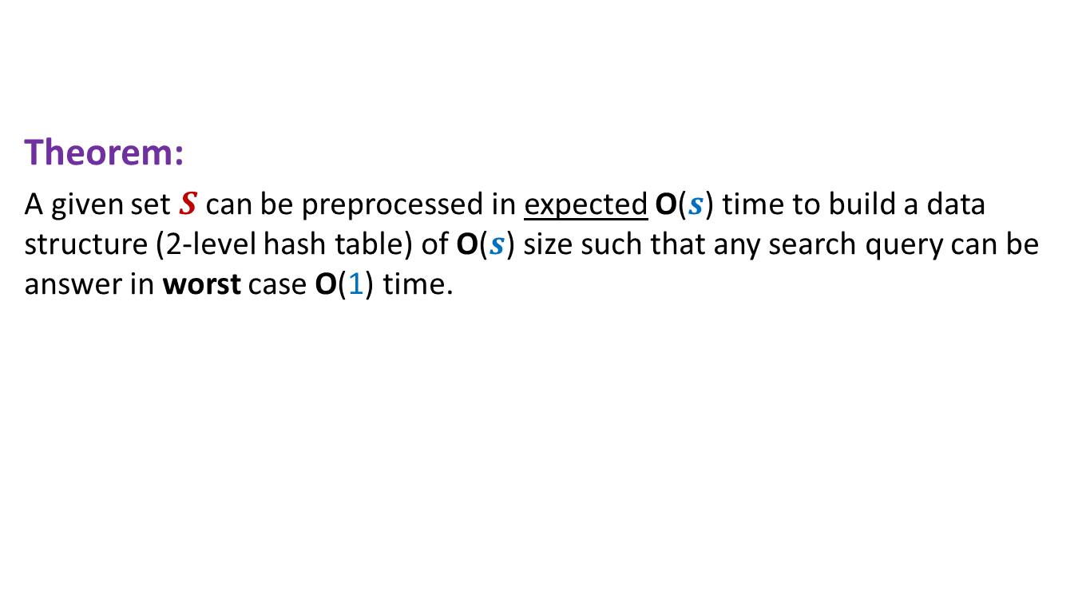
Theorem:
A given set $S$can be preprocessed in expected O($s$) time to build a data structure (2-level hash table) of O($s$) size such that any search query can be answer in worst case O(1) time.

Slide 17
Why such a definition for Universal Hash family ?

Slide 18
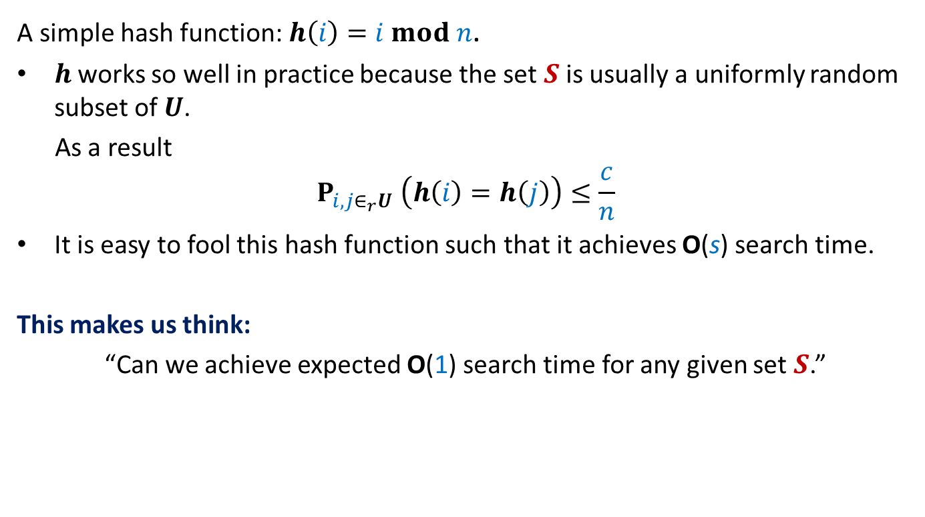
Why does hashing work so well in Practice ?
A simple hash function: $h\left(i\right)=i mod n$.
$h$works so well in practice because the set $S$ is usually a uniformly random subset of $U$.
As a result
$$P_{i,j∈_{r}U} \left(h\left(i\right)=h\left(j\right)\right)≤\frac{c}{n}$$
It is easy to fool this hash function such that it achieves O(s) search time.
This makes us think:
“Can we achieve expected O(1) search time for any given set $S$.”
similar question while
Quick Sort ➔ Randomized Quick Sort

Slide 19
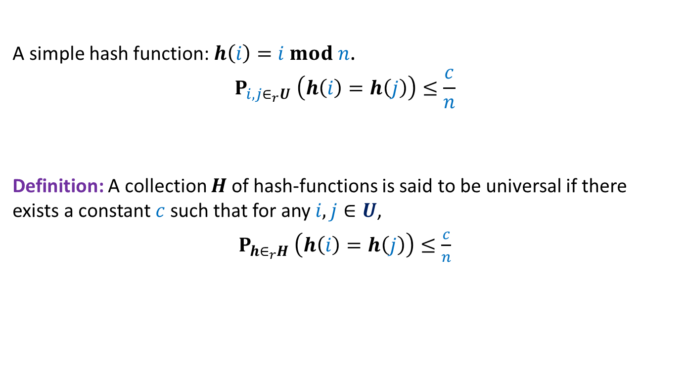
Universal Hash Family
A simple hash function: $h\left(i\right)=i mod n$.
$$P_{i,j∈_{r}U} \left(h\left(i\right)=h\left(j\right)\right)≤\frac{c}{n}$$
Definition: A collection $H$of hash-functions is said to be universal if there exists a constant $c$such that for any $i,j∈U$,
$P_{h∈_{r}H} \left(h\left(i\right)=h\left(j\right)\right)≤\frac{c}{n}$

Slide 20
A simple and Compact
Universal Hash family

Slide 21
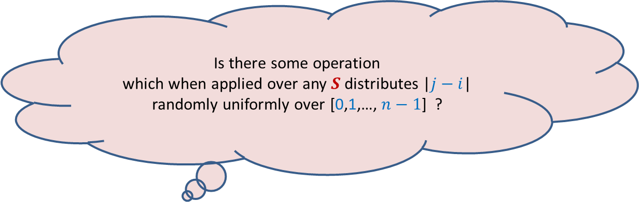

The starting point
The simple hash function: $h\left(i\right)=i mod n$.
Problem: Two elements in $i,j∈S$ are bound to collide if $n$ divides |$j−i$| .
Is there some operation
which when applied over any $S$distributes |$j−i$| randomly uniformly over [0,1,…, $n−1$] ?

Slide 22

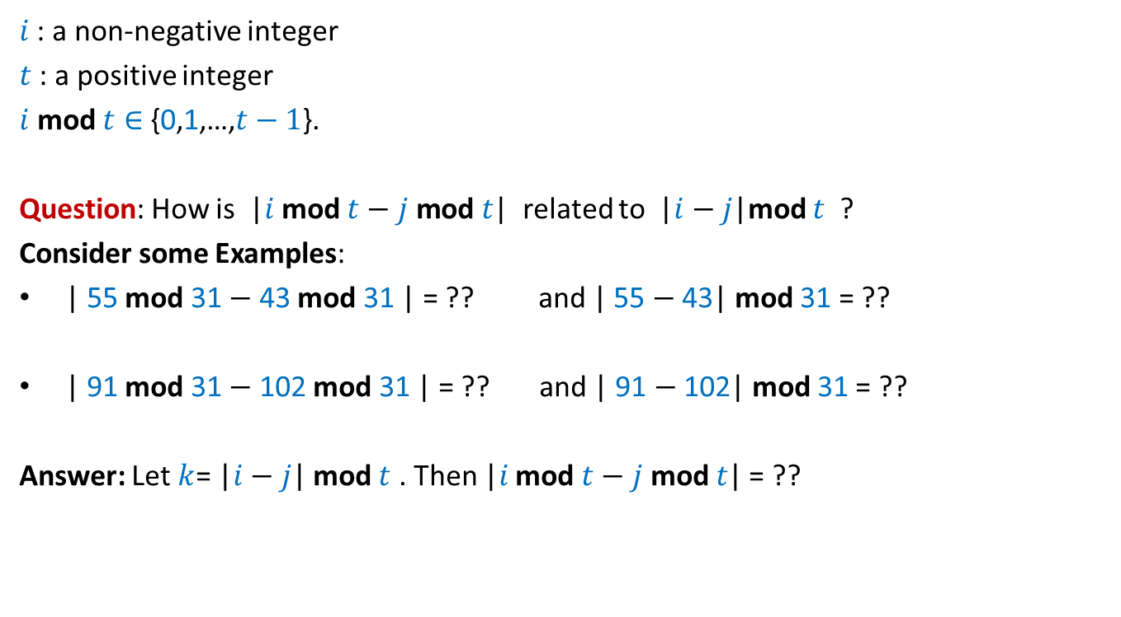
mod operation
$i$ : a non-negative integer
$t$ : a positive integer
$i$ mod $t∈${0,1,…,$t−1$}.
Question: How is |$i$ mod $t−j \text{mod} t$| related to |$i−j$|mod $t$ ?
Consider some Examples:
| 55 mod 31 $−$ 43 mod 31 | = ?? and | 55 $−$43| mod 31 = ??
| 91 mod 31 $−$ 102 mod 31 | = ?? and | 91 $−$102| mod 31 = ??
Answer: Let $k$= |$i−j$| mod $t$ . Then |$i$ mod $t−j \text{mod} t$| = ??
12
12
20
11
$∈${$k$, $t−k$}

Slide 23
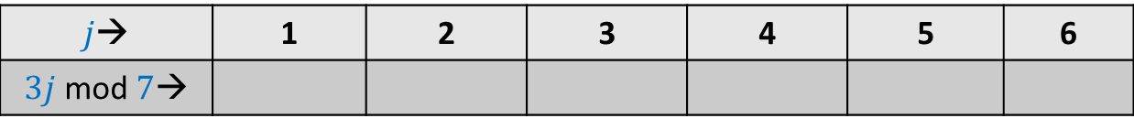

mod operation
$p$ : a prime number
$A$: {$1,2,…,p−1$}
Consider any $i∈A$.
Question: What can we say about set $A_{i}$ = { $ij mod p | j∈A$} ?
Example: $p=7$, $i=2$.
$j$→ | 1 | 2 | 3 | 4 | 5 | 6
$3j$ mod $7$→
3
6
2
5
1
4

Slide 24
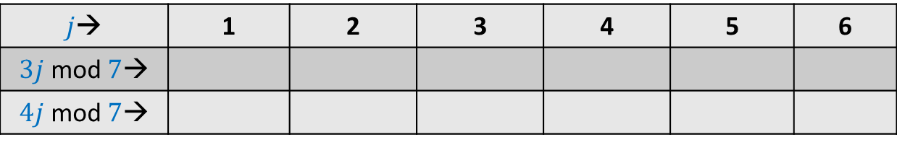
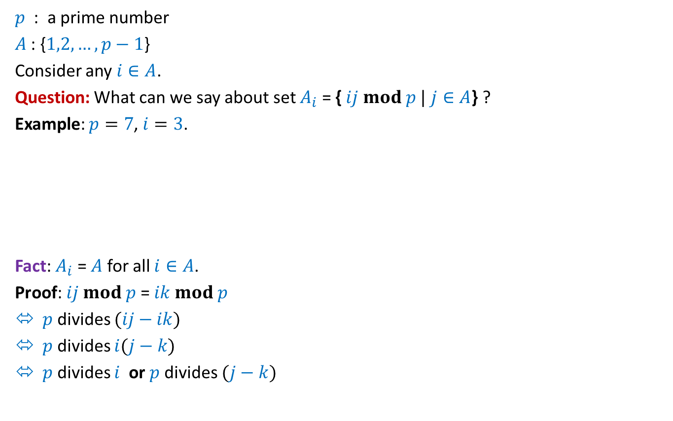
mod operation
$p$ : a prime number
$A$: {$1,2,…,p−1$}
Consider any $i∈A$.
Question: What can we say about set $A_{i}$ = { $ij mod p |$ $j∈A$} ?
Example: $p=7$, $i=3$.
Fact: $A_{i}$ = $A$ for all $i∈A$.
Proof: $ij mod p$= $ik mod p$
$p$ divides $(ij−ik)$
$p$ divides $i(j−k)$
$p$ divides $i$ or $p$divides $(j−k)$
$j$→ | 1 | 2 | 3 | 4 | 5 | 6
$3j$ mod $7$→
$4j$ mod $7$→
3
6
2
5
1
4
4 1 5 2 6 3
Not possible

Slide 25
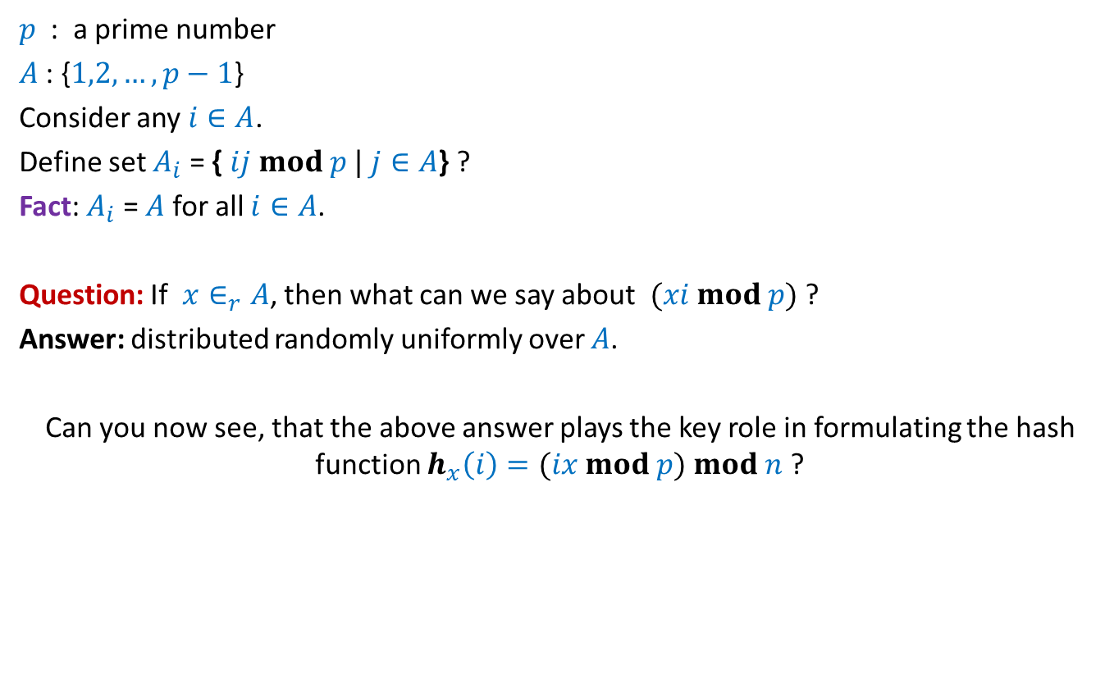
mod operation
$p$ : a prime number
$A$: {$1,2,…,p−1$}
Consider any $i∈A$.
Define set $A_{i}$ = { $ij mod p |$ $j∈A$} ?
Fact: $A_{i}$ = $A$ for all $i∈A$.
Question: If $x∈_{r}A$, then what can we say about $(xi mod p)$?
Answer: distributed randomly uniformly over $A$.
Can you now see, that the above answer plays the key role in formulating the hash function $h_{x}\left(i\right)=(ix mod p) mod n$ ?

Slide 26
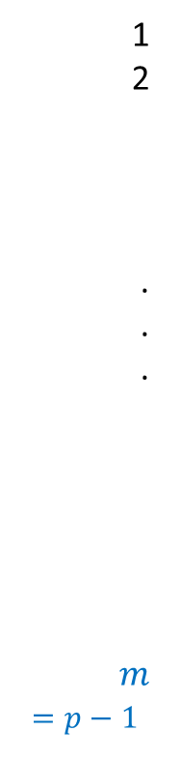
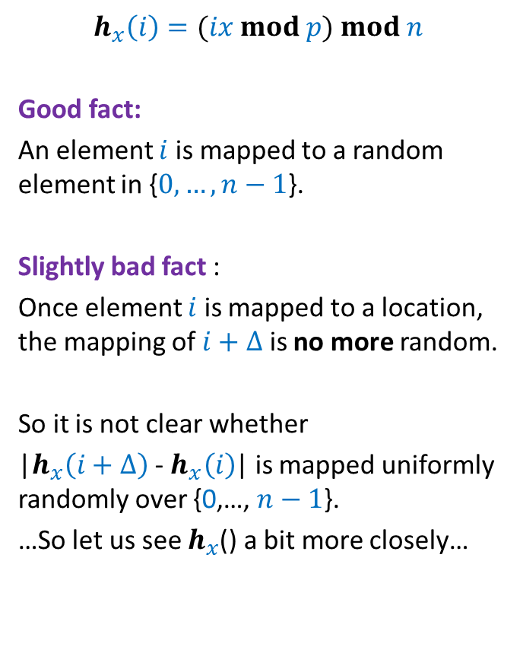



1
2
.
.
.
$$m$$
$=p−1$
$$h_{x}\left(i\right)=(ix mod p) mod n$$
Good fact:
An element $i$ is mapped to a random element in {$0,…,n−1$}.
Slightly bad fact :
Once element $i$ is mapped to a location, the mapping of $i+Δ$is no more random.
So it is not clear whether
|$h_{x}\left(i+Δ\right)$ - $h_{x}\left(i\right)$| is mapped uniformly randomly over {0,…, $n−1$}.
…So let us see $h_{x}$() a bit more closely…
$$ix mod p$$
$$i$$
$$i+Δ$$

Slide 27
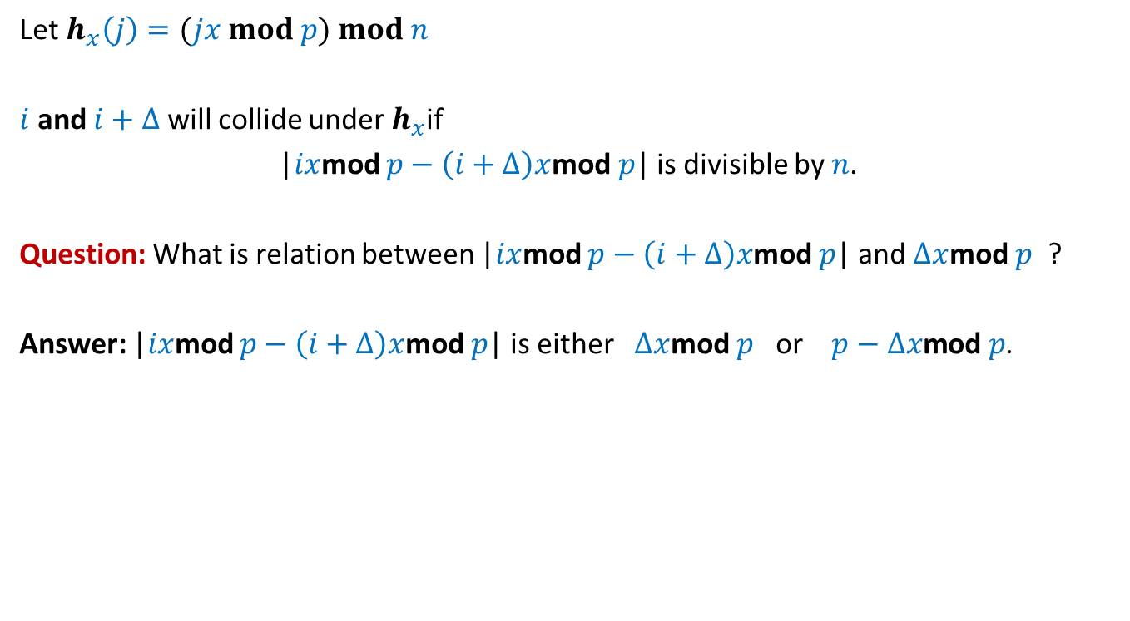

Probability of collision between
$i$ and $i+Δ$
Let $h_{x}\left(j\right)=(jx mod p) mod n$
$i$ and $i+Δ$ will collide under $h_{x}$if
|$ix$mod $p−\left(i+Δ\right)x$mod $p$| is divisible by $n$.
Question: What is relation between |$ix$mod $p−\left(i+Δ\right)x$mod $p$| and $Δx$mod $p$ ?
Answer: |$ix$mod $p−\left(i+Δ\right)x$mod $p$| is either $Δx$mod $p$ or $p−Δx\text{mod} p$.

Slide 28
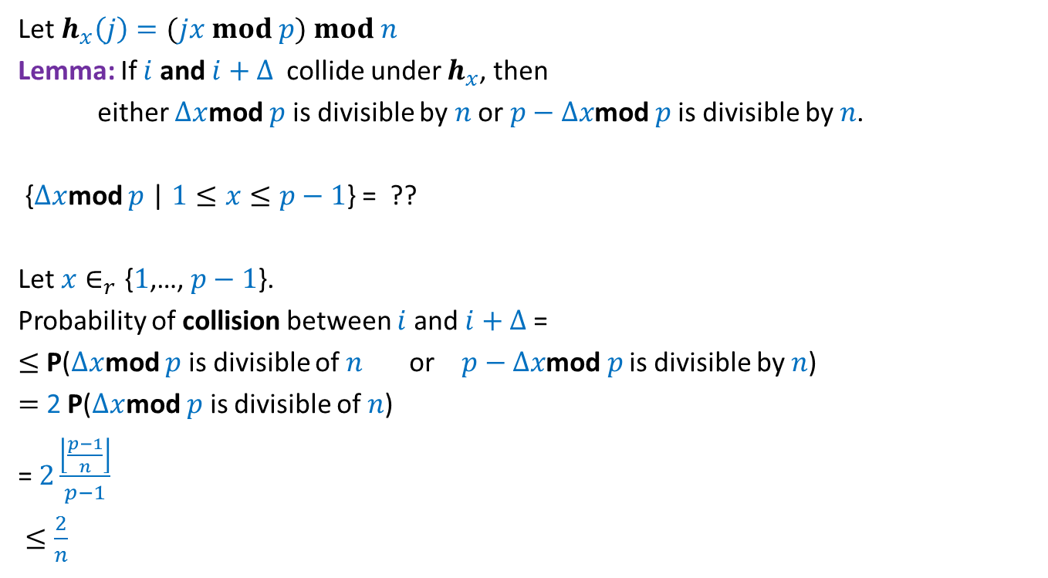

Probability of collision between
$i$ and $i+Δ$
Let $h_{x}\left(j\right)=(jx mod p) mod n$
Lemma: If $i$ and $i+Δ$ collide under $h_{x}$, then
either $Δx$mod $p$ is divisible by $n$ or $p−Δx\text{mod} p$ is divisible by $n$.
{$Δx$mod $p$ | $1≤x≤p−1$} = ??
Let $x∈_{r}\text{\{}1\text{,…,} p−1\text{\}}$.
Probability of collision between $i$ and $i+Δ$ =
$≤$ P($Δx$mod $p$ is divisible of $n$ or $p−Δx\text{mod} p$ is divisible by $n$)
$=$ 2 P($Δx$mod $p$ is divisible of $n$)
= $2\frac{\left\lfloor \frac{p−1}{n}\right\rfloor }{p−1}$
$≤\frac{2}{n}$
{$1$,…, $p−1$}
Students must realize that it is a necessary condition and not sufficient condition for collision. To get an idea, study the example given at the last slide of this lecture.

Slide 29

Theorem:
Let $h_{x}\left(j\right)=(jx mod p) mod n$, then H={$h_{x}$| $1≤x≤p−1$} is universal.

Slide 30

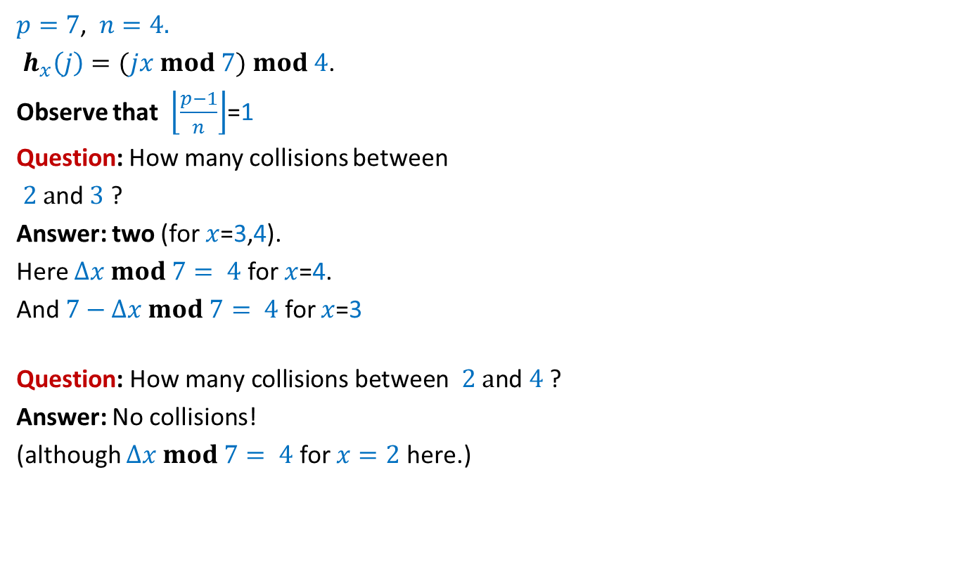


Example
$p=7$, $n=4.$
$h_{x}\left(j\right)=(jx mod 7) mod 4$.
Observe that $\left\lfloor \frac{p−1}{n}\right\rfloor$=1
Question: How many collisions between
$2 a$nd $3$ ?
Answer: two (for $x$=3,4).
Here $Δx mod 7= 4$ for $x$=4.
And $7−Δx mod 7= 4$ for $x$=3
$$\text{Question}\text{:} \text{How} \text{many} \text{collisions} \text{between} 2 a\text{nd} \text{4}\text{ ?}$$
Answer: No collisions!
(although $Δx mod 7= 4$ for $x=2$ here.)
$x$
1 2 3 4 5 6
$j$
1
2
3
4
5
6
1 | 2 | 3 | 4 | 5 | 6
2 | 4 | 6 | 1 | 3 | 5
3 | 6 | 2 | 5 | 1 | 4
4 | 1 | 5 | 2 | 6 | 3
5 | 3 | 1 | 6 | 4 | 2
6 | 5 | 4 | 3 | 2 | 1
Table storing $jx mod 7$

Slide 31
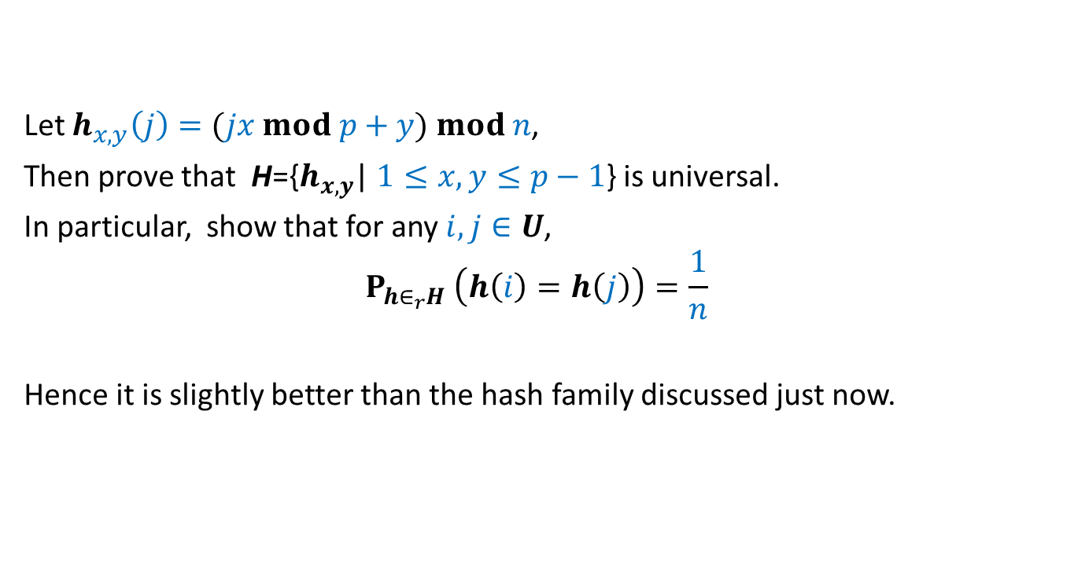
Homework:
Let $h_{x,y}\left(j\right)=(jx mod p+y) mod n$,
Then prove that H={$h_{x,y}$| $1≤x,y≤p−1$} is universal.
In particular, show that for any $i,j∈U$,
$$P_{h∈_{r}H} \left(h\left(i\right)=h\left(j\right)\right)=\frac{1}{n}$$
Hence it is slightly better than the hash family discussed just now.

