Slide 1
Randomized Algorithms
CS648
Lecture 11
Hashing - I

Slide 2

Problem Definition
$U=\left\{1,2,…,m\right\}$ called universe
$S⊆U$ and $s=|S|$
$s≪$ $m$
Examples:
$m={10}^{18}$, $s={10}^{3}$
Aim
Maintain a data structure for storing $S$to support the search query :
“Does $i∈$ $S$ ?” for any given $i∈U$.

Slide 3
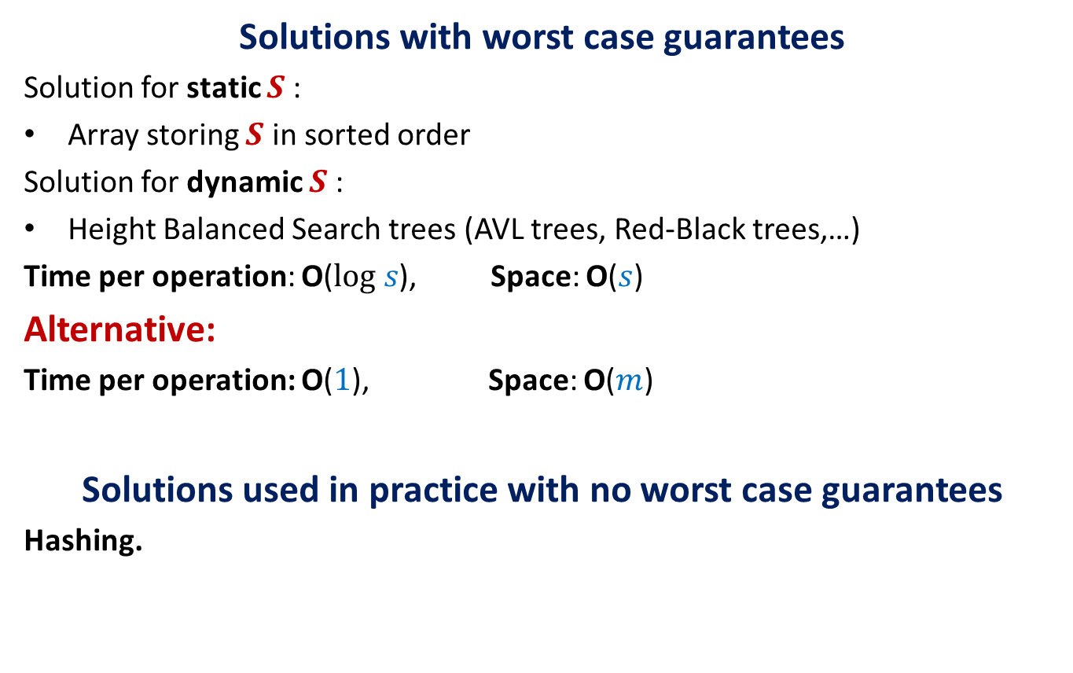
Solutions
Solutions with worst case guarantees
Solution for static $S$:
Array storing $S$ in sorted order
Solution for dynamic $S$:
Height Balanced Search trees (AVL trees, Red-Black trees,…)
Time per operation: O($log s$), Space: O($s$)
Alternative:
Time per operation: O($1$), Space: O($m$)
Solutions used in practice with no worst case guarantees
Hashing.

Slide 4


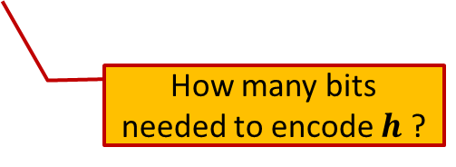
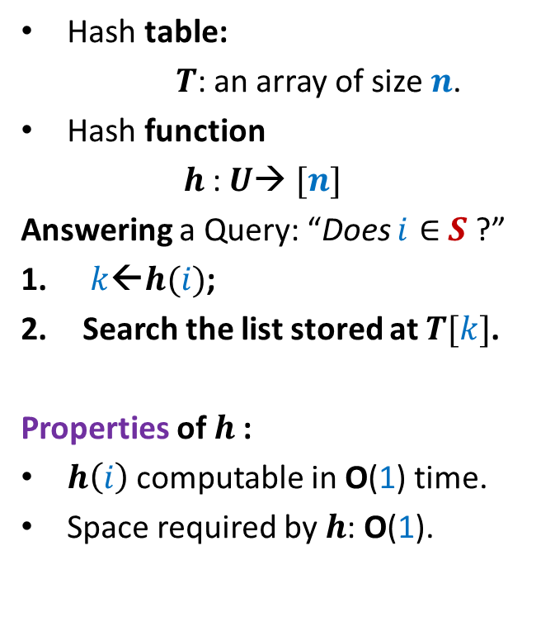

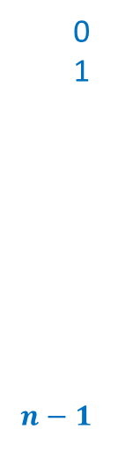

Hashing
Hash table:
$T$: an array of size $n$.
Hash function
$h$: $U$→ $[n]$
Answering a Query: “Does $i∈$ $S$ ?”
$k$←$h(i)$;
Search the list stored at $T[k]$.
Properties of $h$:
$h\left(i\right)$ computable in O(1) time.
Space required by $h$: O(1).
Elements of $S$
$$T$$
0
1
$$n−1$$
$$⋮$$
$$⋮$$
How many bits needed to encode $h$ ?

Slide 5
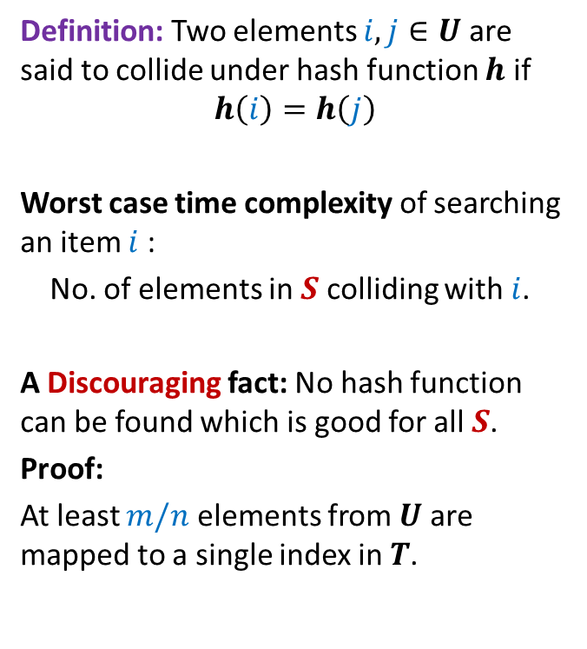
Collision
Definition: Two elements $i,j∈U$ are said to collide under hash function $h$ if
$$h\left(i\right)=h\left(j\right)$$
Worst case time complexity of searching an item $i$:
No. of elements in $S$ colliding with $i$.
A Discouraging fact: No hash function can be found which is good for all $S$.
Proof:
At least $m/n$ elements from $U$are mapped to a single index in $T$.
$$T$$
0
1
$$n−1$$
$$⋮$$
$$⋮$$

Slide 6


Collision
Definition: Two elements $i,j∈U$ are said to collide under hash function $h$ if
$$h\left(i\right)=h\left(j\right)$$
Worst case time complexity of searching an item $i$:
No. of elements in $S$ colliding with $i$.
A Discouraging fact: No hash function can be found which is good for all $S$.
Proof:
At least $m/n$ elements from $U$are mapped to a single index in $T$.
$$T$$
0
1
$$n−1$$
$$⋮$$
$$⋯$$
$$⋮$$
$$m/n$$

Slide 7
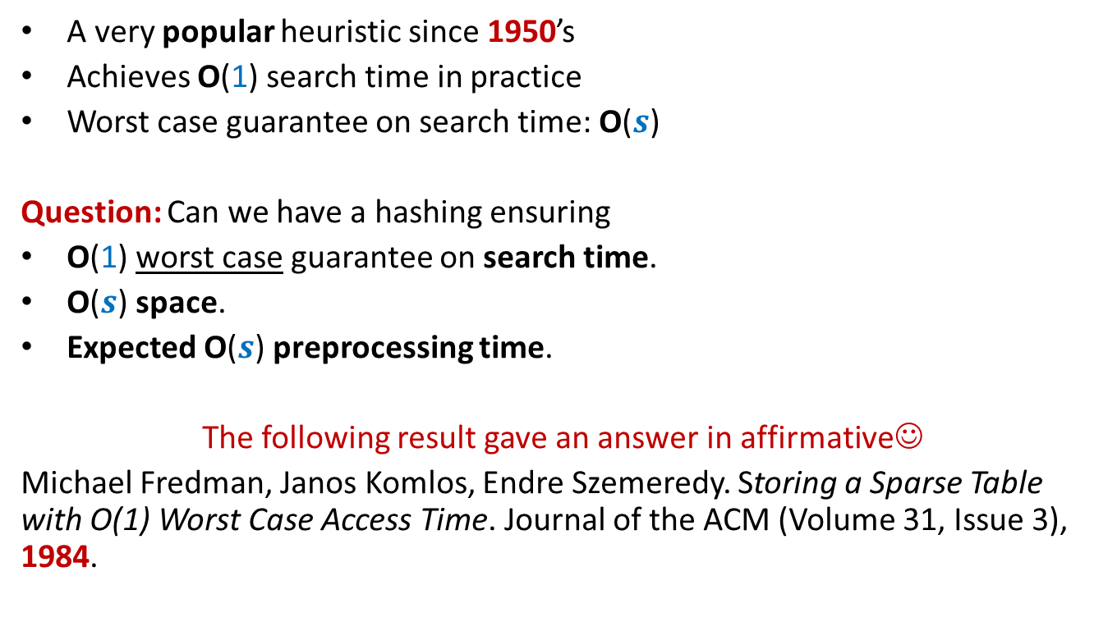
Hashing
A very popular heuristic since 1950’s
Achieves O(1) search time in practice
Worst case guarantee on search time: O($s$)
Question: Can we have a hashing ensuring
O(1) worst case guarantee on search time.
O($s$) space.
Expected O($s$) preprocessing time.
The following result gave an answer in affirmative☺
Michael Fredman, Janos Komlos, Endre Szemeredy. Storing a Sparse Table with O(1) Worst Case Access Time. Journal of the ACM (Volume 31, Issue 3), 1984.

Slide 8
Why does hashing work so well in Practice ?

Slide 9
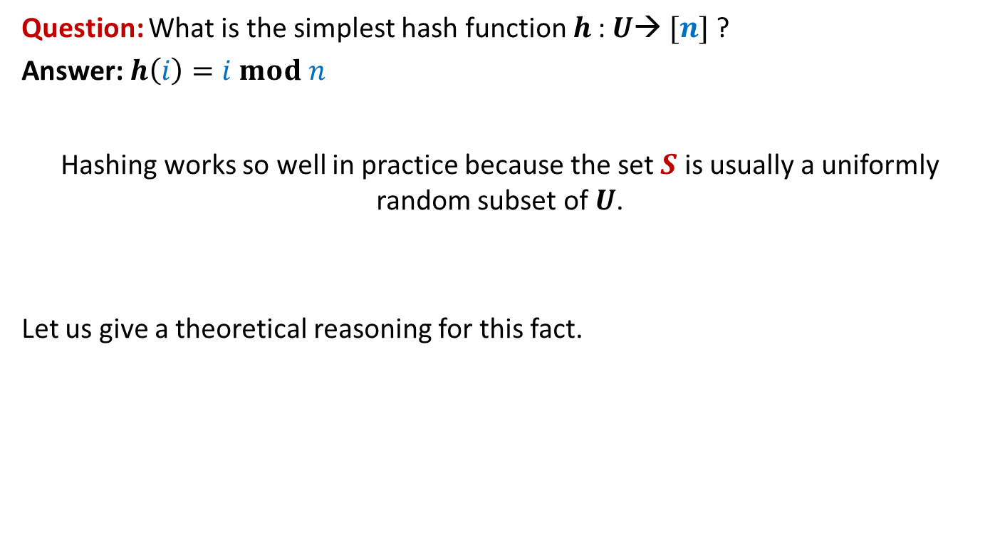
Why does hashing work so well in Practice ?
Question: What is the simplest hash function $h$: $U$→ $[n]$ ?
Answer: $h\left(i\right)=i mod n$
Hashing works so well in practice because the set $S$ is usually a uniformly random subset of $U$.
Let us give a theoretical reasoning for this fact.

Slide 10











Why does hashing work so well in Practice ?
1
2
Let $y_{1},y_{2},…,y_{s}$ denote $s$elements selected randomly uniformly from $U$ to form $S$.
Question: What is expected number of elements colliding with $y_{1}$?
Answer: Let $y_{1}$ takes value $i$.
P($y_{j}$ collides with $y_{1}$) = ??
$$⋮$$
$$i−n$$
$$i$$
How many possible values can $y_{j}$ take ?
How many possible values can collide with $i$ ?
$$i+n$$
$$i+2n$$
$$m−1$$
$$i+3n$$
$$⋮$$
m

Slide 11


Why does hashing work so well in Practice ?
1
2
Let $y_{1},y_{2},…,y_{s}$ denote $s$elements selected randomly uniformly from $U$ to form $S$.
Question: What is expected number of elements colliding with $y_{1}$?
Answer: Let $y_{1}$ takes value $i$.
P($y_{j}$ collides with $y_{1}$) =
$\frac{\left\lceil \frac{m}{n}\right\rceil }{m−1}$
Expected number of elements of $S$ colliding with $y_{1}$ =
$=\frac{\left\lceil \frac{m}{n}\right\rceil }{m−1}$ $(s−1)$
$=O\left(1\right)$ for $n=O(s)$
$$⋮$$
$$i−n$$
Values which may collide with $i$ under the hash function $h\left(x\right)=x mod n$
$$i$$
$$i+n$$
$$i+2n$$
$$i+3n$$
$$⋮$$
m

Slide 12
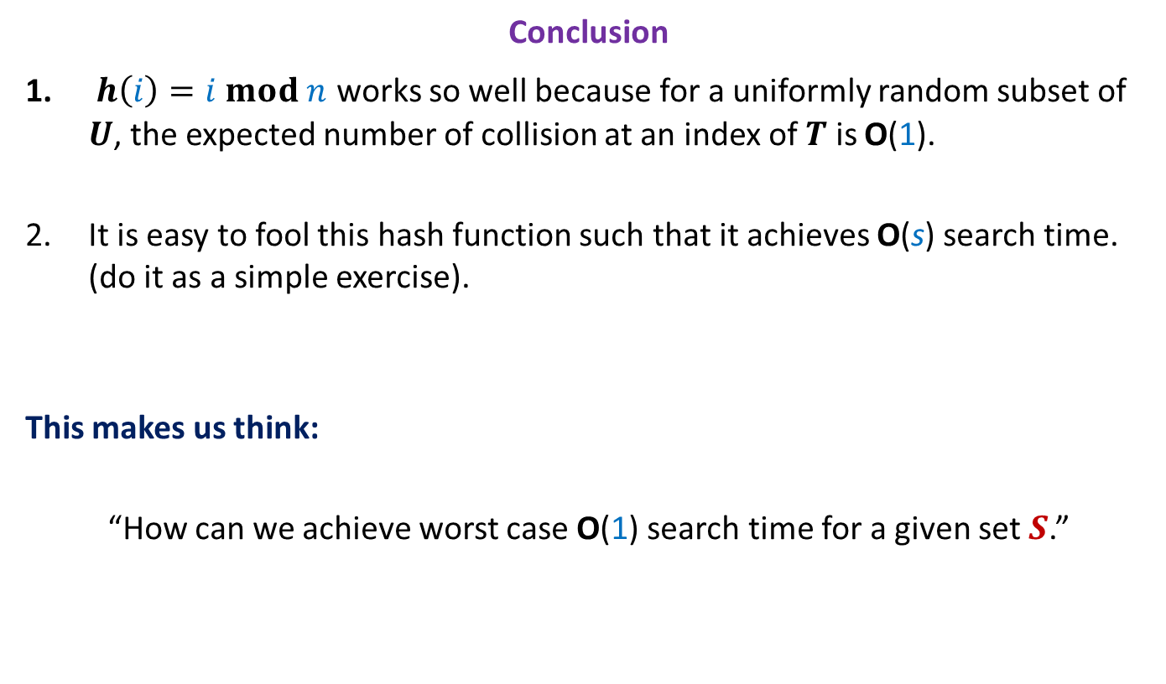
Why does hashing work so well in Practice ?
Conclusion
$h\left(i\right)=i mod n$ works so well because for a uniformly random subset of $U$, the expected number of collision at an index of $T$ is O(1).
It is easy to fool this hash function such that it achieves O(s) search time. (do it as a simple exercise).
This makes us think:
“How can we achieve worst case O(1) search time for a given set $S$.”

Slide 13
How to achieve worst case O(1) search time

Slide 14
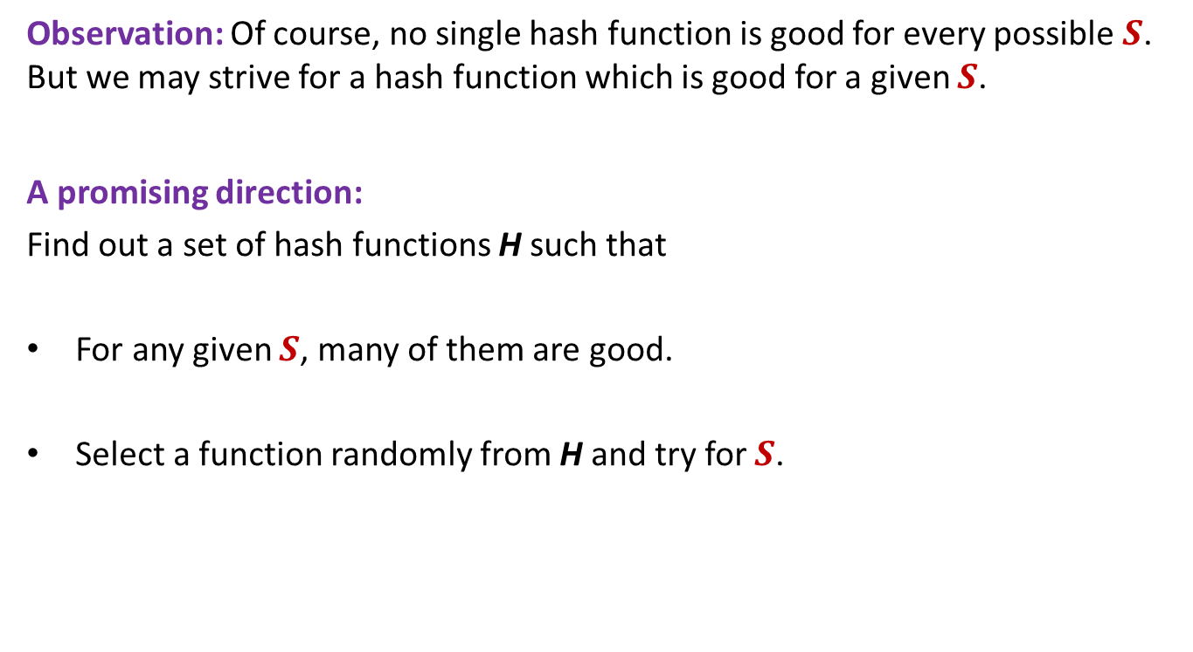
Key idea to achieve worst case O(1) search time
Observation: Of course, no single hash function is good for every possible $S$. But we may strive for a hash function which is good for a given $S$.
A promising direction:
Find out a set of hash functions H such that
For any given $S$, many of them are good.
Select a function randomly from H and try for $S$.
The notion of goodness is captured formally by Universal hash family in the following slide.

Slide 15
Universal Hash Family

Slide 16
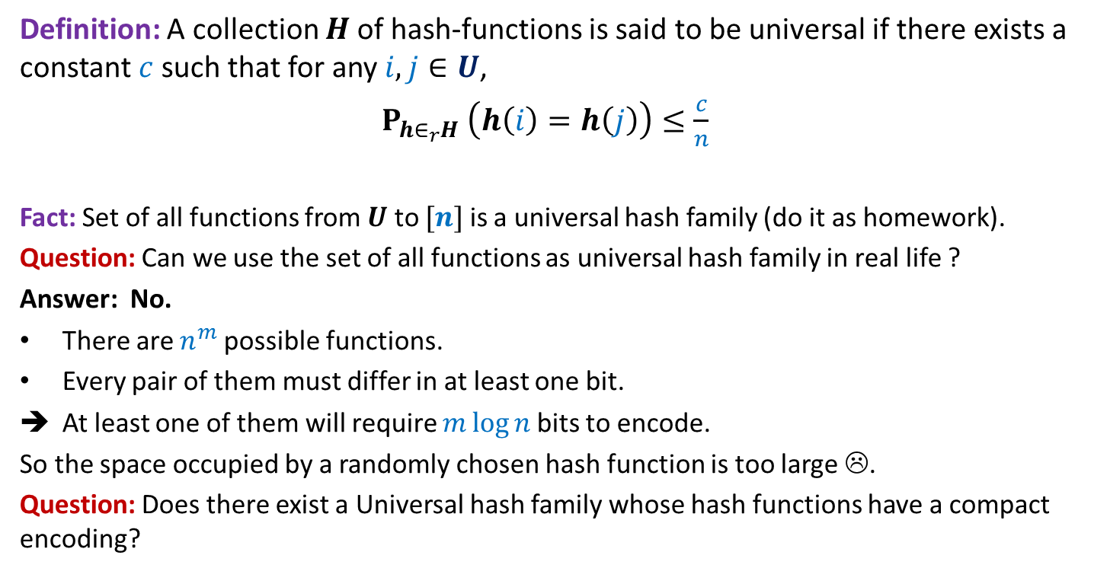
Universal Hash Family
Definition: A collection $H$of hash-functions is said to be universal if there exists a constant $c$such that for any $i,j∈U$,
$P_{h∈_{r}H} \left(h\left(i\right)=h\left(j\right)\right)≤\frac{c}{n}$
Fact: Set of all functions from $U$ to $[n]$ is a universal hash family (do it as homework).
Question: Can we use the set of all functions as universal hash family in real life ?
Answer: No.
There are $n^{m}$possible functions.
Every pair of them must differ in at least one bit.
At least one of them will require $m\log{n}$bits to encode.
So the space occupied by a randomly chosen hash function is too large ☹.
Question: Does there exist a Universal hash family whose hash functions have a compact encoding?

Slide 17
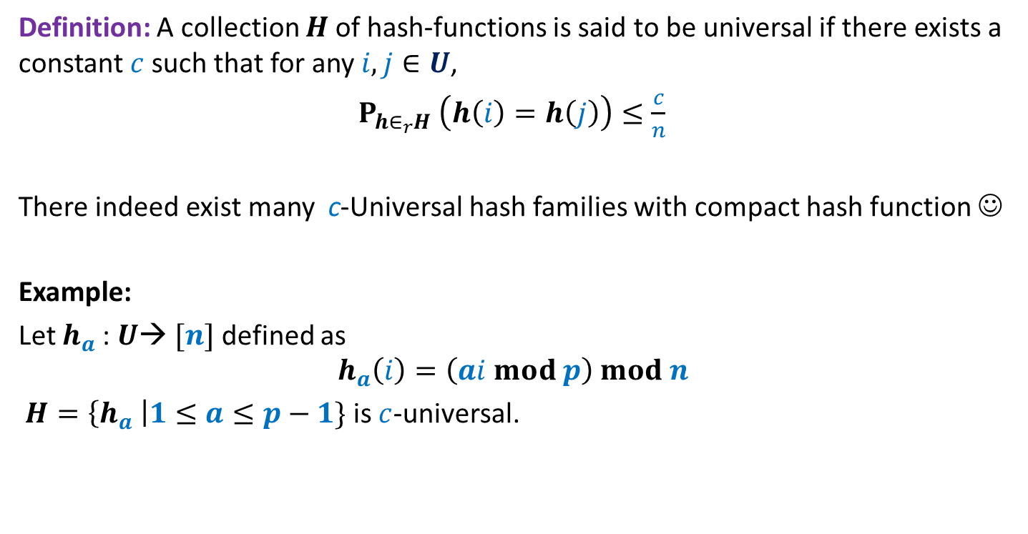
Universal Hash Family
Definition: A collection $H$of hash-functions is said to be universal if there exists a constant $c$such that for any $i,j∈U$,
$P_{h∈_{r}H} \left(h\left(i\right)=h\left(j\right)\right)≤\frac{c}{n}$
There indeed exist many c-Universal hash families with compact hash function ☺
Example:
Let $h_{a}$: $U$→ $[n]$ defined as
$$h_{a}\left(i\right)=\left(ai mod p\right) mod n$$
$H=\left\{h_{a} \right|1≤a≤p−1\}$ is $c$-universal.
This looks complicated. In the next class we shall show that it is very natural and intuitive. For today’s lecture, you don’t need it ☺

Slide 18
Static Hashing worst Case O(1) search time

Slide 19
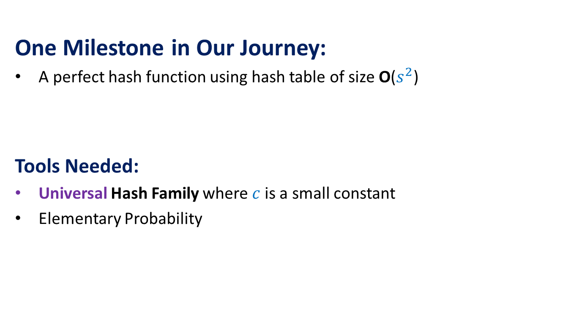
The Journey
One Milestone in Our Journey:
A perfect hash function using hash table of size O($s^{2}$)
Tools Needed:
Universal Hash Family where $c$is a small constant
Elementary Probability

Slide 20
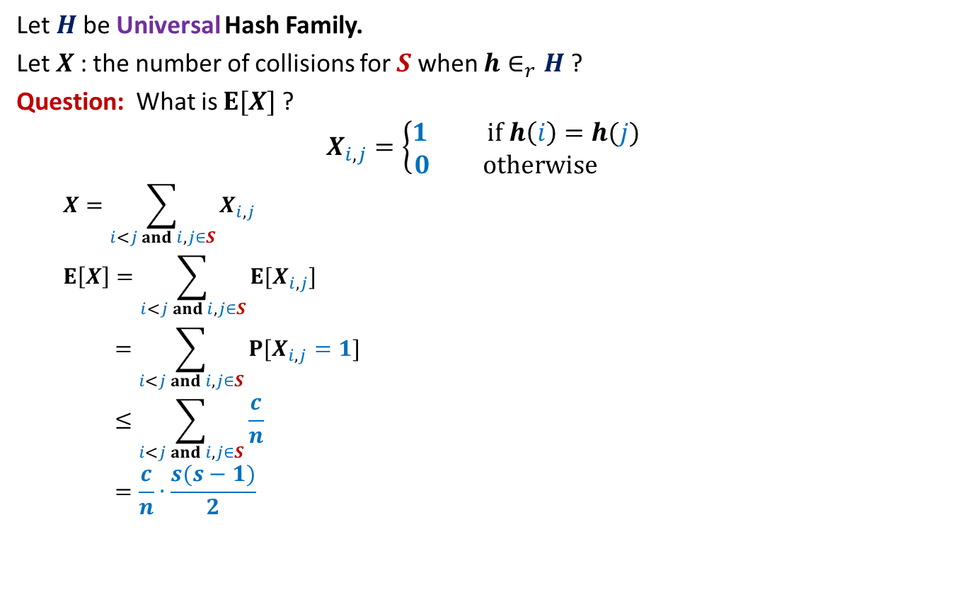

Perfect hashing using O($s^{2}$) space
Let $H$be Universal Hash Family.
Let $X$: the number of collisions for $S$ when $h∈_{r}H$?
Question: What is $E[X]$?
$$X_{i,j}=\left\{\begin{aligned}1 if h\left(i\right)=h(j) \\ 0 otherwise \end{aligned}\right.$$
$$X=\sum_{i<j and i,j∈S}{X_{i,j}}$$
$$E\left[X\right]=\sum_{i<j and i,j∈S}{E[X_{i,j}]}$$
$$=\sum_{i<j and i,j∈S}{P[X_{i,j}=1]}$$
$$≤\sum_{i<j and i,j∈S}{\frac{c}{n}}$$
$$=\frac{c}{n}∙\frac{s(s−1)}{2}$$

Slide 21
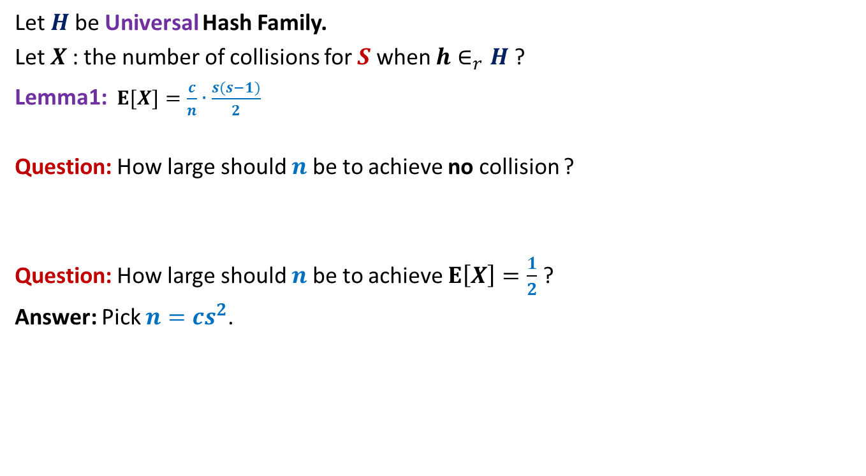
Perfect hashing using O($s^{2}$) space
Let $H$be Universal Hash Family.
Let $X$: the number of collisions for $S$ when $h∈_{r}H$?
Lemma1:$E[X]=\frac{c}{n}∙\frac{s(s−1)}{2}$
Question: How large should $n$be to achieve no collision ?
Question: How large should $n$be to achieve $E\left[X\right]=\frac{1}{2}$ ?
Answer: Pick $n=cs^{2}$.

Slide 22
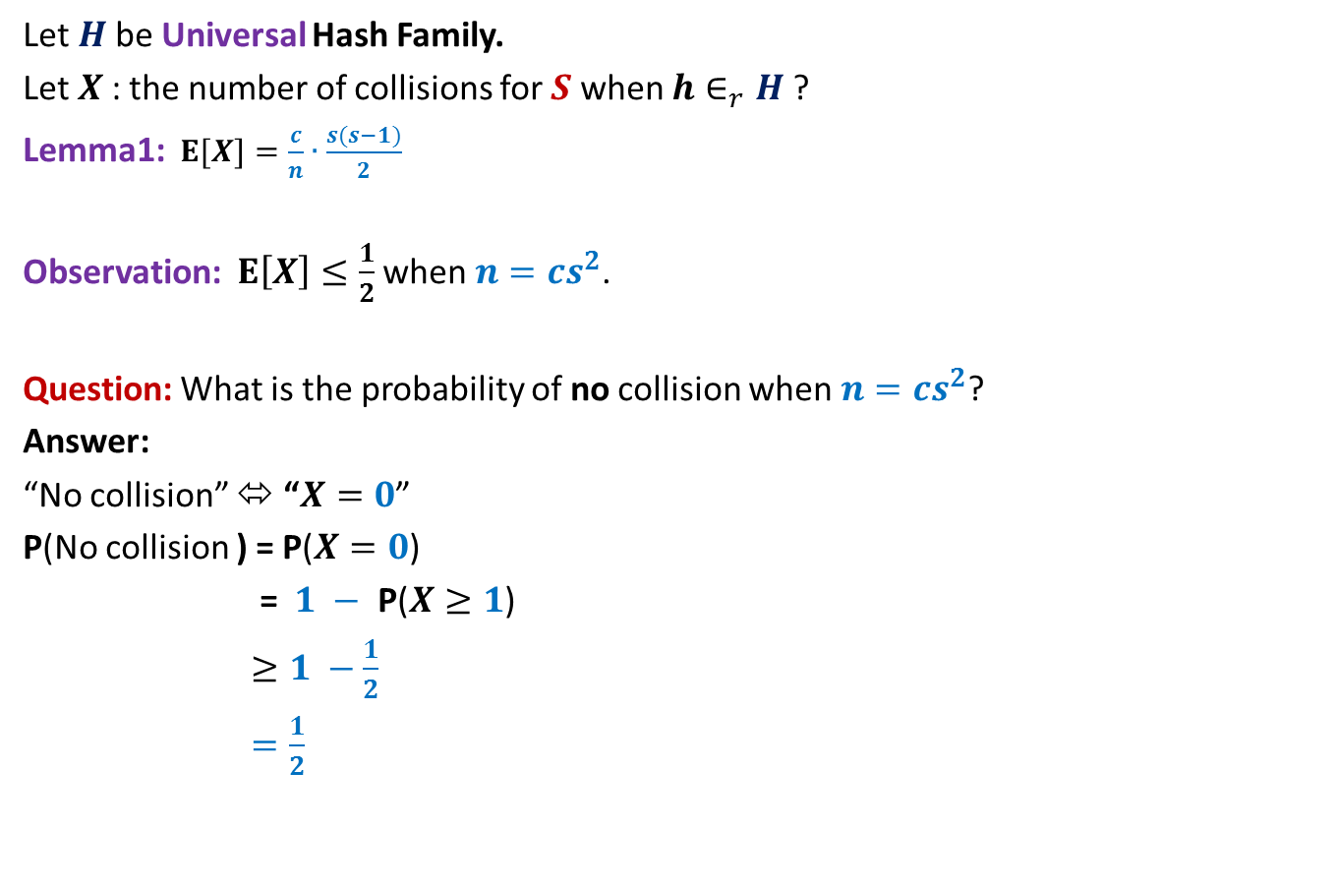
Perfect hashing using O($s^{2}$) space
Let $H$be Universal Hash Family.
Let $X$: the number of collisions for $S$ when $h∈_{r}H$?
Lemma1:$E[X]=\frac{c}{n}∙\frac{s(s−1)}{2}$
Observation: $E\left[X\right]≤\frac{1}{2}$ when $n=cs^{2}$.
Question: What is the probability of no collision when $n=cs^{2}$?
Answer:
“No collision” ⬄ “$X=0$”
P(No collision ) = P($X=0$)
= $1 −$ P($X≥1$)
$≥1 −\frac{1}{2}$
$=\frac{1}{2}$
Use Markov’s Inequality to bound it.

Slide 23
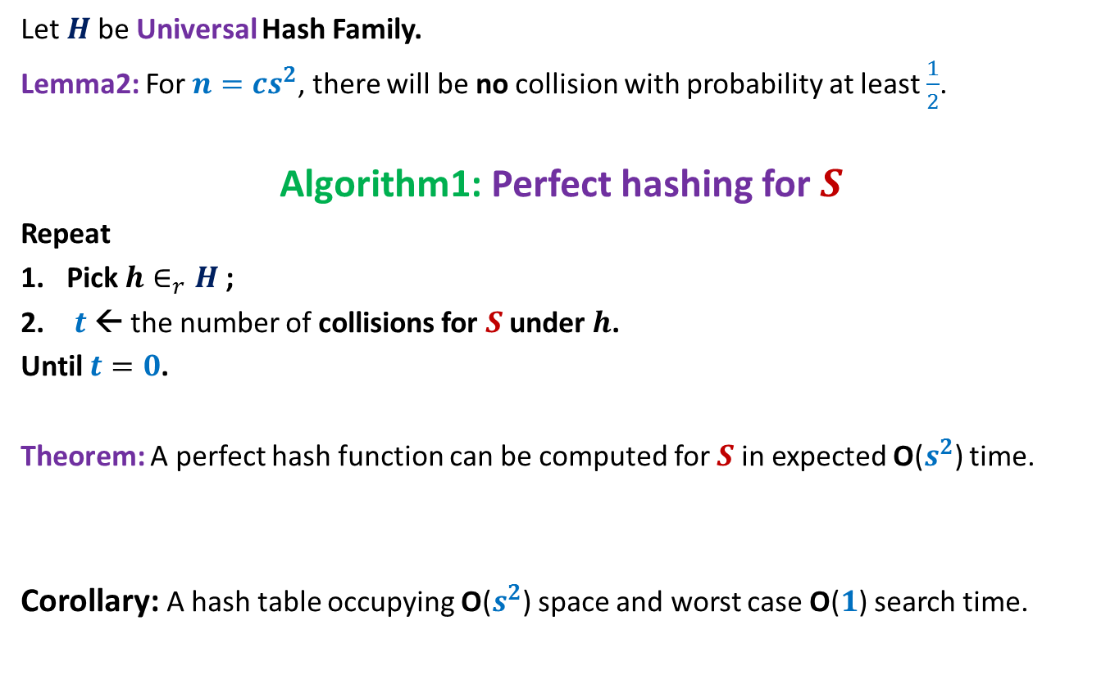
Perfect hashing using O($s^{2}$) space
Let $H$be Universal Hash Family.
Lemma2: For $n=cs^{2}$, there will be no collision with probability at least $\frac{1}{2}$.
Algorithm1: Perfect hashing for $S$
Repeat
Pick $h∈_{r}H$;
$t$← the number of collisions for $S$ under $h$.
Until $t=0$.
Theorem: A perfect hash function can be computed for $S$in expected O($s^{2}$) time.
Corollary: A hash table occupying O($s^{2}$) space and worst case O($1$) search time.

Slide 24
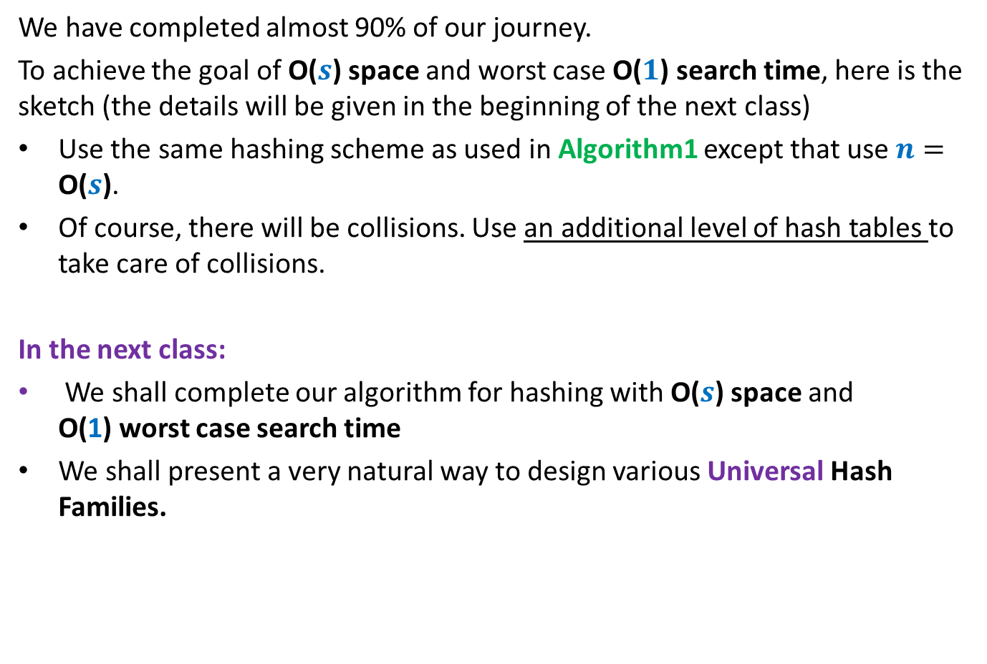

Hashing with O($s$) space and
O(1) worst case search time
We have completed almost 90% of our journey.
To achieve the goal of O($s$) space and worst case O($1$) search time, here is the sketch (the details will be given in the beginning of the next class)
Use the same hashing scheme as used in Algorithm1 except that use $n=$ O($s$).
Of course, there will be collisions. Use an additional level of hash tables to take care of collisions.
In the next class:
We shall complete our algorithm for hashing with O($s$) space and
O(1) worst case search time
We shall present a very natural way to design various Universal Hash Families.

