Slide 1
Randomized Algorithms
CS648
Lecture 10
Random Sampling
part-II
(To find a subset with desired property)

Slide 2
Overview
There is a huge list (1 million) of blood donors.
Unfortunately the blood group information is missing at present.
We need a donor with blood group O+.
What to do ?
Solution: (Select a random subset of donors.)
Repeat until we get a donor of blood group O+.
{ Pick phone number of a donor randomly uniformly
Call him to ask his Blood group.
}

Slide 3
Random Sampling
Suppose there is a computational problem where we require to find a subset with some desired properties.
Unfortunately, computing such a set deterministically may take huge time.
Random sampling carried out suitably may produce a subset with the desired property with some probability.

Slide 4
Randomized Algorithm for BPWM problem

Slide 5
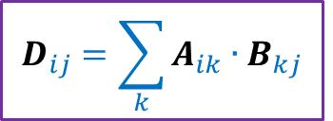
Integer Product of Matrices
1 | 0 | 0 | 1 | 0
1 | 0 | 0 | 0 | 1
0 | 0 | 1 | 0 | 0
0 | 1 | 0 | 1 | 0
1 | 1 | 0 | 1 | 0
1 | 0 | 1 | 0 | 0
0 | 1 | 1 | 0 | 1
1 | 1 | 1 | 1 | 0
1 | 1 | 1 | 0 | 0
1 | 0 | 0 | 1 | 0
2 | 1 | 2 | 0 | 0
2 | 0 | 1 | 0 | 0
1 | 1 | 1 | 1 | 0
1 | 2 | 2 | 0 | 1
2 | 2 | 3 | 0 | 1
A
B
D
$$D_{ij}=\sum_{k}{A_{ik}{∙B}_{kj}}$$

Slide 6
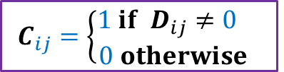
Boolean Product of Matrices
1 | 0 | 0 | 1 | 0
1 | 0 | 0 | 0 | 1
0 | 0 | 1 | 0 | 0
0 | 1 | 0 | 1 | 0
1 | 1 | 0 | 1 | 0
1 | 0 | 1 | 0 | 0
0 | 1 | 1 | 0 | 1
1 | 1 | 1 | 1 | 0
1 | 1 | 1 | 0 | 0
1 | 0 | 0 | 1 | 0
1 | 1 | 1 | 0 | 0
1 | 0 | 1 | 0 | 0
1 | 1 | 1 | 1 | 0
1 | 1 | 1 | 0 | 1
1 | 1 | 1 | 0 | 1
A
B
C
$$C_{ij}=\left\{\begin{aligned}1 if D_{ij}≠0 \\ 0 otherwise \end{aligned}\right.$$

Slide 7
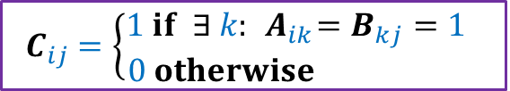
Boolean Product of Matrices
1 | 0 | 0 | 1 | 0
1 | 0 | 0 | 0 | 1
0 | 0 | 1 | 0 | 0
0 | 1 | 0 | 1 | 0
1 | 1 | 0 | 1 | 0
1 | 0 | 1 | 0 | 0
0 | 1 | 1 | 0 | 1
1 | 1 | 1 | 1 | 0
1 | 1 | 1 | 0 | 0
1 | 0 | 0 | 1 | 0
1 | 1 | 1 | 0 | 0
1 | 0 | 1 | 0 | 0
1 | 1 | 1 | 1 | 0
1 | 1 | 1 | 0 | 1
1 | 1 | 1 | 0 | 1
A
B
C
$$C_{ij}=\left\{\begin{aligned}1 if ∃ k:{ A}_{ik}=B_{kj}=1 \\ 0 otherwise \end{aligned}\right.$$
Definition: An integer $k∈[n]$is said to be witness for a pair ($i,j$) if ${ A}_{ik}=B_{kj}=1$

Slide 8

Boolean Product Witness Matrix (BPWM)
Problem: Given two Boolean matrices A and B, and their Boolean product C, compute a matrix $W$, such that:
$W_{ij}$ stores a witness for each ($i,j$) with $C_{ij}=1$.

Slide 9
Motivation for BPWM

Slide 10

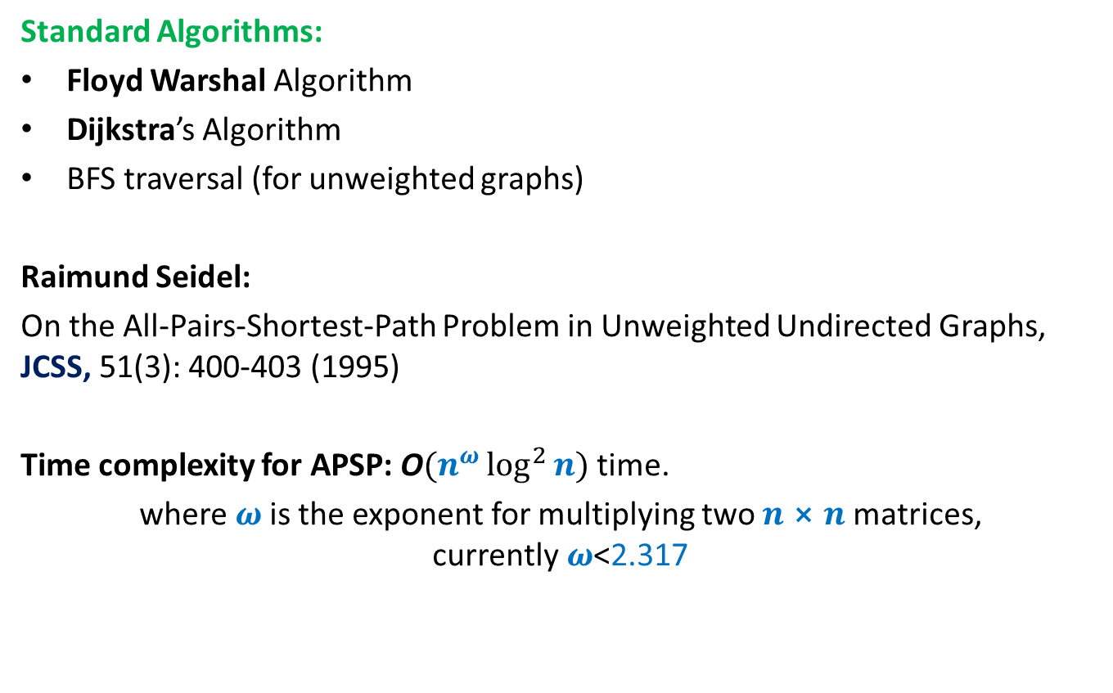
All Pairs Shortest Paths (APSP)
Standard Algorithms:
Floyd Warshal Algorithm
Dijkstra’s Algorithm
BFS traversal (for unweighted graphs)
Raimund Seidel:
On the All-Pairs-Shortest-Path Problem in Unweighted Undirected Graphs, JCSS, 51(3): 400-403 (1995)
Time complexity for APSP: O$(n^{ω}\log^{2}{n})$ time.
where $ω$is the exponent for multiplying two $n⨯n$matrices, currently$ω$<2.317
O$(n^{3})$ time in the worst case

Slide 11
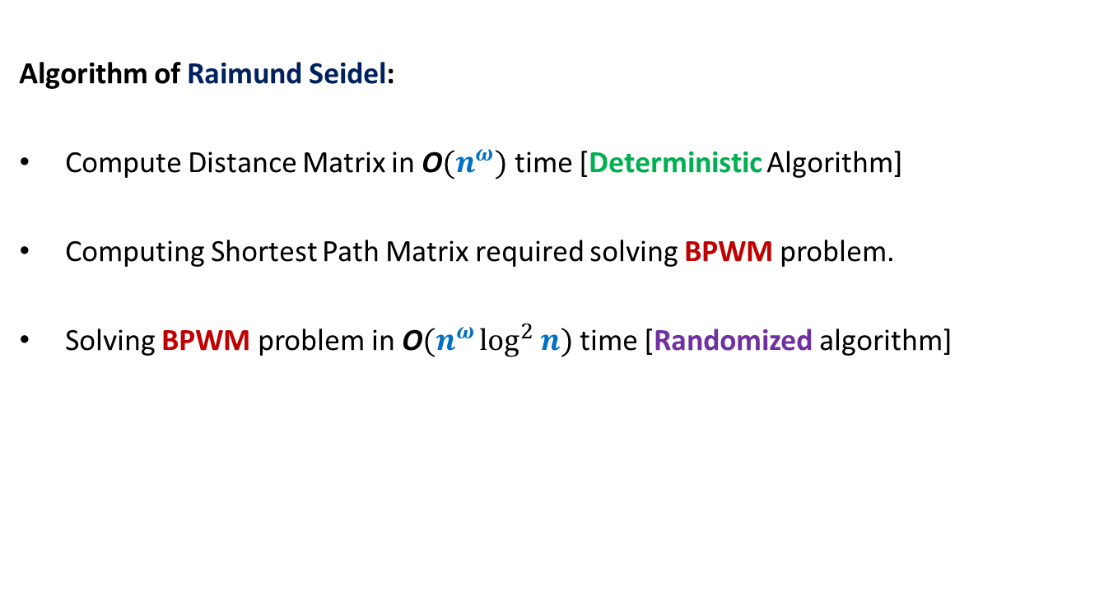
All Pairs Shortest Paths (APSP)
Students having interest in algorithms are strongly advised to study this novel algorithm from Motwani-Raghwan book or the original journal version. (This is, of course, not part of the syllabus for CS648)
Algorithm of Raimund Seidel:
Compute Distance Matrix in O$(n^{ω})$ time [Deterministic Algorithm]
Computing Shortest Path Matrix required solving BPWM problem.
Solving BPWM problem in O$(n^{ω}\log^{2}{n})$ time [Randomized algorithm]

Slide 12
Randomized algorithm for BPWM

Slide 13

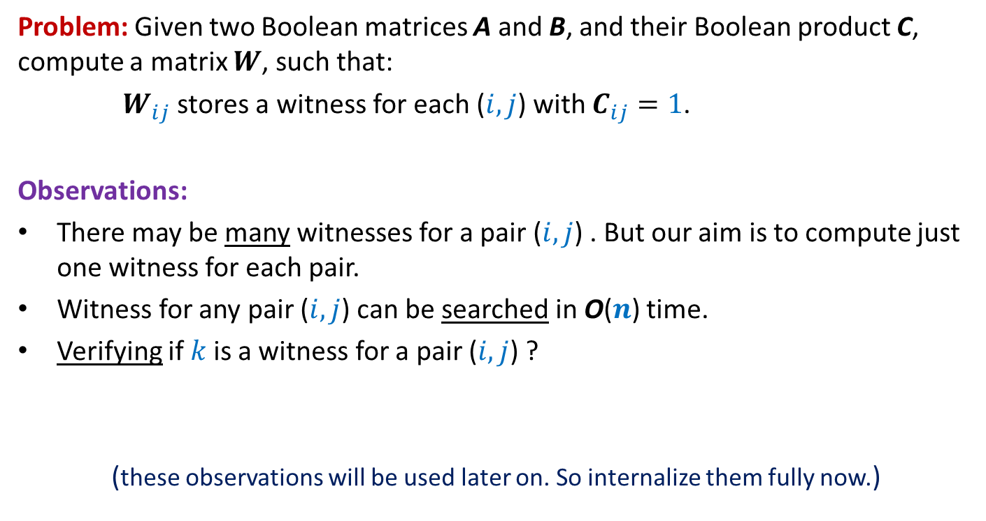

Boolean Product Witness Matrix (BPWM)
Problem: Given two Boolean matrices A and B, and their Boolean product C, compute a matrix $W$, such that:
$W_{ij}$ stores a witness for each ($i,j$) with $C_{ij}=1$.
Observations:
There may be many witnesses for a pair ($i,j$) . But our aim is to compute just one witness for each pair.
Witness for any pair ($i,j$) can be searched in O($n$) time.
Verifying if $k$is a witness for a pair ($i,j$) ?
(these observations will be used later on. So internalize them fully now.)
O($1$) time
Just check whether${ A}_{ik}=B_{kj}=1$.

Slide 14
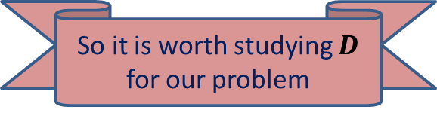

Boolean Product of Matrices
1 | 0 | 0 | 1 | 0
1 | 0 | 0 | 0 | 1
0 | 0 | 1 | 0 | 0
0 | 1 | 0 | 1 | 0
1 | 1 | 0 | 1 | 0
1 | 0 | 1 | 0 | 0
0 | 1 | 1 | 0 | 1
1 | 1 | 1 | 1 | 0
1 | 1 | 1 | 0 | 0
1 | 0 | 0 | 1 | 0
1 | 1 | 1 | 0 | 0
1 | 0 | 1 | 0 | 0
1 | 1 | 1 | 1 | 0
1 | 1 | 1 | 0 | 1
1 | 1 | 1 | 0 | 1
A
B
C
Look carefully at the integer product matrix D. Does it have any thing to do with witnesses.
$D_{ij}$= number of witnesses for ($i,j$)
2 | 1 | 2 | 0 | 0
2 | 0 | 1 | 0 | 0
1 | 1 | 1 | 1 | 0
1 | 2 | 2 | 0 | 1
2 | 2 | 3 | 0 | 1
So it is worth studying $D$ for our problem
D

Slide 15
Boolean Product of Matrices
1 | 0 | 0 | 1 | 0
1 | 0 | 0 | 0 | 1
0 | 0 | 1 | 0 | 0
0 | 1 | 0 | 1 | 0
1 | 1 | 0 | 1 | 0
1 | 0 | 1 | 0 | 0
0 | 1 | 1 | 0 | 1
1 | 1 | 1 | 1 | 0
1 | 1 | 1 | 0 | 0
1 | 0 | 0 | 1 | 0
2 | 1 | 2 | 0 | 0
2 | 0 | 1 | 0 | 0
1 | 1 | 1 | 1 | 0
1 | 2 | 2 | 0 | 1
2 | 2 | 3 | 0 | 1
A
B
D

Slide 16
Boolean Product of Matrices
1 2 3 4 5
⨯ ⨯ ⨯ ⨯ ⨯
1 | 0 | 0 | 1 | 0
1 | 0 | 0 | 0 | 1
0 | 0 | 1 | 0 | 0
0 | 1 | 0 | 1 | 0
1 | 1 | 0 | 1 | 0
1 | 0 | 1 | 0 | 0
0 | 1 | 1 | 0 | 1
1 | 1 | 1 | 1 | 0
1 | 1 | 1 | 0 | 0
1 | 0 | 0 | 1 | 0
2 | 1 | 2 | 0 | 0
2 | 0 | 1 | 0 | 0
1 | 1 | 1 | 1 | 0
1 | 2 | 2 | 0 | 1
2 | 2 | 3 | 0 | 1
A
B
D
There is a way to manipulate A so that D will store a witness for all those pairs which have singleton witness. Can you guess ?

Slide 17
Boolean Product of Matrices
1 2 3 4 5
⨯ ⨯ ⨯ ⨯ ⨯
1 | 0 | 0 | 1 | 0
1 | 0 | 0 | 0 | 1
0 | 0 | 1 | 0 | 0
0 | 1 | 0 | 1 | 0
1 | 1 | 0 | 1 | 0
1 | 0 | 1 | 0 | 0
0 | 1 | 1 | 0 | 1
1 | 1 | 1 | 1 | 0
1 | 1 | 1 | 0 | 0
1 | 0 | 0 | 1 | 0
2 | 4 | 2 | 0 | 0
2 | 0 | 1 | 0 | 0
3 | 3 | 3 | 3 | 0
2 | 2 | 2 | 0 | 2
2 | 2 | 3 | 0 | 2
A
B
D

Slide 18
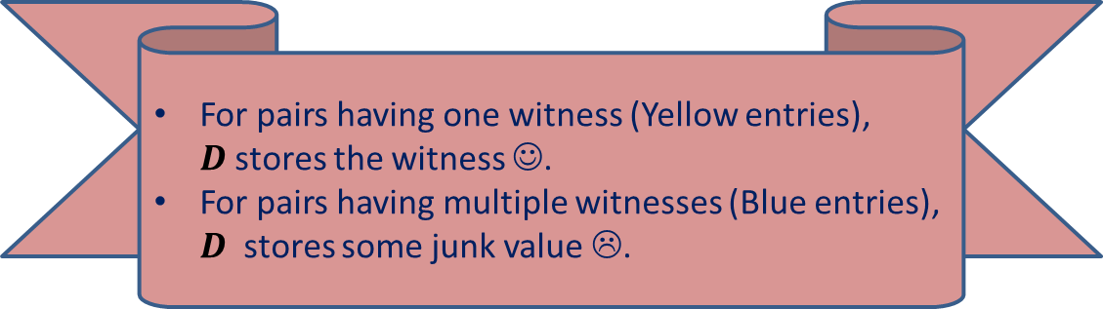
Boolean Product of Matrices
1 2 3 4 5
⨯ ⨯ ⨯ ⨯ ⨯
1 | 0 | 0 | 1 | 0
1 | 0 | 0 | 0 | 1
0 | 0 | 1 | 0 | 0
0 | 1 | 0 | 1 | 0
1 | 1 | 0 | 1 | 0
1 | 0 | 1 | 0 | 0
0 | 1 | 1 | 0 | 1
1 | 1 | 1 | 1 | 0
1 | 1 | 1 | 0 | 0
1 | 0 | 0 | 1 | 0
5 | 4 | 5 | 0 | 0
6 | 0 | 1 | 0 | 0
3 | 3 | 3 | 3 | 0
2 | 6 | 6 | 0 | 2
5 | 6 | 7 | 0 | 2
A
B
D
For pairs having one witness (Yellow entries), $D$stores the witness ☺.
For pairs having multiple witnesses (Blue entries), $D$ stores some junk value ☹.

Slide 19
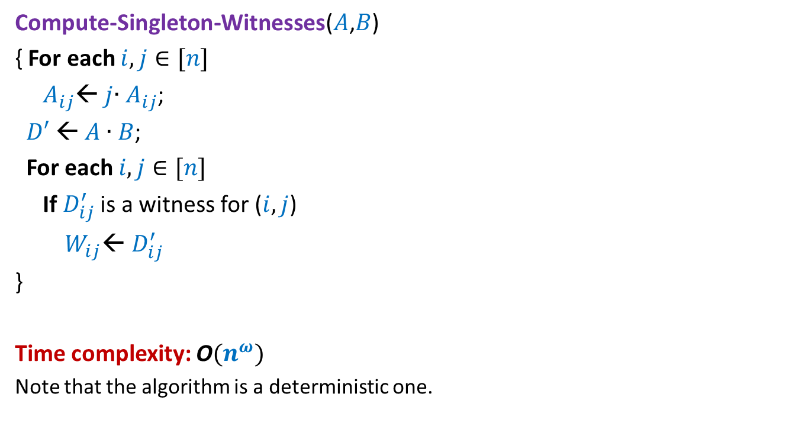
Algorithm for Computing Singleton Witnesses
Compute-Singleton-Witnesses($A$,$B$)
{ For each $i,j∈[n]$
$A_{ij}$← $j$∙ $A_{ij}$;
$D′$← $A$ ∙ $B$;
For each $i,j∈[n]$
If $D_{ij}^{′}$ is a witness for ($i,j$)
$W_{ij}$← $D_{ij}^{′}$
}
Time complexity: O$(n^{ω})$
Note that the algorithm is a deterministic one.

Slide 20
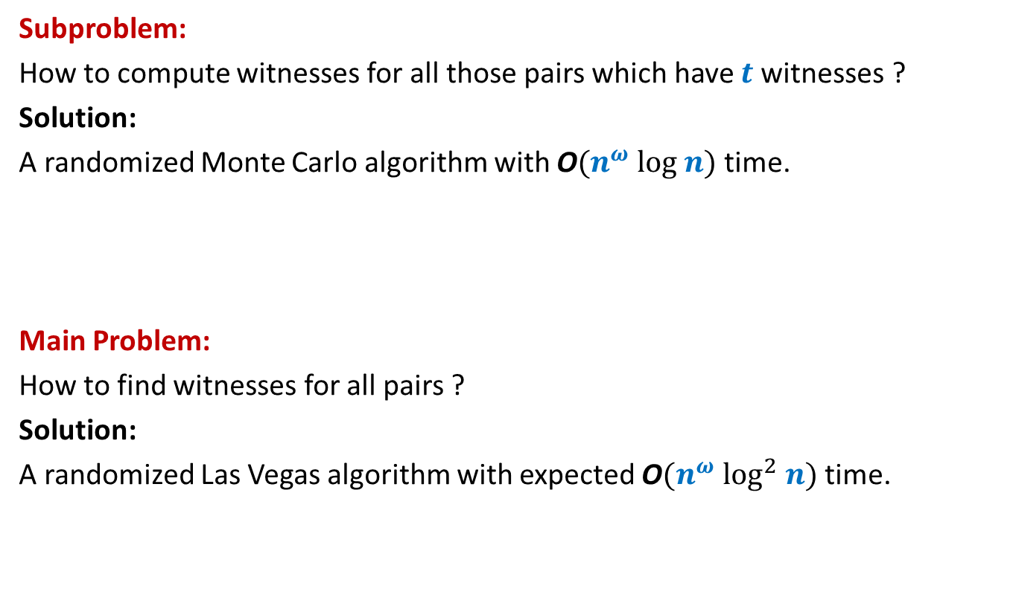
Algorithm Design for BPWM
Subproblem:
How to compute witnesses for all those pairs which have $t$witnesses ?
Solution:
A randomized Monte Carlo algorithm with O$(n^{ω} log n)$ time.
Main Problem:
How to find witnesses for all pairs ?
Solution:
A randomized Las Vegas algorithm with expected O$(n^{ω} \log^{2} n)$ time.

Slide 21
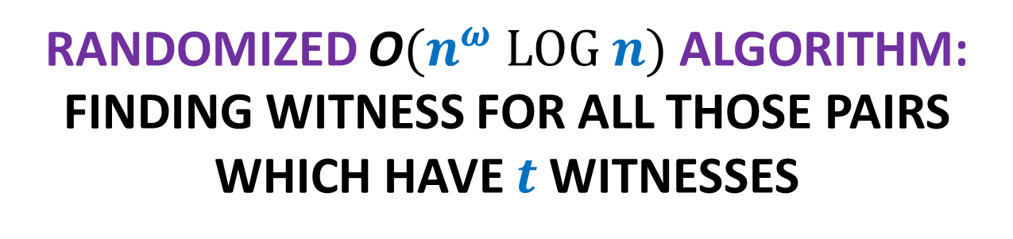
Randomized O$(n^{ω} log n)$ Algorithm:
Finding witness for all those pairs which have $t$witnesses

Slide 22


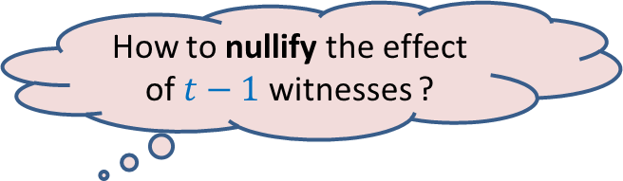


Focus on a single pair ($i$,$j$)
$$j$$
1 2 3 4 … n
⨯ ⨯ ⨯ ⨯ ⨯ ⨯ ⨯ ⨯ ⨯ ⨯
1 | 0 | 1 | 1 | 1 | 0 | 0 | 1 | 0 | 1
 |  |  |  |  |  |  | 1
 |  |  |  |  |  |  | 1
 |  |  |  |  |  |  | 0
 |  |  |  |  |  |  | 1
 |  |  |  |  |  |  | 1
 |  |  |  |  |  |  | 0
 |  |  |  |  |  |  | 1
 |  |  |  |  |  |  | 1
 |  |  |  |  |  |  | 0
 |  |  |  |  |  |  | 0
$$i$$
A
B
How to nullify the effect of $t−1$witnesses ?
Witnesses for ($i$,$j$)

Slide 23
Focus on a single pair ($i$,$j$)
$$j$$
1 2 3 4 … n
⨯ ⨯ ⨯ ⨯ ⨯ ⨯ ⨯ ⨯ ⨯ ⨯
1 | 0 | 1 | 1 | 1 | 0 | 0 | 1 | 0 | 1
 |  |  |  |  |  |  | 1
 |  |  |  |  |  |  | 1
 |  |  |  |  |  |  | 0
 |  |  |  |  |  |  | 1
 |  |  |  |  |  |  | 1
 |  |  |  |  |  |  | 0
 |  |  |  |  |  |  | 1
 |  |  |  |  |  |  | 1
 |  |  |  |  |  |  | 0
 |  |  |  |  |  |  | 0
$$i$$
A
B

Slide 24
Focus on a single pair ($i$,$j$)
$$j$$
1 2 3 4 5 … n-1 n
⨯ ⨯ ⨯ ⨯ ⨯ ⨯ ⨯ ⨯ ⨯ ⨯
1 | 0 | 1 | 1 | 1 | 0 | 0 | 1 | 0 | 1
 |  |  |  |  |  |  | 1
 |  |  |  |  |  |  | 1
 |  |  |  |  |  |  | 0
 |  |  |  |  |  |  | 1
 |  |  |  |  |  |  | 1
 |  |  |  |  |  |  | 0
 |  |  |  |  |  |  | 1
 |  |  |  |  |  |  | 1
 |  |  |  |  |  |  | 0
 |  |  |  |  |  |  | 0
$$i$$
A
B

Slide 25

Focus on a single pair ($i$,$j$)
$$j$$
0 2 3 0 5 … n-1 0
⨯ ⨯ ⨯ ⨯ ⨯ ⨯ ⨯ ⨯ ⨯ ⨯
1 | 0 | 1 | 1 | 1 | 0 | 0 | 1 | 0 | 1
 |  |  |  |  |  |  | 1
 |  |  |  |  |  |  | 1
 |  |  |  |  |  |  | 0
 |  |  |  |  |  |  | 1
 |  |  |  |  |  |  | 1
 |  |  |  |  |  |  | 0
 |  |  |  |  |  |  | 1
 |  |  |  |  |  |  | 1
 |  |  |  |  |  |  | 0
 |  |  |  |  |  |  | 0
$$i$$
A
B
$D_{ij}$ will store this witness for ($i$,$j$) now ☺.

Slide 26
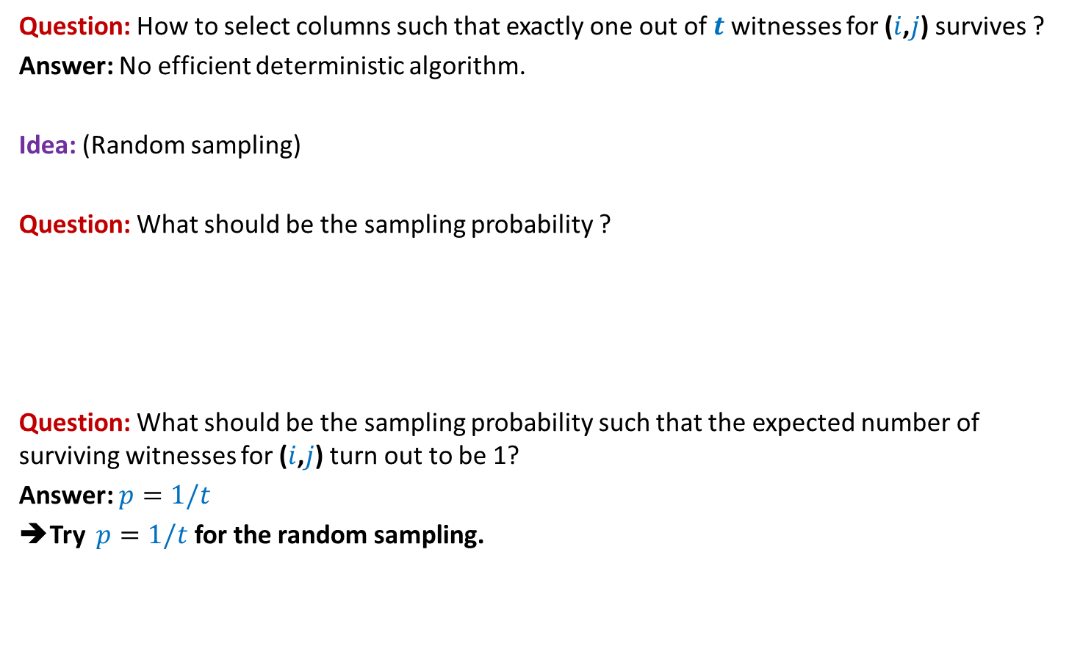
Focus on a single pair ($i$,$j$)
Question: How to select columns such that exactly one out of $t$witnesses for ($i$,$j$) survives ?
Answer: No efficient deterministic algorithm.
Idea: (Random sampling)
Question: What should be the sampling probability ?
Question: What should be the sampling probability such that the expected number of surviving witnesses for ($i$,$j$) turn out to be 1?
Answer: $p=1/t$
➔Try $p=1/t$ for the random sampling.
No idea!
Let us ask the following related but easier question.

Slide 27

Focus on a single pair ($i$,$j$)
Question: If each column is selected independently with $p=1/t$ , what is the probability that exactly one out of $t$witnesses for ($i$,$j$) survives ?
Answer:
=$\left({t \atop 1}\right)\frac{1}{t}{\left(1−\frac{1}{t}\right)}^{t−1}$
=${\left(1−\frac{1}{t}\right)}^{t−1}$
$≥{\left(1−\frac{1}{t}\right)}^{t}$
$≥\frac{1}{e}$

Slide 28


Randomized algorithm for Computing Witnesses for all pairs with $t$witnesses
//The pseudo code for sampling the (indices of) columns
Sample($n$, $p$)
{ $R$← $∅$;
For each $i∈[n]$ do:
add $i$to $R$ with probability $p$;
return $R$;
}

Slide 29
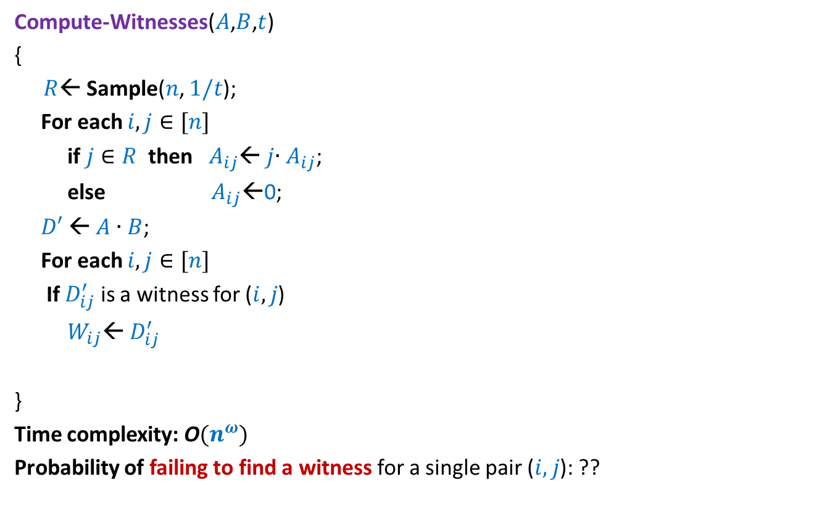

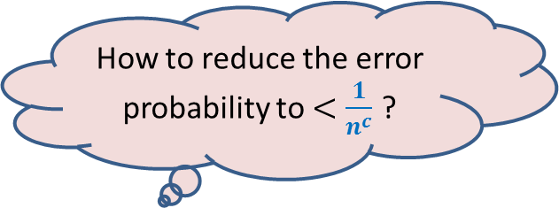
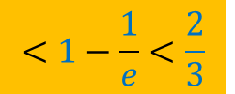
Randomized algorithm for Computing Witnesses for all pairs with $t$witnesses
Compute-Witnesses($A$,$B$,$t$)
{
{ $R$← Sample($n$, $1/t$);
For each $i,j∈[n]$
if $j∈R$ then $A_{ij}$← $j$∙ $A_{ij}$;
else $A_{ij}$←0;
$D′$← $A$ ∙ $B$;
For each $i,j∈[n]$
If $D_{ij}^{′}$ is a witness for ($i,j$)
$W_{ij}$← $D_{ij}^{′}$
}
}
Time complexity: O$(n^{ω})$
Probability of failing to find a witness for a single pair ($i,j$): ??
How to reduce the error probability to $<\frac{1}{n^{c}}$ ?
Repeat the entire process ${c log}_{3/2} n$ times.
$$<1−\frac{1}{e}<\frac{2}{3}$$

Slide 30
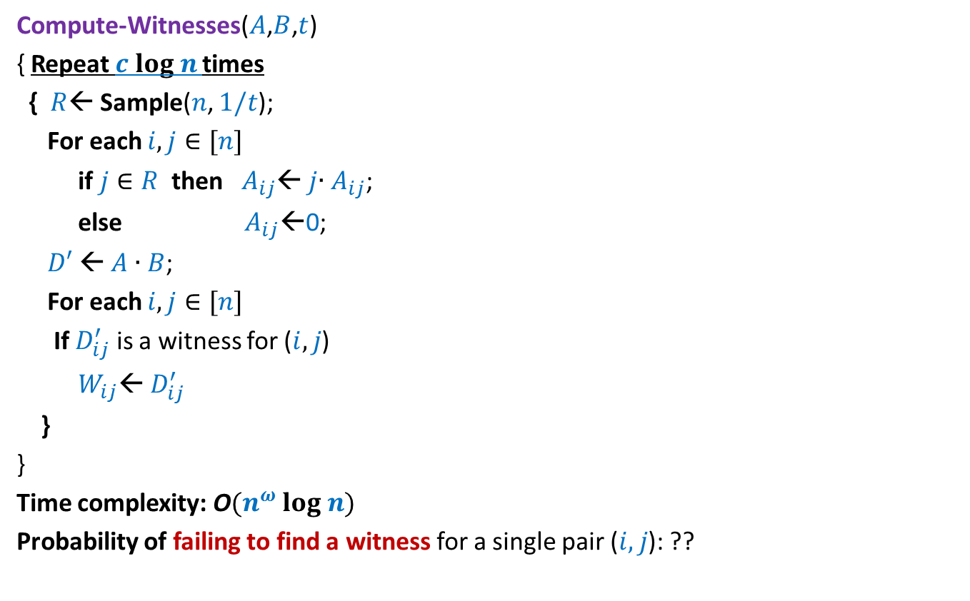
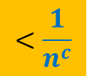
Randomized algorithm for Computing Witnesses for all pairs with $t$witnesses
Compute-Witnesses($A$,$B$,$t$)
{ Repeat $c log n$times
{ $R$← Sample($n$, $1/t$);
For each $i,j∈[n]$
if $j∈R$ then $A_{ij}$← $j$∙ $A_{ij}$;
else $A_{ij}$←0;
$D′$← $A$ ∙ $B$;
For each $i,j∈[n]$
If $D_{ij}^{′}$ is a witness for ($i,j$)
$W_{ij}$← $D_{ij}^{′}$
}
}
Time complexity: O$(n^{ω} log n)$
Probability of failing to find a witness for a single pair ($i,j$): ??
$$<\frac{1}{n^{c}}$$

Slide 31

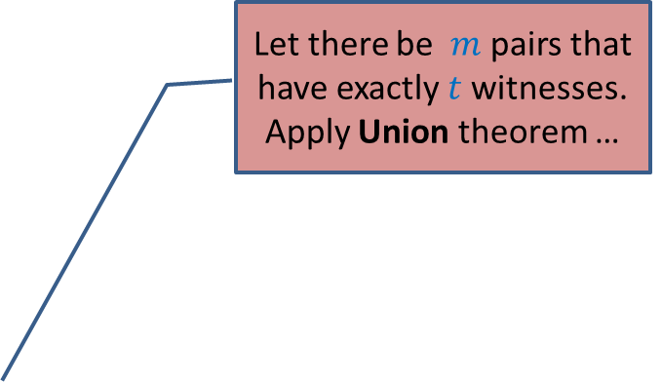

Randomized algorithm for Computing Witnesses for all pairs with $t$witnesses
Compute-Witnesses($A$,$B$,$t$)
{ Repeat $c log n$times
{ $R$← Sample($n$, $1/t$);
For each $i,j∈[n]$
if $j∈R$ then $A_{ij}$← $j$∙ $A_{ij}$;
else $A_{ij}$←0;
$D′$← $A$ ∙ $B$;
For each $i,j∈[n]$
If $D_{ij}^{′}$ is a witness for ($i,j$)
$W_{ij}$← $D_{ij}^{′}$
}
}
Time complexity: O$(n^{ω} log n)$
Probability of failing to find a witness for any pair having $t$witnesses: ??
Let there be $m$ pairs that have exactly $t$witnesses.
Apply Union theorem …
$<\frac{m}{n^{c}}$ < $\frac{1}{n^{c−2}}$

Slide 32
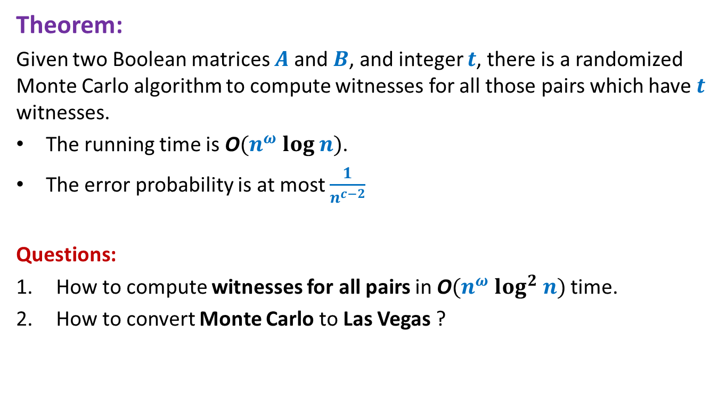
Conclusion
Theorem:
Given two Boolean matrices $A$and $B$, and integer $t$, there is a randomized Monte Carlo algorithm to compute witnesses for all those pairs which have $t$ witnesses.
The running time is O$(n^{ω} log n)$.
The error probability is at most $\frac{1}{n^{c−2}}$
Questions:
How to compute witnesses for all pairs in O$(n^{ω} log^{2} n)$ time.
How to convert Monte Carlo to Las Vegas ?
A sketch of the solution for Question 1 was given in the class. The students are encouraged to work out the exact details. The solution will be presented in the beginning of next lecture class.

