Slide 1
Randomized Algorithms
CS648
Lecture 1

Slide 2
Overview of the lecture
What is a randomized algorithm ?
Motivation
The structure of the course

Slide 3
What is a randomized algorithm ?

Slide 4
Deterministic Algorithm
The output as well as the running time are functions only of the input.
Input
Output
Algorithm

Slide 5
Randomized Algorithm
The output or the running time are functions of the input and random bits chosen .
Random bits
Input
Output
Algorithm

Slide 6
Example 1 : Approximate median

Slide 7

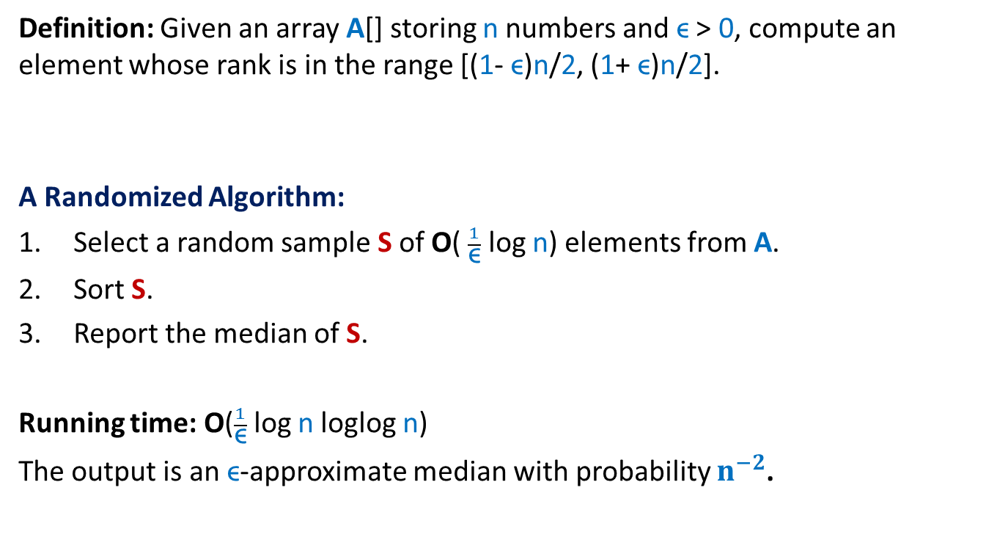
Approximate median
Definition: Given an array A[] storing n numbers and ϵ > 0, compute an element whose rank is in the range [(1- ϵ)n/2, (1+ ϵ)n/2].
A Randomized Algorithm:
Select a random sample S of O( $\frac{1}{\text{ϵ}}$ log n) elements from A.
Sort S.
Report the median of S.
Running time: O($\frac{1}{\text{ϵ}}$log n loglog n)
The output is an ϵ-approximate median with probability $n^{−2}$.
For n ~ a million, the error probability is ${10}^{−12}$.

Slide 8
Example 2 : randomized Quick Sort

Slide 9


QuickSort($S$)
QuickSort($S$)
{ If (|$S$|>1)
Pick and remove an element $x$from $S$;
($S_{<x}$, $S_{>x}$)← Partition($S$,$x$);
return( Concatenate(QuickSort($S_{<x}$), $x$, QuickSort($S_{>x}$))
}

Slide 10
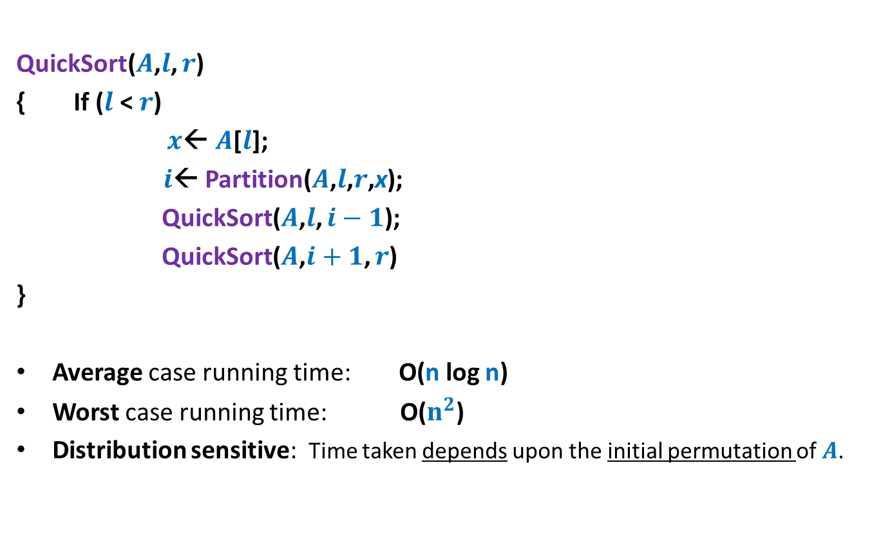

QuickSort($S$)
When the input $S$is stored in an array $A$
QuickSort($A$,$l$, $r$)
{ If ($l$ < $r$)
$x$← $A$[$l$];
$i$← Partition($A$,$l$,$r$,x);
QuickSort($A$,$l$, $i−1$);
QuickSort($A$,$i+1$, $r$)
}
Average case running time: O(n log n)
Worst case running time: O($n^{2}$)
Distribution sensitive: Time taken depends upon the initial permutation of $A$.

Slide 11
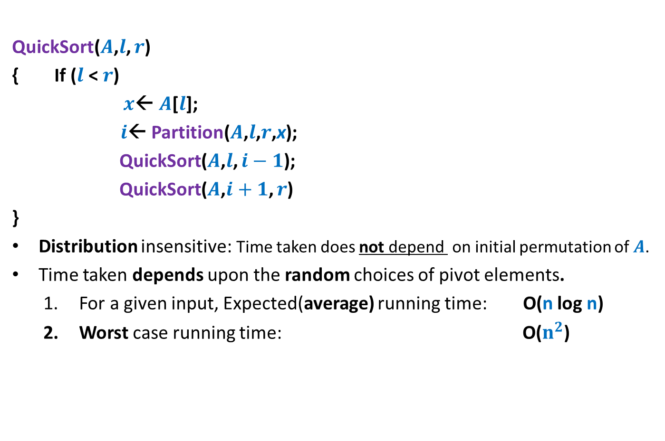

Randomized QuickSort($S$)
When the input $S$is stored in an array $A$
QuickSort($A$,$l$, $r$)
{ If ($l$ < $r$)
$x$← $A$[$l$];
$i$← Partition($A$,$l$,$r$,x);
QuickSort($A$,$l$, $i−1$);
QuickSort($A$,$i+1$, $r$)
}
Distribution insensitive: Time taken does not depend on initial permutation of $A$.
Time taken depends upon the random choices of pivot elements.
  For a given input, Expected(average) running time: O(n log n)
  Worst case running time: O($n^{2}$)
an element selected randomly uniformly from $A$[$l$..$r$];

Slide 12
Types of Randomized Algorithms
Randomized Las Vegas Algorithms:
Output is always correct
Running time is a random variable
Example: Randomized Quick Sort
Randomized Monte Carlo Algorithms:
Output may be incorrect with some probability
Running time is deterministic.
Example: Randomized algorithm for approximate median

Slide 13
Motivation for randomized Algorithms

Slide 14
“Randomized algorithm for a problem is usually simpler and more efficient than its deterministic counterpart.”

Slide 15

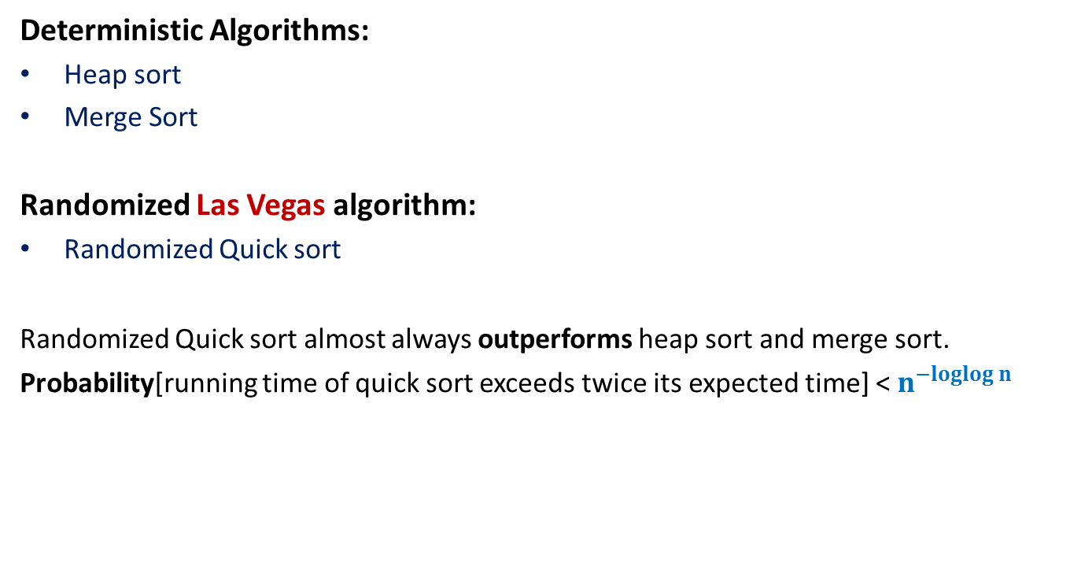
Example 1: Sorting
Deterministic Algorithms:
Heap sort
Merge Sort
Randomized Las Vegas algorithm:
Randomized Quick sort
Randomized Quick sort almost always outperforms heap sort and merge sort.
Probability[running time of quick sort exceeds twice its expected time] < $n^{−loglog n}$
For $n$= 1 million, this probability is ${10}^{−24}$

Slide 16
Example 2: Smallest Enclosing circle
Problem definition: Given n points in a plane, compute the smallest radius circle that encloses all n point.
Applications: Facility location problem
Best deterministic algorithm : [Megiddo, 1983]
O(n) time complexity, too complex, uses advanced geometry
Randomized Las Vegas algorithm: [Welzl, 1991]
Expected O(n) time complexity, too simple, uses elementary geometry

Slide 17
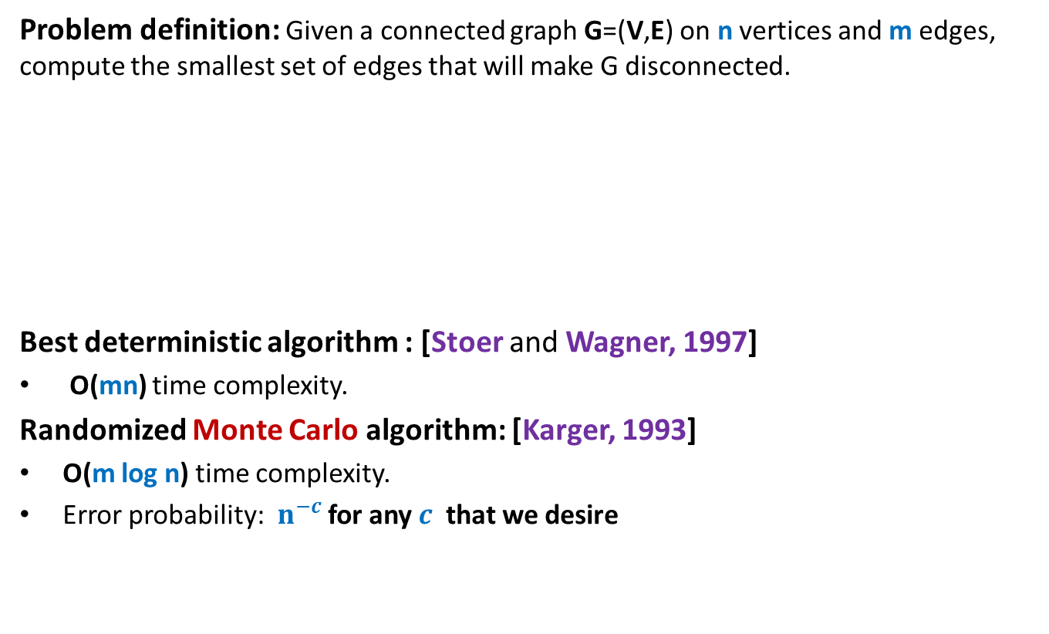
Example 3: minimum Cut
Problem definition: Given a connected graph G=(V,E) on n vertices and m edges, compute the smallest set of edges that will make G disconnected.
Best deterministic algorithm : [Stoer and Wagner, 1997]
O(mn) time complexity.
Randomized Monte Carlo algorithm: [Karger, 1993]
O(m log n) time complexity.
Error probability: $n^{−c}$ for any $c$ that we desire

Slide 18

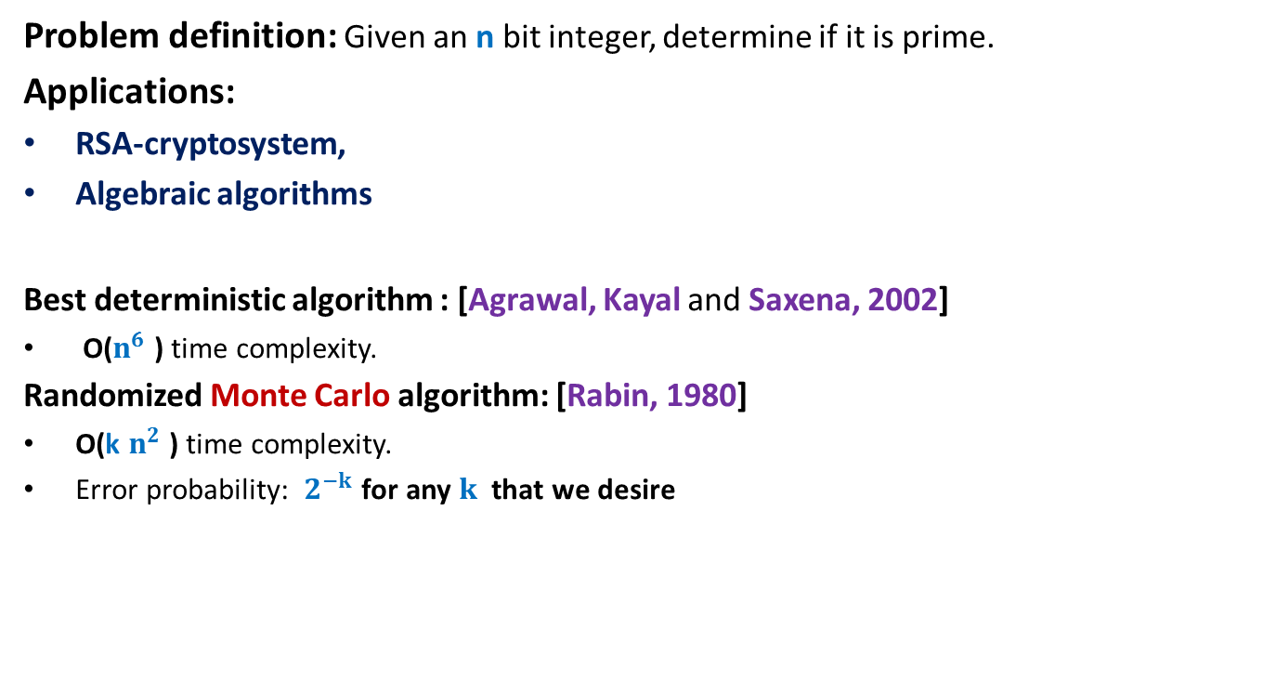
Example 4: Primality Testing
Problem definition: Given an n bit integer, determine if it is prime.
Applications:
RSA-cryptosystem,
Algebraic algorithms
Best deterministic algorithm : [Agrawal, Kayal and Saxena, 2002]
O($n^{6}$ ) time complexity.
Randomized Monte Carlo algorithm: [Rabin, 1980]
O(k $n^{2}$ ) time complexity.
Error probability: $2^{−k}$ for any $k$ that we desire
For $n$= 50, this probability is ${10}^{−15}$

Slide 19
Uncertainty Associated with randomized Algorithms
Is it really a serious issue ?

Slide 20
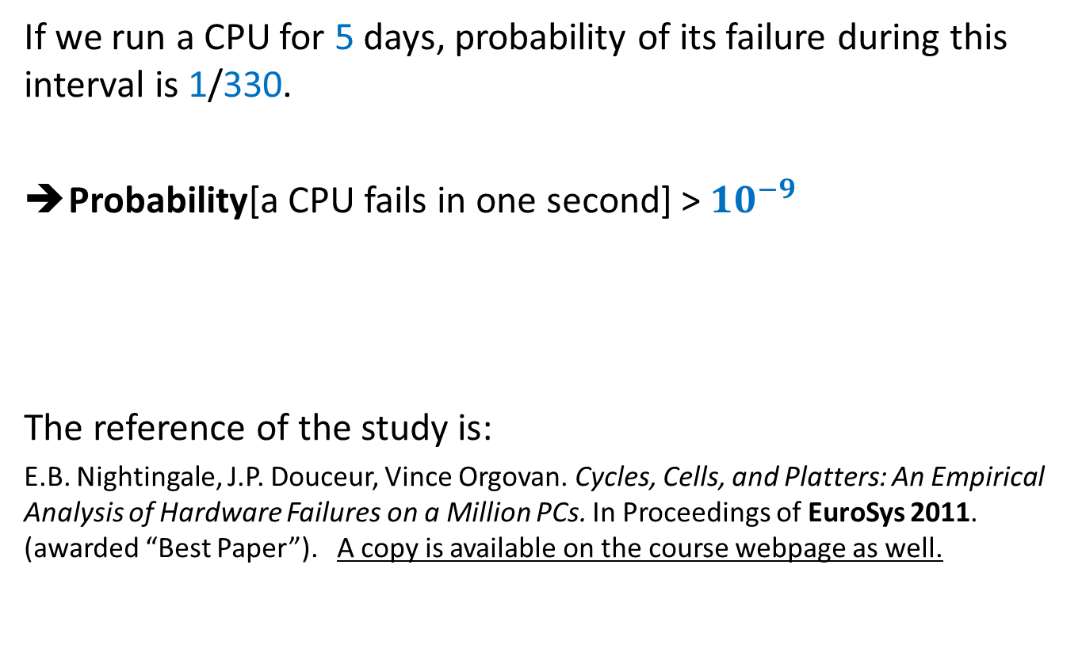
A real Fact
[A study by Microsoft in 2008]
If we run a CPU for 5 days, probability of its failure during this interval is 1/330.
Probability[a CPU fails in one second] > ${10}^{−9}$
The reference of the study is:
E.B. Nightingale, J.P. Douceur, Vince Orgovan. Cycles, Cells, and Platters: An Empirical Analysis of Hardware Failures on a Million PCs. In Proceedings of EuroSys 2011. (awarded “Best Paper”). A copy is available on the course webpage as well.
Compare this probability with the failure (or exceeding the running time) probability of various randomized algorithms mentioned earlier.

Slide 21
Course Structure

Slide 22
Prerequisites
Fundamentals of Data structures
Fundamentals of the design and analysis of Algorithms
Adequate programming skills (in C++)
Elementary probability (12th standard)
Ability to work hard
Commitment to attend classes

Slide 23
Marks Breakup
Assignments: 40%
    Programming as well as theoretical.
    To be done in groups of 2.
Mid Semester Exam: 30%
End Semester Exam: 30%
Passing criteria:
At least 25% marks in both the exam (Total 15 out of 60)
If a student scores less than 50% marks in first mid semester exam, he/she must attend all classes for the rest of the course.

Slide 24
Contact Details
Office: 307, Department of CSE
Office Hours:
  Every week day 12:30PM-1:00PM and 5:30PM-6:00PM
Course website will be maintained at moodle.cse.iitk.ac.in

